Slide 1
Affiliate Marketing
Running a business from home

Slide 2
CORE Requirement for any online business
AUDIENCE
AUDIENCE
AUDIENCE

Slide 3
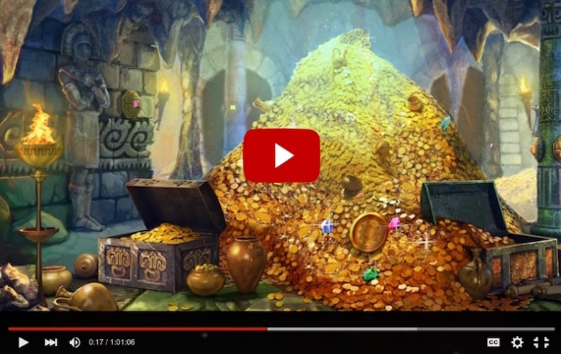


How to earn money online
Online video
Web content
Ecommerce

Slide 4
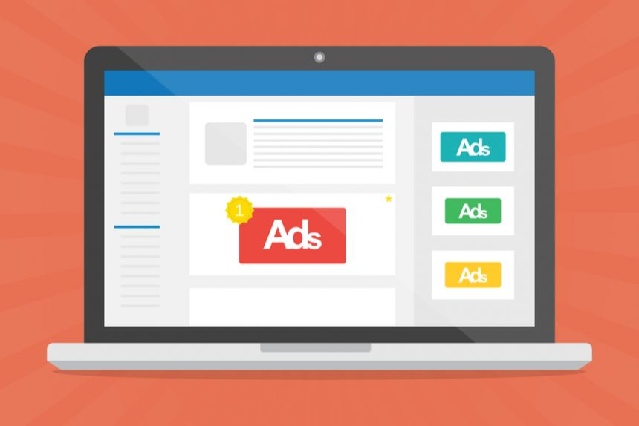
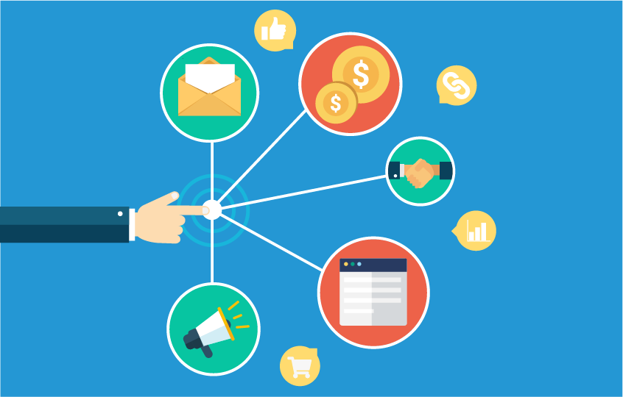
In the background
Ads
Affiliate marketing

Slide 5
What is affiliate marketing
You get a commission for generating leads for products online.
Basic idea is to create a viewership for your content, videos, images or text.
Website not necessary, facebook page, Instagram and pinterest can also work
Whatever you choose you need to ensure that you get a LOT of traffic

Slide 6
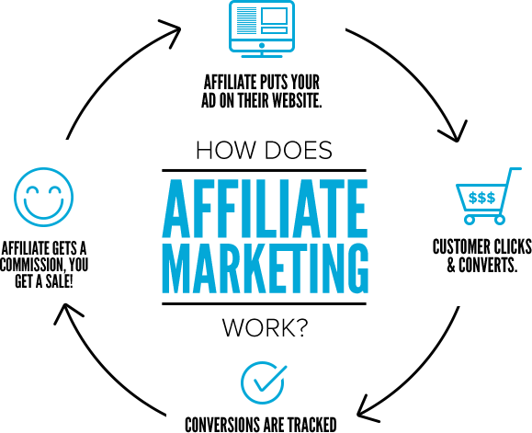
Affiliate Marketing Process

Slide 7
Getting (relevant) traffic
Like all other businesses you need to be in front you potential customers/clients/audience
So the basic idea is to build an audience for the content you are producing (website, youtube or social media account)
Steps you need to take;
Create quality content
Build social media following
Regularly do SEO work for your content

Slide 8
How to choose you affiliate products
There are already BIG players in the market attracting all the traffic for every type of content
You don’t start a chance if you’re focusing on search terms like;
iphone X
Best Android phone
OR even ‘mobile phone reviews’
Always go 2 levels down
Sprots
Basketball
High jump / speed / endurance
You’re more likely to get on top of google search result with in 3-4 months with terms like ‘how to build edurance for basketball’, ‘how to fix disc bulge between L4 & L5’

