Slide 1
Introduction to GIS
By Asim Mushtaq (TPL Maps Pvt. Ltd.)

Slide 2
What is GIS
A geographic information system is a system designed to capture, store, manipulate, analyze, manage, and present spatial or geographic data. GIS applications are tools that allow users to create interactive queries, analyze spatial information, edit data in maps, and present the results of all these operations
Spatial data make GIS different from other systems

Slide 3
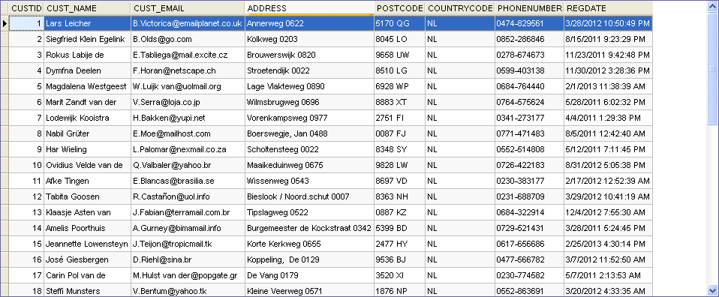
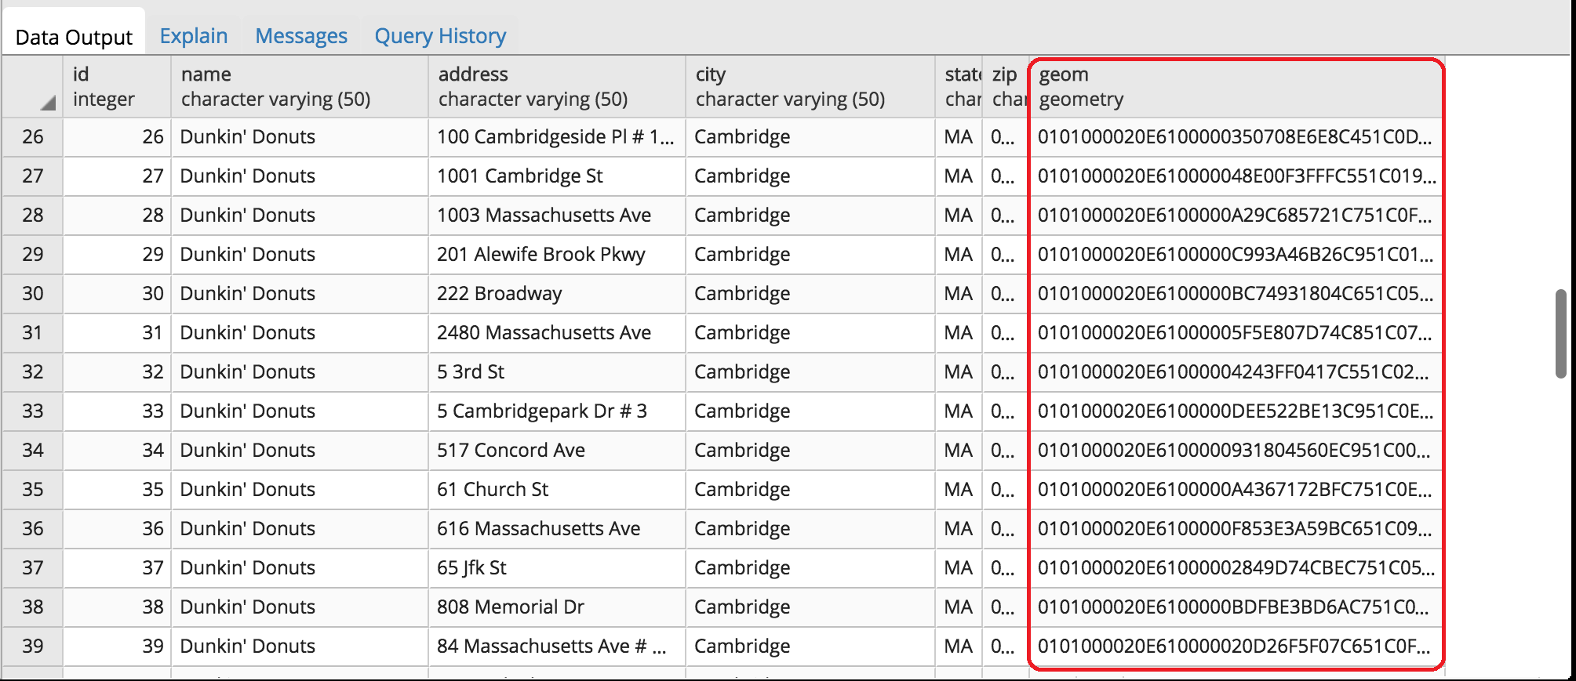
How is GIS Data Different

Slide 4
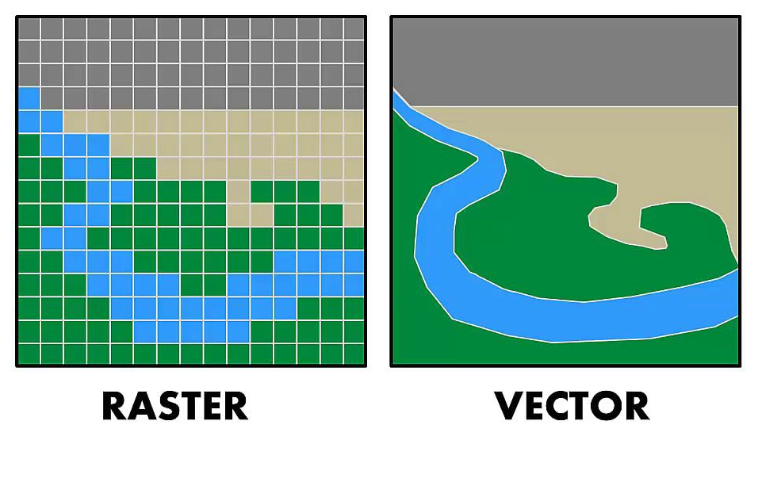
Types Of GIS Data

Slide 5
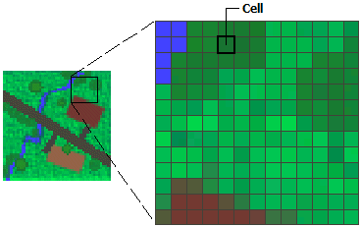
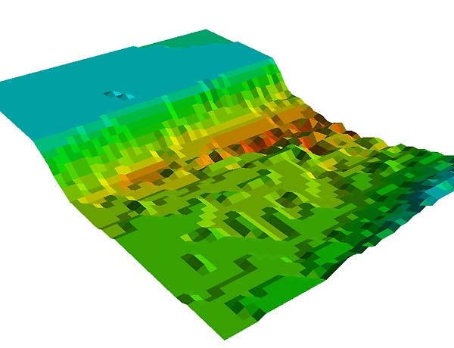
RASTER Data
Raster Data In its simplest form, a raster consists of a matrix of cells (or pixels) organized into rows and columns (or a grid) where each cell contains a value representing information, such as temperature.
Basically its continuous data
Resolution is important
Examples are satellite imagery, elevation models etc

Slide 6
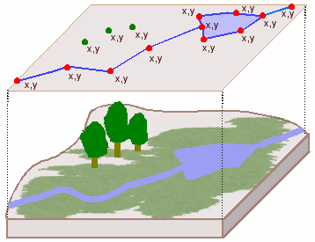
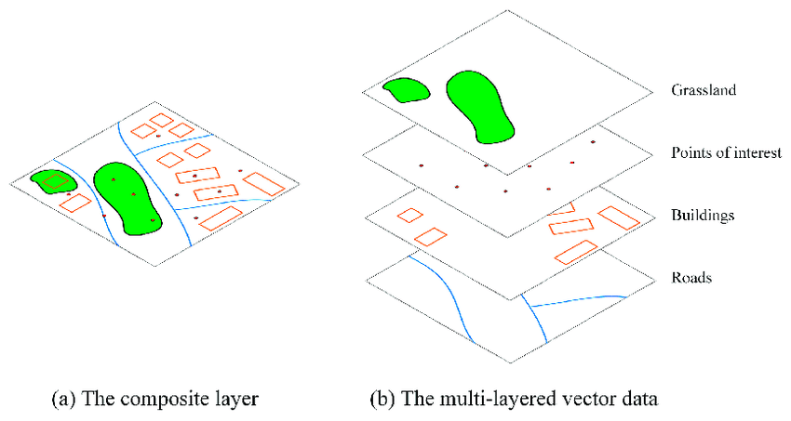
Vector Data
A representation of the world using points, lines, and polygons. Vectormodels are useful for storing data that has discrete boundaries, such as country borders, land parcels, and streets.
Basically discrete data

Slide 7
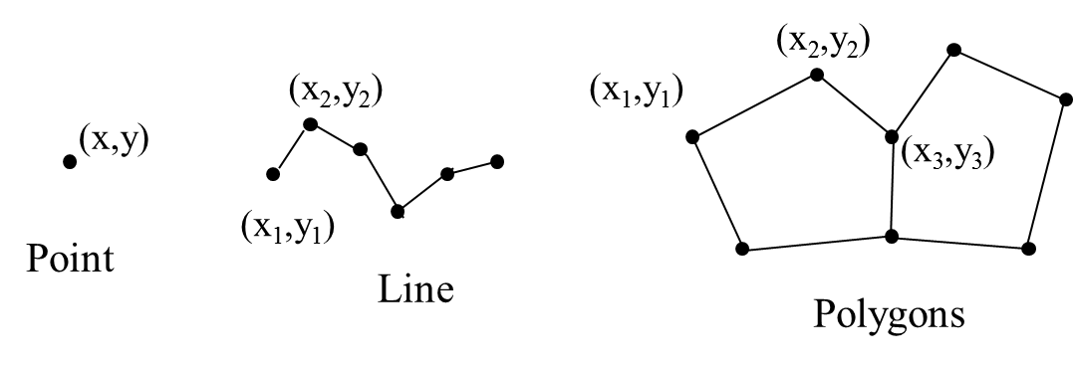
Types of Vector Data

Slide 8
Creating Vector Data

Slide 9
Up Next
Web GIS
GIS Systems Architecture
Concept of tiling
Spatial Servers
Business Applications

