Slide 1
Lecture 12: I2C and SPI Communications
ME6405
Fundamentals of Mechatronics
Dr. Jonathan Rogers

Slide 2
Lesson Objectives
Understand I2C and SPI protocols
Understand the tradeoffs between using UART, I2C, and SPI protocols
Be able to implement I2C communications with MSP432 with multiple slave devices
Be able to implement SPI communications with MSP432

Slide 3
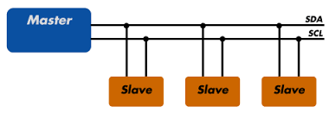
I²C Protocol
I²C = Inter-Integrated Circuit
  Extremely common serial communication protocol used extensively to interface with sensors, actuators, and storage devices
  Developed by Phillips Semiconductors in 1980’s
Primary advantage: Allows communications with multiple devices on same 2-wire bus
“I2C Bus”

Slide 4
I²C Protocol
Terminology
  SDA: Data wire. Data bits flow along this line.
  SCL: Clock wire. This transmits clock signal which is used to synchronize data transfer.
  Master: Device (MCU, sensor, etc) on I2C bus which controls clock line (SCL). Usually only be one per bus.
  Slave: Device (MCU, sensor, etc) on I2C that monitors SCL and communicates on SDA.
“I2C Bus”

Slide 5
I²C Wiring
+V
When implementing I2C bus, pull-up resistor is needed on each line to set the logic level being used (either 3.3V or 5V).
This is an Open Collector circuit (see Lecture 2)
On TI Launchpad, the SCL and SDA lines are already implemented using an open collector circuit, so do not need to implement +V connections
May need to when using other Master/slave devices
R
R
SDA
SCL
SDA
SCL
Master
Slave

Slide 6
I²C Master and Slave Devices
Only Master device can initiate data transfer
Slaves respond to master request
Data can be sent from Master to slave, or from slave to Master (bus can transfer data in either direction)
Each slave on bus is addressable via a unique “address” value assigned to that slave
Addr: 0x18
Addr: 0x19
Addr: 0xE0

Slide 7
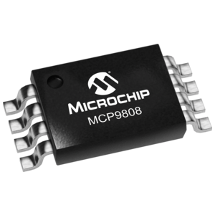
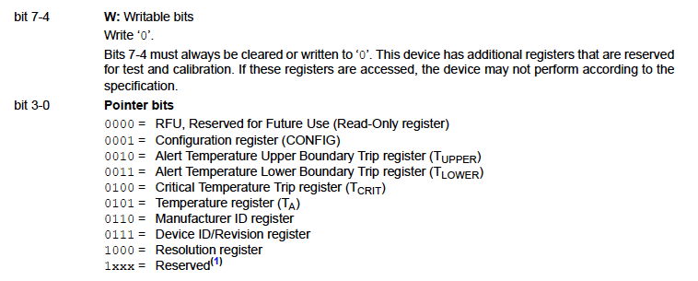
I²C (or SPI) Slave Devices
Most sensors or actuators have multiple registers that can be written or read via I2C (or SPI)
  When reading or writing to these devices, need to specify not only slave address but also register address on that slave
For example, Microchip MCP9808 temp sensor:
Device configuration register is 0x01
Measured temperature stored in register 0x05

Slide 8
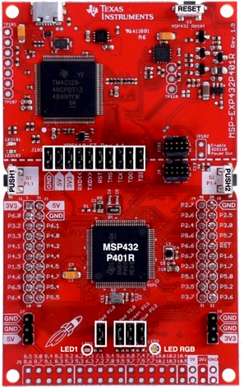
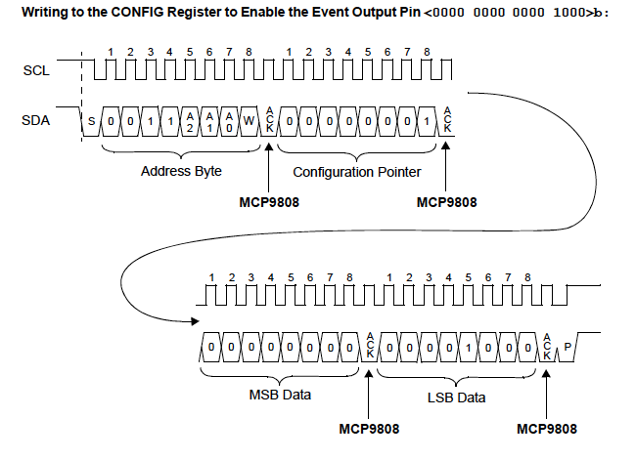
I²C Protocol
Complete protocol (writing data to slave device)
  Example is for writing 2 bytes of data to MCP9808 Configuration register (which is 16 bits)

Slide 9
I²C Protocol
Complete protocol (writing data to slave device)
  Example is for writing 2 bytes of data to MCP9808 Configuration register (which is 16 bits)
Start Sequence
ACK from slave (MCP9808)
Stop Sequence

Slide 10
I²C Protocol
Complete protocol (writing data to slave device)
  Example is for writing 2 bytes of data to MCP9808 Configuration register (which is 16 bits)
Process:
Master transmits slave address byte
Master transmits register address
Master transmits high byte of data
Master transmits low byte of data

Slide 11
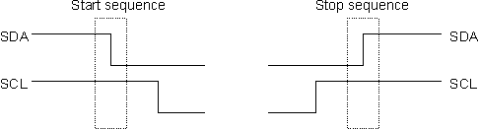
I²C Protocol
Start sequence used by Master to initiate a transaction with a slave device
  Marks beginning of transaction
SDA line changes from high to low while SCL (clock line) held high
Only time (besides stop command) that SDA is allowed to change while SCL remains constant

Slide 12
I²C Protocol
Stop sequence indicates the end of a transaction between Master and slave device
SDA line changes from low to high while SCL (clock line) held high
Only time (besides start command) that SDA is allowed to change while SCL remains constant

Slide 13

I²C Protocol – Transmitting Data
To send data, SDA line holds bit value
  0 for low, 3.3V or 5V for high
SCL clocked from low to high to low during transmission of single bit
Clock speeds of 100 kHz or 400 kHz usually used
  Master generates this clock signal, slaves respond
All I2C communication is done 1 byte at a time.

Slide 14
I²C Protocol – Transmitting Data
When 1 byte is sent, 9 bits are actually transmitted
Last bit is either “ACK” or “NAK”
  If bit 9 is low, this signals an ACK – means receiving device has received data and is ready to accept next byte
  If bit 9 is high, this signals a NAK – means receiving device cannot accept further data and master should end transaction
This bit is needed because actual size of data transfer is never transmitted explicitly.

Slide 15

I²C Protocol – Address Byte
All I2C address are either 7-bit or 10-bit
Majority are 7-bit (10-bit is very rare)
When transmitting address byte, Master also transmits whether operation is read or write using bit 8
7-bit slave address
Set last bit to 1 when reading from slave device
Set last bit to 0 when writing to slave device

Slide 16
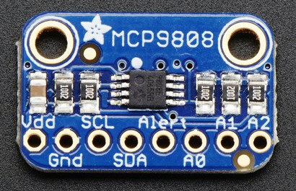
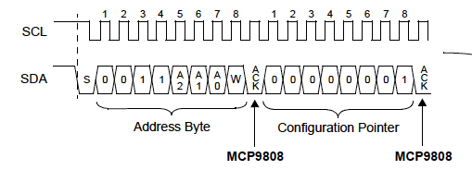
I²C Protocol – Address Byte
Example: MCP9808
  Default address is 0x18
  By driving A0, A1, A2 pins high, can change address (between 0x18 and 0x1F)

Slide 17
I²C Protocol – Address Byte
Example: MCP9808
  When Master sends out address byte, it is shifted left to make room for R/W bit
So if address is 0x18, Master actually sends:
0x30 for write operation
0x31 for read operation
Note: This shifting operation is abstracted from programmer when using Driverlib.

Slide 18
I²C Protocol – Write Operation
Steps Master performs to write to slave
  Example: Writing two bytes to configuration register
Send start sequence (clear SDA while holding SCL high)

Slide 19
I²C Protocol – Write Operation
Steps Master performs to write to slave
  Example: Writing two bytes to configuration register
Send start sequence (clear SDA while holding SCL high)
Send address of slave with read/write bit cleared (byte is I2C address, left shifted one bit with LSB cleared)

Slide 20
I²C Protocol – Write Operation
Steps Master performs to write to slave
  Example: Writing two bytes to configuration register
Send start sequence (clear SDA while holding SCL high)
Send address of slave with read/write bit cleared (byte is I2C address, left shifted one bit with LSB cleared)
Send address of register you want to write to

Slide 21
I²C Protocol – Write Operation
Steps Master performs to write to slave
  Example: Writing two bytes to configuration register
Send start sequence (clear SDA while holding SCL high)
Send address of slave with read/write bit cleared (byte is I2C address, left shifted one bit with LSB cleared)
Send address of register you want to write to
Send data, in order of high byte to low byte (see spec sheet of slave device)

Slide 22
I²C Protocol – Write Operation
Steps Master performs to write to slave
  Example: Writing two bytes to configuration register
Send start sequence (clear SDA while holding SCL high)
Send address of slave with read/write bit cleared (byte is I2C address, left shifted one bit with LSB cleared)
Send address of register you want to write to
Send data, in order of high byte to low byte (see spec sheet of slave device)
Send stop sequence (set SDA high while holding SCL high)

Slide 23
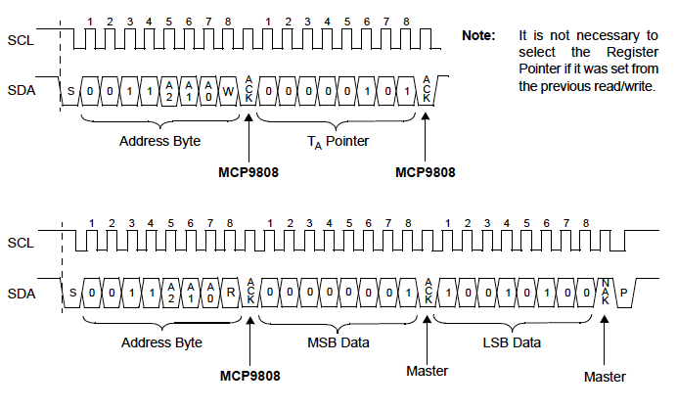
I²C Protocol – Read Operation
Steps Master performs to read from slave
  Example: Reading 2-byte register from slave device
Send start sequence (clear SDA while holding SCL high)

Slide 24
I²C Protocol – Read Operation
Steps Master performs to read from slave
  Example: Reading 2-byte register from slave device
Send start sequence (clear SDA while holding SCL high)
Send address of slave with read/write bit cleared (byte is I2C address, left shifted one bit with LSB cleared)

Slide 25
I²C Protocol – Read Operation
Steps Master performs to read from slave
  Example: Reading 2-byte register from slave device
Send start sequence (clear SDA while holding SCL high)
Send address of slave with read/write bit cleared (byte is I2C address, left shifted one bit with LSB cleared)
Send address of register you want to read from

Slide 26
I²C Protocol – Read Operation
Steps Master performs to read from slave
  Example: Reading 2-byte register from slave device
Send start sequence (clear SDA while holding SCL high)
Send address of slave with read/write bit cleared (byte is I2C address, left shifted one bit with LSB cleared)
Send address of register you want to read from
Send start sequence (clear SDA while holding SCL high)
This is sometimes called a “Restart”.

Slide 27
I²C Protocol – Read Operation
Steps Master performs to read from slave
  Example: Reading 2-byte register from slave device
Send start sequence (clear SDA while holding SCL high)
Send address of slave with read/write bit cleared (byte is I2C address, left shifted one bit with LSB cleared)
Send address of register you want to read from
Send start sequence (clear SDA while holding SCL high)
Send address of slave with read/write bit set (byte is I2C address, left shifted one bit with LSB set)

Slide 28
I²C Protocol – Read Operation
Steps Master performs to read from slave
  Example: Reading 2-byte register from slave device
Send start sequence (clear SDA while holding SCL high)
Send address of slave with read/write bit cleared (byte is I2C address, left shifted one bit with LSB cleared)
Send address of register you want to read from
Send start sequence (clear SDA while holding SCL high)
Send address of slave with read/write bit set (byte is I2C address, left shifted one bit with LSB set)
Read data in order of high byte to low byte (see spec sheet of slave device)

Slide 29
I²C Protocol – Read Operation
Steps Master performs to read from slave
  Example: Reading 2-byte register from slave device
Send start sequence (clear SDA while holding SCL high)
Send address of slave with read/write bit cleared (byte is I2C address, left shifted one bit with LSB cleared)
Send address of register you want to read from
Send start sequence (clear SDA while holding SCL high)
Send address of slave with read/write bit set (byte is I2C address, left shifted one bit with LSB set)
Read data in order of high byte to low byte (see spec sheet of slave device)
Send stop sequence

Slide 30
I²C on the MSP432
While I2C can be implemented on MSP432 by using registers directly, we will only discuss use of Driverlib here
Driverlib provides (somewhat intuitive) interface
void I2C_masterSendStart(uint32_t moduleInstance)
void I2C_masterSendSingleByte(uint32_t moduleInstance, uint8_t txData)
void I2C_masterSendMultiByteNext(uint32_t moduleInstance, uint8_t txData)
void I2C_masterSendMultiByteFinish(uint32_t moduleInstance, uint8_t txData)
void I2C_masterSendMultiByteStop(uint32_t moduleInstance)
bool I2C_masterSendSingleByteWithTimeout(uint32_t moduleInstance, uint8_t txData, uint32_t timeout)
bool I2C_masterSendMultiByteFinishWithTimeout(uint32_t moduleInstance, uint8_t txData, uint32_t timeout)
Used when operating MSP as I2C Master
Used when operating MSP as I2C slave
uint8_t I2C_slaveGetData(uint32_t moduleInstance)
void I2C_slavePutData(uint32_t moduleInstance, uint8_t txData)
void I2C_slaveSendNAK(uint32_t moduleInstance)

Slide 31
I²C on the MSP432
To configure I2C Master, use these functions
Initialize I2C parameters for Master operation (similar exists for slave):
void I2C_initMaster(uint32_t moduleInstance, const eUSCI_I2C_MasterConfig *config)
Argument 1: moduleInstance
EUSCI_B0_BASE
EUSCI_B1_BASE
EUSCI_B2_BASE
EUSCI_B3_BASE
Argument 2: Configuration Struct
typedef struct _eUSCI_I2C_MasterConfig
{
uint_fast8_t selectClockSource;
uint32_t i2cClk;
uint32_t dataRate;
uint_fast8_t byteCounterThreshold;
uint_fast8_t autoSTOPGeneration;
} eUSCI_I2C_MasterConfig;
Defined in i2c.h
dataRate field set to either:
EUSCI_B_I2C_SET_DATA_RATE_100KBPS
EUSCI_B_I2C_SET_DATA_RATE_400KBPS
(check spec sheet of slave device)

Slide 32
I²C on the MSP432
To configure I2C Master, use these functions
Initialize I2C parameters for Master operation (similar exists for slave):
void I2C_initMaster(uint32_t moduleInstance, const eUSCI_I2C_MasterConfig *config)
Enable the I2C module:
void I2C_enableModule(uint32_t moduleInstance)
Set slave address:
void I2C_setSlaveAddress(uint32_t moduleInstance, uint_fast16_t slaveAddress)
Note: To call different slaves on same bus, call I2C_setSlaveAddress each time prior to read-write calls.

Slide 33
I²C on the MSP432
To configure I2C Master, use these functions
Initialize I2C parameters for Master operation (similar exists for slave):
void I2C_initMaster(uint32_t moduleInstance, const eUSCI_I2C_MasterConfig *config)
Enable the I2C module:
void I2C_enableModule(uint32_t moduleInstance)
Set slave address:
void I2C_setSlaveAddress(uint32_t moduleInstance, uint_fast16_t slaveAddress)
Set Master in transmit or receive mode:
void I2C_setMode(uint32_t moduleInstance, uint_fast8_t mode)
mode field set to either: EUSCI_B_I2C_TRANSMIT_MODE or EUSCI_B_I2C_RECEIVE_MODE

Slide 34
I²C on the MSP432
setMode function must be used each time Master switches from read to write or vice versa
Set Master in transmit or receive mode:
void I2C_setMode(uint32_t moduleInstance, uint_fast8_t mode)
Master in transmit mode
Master in receive mode
(switch from transmit to receive called a “restart”)

Slide 35
I²C on the MSP432
I2C configuration function
void initializeI2C(void)
{
/* Select I2C function for I2C_SCL & I2C_SDA */
GPIO_setAsPeripheralModuleFunctionOutputPin(GPIO_PORT_P6, GPIO_PIN5,
GPIO_PRIMARY_MODULE_FUNCTION);
GPIO_setAsPeripheralModuleFunctionOutputPin(GPIO_PORT_P6, GPIO_PIN4,
GPIO_PRIMARY_MODULE_FUNCTION);
/* Initializing I2C Master to SMCLK at 400kbs with no-autostop */
MAP_I2C_initMaster(EUSCI_B1_BASE, (const eUSCI_I2C_MasterConfig *)&i2cConfig);
/* Enable I2C Module to start operations */
MAP_I2C_enableModule(EUSCI_B1_BASE);
}
volatile eUSCI_I2C_MasterConfig i2cConfig =
{
EUSCI_B_I2C_CLOCKSOURCE_SMCLK, // SMCLK Clock Source
3000000, // Use clock of 3MHz
EUSCI_B_I2C_SET_DATA_RATE_400KBPS, // Desired I2C Clock of 400khz
0, // No byte counter threshold
EUSCI_B_I2C_NO_AUTO_STOP};

Slide 36
I²C on the MSP432
Read function (part 1/2)
int tempReadReg (uint8_t address, uint8_t reg, uint16_t *value)
{
int result = false; // return value
uint8_t temp[2] = {0,0}; // data to send over I2C
int i = 0 ;
// Set the I2C address of the device we wish to talk to.
MAP_I2C_setSlaveAddress(EUSCI_B1_BASE, address);
// Set write mode.
MAP_I2C_setMode(EUSCI_B1_BASE, EUSCI_B_I2C_TRANSMIT_MODE);
// Write START + address + register to the sensor.
result = MAP_I2C_masterSendSingleByteWithTimeout(EUSCI_B1_BASE, reg, TEMP_TIMEOUT);
...

Slide 37
I²C on the MSP432
Read function (part 2/2)
int tempReadReg (uint8_t address, uint8_t reg, uint16_t *value)
{
...
// Continue only if the write was successful.
if (result == true)
{
// Set read mode.
MAP_I2C_setMode(EUSCI_B1_BASE, EUSCI_B_I2C_RECEIVE_MODE);
// RESTART.
MAP_I2C_masterReceiveStart(EUSCI_B1_BASE);
// Read two bytes from the sensor, STOP.
temp[0] = MAP_I2C_masterReceiveSingle(EUSCI_B1_BASE);
result = MAP_I2C_masterReceiveMultiByteFinishWithTimeout(EUSCI_B1_BASE, &(temp[1]), TEMP_TIMEOUT);
// Parse the sensor's data.
*value = (uint16_t)(temp[0] << 8 | temp[1]);
}
return result;
}

Slide 38
I²C on the MSP432
Write function (part 1/2)
int configRegWrite(uint8_t ui8Addr, uint8_t ui8Reg, uint8_t *Data, uint8_t ui8ByteCount)
{
int i = 0 ;
/* Load device slave address */
MAP_I2C_setSlaveAddress(EUSCI_B1_BASE, ui8Addr);
// Set write mode.
MAP_I2C_setMode(EUSCI_B1_BASE, EUSCI_B_I2C_TRANSMIT_MODE);
/* Send start bit and register */
MAP_I2C_masterSendMultiByteStart(EUSCI_B1_BASE,ui8Reg);
// Delay
for(i = 0; i < 2000; i++){}
...
Sometimes delays need to be added to I2C read-write functions to ensure that data is available.

Slide 39
I²C on the MSP432
Write function (part 2/2)
int configRegWrite(uint8_t ui8Addr, uint8_t ui8Reg, uint8_t *Data, uint8_t ui8ByteCount)
{
...
/* Now write one or more data bytes */
while(1)
{
for(i = 0; i < 2000; i++){} // Delay
/* While we still have data to send */
if(ui8ByteCount > 0 )
{
MAP_I2C_masterSendMultiByteNext(EUSCI_B1_BASE, *Data++);
}
else
{
MAP_I2C_masterSendMultiByteStop(EUSCI_B1_BASE);
return(true);
}
ui8ByteCount--;
}
}

Slide 40
I²C Summary
Flexible interface – can communicate with up to 128 peripheral devices with only 2 wires!
  Perhaps most common sensor interface for mechatronic devices
Not nearly as easy to use as UART
  Nuances of START, STOP, ACK, NAK can complicate functionality
  Bus can also hang if protocol not configured right!

Slide 41
I²C Summary
Will post a basic MSP432 I2C code on T-Square
  Can receive data from MCP9808 and TMP007 sensors
Use my code as a template and:
  Customize for particular sensors/processors you are using
  Add checks so to protect against bus hanging
  Consider using interrupts for I2C reads and writes
See Driverlib documentation for functions that can be used for all of the above

Slide 42
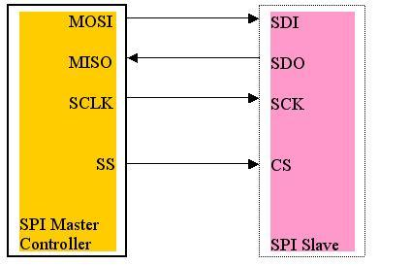
SPI Communications
SPI = Serial Peripheral Interface
Features:
  Extremely fast protocol often used for streaming continuous data
    Unlike I2C, data can flow continuously without being interrupted by address bytes, start/stop bits, etc.
  Data rates up to 10 Mbps (a lot faster than I2C)
  One bus can handle (theoretically) unlimited number of slaves

Slide 43
SPI Protocol
Terminology
  SCLK: Clock wire. This transmits clock signal which is used to synchronize data transfer.
  MOSI: Master out slave in wire. Transfers data from Master to slave device.
  MISO: Master in slave out wire. Transfers data from slave to Master device.
  SS: Slave select wire. Activates this slave for communication.

Slide 44
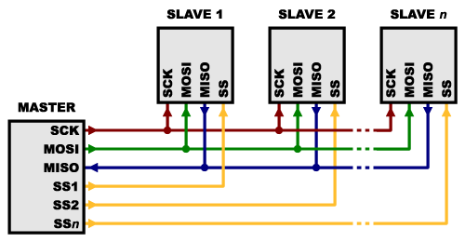
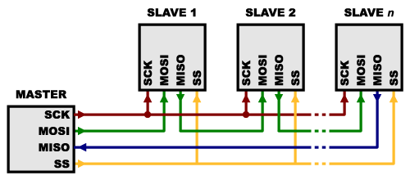
SPI Master-Slave Configuration
Multiple slaves can be located on same SPI bus
General Configuration
Daisy-Chained Configuration
Use multiple slave select lines
Set SSx line to low to read from slave x
Use single slave select line
Data passed from Master through each slave sequentially
Used only when sending data out from master exclusively
MISO line on Master typically not used

Slide 45
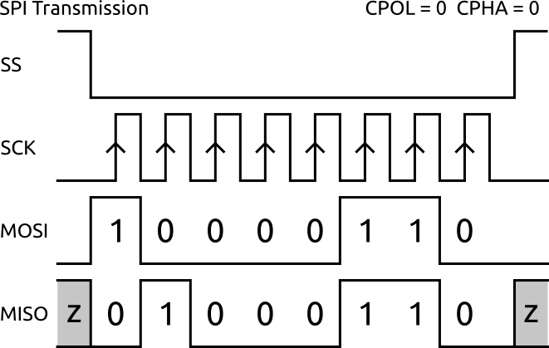
SPI Protocol
Example SPI transmission of 1 byte of data
Master
Slave

Slide 46
SPI Protocol
Master
Slave
SPI communication is full duplex. This means that data is always being transferred from Master to slave, AND from slave to Master.
There are no “read only” or “write only” operations – a bit is always transmitted in both directions when a clock pulse is generated on SCK
If Master just wants to receive data from slave, Master can just transmit “dummy” value like 0x00. Slave will know to ignore it.

Slide 47
SPI Protocol
TxIFG
RxIFG
Master
Slave
Tx Buffer (1 byte)
Tx Shift Reg (1 byte)
Tx Shift Reg (1 byte)
10000110
01000110
Rx Buffer (1 byte)
Rx Shift Reg (1 byte)
Rx Shift Reg (1 byte)
Step 1: Master puts data into transmit buffer register
(Note: Some data is located in Tx Shift Register of slave. This could be “real” data or “dummy” data.)

Slide 48
SPI Protocol
TxIFG
RxIFG
Master
Slave
Tx Buffer (1 byte)
Tx Shift Reg (1 byte)
Tx Shift Reg (1 byte)
10000110
01000110
Rx Buffer (1 byte)
Rx Shift Reg (1 byte)
Rx Shift Reg (1 byte)
Step 2: Data is transferred to Tx Shift Register on Master.
This causes transmit interrupt flag to be set (on MSP432), signifying that a new byte can be placed in Tx Buffer.

Slide 49
SPI Protocol
TxIFG
RxIFG
Master
Slave
Tx Buffer (1 byte)
Tx Shift Reg (1 byte)
Tx Shift Reg (1 byte)
10000110
01000110
Rx Buffer (1 byte)
Rx Shift Reg (1 byte)
Rx Shift Reg (1 byte)
Step 3: Master lowers SS line to zero to indicate start of transmission

Slide 50
SPI Protocol
TxIFG
RxIFG
Master
Slave
Tx Buffer (1 byte)
Tx Shift Reg (1 byte)
Tx Shift Reg (1 byte)
Rx Buffer (1 byte)
Rx Shift Reg (1 byte)
Rx Shift Reg (1 byte)
01000110
10000110
Step 4: Master generates 8 clock pulses, which clocks data into Rx shift registers on both Master and slave devices

Slide 51
SPI Protocol
TxIFG
RxIFG
Master
Slave
Tx Buffer (1 byte)
Tx Shift Reg (1 byte)
Tx Shift Reg (1 byte)
Rx Buffer (1 byte)
Rx Shift Reg (1 byte)
Rx Shift Reg (1 byte)
01000110
10000110
Step 5: Data is transferred from Receive shift register to Receive Buffer for retrieval by software. Receive interrupt flag (RxIFG) flag is set denoting that new data is ready to be retrieved.
Step 6. Master raises SS line to 1 indicating end of transmission.
Note: Master can leave SS line high if wanting to initiate another transmission.

Slide 52
SPI on the MSP432
Key SPI-related registers
UCAxTXBUF
8-bit register that holds data waiting to be moved to transmit shift register. Writing to this clears UCTXIFG (transmit interrupt flag).
UCAxRXBUF
8-bit register that holds the last received byte from receive shift register. Reading from this clears UCTRXIFG (receive interrupt flag).
UCAxIFG
16-bit register that holds interrupt flags for specific SPI module (UCA0, UCA1, etc). Bits 2-15 do nothing. Bit 1 is transmit interrupt flag (UCTXIFG). Bit 0 is receive interrupt flag (UCRXIFG)
Note: Similar descriptions hold for EUSCI_B devices (UCB0, UCB1, etc.)

Slide 53
SPI on the MSP432
To configure SPI Master, use these functions
Initialize I2C parameters for Master operation (similar exists for slave):
void SPI_initMaster(uint32_t moduleInstance, const eUSCI_SPI_MasterConfig *config)
Argument 1: moduleInstance
EUSCI_A0_BASE
EUSCI_A1_BASE
EUSCI_A2_BASE
EUSCI_A3_BASE
EUSCI_B0_BASE
EUSCI_B1_BASE
EUSCI_B2_BASE
EUSCI_B3_BASE
Argument 2: Configuration Struct
typedef struct _eUSCI_SPI_MasterConfig
{
uint_fast8_t selectClockSource;
uint32_t clockSourceFrequency;
uint32_t desiredSpiClock;
uint_fast16_t msbFirst;
uint_fast16_t clockPhase;
uint_fast16_t clockPolarity;
uint_fast16_t spiMode;
} eUSCI_SPI_MasterConfig;
Defined in spi.h

Slide 54
SPI on the MSP432
To initialize MSP432 as Master, use these functions
Initialize SPI parameters for Master operation (similar exists for slave):
void SPI_initMaster(uint32_t moduleInstance, const eUSCI_SPI_MasterConfig *config)
Enable the SPI module:
void SPI_enableModule(uint32_t moduleInstance)
If setting up interrupt (optional):
void SPI_enableInterrupt(uint32_t moduleInstance, uint_fast8_t mask)
mask field set to either:
EUSCI_SPI_RECEIVE_INTERRUPT
EUSCI_SPI_TRANSMIT_INTERRUPT

Slide 55
SPI on the MSP432
Key transmission and receive functions
  Can only send one byte at a time – the Tx and Rx buffers are only one byte big
Transmitting data:
void SPI_transmitData(uint32_t moduleInstance, uint_fast8_t transmitData)
This function initiates the following sequence:
Places data in the Transmit buffer register.
The EUSCI_A/B module immediately transfers byte from buffer to transmit shift register.
EUSCI_A/B module generates 8 clock pulses and transmits data on MOSI line.

Slide 56
SPI on the MSP432
Key transmission and receive functions
  Can only receive one byte at a time – the Tx and Rx buffers are only one byte big
Receive data:
uint8_t SPI_receiveData(uint32_t moduleInstance)
This function ONLY grabs data from the Receive Buffer register. No actual SPI transfer is initiated by this call.
Thus you MUST check to make sure the RxIFG interrupt flag is set before calling this function.
No clock pulses are generated by calling this function. Only way to initiate data transfer is by calling SPI_transmitData(…) function.

Slide 57
SPI on the MSP432
To check if interrupt flag is set, use following function
uint_fast8_t SPI_getInterruptStatus(uint32_t moduleInstance, uint16_t mask)
Argument 2 is either: EUSCI_SPI_RECEIVE_INTERRUPT or EUSCI_SPI_TRANSMIT_INTERRUPT
(use if you want to check only Tx or Rx flag)
Returns: EUSCI_SPI_RECEIVE_INTERRUPT if only RxIFG set EUSCI_SPI_TRANSMIT_INTERRUPT if only TxIFG set
(EUSCI_SPI_RECEIVE_INTERRUPT & EUSCI_SPI_RECEIVE_INTERRUPT) if RxIFG and TxIFG are set

Slide 58
SPI on the MSP432
SPI configuration function
void initializeI2C(void)
{
/* Selecting P1.5 P1.6 and P1.7 in SPI mode */
GPIO_setAsPeripheralModuleFunctionInputPin(GPIO_PORT_P1, GPIO_PIN5 | GPIO_PIN6 | GPIO_PIN7, GPIO_PRIMARY_MODULE_FUNCTION);
/* Use P4.3 as the CS pin (Active Low) */
GPIO_setAsOutputPin(GPIO_PORT_P4, GPIO_PIN3); GPIO_setOutputHighOnPin(GPIO_PORT_P4, GPIO_PIN3);
/* Configuring SPI in 3wire master mode */
SPI_initMaster(EUSCI_B0_BASE, &spiMasterConfig);
/* Enable SPI module */
SPI_enableModule(EUSCI_B0_BASE);
}
volatile eUSCI_SPI_MasterConfig spiMasterConfig =
{
EUSCI_B_SPI_CLOCKSOURCE_SMCLK, // SMCLK Clock Source
3000000, // SMCLK = DCO = 3MHZ
200000, // SPICLK = 200khz
EUSCI_B_SPI_MSB_FIRST, // MSB First
EUSCI_B_SPI_PHASE_DATA_CHANGED_ONFIRST_CAPTURED_ON_NEXT, // Phase
EUSCI_B_SPI_CLOCKPOLARITY_INACTIVITY_HIGH, // High polarity
EUSCI_B_SPI_3PIN // 3Wire SPI Mode - this means we will set/clear the CS line manually via GPIO};

Slide 59
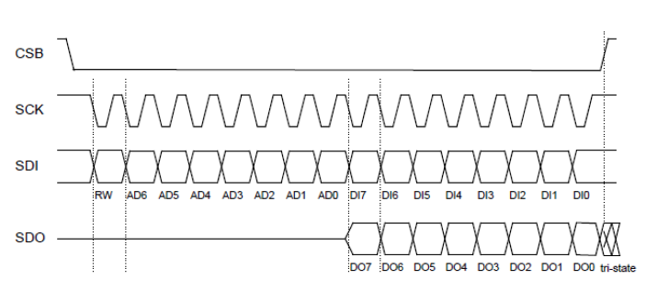
SPI on the MSP432
Write function
  This writes an 8-bit value to a certain register on the slave device
void spi_bmp183_write8(uint8_t reg, uint8_t value) {
reg = reg & ~0x80; // Clear high bit to write to this register
// Set Slave Select (CS) line low to begin transmission
GPIO_setOutputLowOnPin(GPIO_PORT_P4, GPIO_PIN3);
// Transmit slave register address
SPI_transmitData(EUSCI_B0_BASE, reg);
// Transmit write value
SPI_transmitData(EUSCI_B0_BASE, value);
// Set Slave Select (CS) line high to end transmission
GPIO_setOutputHighOnPin(GPIO_PORT_P4, GPIO_PIN3);
}

Slide 60
SPI on the MSP432
Read function
  This reads an 8-bit value from a certain register on the slave device
uint8_t spi_bmp183_read8(uint8_t reg) {
uint8_t RXData = 0;
reg = 0x80 | reg; // Set high bit to read from this register
// Set Slave Select (CS) line low to begin transmission
GPIO_setOutputLowOnPin(GPIO_PORT_P4, GPIO_PIN3);
// Make sure transmit buffer is clear
while (!(SPI_getInterruptStatus(EUSCI_B0_BASE,EUSCI_B_SPI_TRANSMIT_INTERRUPT)));
SPI_transmitData(EUSCI_B0_BASE, reg); // Transmit register address
// Send clock pulses. This will push slave to send data to master on MISO line.
SPI_transmitData(EUSCI_B0_BASE, 0x00);
// Make sure transmit buffer is clear
while (!(SPI_getInterruptStatus(EUSCI_B0_BASE,EUSCI_B_SPI_RECEIVE_INTERRUPT)));
RXData = SPI_receiveData(EUSCI_B0_BASE); // Pick up received byte in SPI receive data register
// Set Slave Select (CS) line high to end transmission
GPIO_setOutputHighOnPin(GPIO_PORT_P4, GPIO_PIN3);
return RXData;
}

Slide 61
SPI on the MSP432
Read function
  This reads an 8-bit value from a certain register on the slave device
uint8_t spi_bmp183_read8(uint8_t reg) {
uint8_t RXData = 0;
reg = 0x80 | reg; // Set high bit to read from this register
// Set Slave Select (CS) line low to begin transmission
GPIO_setOutputLowOnPin(GPIO_PORT_P4, GPIO_PIN3);
// Make sure transmit buffer is clear
while (!(SPI_getInterruptStatus(EUSCI_B0_BASE,EUSCI_B_SPI_TRANSMIT_INTERRUPT)));
SPI_transmitData(EUSCI_B0_BASE, reg); // Transmit register address
// Send clock pulses. This will push slave to send data to master on MISO line.
SPI_transmitData(EUSCI_B0_BASE, 0x00);
// Make sure transmit buffer is clear
while (!(SPI_getInterruptStatus(EUSCI_B0_BASE,EUSCI_B_SPI_RECEIVE_INTERRUPT)));
RXData = SPI_receiveData(EUSCI_B0_BASE); // Pick up received byte in SPI receive data register
// Set Slave Select (CS) line high to end transmission
GPIO_setOutputHighOnPin(GPIO_PORT_P4, GPIO_PIN3);
return RXData;
}
Note that Master actually has to write data in order to read data

Slide 62
SPI Summary
SPI is a synchronous communication protocol that has unique advantages:
  Hardware needed to communicate is very simple (i.e., can be made very cheap) compared to UART, I2C
  Low overhead, supports very high speeds
  Can implement full duplex (simultaneous read-write communication)
  Can use multiple slaves on same SPI bus

Slide 63
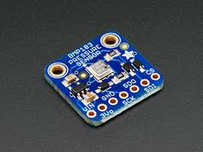
SPI Summary
Will post a basic MSP432 SPI code on T-Square
  Can receive data from BMP183 pressure sensor
Use my code as a template and customize for particular sensors/processors you are using
See Driverlib documentation for functions that can be used for all of the above

Slide 64
Serial Communications Summary
Protocol | Typical Speeds | Sync / Async | No. Pins Required | Full Duplex | Multiple Slaves
UART | 8 Mbit/s | Asynchronous | 2 (Tx, Rx) | No | No
I²C | 400 kbit/s or 1 Mbit/s | Synchronous | 2 (SDA, SCL) | No | Yes
SPI | 25 Mbit/s | Synchronous | 3 or 4 (MISO, MOSI, SCK, CS) | Yes | Yes
I2C and SPI used commonly for on-chip communication between devices
UART commonly used to communicate between multiple devices not on same chip (multiple MCUs, etc)

