Slide 1
Progess of the Project
Tsung-Min Pai
2023/12/01

Slide 2
Outline
GNN
Recap
Experiment – Change the Dataset
Experiment – Predict More Labels
Experiment – DAPRA Format
Future Work

Slide 3
Recap

Slide 4
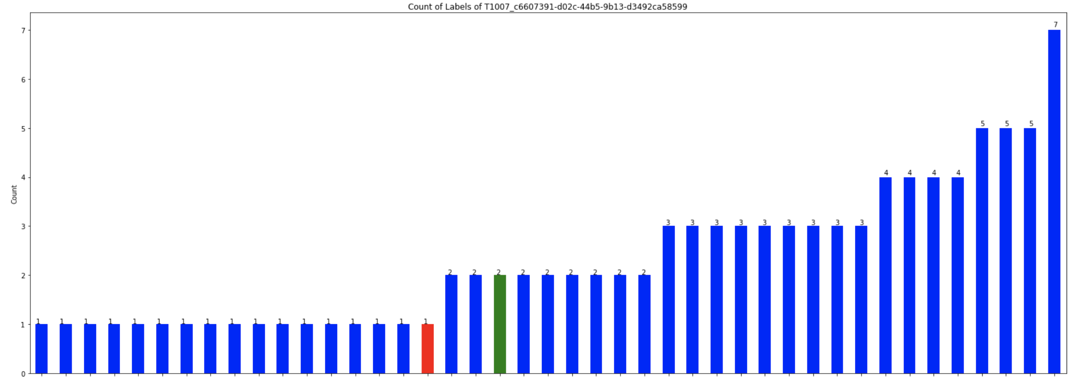
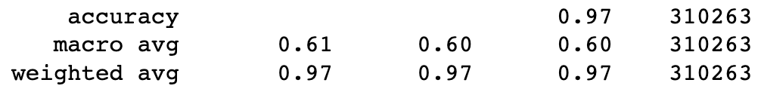
Observation of the Prediction
Use the original training set
The distribution of the prediction is so sparse
Most of the predictions are like this:
Red: non-single triplet edge
Blue: single triplet edge
Green: itself

Slide 5
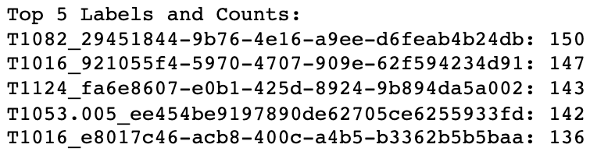
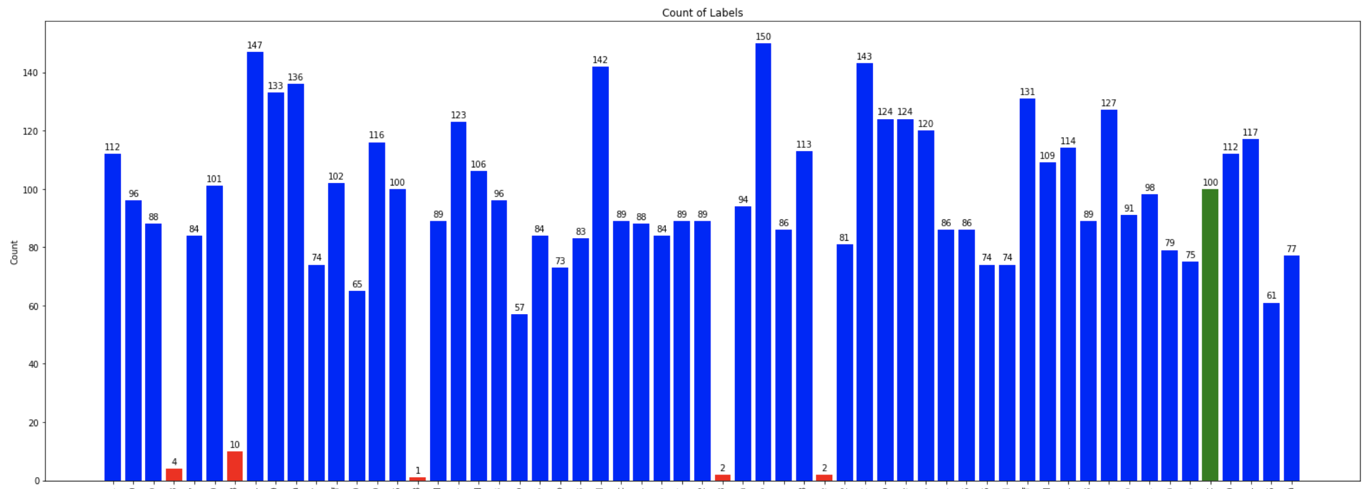
Observation of the Prediction
The # of the predicted labels
T1016
T1047
T1518_c9b (well predicted one)
T1490

Slide 6
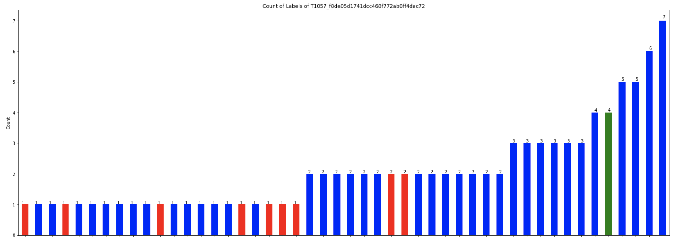
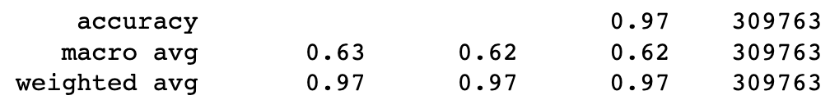
Remove the Popular TTPs
Remove these 5 TTPs from the dataset and then train it again:
More prediction on the non-single triplet case is like this:

Slide 7
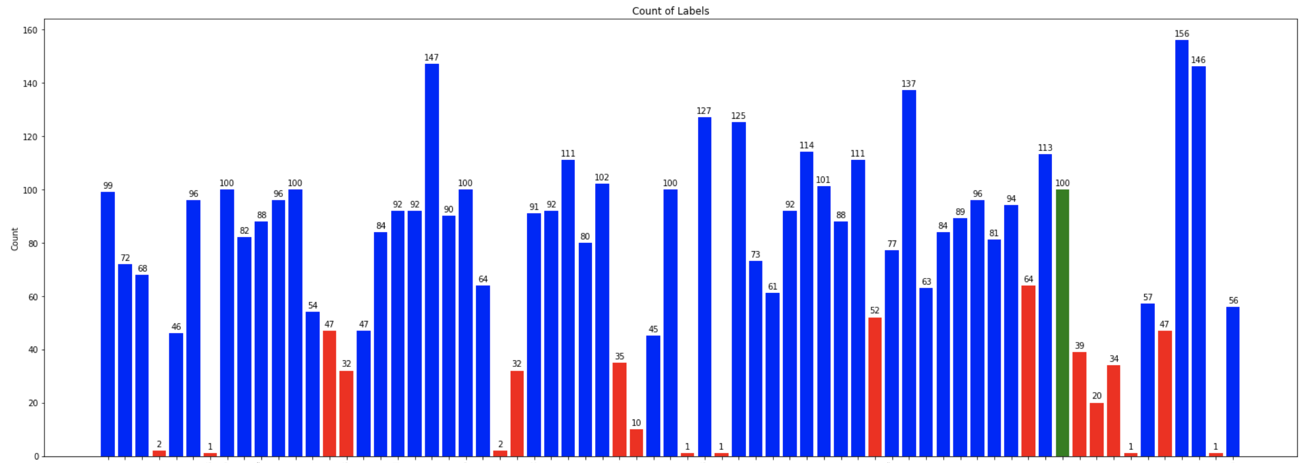
Remove the Popular TTPs
Remove these 5 TTPs from the dataset and then train it again:
The # of the predicted labels

Slide 8
Experiment – Change the Dataset

Slide 9
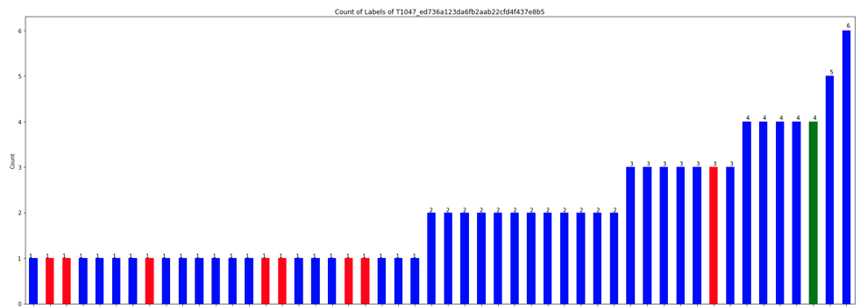

Observation of the Prediction
Remove the TTPs with support > 1000 (Removed 32 TTPs)
The predictions on the single triplet cases are still a mess
Red: non-single triplet edge
Blue: single triplet edge
Green: itself

Slide 10
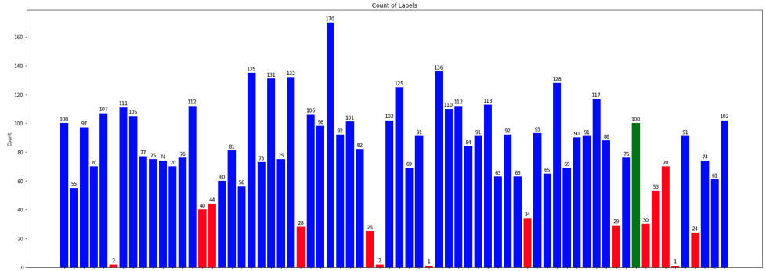
Observation of the Prediction
T1518_c9b (well predicted one)

Slide 11
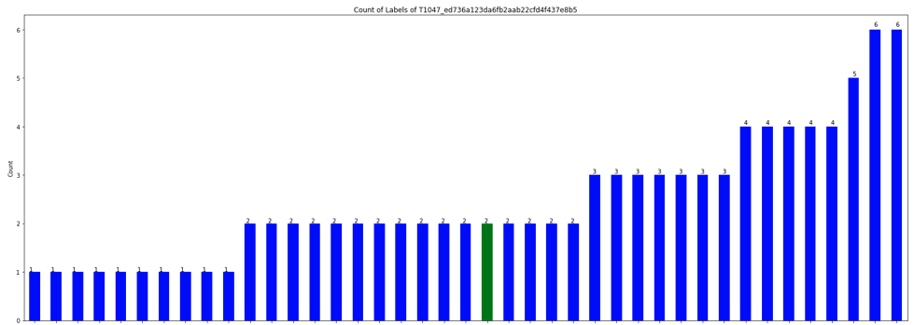

Observation of the Prediction
Only use the single triplet (support=100) cases:
Still messy and even have a worse performance

Slide 12
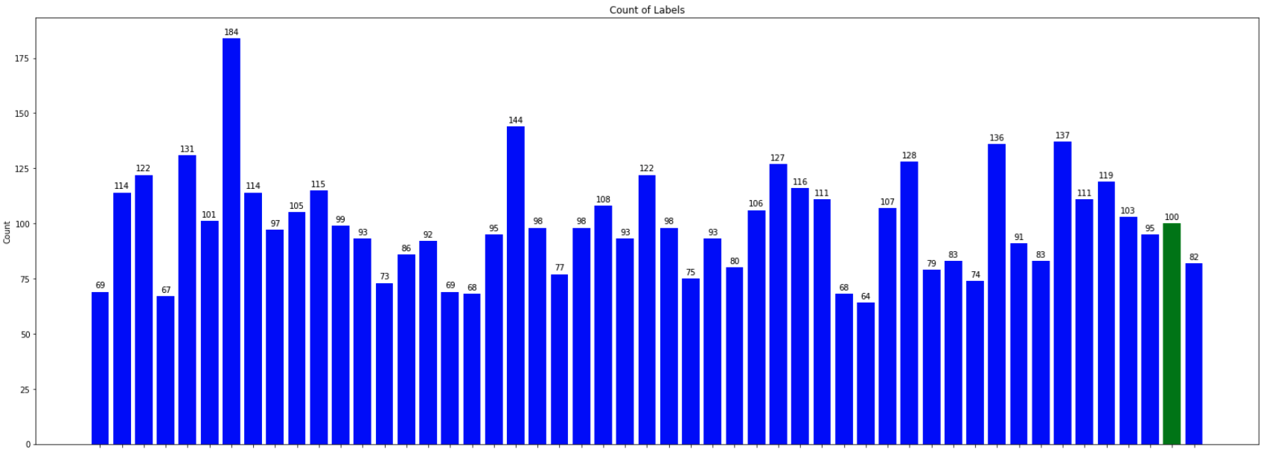
Observation of the Prediction
T1518_c9b (well predicted one)

Slide 13
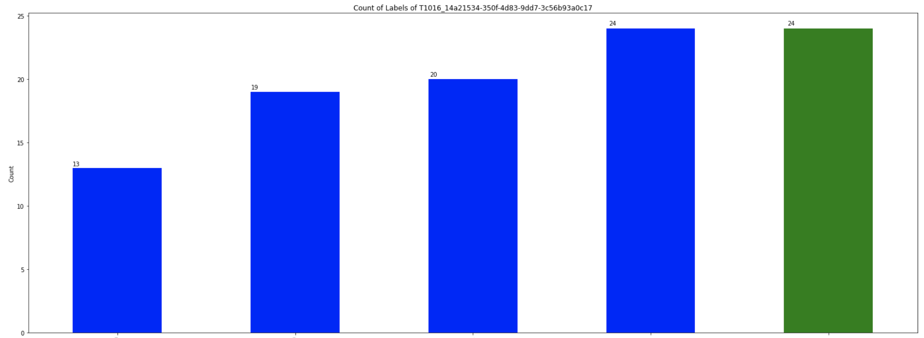
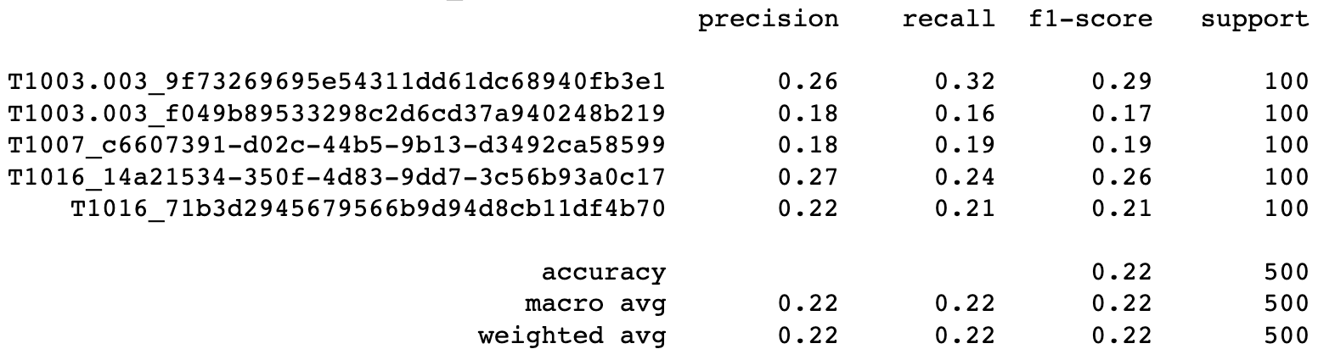
Observation of the Prediction
Dataset only has the 5 single triplet labels

Slide 14
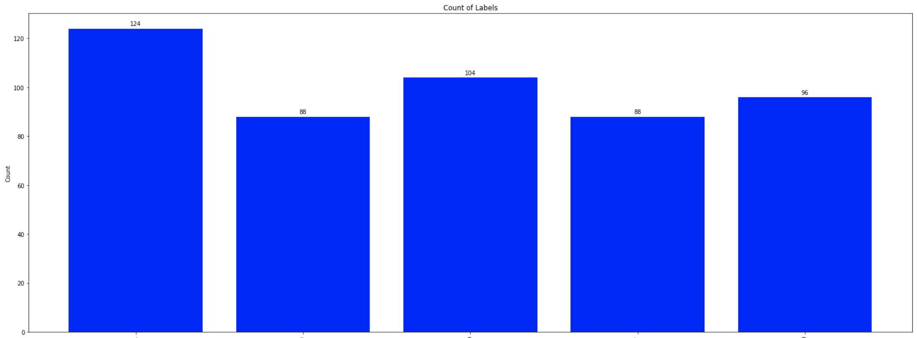
Observation of the Prediction

Slide 15
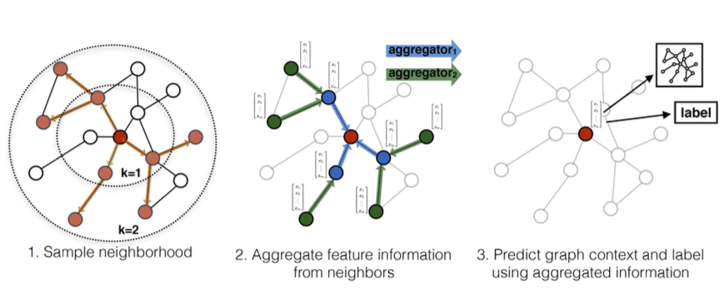
Conclusion
GraphSAGE really have a bad performance on the isolated triplet case
Even training dataset consists of isolated triplet case only
Even training dataset consists of only 5 isolated triplet cases
Possible Reason:
Lack of Neighborhood Information: GraphSAGE aggregates features from a node's local neighborhood to learn its representation. In the case of isolated triplets, each node has very limited neighborhood information (only one neighbor), which restricts the model's ability to learn complex or rich representations
Visual illustration of the GraphSAGE
sample and aggregate approach:

Slide 16
Experiment – Predict More Labels

Slide 17


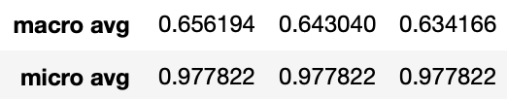
Predict the Top 3
Thought:
The experts can use the DL prediction and combine with their expertise to make the final prediction
Prediction Format:
Predict the top 3 classes of the edge
True: Predicted:
Performance:
Previous one:

Slide 18


Predict the Top 5
Prediction Format:
Predict the top 5 classes of the edge
True: Predicted:
Performance:
Previous one:
Version of top3:

Slide 19
Experiment – DAPRA Format

Slide 20
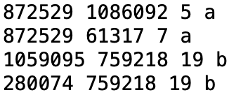
Change the DARPA Format
Original Format:
{"subj": {"uuid": "F9F5DC58-9431-4519-82CF-2BBFF40796E9", "type": "Subject", "n_attrbiute": {"cmdline": "None", "type": "SUBJECT_THREAD", "pid": 8920}}, "relation": "EVENT_WRITE", "obj": {"uuid": "F5D43721-2AD3-487C-B3DA-0A5D551FAE0D", "type": "FileObject", "n_attrbiute": {"filepath": "\\Device\\HarddiskVolume2\\ProgramData\\Microsoft\\Windows Defender\\Network Inspection System\\Support\\NisLog.txt"}}, "timestamp": 1523295276588000000, "label": "benign"}
Final Format:
Encode the subj uuid, relation, obj uuid and combine them with the label
Keep the mapping information into 2 mapping file
a is attack; b is benign

Slide 21
Future Work

Slide 22
Future Work
Figure out why the model can detect the T1518_c9b (if available?)
Is the label overlap or not overlap at all with other labels
Figure out what the model really predict about
Observe the real data in the original form (before embedding)
Run the training of the DAPRA dataset
GraphSMOTE

Slide 23
Thanks!!

Slide 24
NOTE!!

Slide 25
NOTE
每次都要再複習一下問題點
Show 以前的數據等等
為何要做現在這個實驗
圖表要清楚一點
X and Y-axis
給的example要是真的有解決那個問題的example

Slide 26
Appendix

Slide 27
Recap
Noticed that T1518_c9b always got predicted in all the experiments
MLP, RNN, GNN
Ensemble is not useful here
Hidden Dimension do have an effect on the result → but it’s all about from 0 to 0.05
Embedding (transR_50 and tansH_150) seems to have the similar result

Slide 28
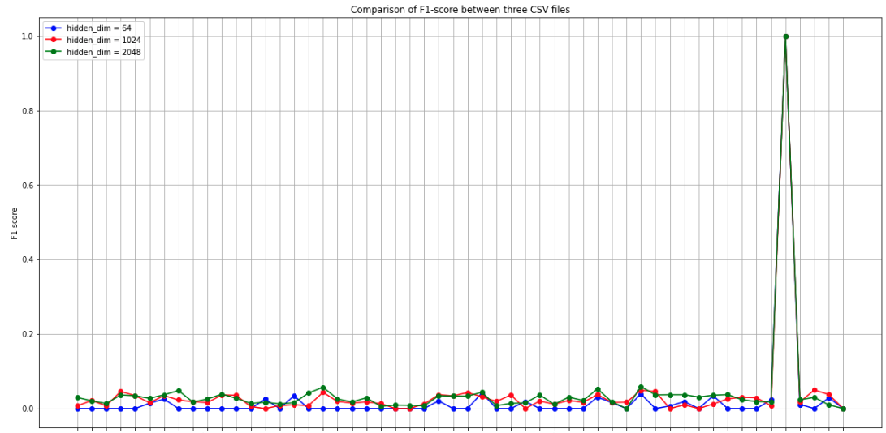
Observation on Different Dimension
T1518_c9b…

Slide 29
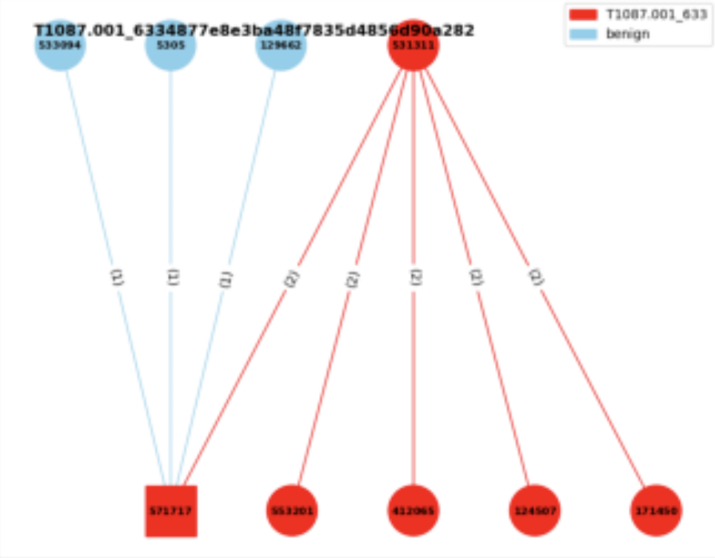
Experiment 3
Experiment 3:
Consider the neighbor benign nodes
Edge classification
Given a graph → label the triplets
with the benign or the specific AP
benign
T1003.001

Slide 30

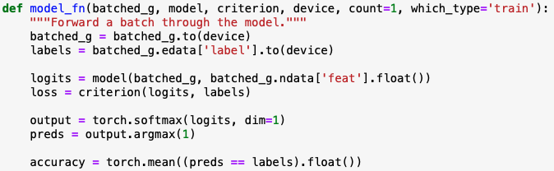
Experiment 3 - Model
Concept from the DGL official website:
Let the dgl graph’s edge data have the attribute: edata[“label”]
Use GraphSAGE model to get the new node embedding
Use MLP model to get the score of the edge
Concatenate these two models
Train the final model

Slide 31
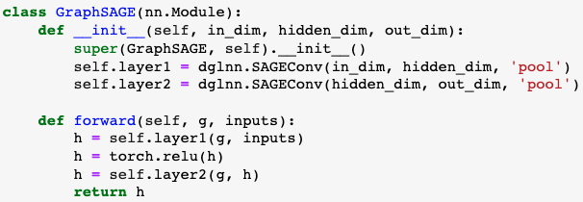
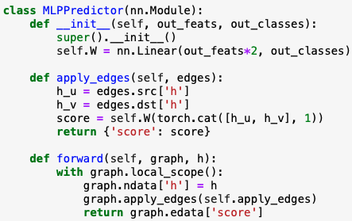
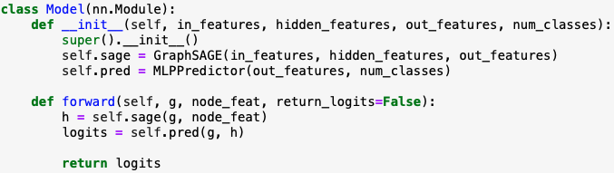
Experiment 3 - Model
Notes:
這個`MLPPredictor`模型是用於邊預測或稱為鏈接預測的。鏈接預測的目的是預測兩個節點之間是否存在邊。這是圖學習中的一個重要任務，被應用於許多領域，例如社交網絡中的好友推薦或蛋白質互作網絡的互作預測。
1. **初始化 (`__init__` 方法)**:
- 定義一個全連接線性層`self.W`，其輸入特徵的大小是 `in_features * 2`。這是因為我們將來源節點`h_u`和目標節點`h_v`的表示向量拼接起來，所以尺寸變為雙倍。
- 輸出的尺寸是 `out_classes`，這對應於邊的類別數量。
2. **apply_edges 方法**:
- 這個方法的作用是為圖中的每一條邊計算一個'score'。這個'score'可以被解釋為邊的類別。
- 它首先從圖中提取來源節點`h_u`和目標節點`h_v`的表示向量。
- 接著，它將這兩個表示向量拼接起來，並通過`self.W`線性層計算'score'。
3. **前向方法 (`forward`)**:
- 接收一個圖和它的節點表示`h`。
- 它將這些節點表示設定為圖的節點數據。
- 使用`apply_edges`方法為圖中的每一條邊計算一個'score'。
- 返回邊的'score'。
總之，`MLPPredictor`使用來源和目標節點的表示計算圖中每一條邊的'score'，這些'score'可以用於邊的預測任務。

Slide 32
GraphSMOTE: Imbalanced Node Classification on Graphs with Graph Neural Networks
WSDM ’21, March 8–12, 2021, Virtual Event, Israel
Tianxiang Zhao, Xiang Zhang, Suhang Wang
{tkz5084,xzz89,szw494}@psu.edu College of Information Science and Technology, Penn State University State College, The USA
https://github.com/TianxiangZhao/GraphSmote
Notes:
Arxiv 引用 190
WSDM 引用193
https://scholar.google.com.tw/scholar?q=Tianxiang+Zhao,+Xiang+Zhang,+Suhang+Wang&hl=zh-TW&as_sdt=0&as_vis=1&oi=scholar

Slide 33
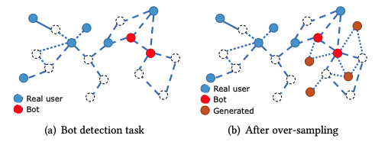
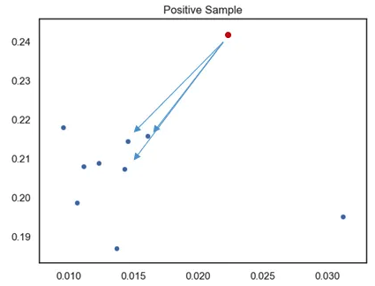
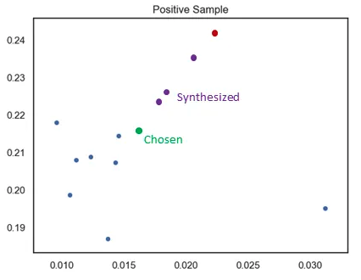
GraphSMOTE
Task:
Synthesized Minority Oversampling Technique (SMOTE)
Used on i.i.d. data
Doesn’t consider the structure of the graph
No edge connection between the nodes
K=3
N=3
Notes:
設定一個採樣倍率 N，也就是對每個樣本需要生成幾個合成樣本
設定一個近鄰值 K ，針對該樣本找出 K 個最近鄰樣本並從中隨機選一個
根據以下公式來創造 N 個樣本

Slide 34
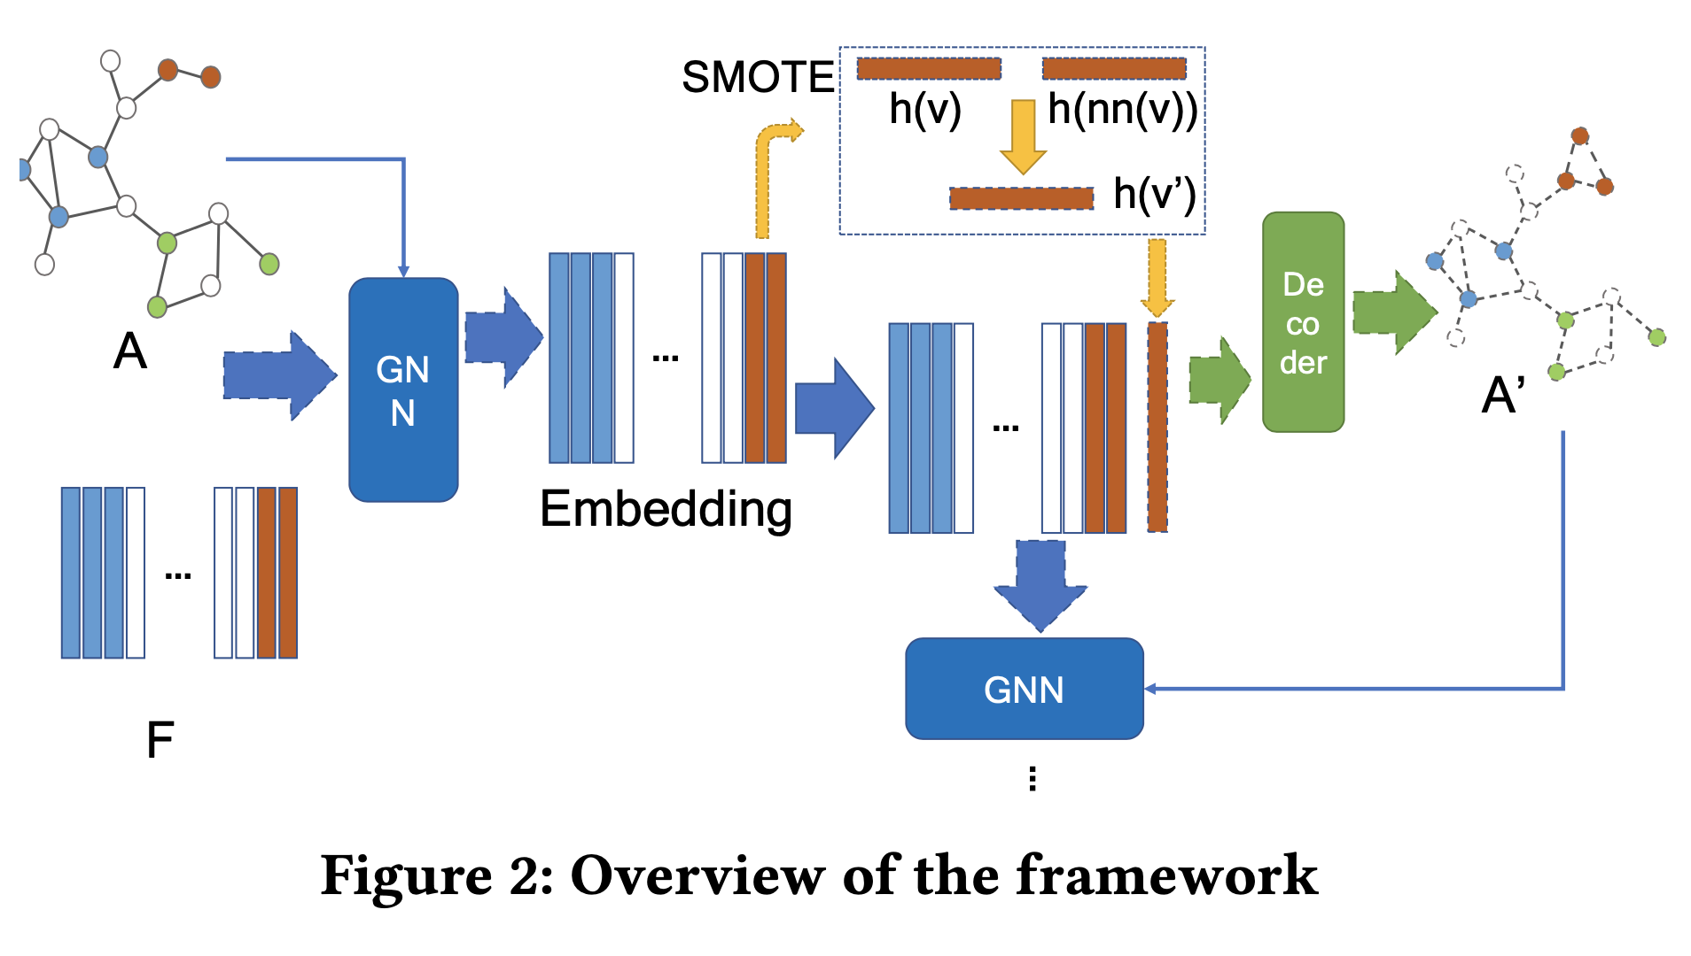
GraphSMOTE
Framework
a GNN-based feature extractor
→ Use GraphSAGE
Synthetic Node Generation
→ Use SMOTE algorithm
Edge Generator
→ weighted inner product decoder
GNN Classifier (downstream task)
Notes:
設定一個採樣倍率 N，也就是對每個樣本需要生成幾個合成樣本
設定一個近鄰值 K ，針對該樣本找出 K 個最近鄰樣本並從中隨機選一個
根據以下公式來創造 N 個樣本

