Slide 1
Progess of the Project
Vincent Pai 2023/7/12

Slide 2
Outline
TRAM
What’s TRAM
How to use TRAM
My automation code
Finding the models
My task
Graphormer
Others may be useful
Future Plan

Slide 3
TRAM

Slide 4

What is TRAM
Threat Report ATT&CK MAPPER (TRAM)
TRAM is an open-source platform designed to advance research into automating the mapping of CTI reports to MITRE ATT&CK.
TRAM enables researchers to test and refine Machine Learning models for identifying ATT&CK techniques in prose-based threat intel reports and allows threat intel analysts to train ML models and validate ML results.
There’s 4 ML models exist now and all of them are implemented as an SKLearn Pipeline

Slide 5
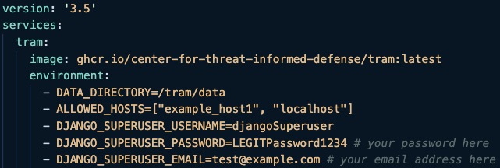
How to Use TRAM
Need to use the Docker
Download the docker-compose.yml for TRAM
Run some command in the same directory with the yml file to download the Docker images
Navigate to http://localhost:8000/ and login
Notes:
YML檔案（也稱為YAML檔案）是一種基於文本的標記語言，用於表示結構化的數據。YML是「YAML Ain't Markup Language」的縮寫，它強調了YML的設計初衷，即作為一種人類可讀的數據序列化格式。
YML檔案使用縮進和冒號來表示數據的結構。它可以用於配置文件、數據序列化、構建工具配置等多個領域。YML的主要優點是易於閱讀和編寫，並且可以跨多種編程語言進行解析和生成。
YML檔案通常以「.yml」或「.yaml」作為文件擴展名。您可以使用文本編輯器或專門的YAML編輯器來編輯和處理YML檔案。
在YML檔案中，您可以定義鍵值對、數組、嵌套結構等數據結構。以下是一個簡單的YML檔案的示例：

Slide 6
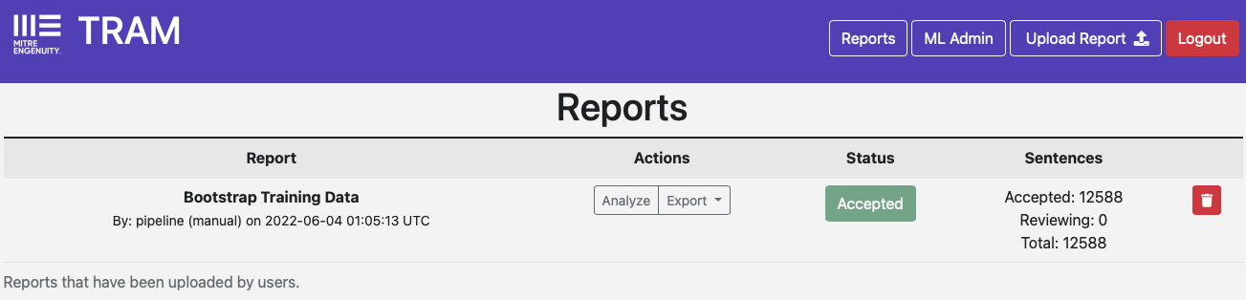
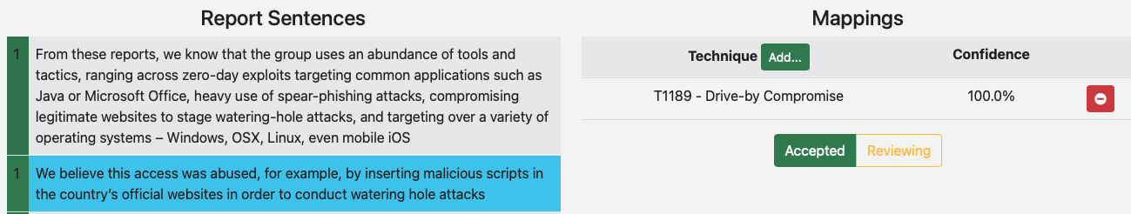
How to Use TRAM
After clicking the analyze:
Show the sentences and the corresponding MITRE ATT&CK technique

Slide 7
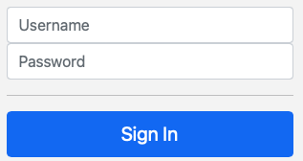

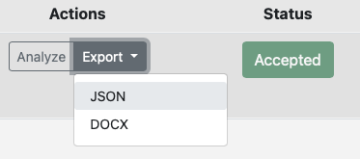
Automation - Tasks
1.
2.
3.
4. Postprocessing

Slide 8
Automation - programming
Packages we need to import: Selenium, os, csv, json
Upload.py: Sign in and upload the files
Export.py: After singing in, press the export and JSON for all the files
Postprocess.py: Turn the all json files in a directory into the labeled csv file(Only the sentenses and the corresponding MITRE ATT&CK techniques.

Slide 9
Finding the models

Slide 10
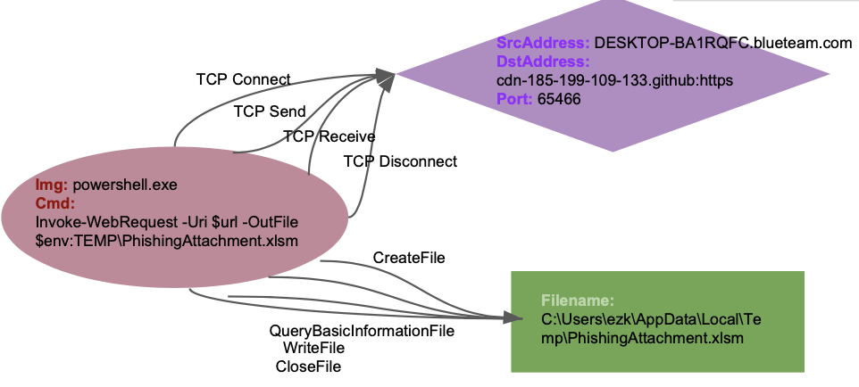
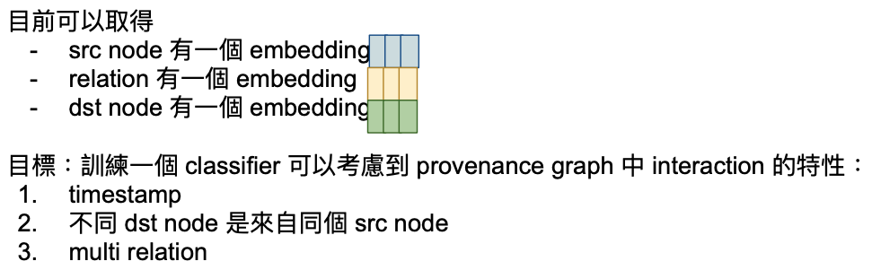
My task
Find a multi-head self-attention NN that can explain the multi-relation of out graph
Find a multi-label classification
GNN is my current searching direction – GCN, GAT
Notes:
為注意力層提供了多個“表示子空間”。對於多頭注意力，我們不僅有一個，而且還有多組Query/Key/Value權重矩陣，這些權重矩陣集合中的每一個都是隨機初始化的。然後，在訓練之後，每組用於將輸入Embedding投影到不同的表示子空間中。多個head學習到的Attention側重點可能略有不同，這樣給了模型更大的容量。
1. Multi-head 感覺可以解決multi-relation
2. Multi-label 有某些model可用 -> head to tail中間的multi-relation and tail may comes from many heads都算是

Slide 11
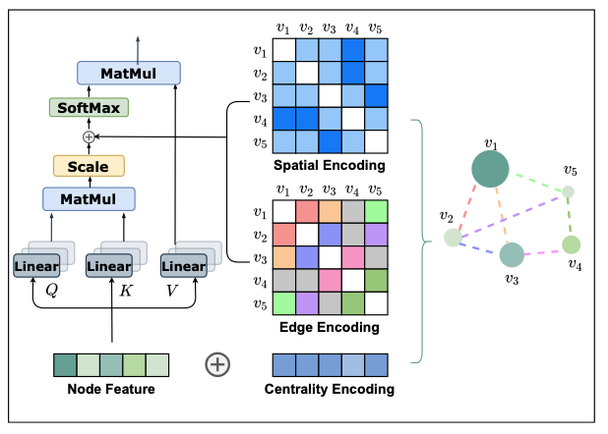
Graphormer
Published by Microsoft
Structural encoding: Centrality Encoding, Edge Encoding
The only available graph transformer model
Realize on Transformer
Do layer normalization and feed-forward blocks before applying multi-head self-attention instead of after.
Need to find out the input format and whether our datas could be the input.
Notes:
除了节点的中心性编码和节点间的结构信息编码可以捕捉图数据的结构信息外，还有一些结构信息保存在边的特征中。比如分子图中两个原子之间的键的类型就属于边的的特征，保存了图数据的结构信息。
Structural encoding 就像一般用在 self-attention 的 positional encoding. However, for graphs, nodes are not arranged as a sequence.
Graphormer 模型通過編碼圖結構更多的結構特徵取得了更好的結果，但是自註意力模型的二次方復雜度限制了其不能在大規模的圖上使用。未來的研究方向：1.效率更高的模型，可用於大規模的圖數據；2.圖信息編碼的改進；3.應用更好的採樣策略，提取節點特徵表示。
本來transformer是after才MHA，This modification has been unanimously adopted by all current Transformer implementations because it leads to more effective optimization

Slide 12
Graphormer
Paper
Explanation of the paper
How to use Graphormer to train a graph classification

Slide 13
Others may be useful
Graph Transformer – improvement of the GNN
Graph attention network (GAT) for node classification
Multilabel graph classification using GAT
MULTIHEADATTENTION
Self-attention does not need O(n^2) memory
Notes:
Graph transformer -> 多了edge feature的GNN

Slide 14
Future Plan

Slide 15
Plan of Next Week
For TRAM
Try to use the real dataset to upload and then labeled them
For Model
Find out what the input of the Graphormer should be
If Graphmor is feasible, read the paper
Try to implement or use the simplest model to train
if Graphormer is not feasible, try some more models

Slide 16
Appendix

Slide 17
List of Models and Useful Techniques
Graphormer
Graph Transformer
Graph attention network (GAT) for node classification
Multilabel graph classification using graph attention networks
MULTIHEADATTENTION
Self-attention does not need O(n^2) memory

Slide 18
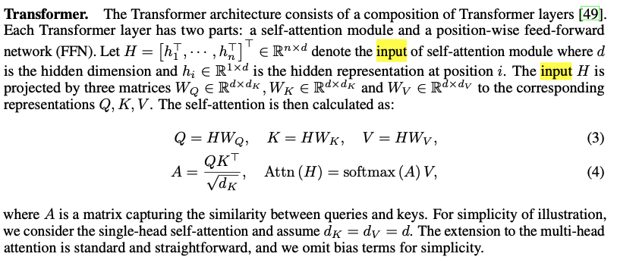
Graphormer’s Input
By using the centrality encoding in the input, the softmax attention can catch the node importance signal in the queries and the keys.
Someone use the ogbg-mohiv dataset

Slide 19
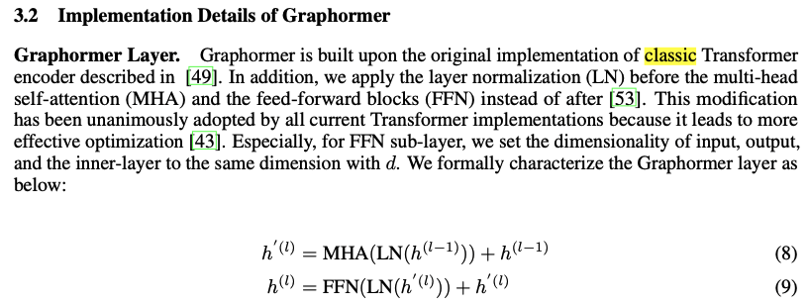
Graphormer’s Implementation
Based on the classic Transformer -> do I think the input may be same as the transformer(embedding).
Notes:
Edge 有料，像是兩個原子間的鍵，但這個模型就考慮了整張圖的所有節點，或許有點浪費？ 感覺可以只觀察鄰居節點
Graphormer 模型通過編碼圖結構更多的結構特徵取得了更好的結果，但是自註意力模型的二次方復雜度限制了其不能在大規模的圖上使用。未來的研究方向：1.效率更高的模型，可用於大規模的圖數據；2.圖信息編碼的改進；3.應用更好的採樣策略，提取節點特徵表示。

Slide 20
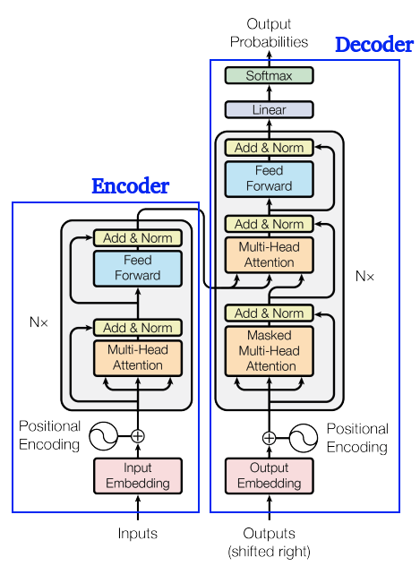
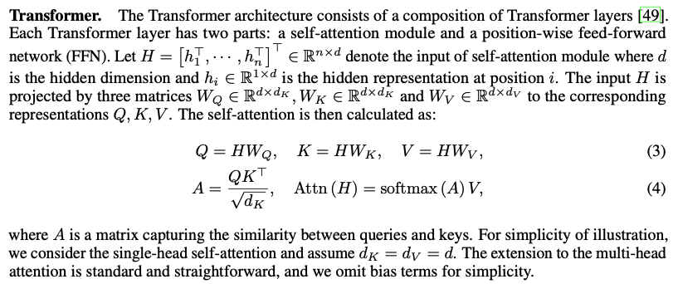
Transformer Architecture
Input is a sequence (node’s embedding)
Notes:
Edge 有料，像是兩個原子間的鍵，但這個模型就考慮了整張圖的所有節點，或許有點浪費？ 感覺可以只觀察鄰居節點
Graphormer 模型通過編碼圖結構更多的結構特徵取得了更好的結果，但是自註意力模型的二次方復雜度限制了其不能在大規模的圖上使用。未來的研究方向：1.效率更高的模型，可用於大規模的圖數據；2.圖信息編碼的改進；3.應用更好的採樣策略，提取節點特徵表示。

Slide 21
Graphormer’s Encoding
Centrality Encoding: 可能有某個 node 特別重要，we simply add centrality encoding to the node features as the input.
Edge Encoding in attention: 在許多圖形任務中，邊緣也具有結構特徵，例如在分子圖中，原子對之間的特徵可以描述它們之間的鍵類型。這些特徵對於圖形表示非常重要，將它們與節點特徵一起編碼到網絡中是必不可少的。在先前的研究中，主要有兩種邊編碼方法。
第一種方法是將邊特徵添加到相關節點的特徵中。
第二種方法是對於每個節點，將其相關邊的特徵與節點特徵一起在聚合中使用。
然而，這樣使用邊特徵只將邊的信息傳播到相關的節點，可能不是利用邊信息表示整個圖形的有效方法。 為了更好地將邊特徵編碼到注意力層中，我們在Graphormer中提出了一種新的邊編碼方法。注意機制需要估計每對節點(vi, vj)之間的相關性，我們認為連接它們的邊應該在相關性中考慮，就像[34, 51]中那樣。對於每對有序節點(vi, vj)，我們找到從vi到vj的(其中之一)最短路徑SPij = (e1, e2, ..., eN)，並計算沿該路徑的邊特徵與可學習嵌入之間點積的平均值。所提出的邊編碼通過一個偏差項將邊特徵納入注意模塊。
Notes:
除了在前一節中描述的傳統方法來編碼邊緣特徵外，還有幾種試圖更好地編碼邊緣特徵的方法：[16]中開發了一種基於注意力的GNN層來編碼邊緣特徵，其中邊緣特徵根據其兩個節點特徵的相似性進行加權；在[5]中，已將邊緣特徵編碼到流行的GIN [54]中；在[13]中，作者提出將邊緣特徵投影到嵌入向量中，然後將其乘以注意力係數，將結果傳遞給額外的FFN子層以生成邊緣表示。

Slide 22
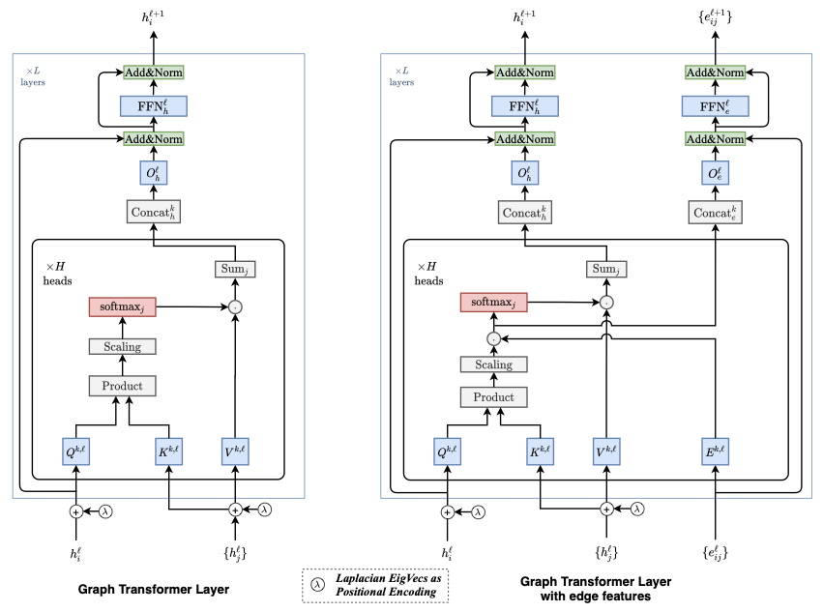
Graph Transformer - Improvement of GNN
Improved Graph Transformer, which extends the key design components of the NLP transformers to arbitrary graphs.
Notes:
In this extension, the available edge attributes in a graph is used to explicitly modify the corresponding pairwise attention scores.

Slide 23
Graph Transformer - Improvement of GNN
https://arxiv.org/pdf/2012.09699v2.pdf
https://github.com/graphdeeplearning/graphtransformer

Slide 24
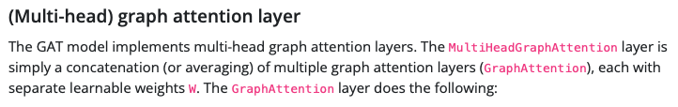
Graph attention network (GAT) for node classification
In this tutorial, we will implement a specific graph neural network known as a GAT to predict labels of scientific papers based on what type of papers cite them.
Notes:
use tensorflow (need to be changed to Pytorch)

Slide 25
Graph attention network (GAT) for node classification
https://keras.io/examples/graph/gat_node_classification/
For original GAT: https://arxiv.org/pdf/1710.10903.pdf
other: https://towardsdatascience.com/graph-attention-networks-in-python-975736ac5c0c

Slide 26
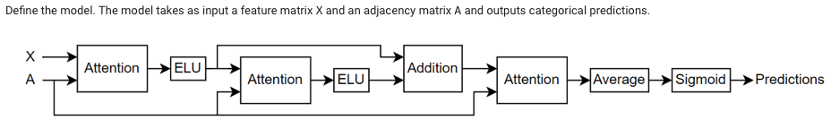
Multilabel graph classification using graph attention networks
The model uses a masked multi-head self-attention mechanism to aggregate features across the neighborhood of a node, that is, the set of nodes that are directly connected to the node.
The mask, which is obtained from the adjacency matrix, is used to prevent attention between nodes that are not in the same neighborhood.
Notes:
Based on MATLAB(can use the architecture or change to python maybe)

Slide 27
Multilabel graph classification using graph attention networks
https://www.mathworks.com/help/deeplearning/ug/multilabel-graph-classification-using-graph-attention-networks.html

Slide 28


MULTIHEADATTENTION
Allows the model to jointly attend to information from different representation subspaces
Determine mask type and combine masks if necessary.

Slide 29
MULTIHEADATTENTION
https://pytorch.org/docs/stable/generated/torch.nn.MultiheadAttention.html
https://arxiv.org/abs/1706.03762

Slide 30
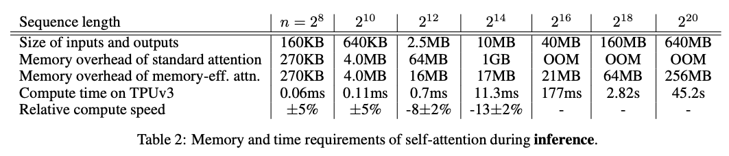
Self-attention does not need O(n^2) memory
Only need O(log n) space complexity (usually considered to be O(n^2) )

Slide 31
Self-attention does not need O(n^2) memory
https://arxiv.org/pdf/2112.05682.pdf
https://github.com/google-research/google-research/blob/master/memory_efficient_attention/memory_efficient_attention.ipynb

Slide 32
Question
QA? BERT? Can it explain the multi-relation?
If use GNN: Graph Convolutional Networks (GCNs), Graph Attention Networks (GATs), Graph Isomorphism Networks (GINs), GraphSAGE.
https://pytorch-geometric.readthedocs.io/en/latest/
Notes:
If use NLP, what kind of task it is.

Slide 33
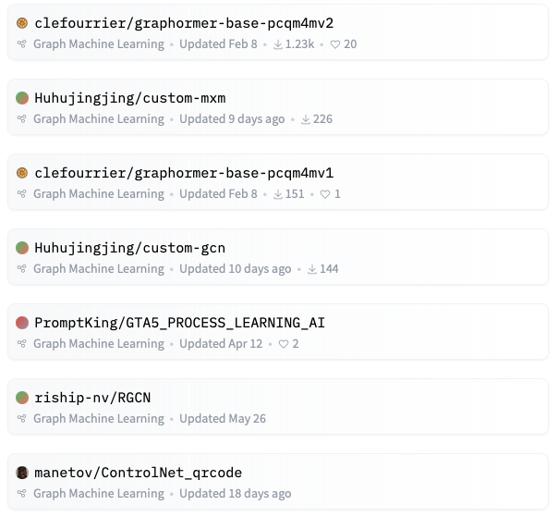
Question
Basically, the only useful model that can be directly imported in the realm of graph classifier is Graphomer.

