Slide 1
Discussion of the Model
Vincent Pai 2023/7/11

Slide 2
Outline
TRAM
Automation
Finding the model and architecture
Multi-head self-attention in graph classification

Slide 3
TRAM

Slide 4
Automation

Slide 5
Some models may be suitable for our task
Vincent Pai 2023/7/11

Slide 6
List of Models and Useful Techniques
Graphormer
Graph Transformer
Graph attention network (GAT) for node classification
Multilabel graph classification using graph attention networks
MULTIHEADATTENTION
Self-attention does not need O(n^2) memory

Slide 7
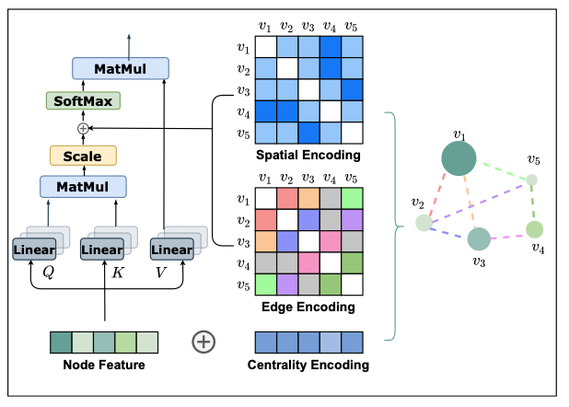
Graphormer
Encoding: Spatial Encoding, Centrality Encoding, Edge Encoding
At the moment, the only graph transformer model available in Transformers
Realize on Transformer
Do layer normalization (LN) and feed-forward blocks (FFN) before applying multi-head self-attention (MHA)
Notes:
Edge 有料，像是兩個原子間的鍵，但這個模型就考慮了整張圖的所有節點，或許有點浪費？ 感覺可以只觀察鄰居節點
除了节点的中心性编码和节点间的结构信息编码可以捕捉图数据的结构信息外，还有一些结构信息保存在边的特征中。比如分子图中两个原子之间的键的类型就属于边的的特征，保存了图数据的结构信息。
Graphormer 模型通過編碼圖結構更多的結構特徵取得了更好的結果，但是自註意力模型的二次方復雜度限制了其不能在大規模的圖上使用。未來的研究方向：1.效率更高的模型，可用於大規模的圖數據；2.圖信息編碼的改進；3.應用更好的採樣策略，提取節點特徵表示。

Slide 8
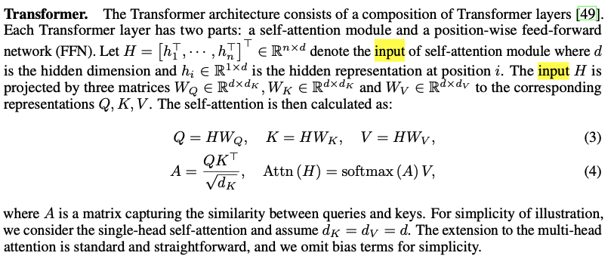
Graphormer’s Input
By using the centrality encoding in the input, the softmax attention can catch the node importance signal in the queries and the keys.
Someone use the ogbg-mohiv dataset

Slide 9
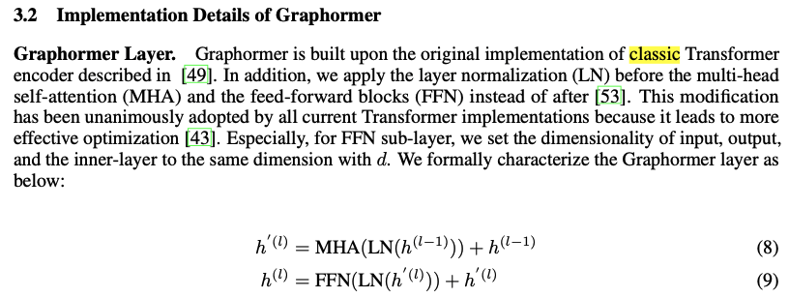
Graphormer’s Implementation
Based on the classic Transformer -> do I think the input may be same as the transformer(embedding).
Notes:
Edge 有料，像是兩個原子間的鍵，但這個模型就考慮了整張圖的所有節點，或許有點浪費？ 感覺可以只觀察鄰居節點
Graphormer 模型通過編碼圖結構更多的結構特徵取得了更好的結果，但是自註意力模型的二次方復雜度限制了其不能在大規模的圖上使用。未來的研究方向：1.效率更高的模型，可用於大規模的圖數據；2.圖信息編碼的改進；3.應用更好的採樣策略，提取節點特徵表示。

Slide 10
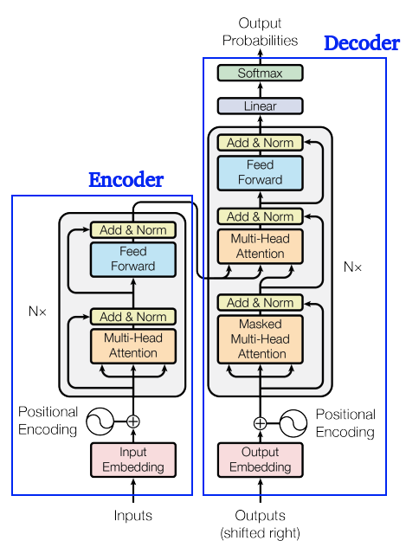
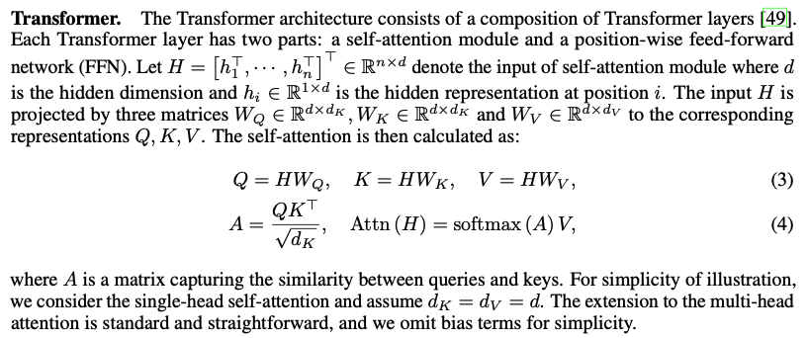
Transformer Architecture
Input is a sequence (node’s embedding)
Notes:
Edge 有料，像是兩個原子間的鍵，但這個模型就考慮了整張圖的所有節點，或許有點浪費？ 感覺可以只觀察鄰居節點
Graphormer 模型通過編碼圖結構更多的結構特徵取得了更好的結果，但是自註意力模型的二次方復雜度限制了其不能在大規模的圖上使用。未來的研究方向：1.效率更高的模型，可用於大規模的圖數據；2.圖信息編碼的改進；3.應用更好的採樣策略，提取節點特徵表示。

Slide 11
Graphormer’s Encoding
Centrality Encoding: 可能有某個 node 特別重要，we simply add centrality encoding to the node features as the input.
Edge Encoding in attention: 在許多圖形任務中，邊緣也具有結構特徵，例如在分子圖中，原子對之間的特徵可以描述它們之間的鍵類型。這些特徵對於圖形表示非常重要，將它們與節點特徵一起編碼到網絡中是必不可少的。在先前的研究中，主要有兩種邊編碼方法。
第一種方法是將邊特徵添加到相關節點的特徵中。
第二種方法是對於每個節點，將其相關邊的特徵與節點特徵一起在聚合中使用。
然而，這樣使用邊特徵只將邊的信息傳播到相關的節點，可能不是利用邊信息表示整個圖形的有效方法。 為了更好地將邊特徵編碼到注意力層中，我們在Graphormer中提出了一種新的邊編碼方法。注意機制需要估計每對節點(vi, vj)之間的相關性，我們認為連接它們的邊應該在相關性中考慮，就像[34, 51]中那樣。對於每對有序節點(vi, vj)，我們找到從vi到vj的(其中之一)最短路徑SPij = (e1, e2, ..., eN)，並計算沿該路徑的邊特徵與可學習嵌入之間點積的平均值。所提出的邊編碼通過一個偏差項將邊特徵納入注意模塊。
Notes:
除了在前一節中描述的傳統方法來編碼邊緣特徵外，還有幾種試圖更好地編碼邊緣特徵的方法：[16]中開發了一種基於注意力的GNN層來編碼邊緣特徵，其中邊緣特徵根據其兩個節點特徵的相似性進行加權；在[5]中，已將邊緣特徵編碼到流行的GIN [54]中；在[13]中，作者提出將邊緣特徵投影到嵌入向量中，然後將其乘以注意力係數，將結果傳遞給額外的FFN子層以生成邊緣表示。

Slide 12
Graphormer
Paper
Explanation of the paper
How to use Graphormer to train a graph classification

Slide 13
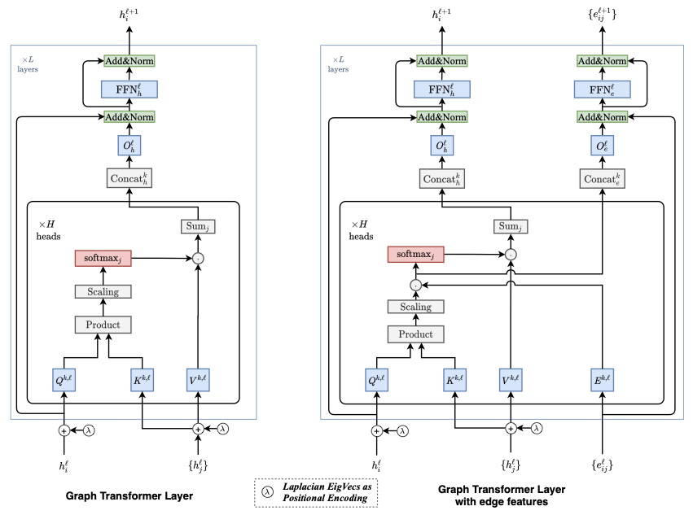
Graph Transformer - Improvement of GNN
Improved Graph Transformer, which extends the key design components of the NLP transformers to arbitrary graphs.
Notes:
In this extension, the available edge attributes in a graph is used to explicitly modify the corresponding pairwise attention scores.

Slide 14
Graph Transformer - Improvement of GNN
https://arxiv.org/pdf/2012.09699v2.pdf
https://github.com/graphdeeplearning/graphtransformer

Slide 15
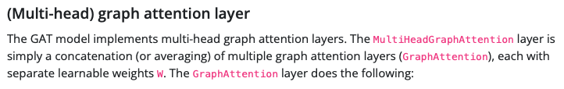
Graph attention network (GAT) for node classification
In this tutorial, we will implement a specific graph neural network known as a GAT to predict labels of scientific papers based on what type of papers cite them.
Notes:
use tensorflow (need to be changed to Pytorch)

Slide 16
Graph attention network (GAT) for node classification
https://keras.io/examples/graph/gat_node_classification/
For original GAT: https://arxiv.org/pdf/1710.10903.pdf
other: https://towardsdatascience.com/graph-attention-networks-in-python-975736ac5c0c

Slide 17
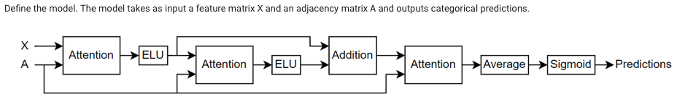
Multilabel graph classification using graph attention networks
The model uses a masked multi-head self-attention mechanism to aggregate features across the neighborhood of a node, that is, the set of nodes that are directly connected to the node.
The mask, which is obtained from the adjacency matrix, is used to prevent attention between nodes that are not in the same neighborhood.
Notes:
Based on MATLAB(can use the architecture or change to python maybe)

Slide 18
Multilabel graph classification using graph attention networks
https://www.mathworks.com/help/deeplearning/ug/multilabel-graph-classification-using-graph-attention-networks.html

Slide 19


MULTIHEADATTENTION
Allows the model to jointly attend to information from different representation subspaces
Determine mask type and combine masks if necessary.

Slide 20
MULTIHEADATTENTION
https://pytorch.org/docs/stable/generated/torch.nn.MultiheadAttention.html
https://arxiv.org/abs/1706.03762

Slide 21
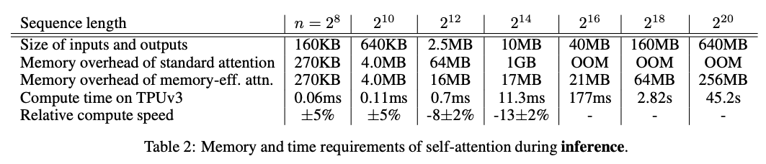
Self-attention does not need O(n^2) memory
Only need O(log n) space complexity (usually considered to be O(n^2) )

Slide 22
Self-attention does not need O(n^2) memory
https://arxiv.org/pdf/2112.05682.pdf
https://github.com/google-research/google-research/blob/master/memory_efficient_attention/memory_efficient_attention.ipynb

Slide 23
Appendix
QA? BERT? Can it explain the multi-relation?
If use GNN: Graph Convolutional Networks (GCNs), Graph Attention Networks (GATs), Graph Isomorphism Networks (GINs), GraphSAGE.
https://pytorch-geometric.readthedocs.io/en/latest/
Notes:
If use NLP, what kind of task it is.

Slide 24
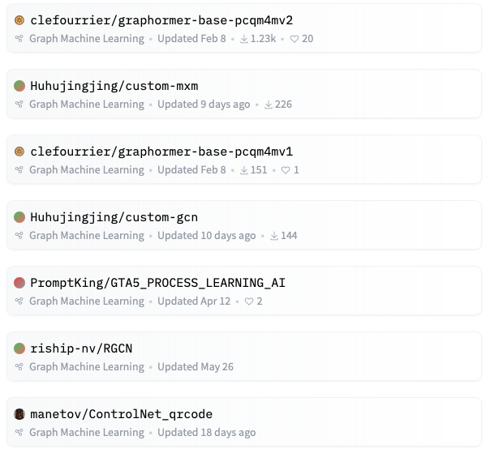
Appendix
Basically, the only useful model that can be directly imported in the realm of graph classifier is Graphomer.
Notes:
If use NLP, what kind of task it is.

