Slide 1
Progess of the Project
Vincent Pai 2023/7/19

Slide 2
Outline
Graph Classification
Model
Background
Architecture
Input Format
Possible Issue
Future Plan

Slide 3
Graph Classification

Slide 4
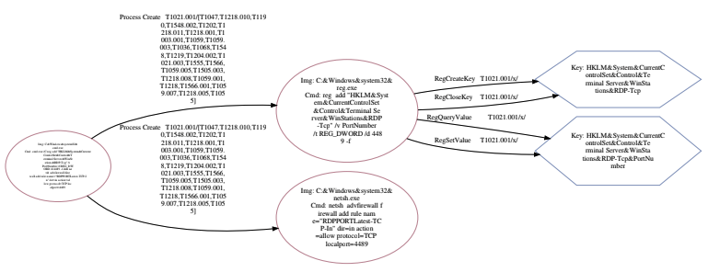
My task
Considering:
Sequence
Multi-relation
Different destinaiton nodes come from same source node

Slide 5
Model - Graphormer
Published by Microsoft
Paper: Do Transformers Really Perform Bad for Graph Representation
Author: Chengxuan Ying, Tianle Cai, Shengjie Luo, Shuxin Zheng, Guolin Ke, Di He, Yanming Shen, Tie-Yan Liu from Microsoft Research Asia
Published at: 2016 arXiv
They want to apply Transformer in the realm of the graph, and in the past, the only effective way is to replace some key modules (e.g., feature aggregation) in classic GNN variants by the softmax attention.

Slide 6
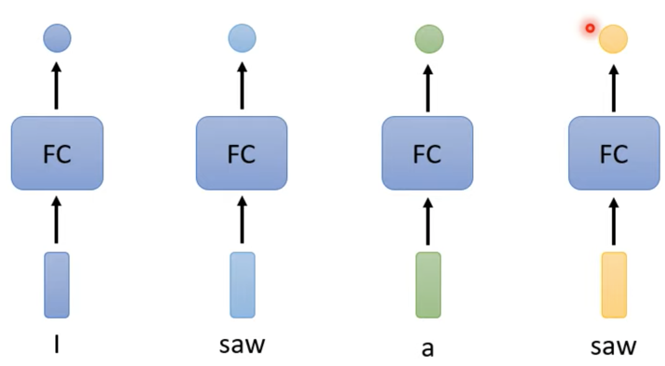
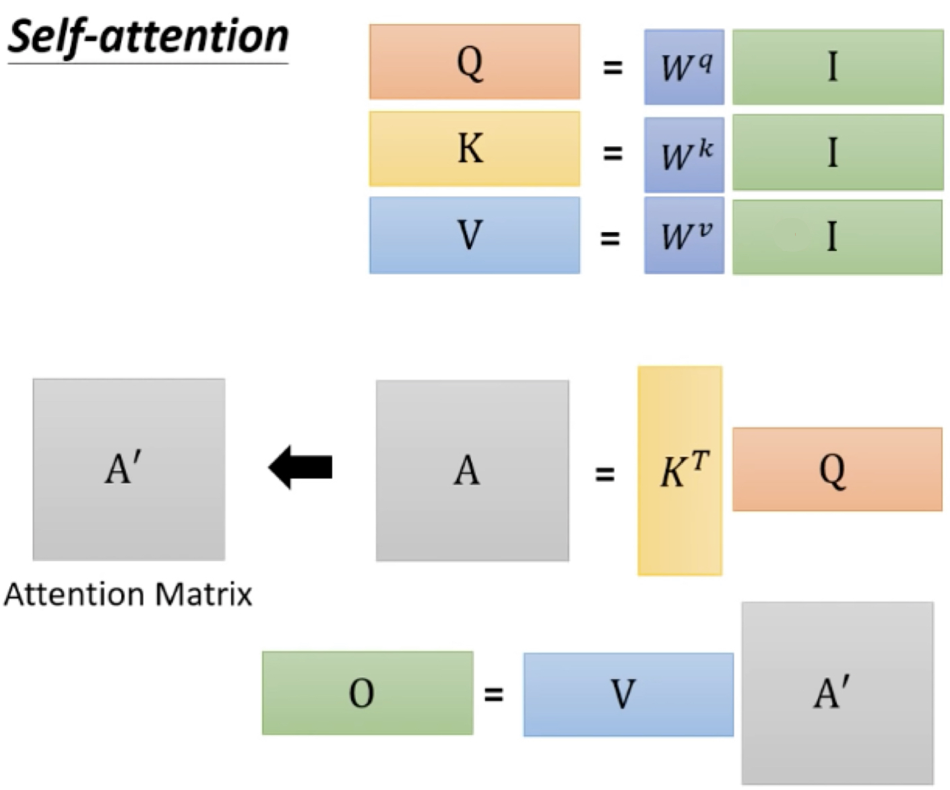
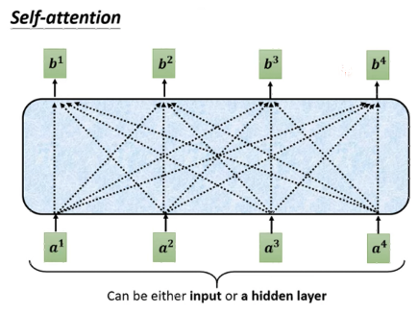
Background – Self-attention
Can do the sequence labeling task:
Since considering the context (whole sequence)
It can be apply on our task: considering the whole graph(causility)
Steps:
(W^{q}, W^{k}, W^{v} are what we need to learn)
Attention matrix: we’ll extract information based on attention scores
Notes:
A to A’ may be any activation function(soft-max for example)
graph 也可以看成是一堆 vector，所以可以用 self-attention 來處理，每個 graph 包還了很多 node，也包含了 edge 的資訊，知道哪些 node 是有關連性的，所以 self-attention for graph 也是一種 GNN，最大問題是資訊量非常大。

Slide 7
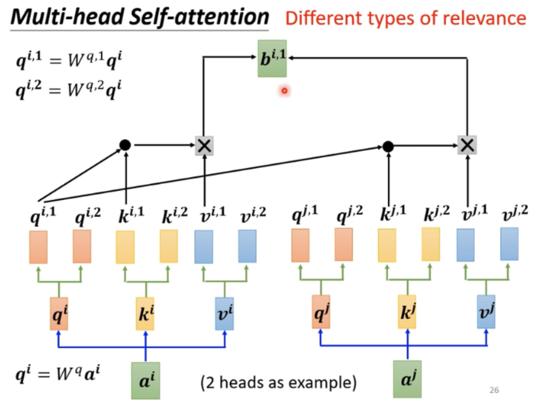
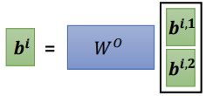
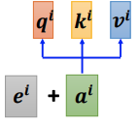
Background – Self-attention
Multi-head Self-attetnion:
Each head has their own concern
They can learn more details
Can be applied on our task: multi-relation
Positional Encoding:
Every input is the same position to the self-attention – 天涯若比鄰
If the position is important, use positional encoding
In Attention is all you need: they use sin and cos function to get the positional vector
Notes:
不同的head 負責不同的相關性;
我們在做 self-attention 的時候，就是用 q 去找相關的 k。但是相關這件事情有很多不同的形式，所以也許我們不能只有一個 q。我們應該要有多個 q，不同的 q 負責不同種類的相關性。
Positional example: 舉例來說我們在做 POS tagging(詞性標記)，也許你知道動詞比 較不容易出現在句首。

Slide 8
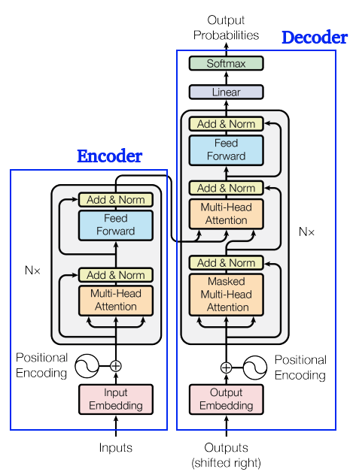
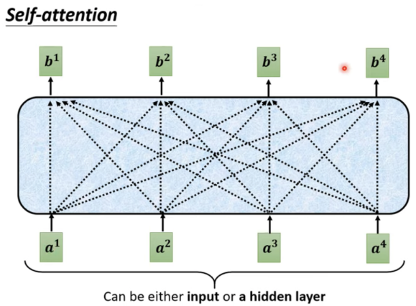
Background - Transformer
Encoder: input a sequence of vectors and output is a sequence of vectors too.
Decoder: output is a set of probabilities.
Positional Encoding: positonal information.
Notes:
Add & Norm（[3]殘差連接residual connection）：把Multi-head attention的input a和output b加起來得到b′，再做[1]Layer Normalization
計算完後丟到前向傳播，再經過一個Add & Norm
Decoder input為前一個time step的output，通過output embedding，考慮位置資訊，加上人為設置的positional encoding，進入會重複n次的block
Masked Multi-head Attention：做Attention，Masked表示只會attend到已經產生出來的sequenc e，再經過Add & Norm Layer
再經過Multi-head Attention Layer，attend到之前Encoder的輸出，然後再進到Add & Norm Layer
計算完丟到Feed Forward前向傳播，再做Linear和Softmax，產生最終輸出

Slide 9
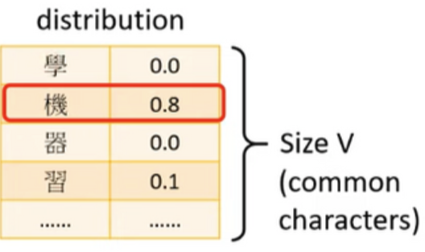
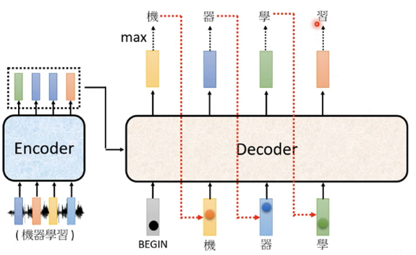
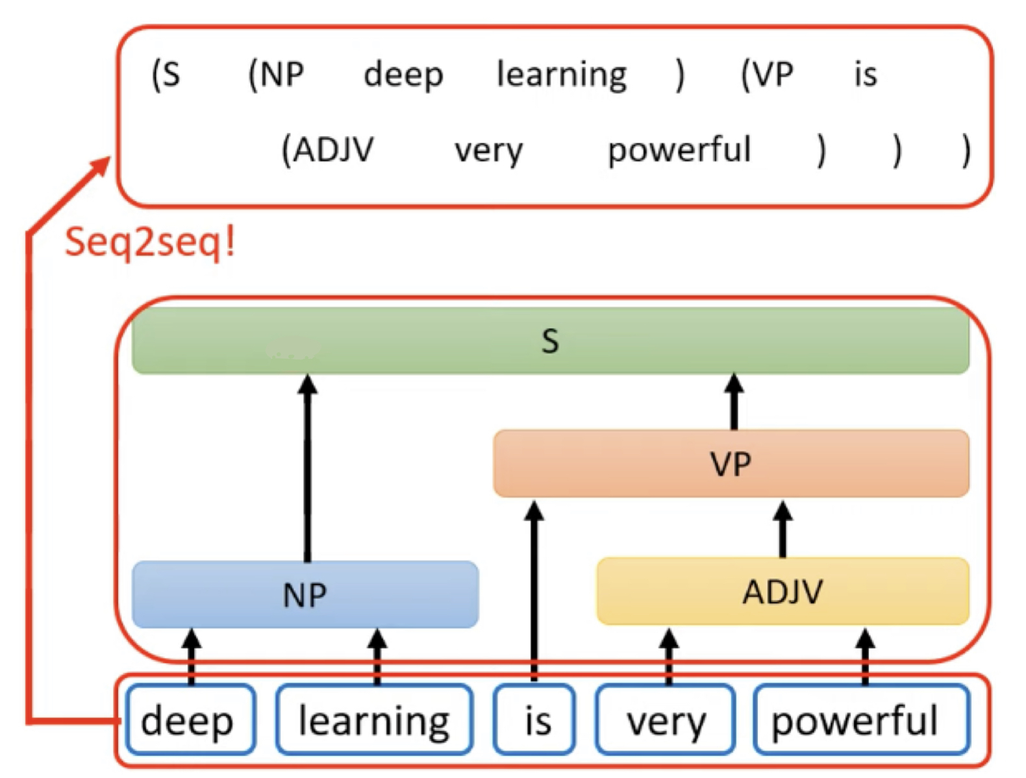
Background - Transformer
Encoder and decoder of the Transformer:
Related task it can do:

Slide 10
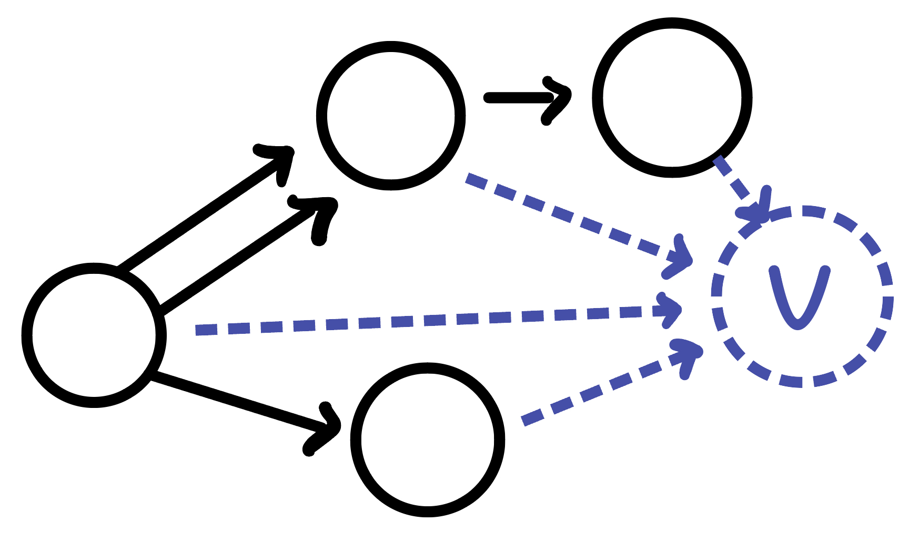
Architecture
Directly built on the classic architecture of Transformer
Graphormer Layer:
Change multi-head self-attention(MHA) part of the Transformer
Apply the layer normalization before applying multi-head self-attention and the feed-forward blocks instead of after.
Having some special structural encoding
Virtual Node:
Connect to every node in the graph
Representation of the whole graph would be the node feature of the [VNode] in the final layer

Slide 11
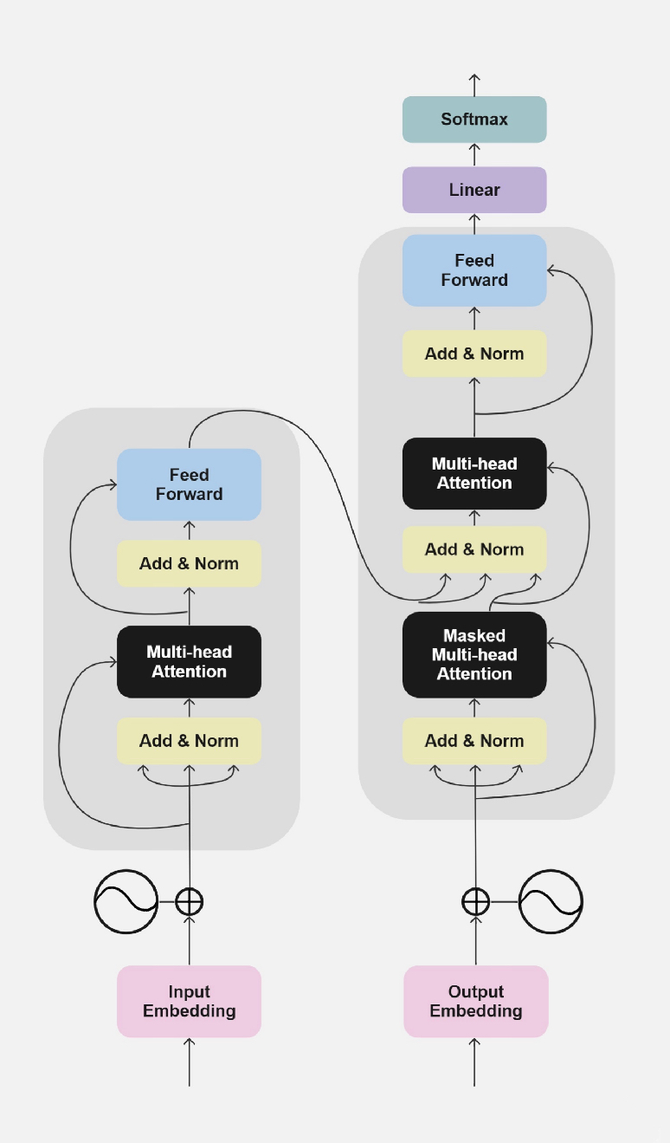
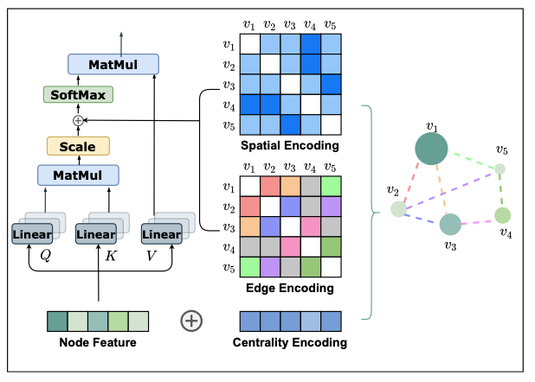
Architecture
Graphormer
Outputs
Probabilities
Decoder
Multi-head Self-attention part of the graphormer
Encoder
Nx
Nx
Triplet
Src ID
Rel ID
Dest ID
Positional
Encoding
Positional
Encoding
Triplet x 4932605
Inputs
Outputs
(shifted right)

Slide 12
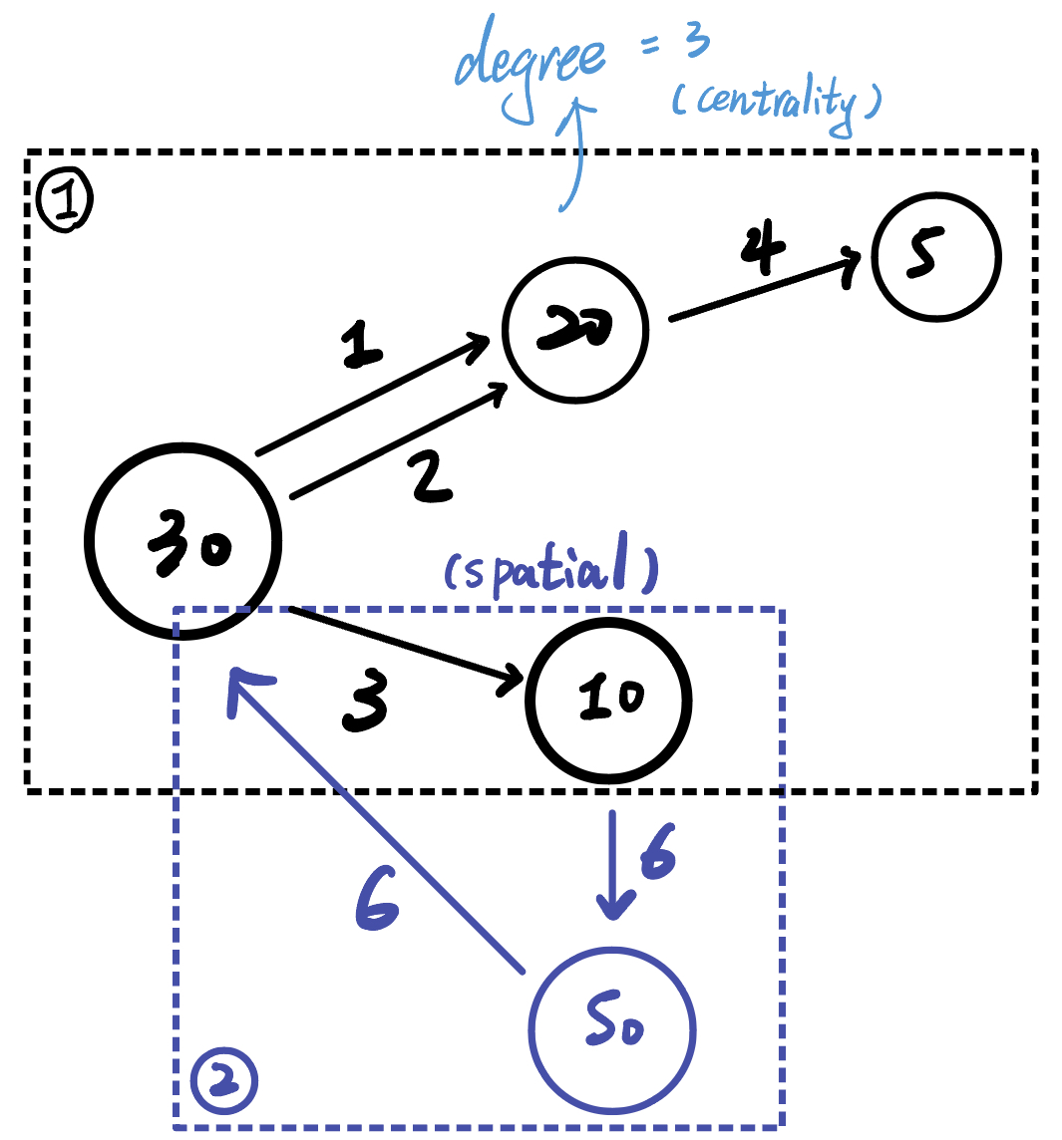
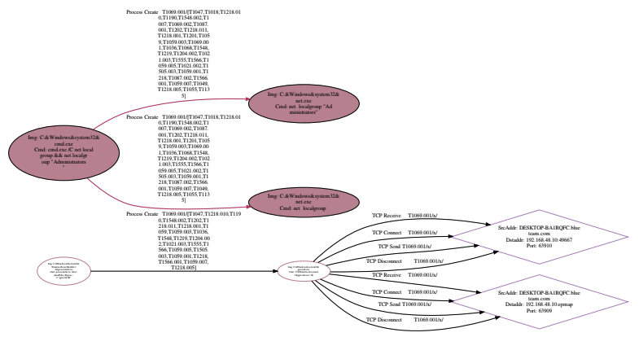
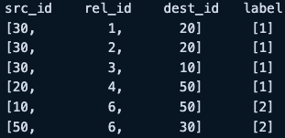
Architecture – Graph

Slide 13

Architecture – Centrality Encoding
Based on the degree of each node and add them to the node inputs
Capture both semantic correlation and the node importance.
Notes:
Ex: 某些名人的作用是很大的; 為每個節點分配兩個實值嵌入向量，根據節點的indegree and outdegree 進行分配。softmax注意力可以捕捉query and key中的節點重要性信號

Slide 14

Architecture – Spatial Encoding
Consider the multi-dimension or non-sequence case → Graph
Ø(vi, vj) is defined as the SPD(shortest path distance) of vi and vj
If not connected → set to -1
Be a bias term of the attention module
Adaptively attend to all other nodes according to the graph structure
Notes:
Aij表示為query-ket product 矩陣A的（i，j）元素 ; bφ(vi, vj)是由φ(vi, vj)索引的可學習標量，在所有層中共享。
GNN相比，其感受僅限於鄰居，我們可以看到在公式（6）中，Transformer層提供了全局信息，使每個節點都能關注圖中的所有其他節點。其次，通過使用bφ(vi, vj)，每個Transformer層中的每個節點可以根據圖的結構信息自適應地關注所有其他節點。
例如，如果bφ(vi, vj)學習為對φ(vi, vj)遞減的函數，對於每個節點，模型可能更關注靠近它的節點，並較少關注遠離它的節點。

Slide 15
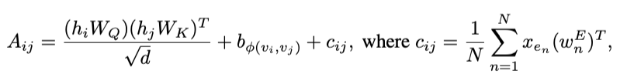
Architecture – Edge Encoding
In many case, edges also have structural features
E.g., in molecular graph, atom pairs may have some features
Compute the average of the dot-products of the edge features and a learnable embedding along the path
A bias tram of the attention module
, and
Notes:
注意機制需要估計每對節點（vi，vj）的相關性，我們認為連接它們的邊應該在相關性中被考慮，就像[34, 51]中一樣。對於每對有序節點（vi，vj），我們找到從vi到vj的（其中之一）最短路徑SPij =（e1，e2，...，eN），並計算沿路徑的邊特徵和可學習嵌入的點積的平均值。
Cij = 取節點間的SP上所有edge feature可學習的embedding的平均值

Slide 16
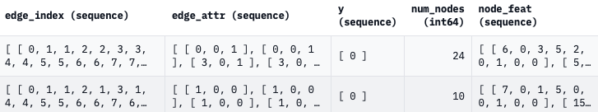
Input Format
A jsonl file:
Edge_index: contains the indices of nodes in edges, stored as a list containing two parallel lists of edge indices
Labels: list or an integer contain the corresponding techniques
Nodes_nums: total number of the nodes
Node_feat: contains the available features of each node (if present)
Edge_feat: contains the available features of each edge (if present)
Notes:
JSONL（JSON Lines）是一種用於存儲和傳輸結構化數據的文本格式。JSONL與JSON（JavaScript Object Notation）非常相似，但它使用每行一個JSON對象的方式來組織數據。
JSONL文件由多行文本組成，每行都是一個獨立的JSON對象。這種結構使得JSONL非常適合處理大型數據集，特別是當每個JSON對象都是獨立的時候。每個JSON對象可以包含不同的鍵值對，以描述數據的屬性。
Node_feat: for example, types (like different atoms in a molecule). Edge_feat: for example, types (like molecular bonds)

Slide 17
Possible Issue
Graphormer is more easily trapped in the over-fitting problem due to the large size of the model and the small size of the dataset.
Therefore, we may need to employ a widely used data augmentation for graph - FLAG to mitigate the over-fitting problem on OGB datasets.
Paper: Adversarial Data Augmentation for Graph Neural Networks
Notes:
JSONL（JSON Lines）是一種用於存儲和傳輸結構化數據的文本格式。JSONL與JSON（JavaScript Object Notation）非常相似，但它使用每行一個JSON對象的方式來組織數據。
JSONL文件由多行文本組成，每行都是一個獨立的JSON對象。這種結構使得JSONL非常適合處理大型數據集，特別是當每個JSON對象都是獨立的時候。每個JSON對象可以包含不同的鍵值對，以描述數據的屬性。
Node_feat: for example, types (like different atoms in a molecule). Edge_feat: for example, types (like molecular bonds)

Slide 18
Future Plan

Slide 19
Plan of Next Week
For TRAM
Try to use the real dataset to upload and then labeled them
For Graphormer
Try to successfully input the data(jsonl format)
Try to implement or use the simplest model to train
If needed, try the data augmentation - FLAG
if Graphormer is not feasible, try some more models

Slide 20
Appendix

Slide 21
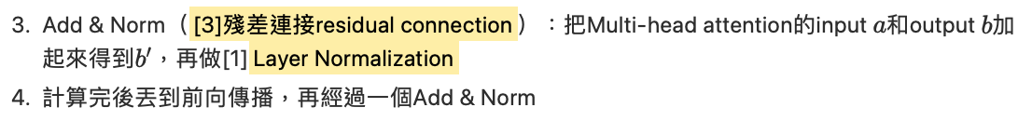
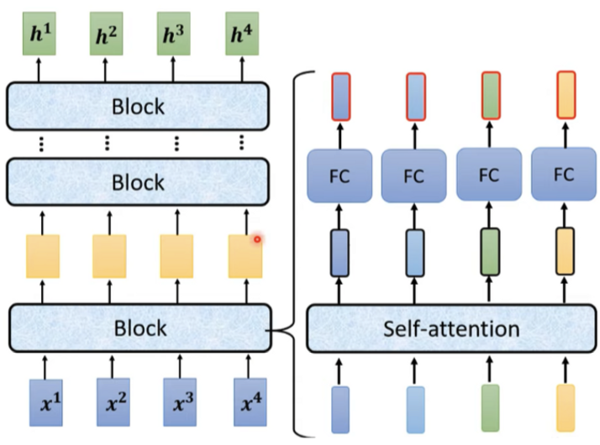
Transformer -encoder
Notes:
If use NLP, what kind of task it is.

Slide 22
Others may be useful
Graph Transformer – improvement of the GNN
Graph attention network (GAT) for node classification
Multilabel graph classification using GAT
MULTIHEADATTENTION
Self-attention does not need O(n^2) memory
Notes:
Graph transformer -> 多了edge feature的GNN

Slide 23
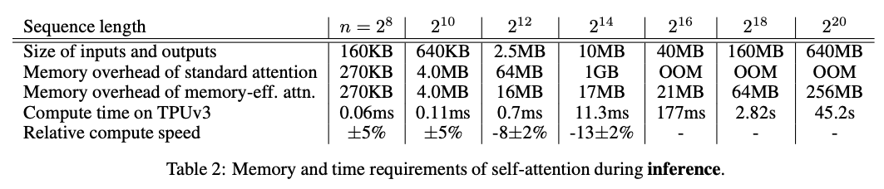
Self-attention does not need O(n^2) memory
Only need O(log n) space complexity (usually considered to be O(n^2) )

Slide 24
Self-attention does not need O(n^2) memory
https://arxiv.org/pdf/2112.05682.pdf
https://github.com/google-research/google-research/blob/master/memory_efficient_attention/memory_efficient_attention.ipynb

