Slide 1
Progess of the Project
Tsung-Min Pai
2023/8/16

Slide 2
Outline
GNN - Graph Attention Network
Dataset
Model
Observation
Modification
Repeat time
Model
Data Format
Future Work

Slide 3
GNN

Slide 4
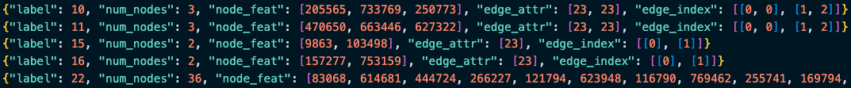
Data Format
Old Version:
New Version:
Train, Validation, Test all in this format → graph
Validation, Test in this format(triplet → subgraph)
Triplets woud not repeat

Slide 5
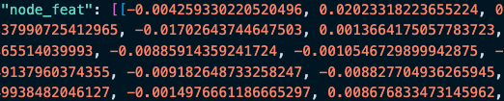
Data Format
Original data format:
Since assigning the node id as the node feature is a little bit weird
Map the node_feat to its embedding based on the transR_50.vec.json → node id correspond to a vector of 50-dim
We have the maps recording the:
label to original name of AP
Real node id to the DGL (Deep Graph Library) node id

Slide 6
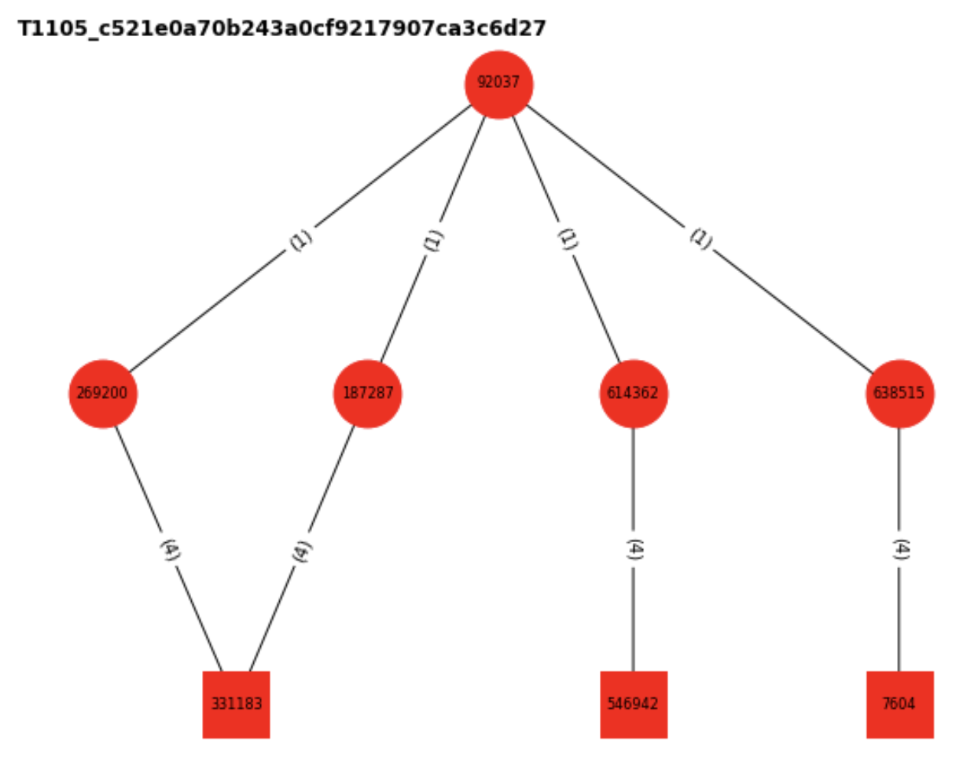
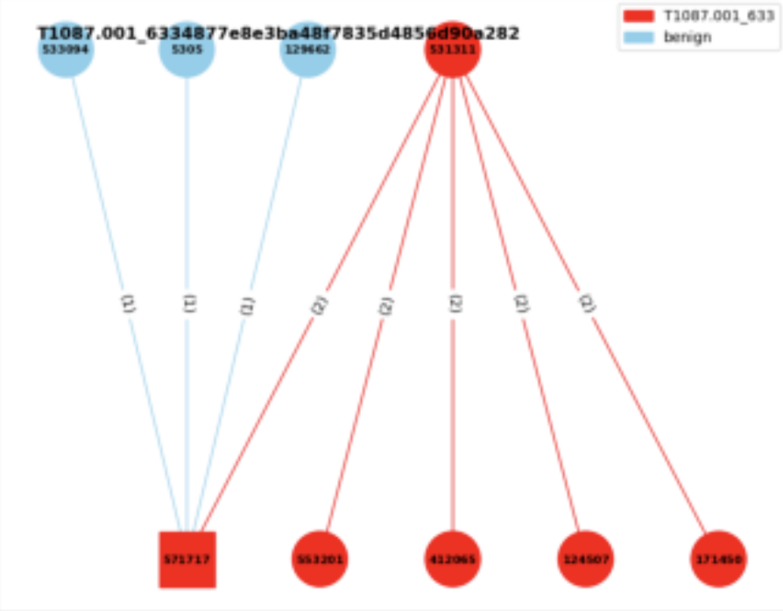
Data Format
Current version:
Q: How to label?

Slide 7
Graph Attention Network - GAT

Slide 8
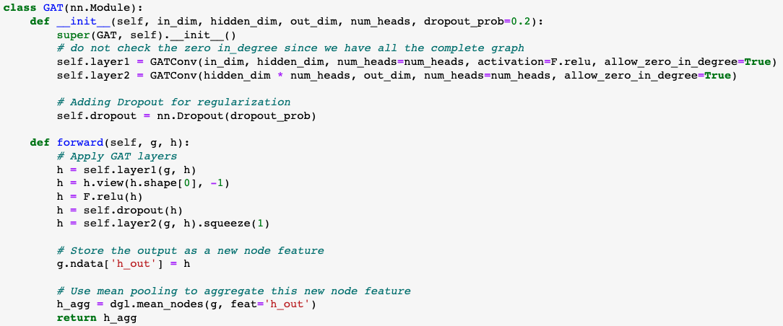
Graph Attention Network - GAT
Model:
Use the new verison of the dataset
Notes:
你定義了一個基於 GAT (Graph Attention Network) 的神經網路模型。GAT 是一種圖卷積神經網路，其中每個節點通過 attention mechanism 而不僅僅是平均鄰居特徵來更新其特徵。
前向方法 (forward):
首先，它通過第一個 GAT 層將輸入特徵 h 轉換成新的特徵。
使用 view 方法來重塑特徵 tensor，使其維度適應多頭注意力的輸出。
使用 dropout 進行正則化。
通過第二個 GAT 層進行另一次特徵轉換。
將這些輸出特徵存儲為新的節點特徵 h_out。
最後，使用平均池化來彙總整個圖的節點特徵，得到一個圖級別的輸出特徵。
view 是 PyTorch tensor 中的一個方法，它允許您重塑 tensor。換句話說，您可以使用它來改變 tensor 的維度和大小，但是內容和數據順序保持不變。

Slide 9


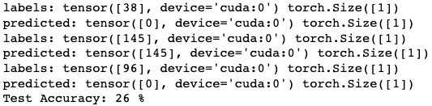
Observation
While batch size = 1:
# of repeat time affect the performance dramatically
10 APs x 50 times:
→ All guess 74
165 APs x 5 times:
→ 92.7% guess 74 (153/165)
AP + benign x 50 times:
→ 74% guess benign (1480/2000)

Slide 10

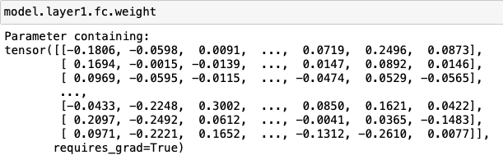
Prerequesite
Try to find where the problem comes from
Dataset, Data Format, Model, Training Code…
Fix the random seed , initial weight, seqeunce and learning rate

Slide 11
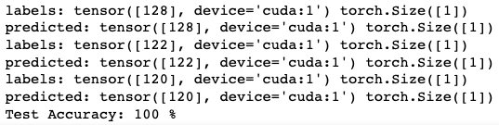
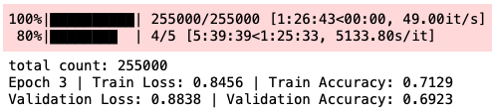
Modification – Repeat Time
While batch size is small or the training data repeat many times:
→ Test Accuracy = 1
(5 APs x 500 times, batch size = 1)
→ Validation Accuracy = 0.6923
(51 APs x 20000 times, batch size = 4)
Epoch is small
Training data appear in validation and testing data → check the capability of derectly remembering the graph
Data probably is not the problem causing the bad performance
suspected that maybe some APs’ embedding is far away from others

Slide 12
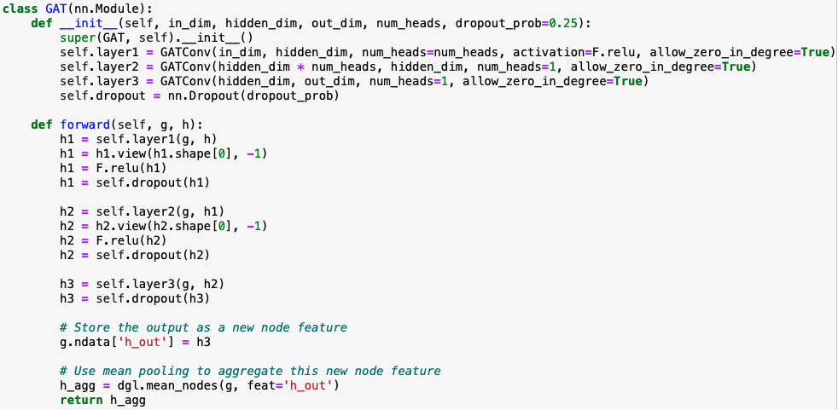
Modification – Model
Performance is worse then model 1 with the same dataset, repeat time and batch size
Maybe need more training steps

Slide 13
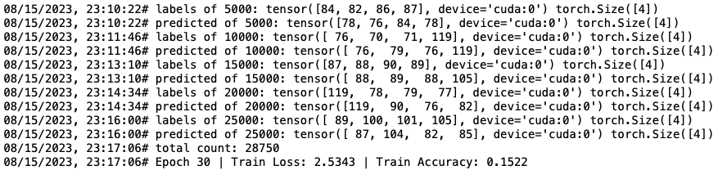
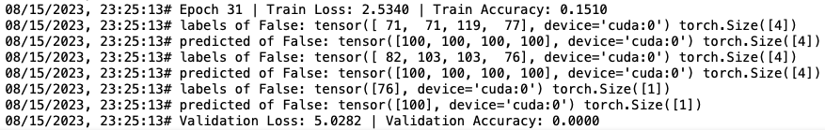
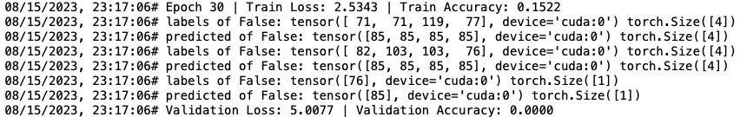
Modification – Data Format
Use the new format:
training data do not appear in the validation and testing data
Validation and testing data are triplets not in the training graph → extract from the original graph
(23 APs x 5000 times, batch size = 4)
(23 APs x 5000 times, batch size = 4)

Slide 14


Modification – Data Format
With new version(triplet) of dataset
But training data would be in the validation and testing data
Not shuffle but the predction of validation is different
Training accuracy slowly increase → 6h, from 0.05 to 0.13
Epoch 30
Epoch 32

Slide 15
Future Work

Slide 16
Future Work
GNN
Figure out the reason causing the currently bad performance on both GCN, GAT
Read some paper about these GNN models in classification
Try the GraphSAGE
Graphormer (if available)
Write the trainer (training part)

Slide 17
Thanks!!

Slide 18
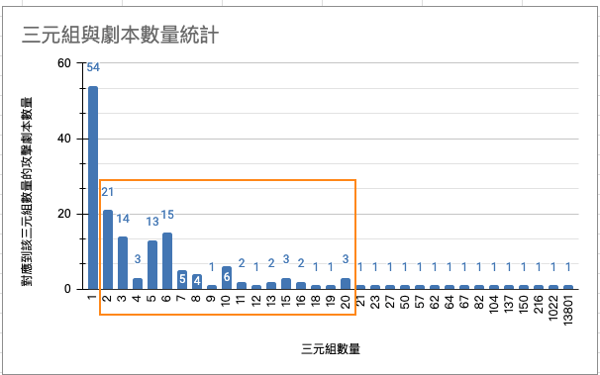
Appendix

Slide 19
Graph Convolutional Network - GCN

Slide 20
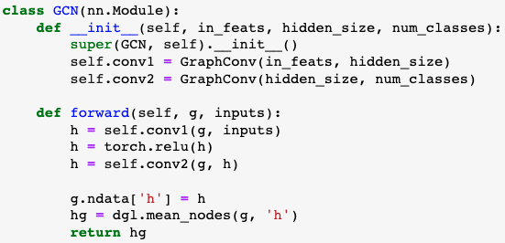
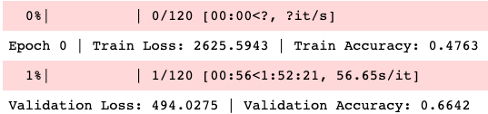
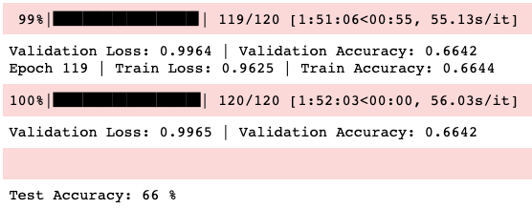
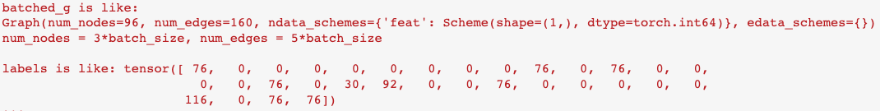
Graph Convolutional Network - GCN
Model:
Result:
Use the old verison of the dataset
Use DGL to be our library
DGL data format:
GAT applied on the old data has the similar result

Slide 21
TRAM

Slide 22
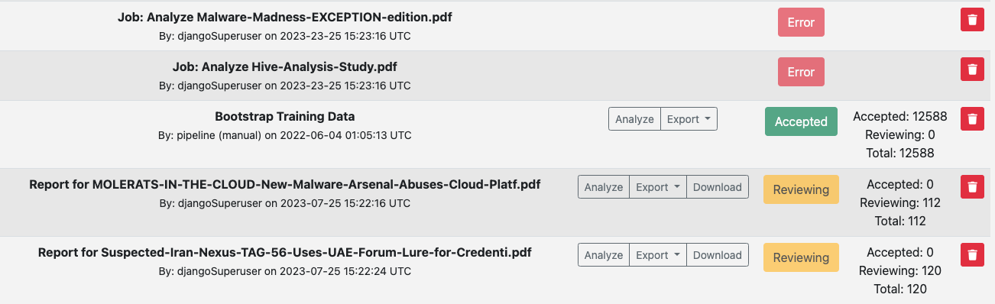

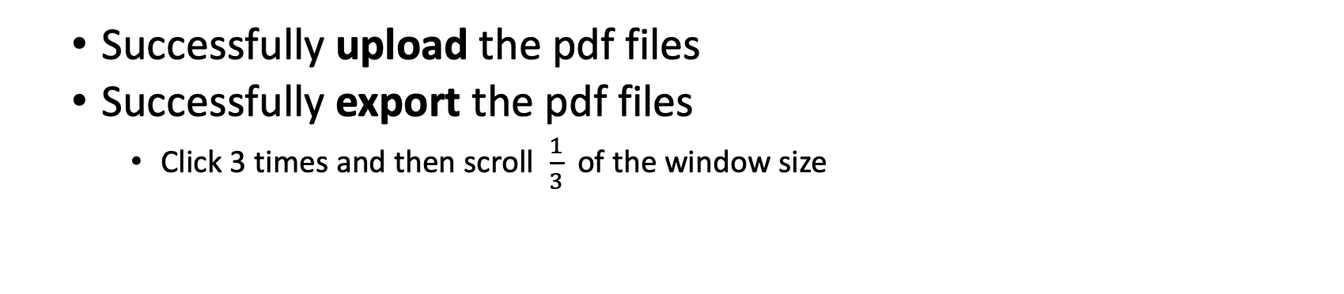
Automation
Successfully upload the pdf files
Successfully export the pdf files
Click 3 times and then scroll $\frac{1}{3}$of the window size

