Slide 1
Progess of the Project
Tsung-Min Pai
2023/9/16
Notes:
hello

Slide 2
Outline
GNN
Experiment 1 and 2
Experiment 3
Future Work

Slide 3
Experiment 1 and 2

Slide 4
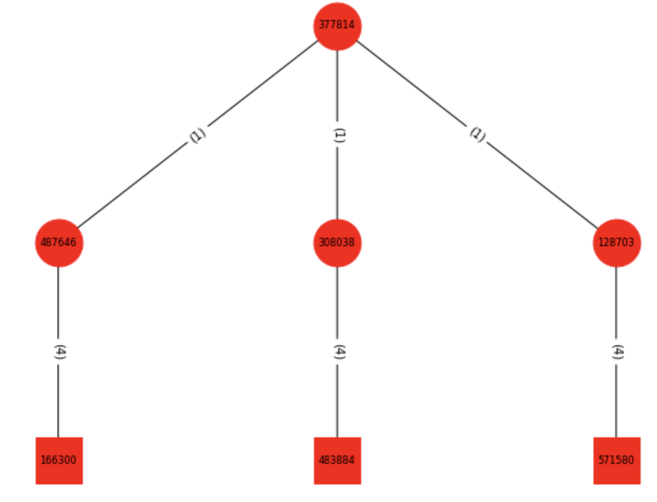
Experiment 1 and 2
Experiment 1:
Dataset is 165 APs with 11 versions of embedding
Graph classification
Experiment 2:
Experiment 1 + benign data
Benign made from benign.txt → 1000 graphs
Graph classification
(Smaple of the graph in exp1 and exp2)

Slide 5
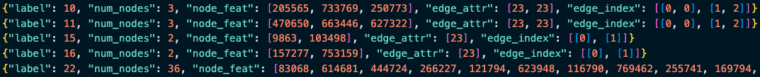

Dataset
Format:
Have 165 APs, each AP has 1000 variation → nodes are different but relations are same
0~99 test, 100~199 validation, 200~999 train → 1:1:8
Use transR_50, transE_50, transH_50, secureBERT… as embedding → 11 versions
secureBERT → dimension = 250, 150, 100, 50

Slide 6
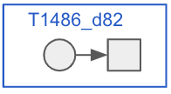
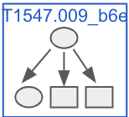
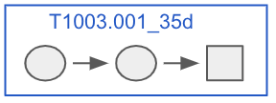
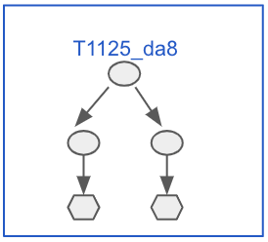
Dataset
Benign graphs for experiment 2:
1. 400: Leaf nodes + their source nodes
2. 300: Leaf nodes + their source nodes with source nodes’ neighbor nodes
3. 200: Leaf nodes + their 2 layer source nodes
4. 100: Leaf nodes + their 2 layer source nodes with source nodes’ neighbor nodes
For version 2 and 4 graphs:
Constrain the # of relation between the same nodes within 8
Constrain the # of the triplets in the graph within 32

Slide 7
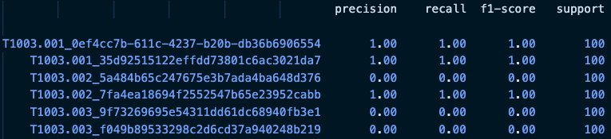
Experiment 1 and 2
Record the training message in a log file
Also record the classification report supportedd by sklearn
Log file:
Classification report:
Similar with the MLP, RNN:
Can barely predict the graph
with only one triplet
Notes:
Precision（精確率）： 也被稱為陽性預測的準確率。對於某個特定類別，精確率是指預測為該類別的樣本中實際屬於該類別的比例。高精確率表示模型在預測該類別時，做出的正確預測比例較高。
Recall（召回率）： 也被稱為靈敏度、真陽性率。對於某個特定類別，召回率是指實際屬於該類別的樣本中被成功預測為該類別的比例。高召回率表示模型能夠有效地檢測出實際屬於該類別的樣本。
F1-Score（F1 分數）： F1 分數是精確率和召回率的加權調和平均數，可以看作是綜合考慮了模型的準確率和能夠檢測出真實陽性的能力。F1 分數越高，表示模型在平衡精確率和召回率方面表現越好。
Support（支持數）： 支持數是指屬於該類別的實際樣本數。這個數字可以幫助你理解模型在進行評估時所基於的統計數據。

Slide 8
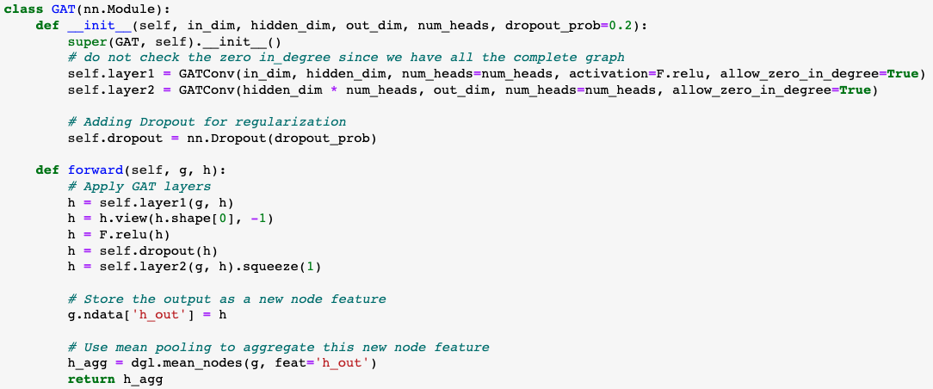
Graph Attention Network - GAT
Model:
Notes:
你定義了一個基於 GAT (Graph Attention Network) 的神經網路模型。GAT 是一種圖卷積神經網路，其中每個節點通過 attention mechanism 而不僅僅是平均鄰居特徵來更新其特徵。
前向方法 (forward):
首先，它通過第一個 GAT 層將輸入特徵 h 轉換成新的特徵。
使用 view 方法來重塑特徵 tensor，使其維度適應多頭注意力的輸出。
使用 dropout 進行正則化。
通過第二個 GAT 層進行另一次特徵轉換。
將這些輸出特徵存儲為新的節點特徵 h_out。
最後，使用平均池化來彙總整個圖的節點特徵，得到一個圖級別的輸出特徵。
view 是 PyTorch tensor 中的一個方法，它允許您重塑 tensor。換句話說，您可以使用它來改變 tensor 的維度和大小，但是內容和數據順序保持不變。

Slide 9
Experiment 1 and 2 with GAT
Total: 25 epochs
Optimizer = AdamW(model.parameters(), lr=5e-4)
Criterion = nn.CrossEntropyLoss()
Batch size = 16
Except secureBERT, all about 35~40% test accuracy
secureBERT family ≈ 12% test accuracy
Experiment 1 and 2 have similar performance
since benign only has 1000 graph → kind of balance
If we make the benign graph much more than AP(real data) → imbalance

Slide 10
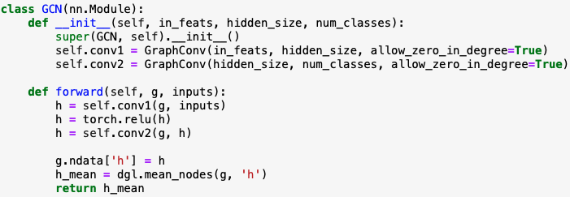
Graph Convolutional Network - GCN
Model:
Since the bad performance (14% accuracy on transH_50 test), I didn’t go any further with GCN

Slide 11
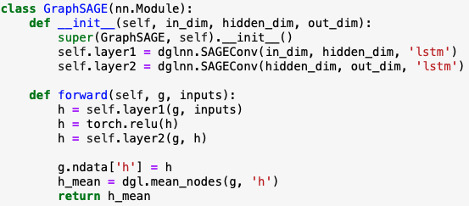
Graph SAmple and aggreGateE - GraphSAGE
Model:
In_dim: dimension of the node embedding
out_dim: # of the classes
Aggregate type: mean, gcn, pool, lstm → performance of lstm is the best but take 5 times of the time in training

Slide 12
Experiment 1 and 2 with GraphSAGE
Total: 25 epochs
Optimizer = AdamW(model.parameters(), lr=5e-4)
Criterion = nn.CrossEntropyLoss()
Batch size = 16
All about 60~62% test accuracy → increase 20% compared to GAT
All secureBERT family ≈ 60% test accuracy
Experiment 1 and 2 have similar performance
since benign only has 1000 graph → kind of balance
If we make the benign graph much more than AP(real data) → imbalance

Slide 13
Experiment 3

Slide 14
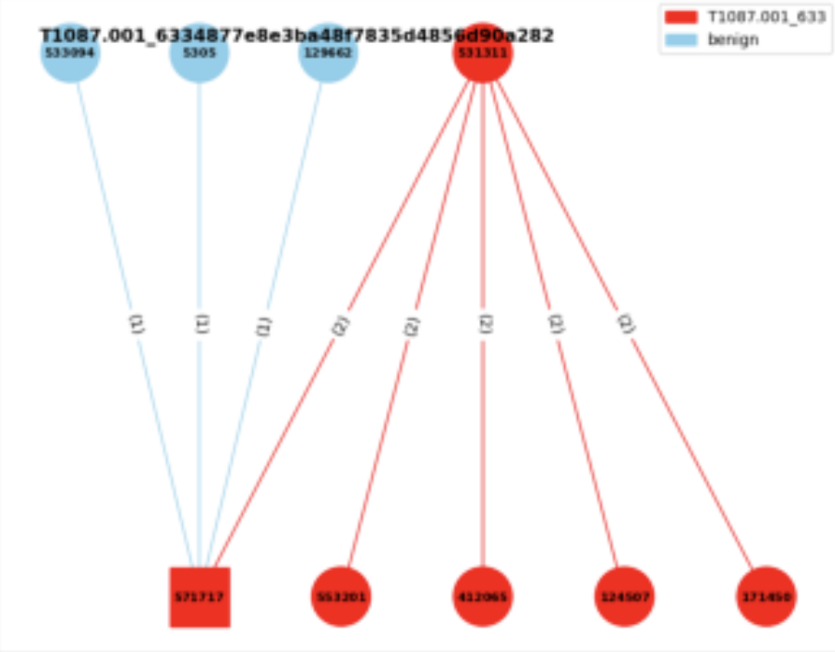

Experiment 3
Experiment 3:
Consider the neighbor benign nodes
Edge classification
I think it’s more like an triplet classification?
Given a graph → label the triplets
with the benign or the specific AP
benign
T1003.001
Source txt file:
a means attack pattern
b means benign

Slide 15
Experiment 3
Concept:
Use the node embedding from the GraphSAGE model
Concatenate with the edge embedding
Train the MLP model to do the triplet classification
Current Difficulty:
Format of the dataset

Slide 16
Dataset
Format in experiment 1 and 2:
Format in experiment 3:
From graph classification to edge classification
# of labels = # of triplets
Haven’t successfully trained → # of labels of each data(graph) are different

Slide 17
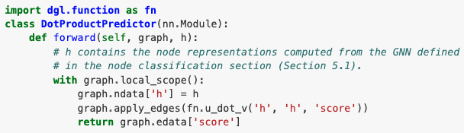
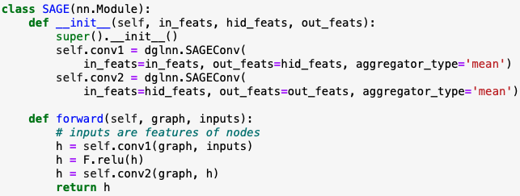
Official Edge Classification Sample of DGL

Slide 18
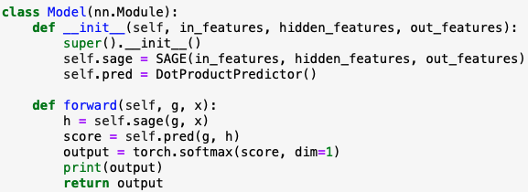
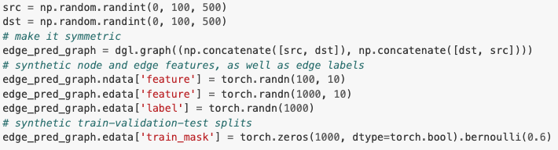
Official Edge Classification Sample of DGL

Slide 19
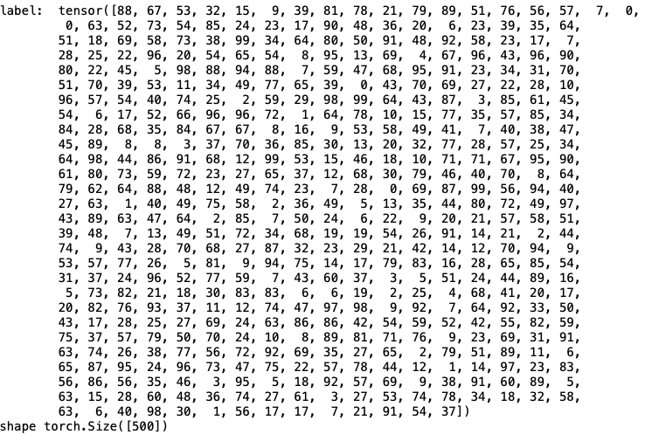
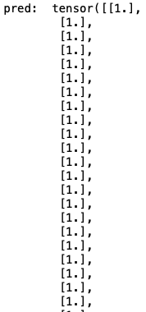
Official Edge Classification Sample of DGL
Shape: [500, 1]
Shape: [500]
The result seems to be not suitable for our task

Slide 20
Future Work

Slide 21
Future Work
GNN
Successfully run the experiment 3
Improve the performance of the model (if available)

Slide 22
Thanks!!

Slide 23
Appendix

Slide 24
Useful Links
https://zhuanlan.zhihu.com/p/107737824
https://zhuanlan.zhihu.com/p/315800604
https://blog.csdn.net/uncle_ll/article/details/82778750
https://docs.dgl.ai/en/1.1.x/guide_cn/minibatch-edge.html#guide-cn-minibatch-edge-classification-sampler
https://docs.dgl.ai/en/0.8.x/generated/dgl.nn.pytorch.conv.SAGEConv.html
https://docs.dgl.ai/en/0.8.x/generated/dgl.nn.pytorch.conv.GATConv.html
https://www.modb.pro/db/111133

Slide 25

Experiment 3
Total: 25 epochs
Optimizer = AdamW(model.parameters(), lr=5e-4)
Criterion = nn.CrossEntropyLoss()
Batch size = 4

Slide 26
Graph Convolutional Network - GCN

Slide 27
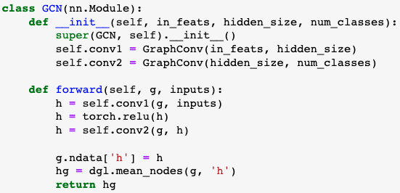
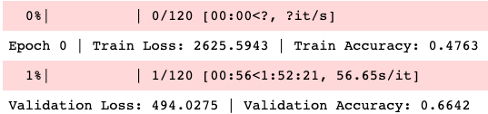
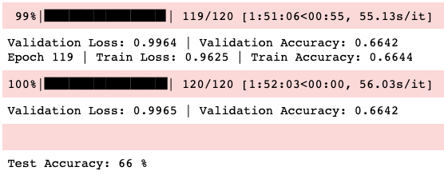
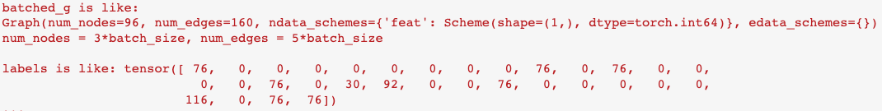
Graph Convolutional Network - GCN
Model:
Result:
Use the old verison of the dataset
Use DGL to be our library
DGL data format:
GAT applied on the old data has the similar result

Slide 28
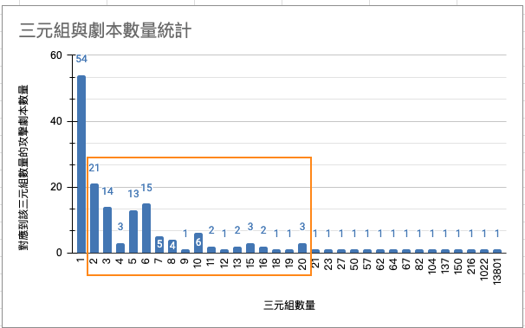
Appendix

