Slide 1
Progess of the Project
Tsung-Min Pai
2023/10/13
Notes:
hello

Slide 2
Outline
Previous Experiments
Graphing
Experiment 1 & 2
GNN
Experiment 3
Future Work

Slide 3
Previous Experiments

Slide 4
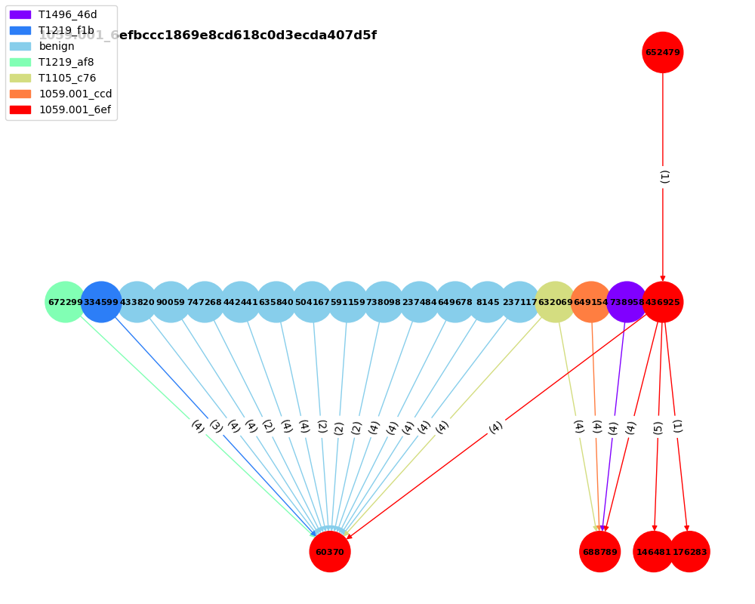
Graphing
Main graph is red
Number on the edges is the # of the relations in the pair
12 related benign nodes
Other 5 related Aps

Slide 5
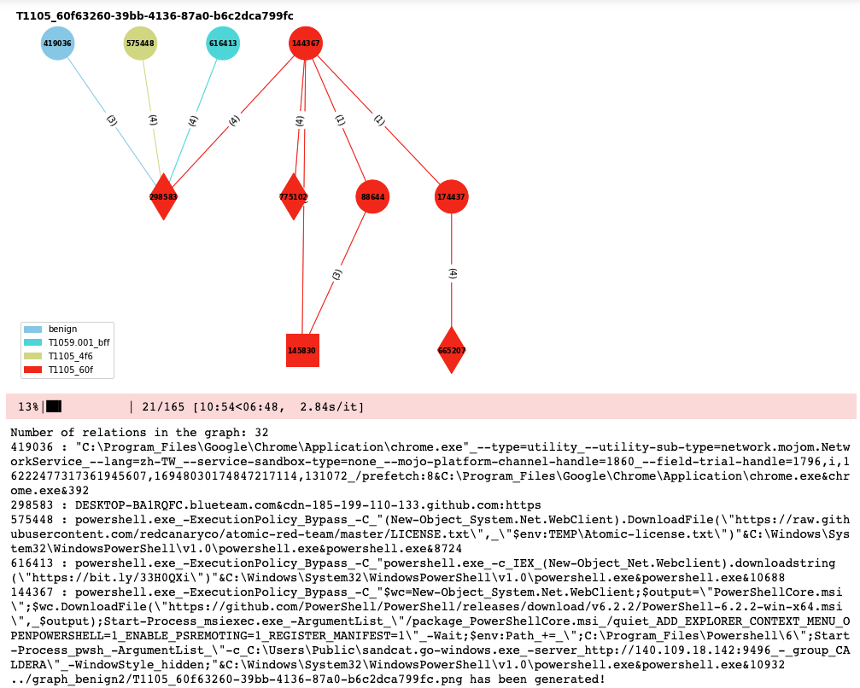
Graphing
32 relations
2 related APs
1 related benign

Slide 6
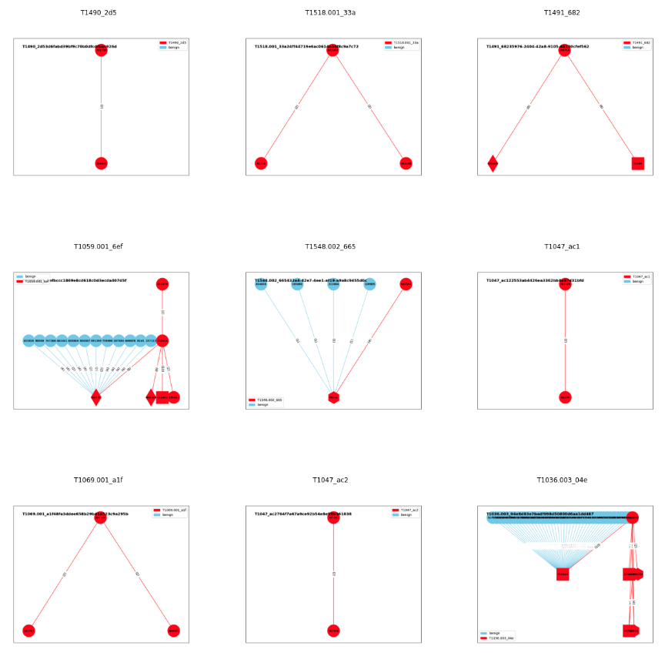
Graphing
165 Aps
29 related to benign(17.5%)
Only consider the AP itself and the related benign
Not consider the related AP like before

Slide 7
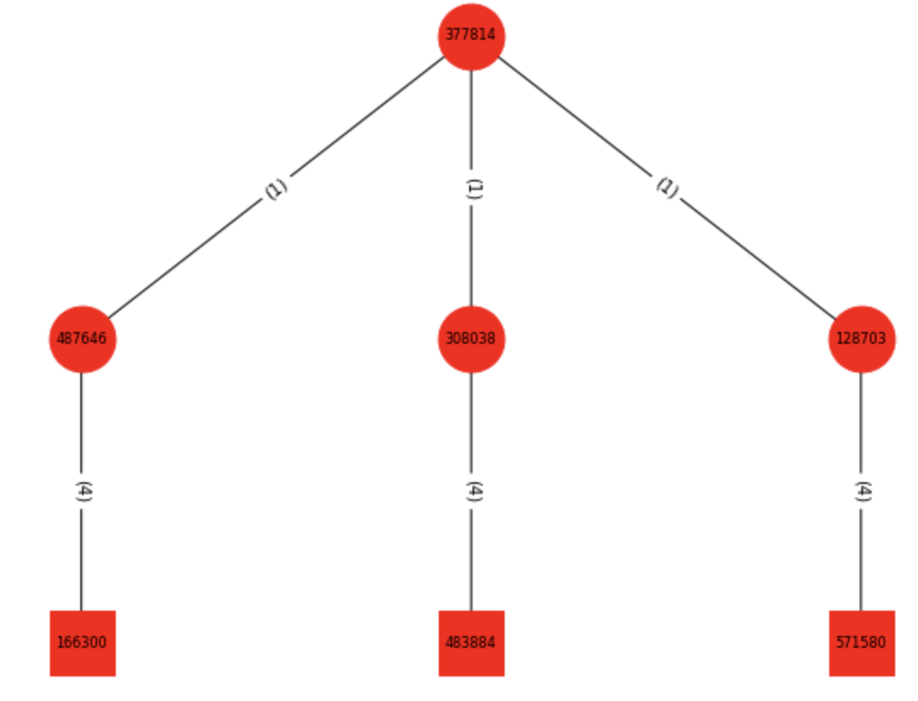
Experiment 1 and 2
Experiment 1:
Dataset is 165 APs with 11 versions of embedding
Graph classification
Experiment 2:
Experiment 1 + benign data
Benign made from benign.txt → 1000 graphs
Graph classification
(Smaple of the graph in exp1 and exp2)

Slide 8
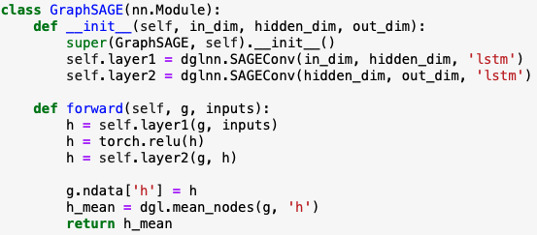
Graph SAmple and aggreGateE - GraphSAGE
Model:
In_dim: dimension of the node embedding
out_dim: # of the classes
Aggregate type: mean, gcn, pool, lstm → performance of the pool and lstm are better

Slide 9
Experiment 1 and 2
Total: 25 epochs
Optimizer = AdamW(model.parameters(), lr=5e-4)
Loss function = nn.CrossEntropyLoss()
Batch size = 16
Model: 2 layers GraphSAGE
All about 60~62% test accuracy → increase 20% compared to GAT
All secureBERT family ≈ 60% test accuracy
Experiment 1 and 2 have similar performance

Slide 10
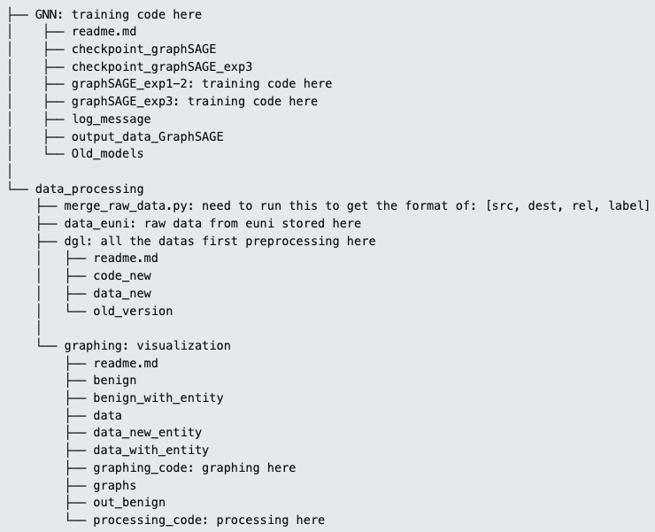
Structure

Slide 11
Experiment 3

Slide 12
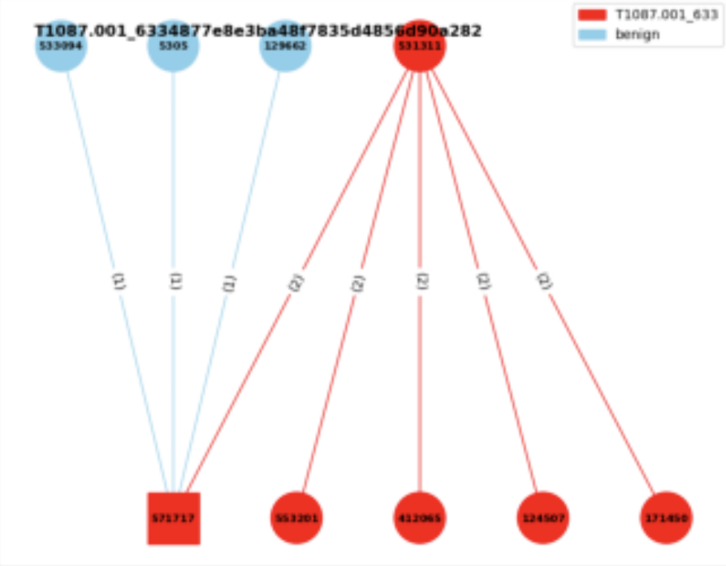
Experiment 3
Experiment 3:
Consider the neighbor benign nodes
Edge classification
Given a graph → label the triplets
with the benign or the specific AP
benign
T1003.001

Slide 13

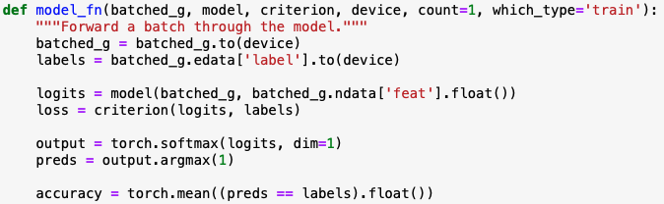
Experiment 3
Concept from the DGL official website:
Let the dgl graph’s edge data have the attribute: edata[“label”]
Use GraphSAGE model to get the new node embedding
Use MLP model to get the score of the edge
Concatenate these two models
Train the final model

Slide 14
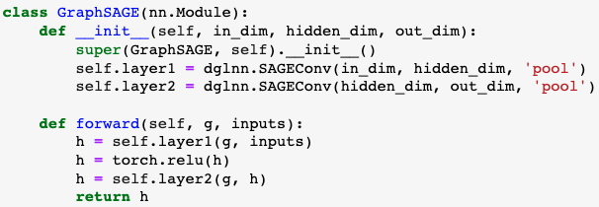
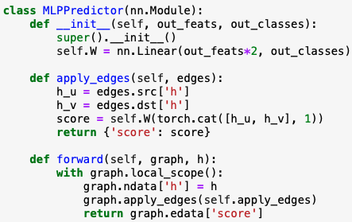
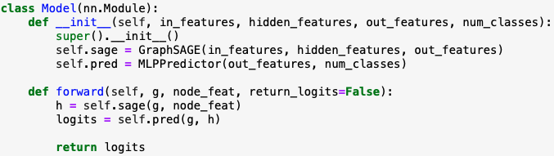
Experiment 3
Notes:
這個`MLPPredictor`模型是用於邊預測或稱為鏈接預測的。鏈接預測的目的是預測兩個節點之間是否存在邊。這是圖學習中的一個重要任務，被應用於許多領域，例如社交網絡中的好友推薦或蛋白質互作網絡的互作預測。
1. **初始化 (`__init__` 方法)**:
- 定義一個全連接線性層`self.W`，其輸入特徵的大小是 `in_features * 2`。這是因為我們將來源節點`h_u`和目標節點`h_v`的表示向量拼接起來，所以尺寸變為雙倍。
- 輸出的尺寸是 `out_classes`，這對應於邊的類別數量。
2. **apply_edges 方法**:
- 這個方法的作用是為圖中的每一條邊計算一個'score'。這個'score'可以被解釋為邊的類別。
- 它首先從圖中提取來源節點`h_u`和目標節點`h_v`的表示向量。
- 接著，它將這兩個表示向量拼接起來，並通過`self.W`線性層計算'score'。
3. **前向方法 (`forward`)**:
- 接收一個圖和它的節點表示`h`。
- 它將這些節點表示設定為圖的節點數據。
- 使用`apply_edges`方法為圖中的每一條邊計算一個'score'。
- 返回邊的'score'。
總之，`MLPPredictor`使用來源和目標節點的表示計算圖中每一條邊的'score'，這些'score'可以用於邊的預測任務。

Slide 15
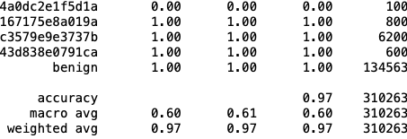
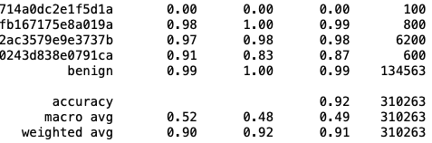
Experiment 3
Format of the edge labels:
Label 65 is benign
Classification report:
transR_50:
secureBERT_50:
Macro average is similar to previous experiments → won’t be affected by benign
Weighted average is very high since the # of the benign is high(unbalanced) and predictable
TransX family performs better than secureBERT

Slide 16
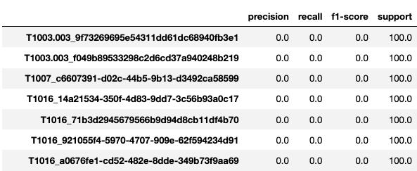

Experiment 3
Current Problem:
Can’t predict the edge in the small graphs consist of single triplet

Slide 17
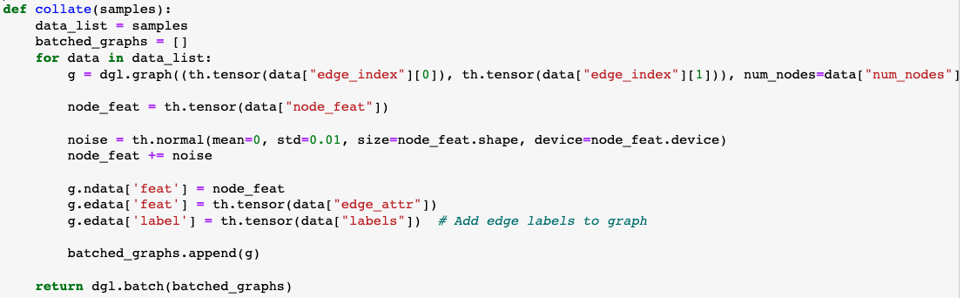

Experiment 3
Current Trial 1:
Add the noise to the node feature

Slide 18
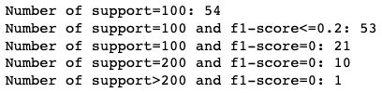





Experiment 3
Current Trial 2: (Kinda dummy)
Duplicate the data with single triplets → 20, 40, 80, 320 times
20 times
40 times
80 times

Slide 19
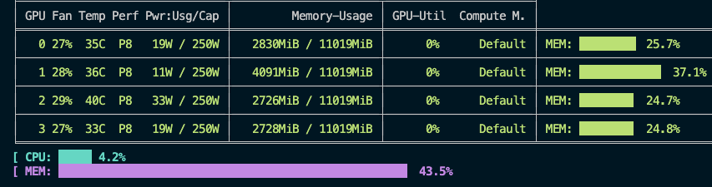
Experiment 3
Probable Issue:
While trying repeat 320 times:
→ seems like the computation resource might be a probelm

Slide 20
Future Work

Slide 21
Future Work
GNN
Try some other methods to improve the performance of single triplet issue
Maybe try some other embeddings?
Maybe try some other models?
Maybe try some data augmentation methods?
…

Slide 22
Thanks!!

