Slide 1
Progess of the Project
Tsung-Min Pai
2023/8/30
Notes:
hello

Slide 2
Outline
GAT
Dataset
Experiment
TRAM
Future Work

Slide 3
Graph Attention Network - GAT

Slide 4
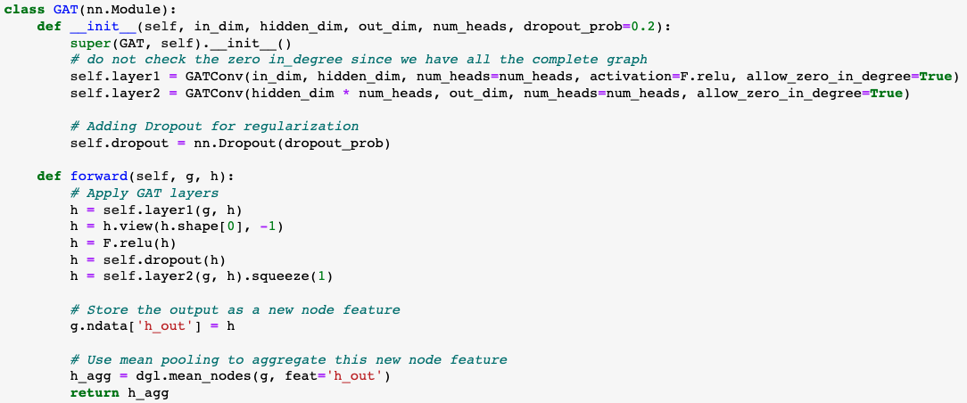
Graph Attention Network - GAT
Model:
Use the new verison of the dataset
Notes:
你定義了一個基於 GAT (Graph Attention Network) 的神經網路模型。GAT 是一種圖卷積神經網路，其中每個節點通過 attention mechanism 而不僅僅是平均鄰居特徵來更新其特徵。
前向方法 (forward):
首先，它通過第一個 GAT 層將輸入特徵 h 轉換成新的特徵。
使用 view 方法來重塑特徵 tensor，使其維度適應多頭注意力的輸出。
使用 dropout 進行正則化。
通過第二個 GAT 層進行另一次特徵轉換。
將這些輸出特徵存儲為新的節點特徵 h_out。
最後，使用平均池化來彙總整個圖的節點特徵，得到一個圖級別的輸出特徵。
view 是 PyTorch tensor 中的一個方法，它允許您重塑 tensor。換句話說，您可以使用它來改變 tensor 的維度和大小，但是內容和數據順序保持不變。

Slide 5
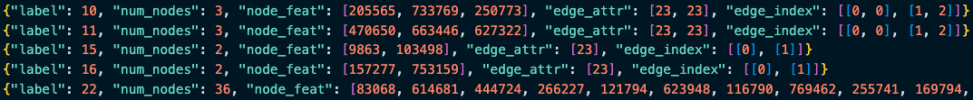
Dataset
Format:
Have 165 APs, each AP has 1000 variation → nodes are different but relations are same
0~99 test, 100~199 validation, 200~999 train → 1:1:8
Use transR_50, transE_50, transH_50, secureBERT… as embedding → 8 versions
Benign → benign.txt

Slide 6
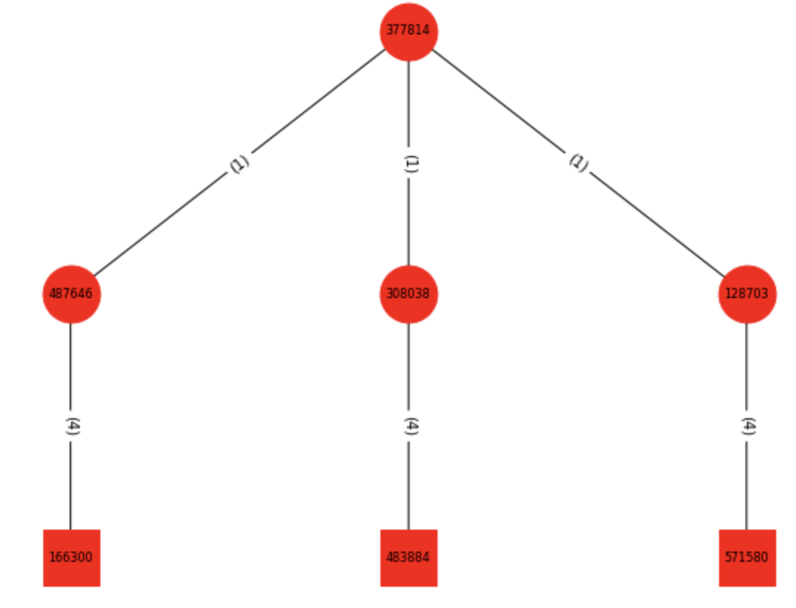
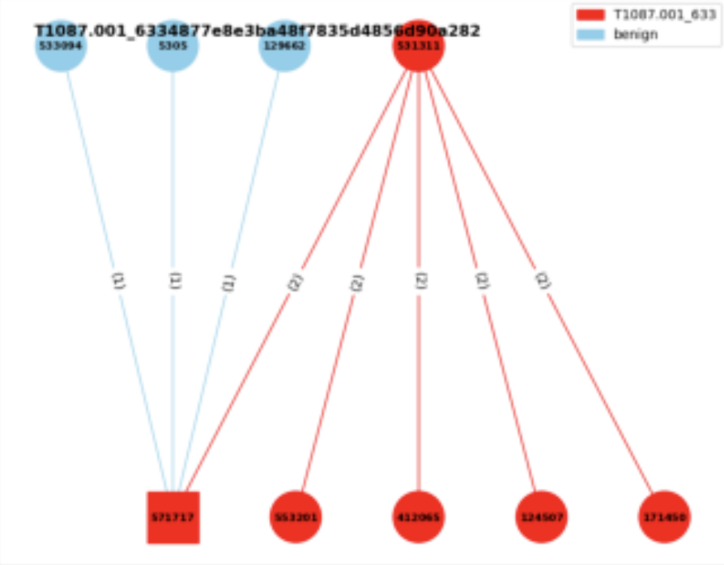
Experiment
Experiment 1:
Dataset is 165 APs with 8 versions of embedding
Graph classification
Experiment 2:
Experiment 1 + benign data
Benign made from benign.txt → 1000 graphs
Graph classification
Experiment 3:
Consider the neighbor benign nodes
Edge classification

Slide 7
Experiment 1
Total: 100 epochs
About 30 epochs, they seem to be have the similar performance
Except secureBERT, all about 40% test accuracy
secureBERT early stopped at epoch 50 with 10% test accuracy
Since the dimension of the embedding is way more larger ?!
Dimension of SeureBERT’s node embedding is from 768 → 250
Record the training in a log file
Also record the classification report supportedd by sklearn

Slide 8
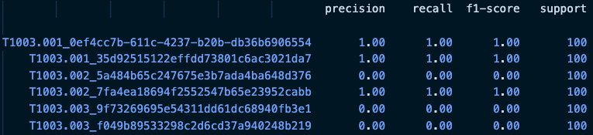
Experiment 1
Log file:
Classification report:
Similar with the MLP, RNN:
More triplets, more accurate
Notes:
Precision（精確率）： 也被稱為陽性預測的準確率。對於某個特定類別，精確率是指預測為該類別的樣本中實際屬於該類別的比例。高精確率表示模型在預測該類別時，做出的正確預測比例較高。
Recall（召回率）： 也被稱為靈敏度、真陽性率。對於某個特定類別，召回率是指實際屬於該類別的樣本中被成功預測為該類別的比例。高召回率表示模型能夠有效地檢測出實際屬於該類別的樣本。
F1-Score（F1 分數）： F1 分數是精確率和召回率的加權調和平均數，可以看作是綜合考慮了模型的準確率和能夠檢測出真實陽性的能力。F1 分數越高，表示模型在平衡精確率和召回率方面表現越好。
Support（支持數）： 支持數是指屬於該類別的實際樣本數。這個數字可以幫助你理解模型在進行評估時所基於的統計數據。

Slide 9
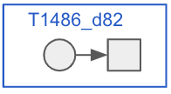
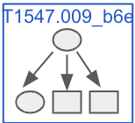
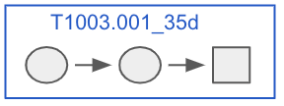
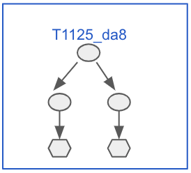
Experiment 2 & 3
Experiment 2:
Haven’t made the dataset of benign yet
Dataset would be
400: Leaf nodes + their source nodes
300: Leaf nodes + their source nodes with source nodes’ neighbor nodes
200: Leaf nodes + their 2 layer source nodes
100: Leaf nodes + their 2 layer source nodes with source nodes’ neighbor nodes
Experiment 3:
After finishing the experiment 2, discuss with Euni

Slide 10
TRAM

Slide 11
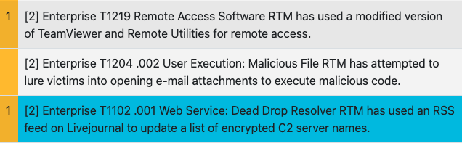

Format
On TRAM:
Exported json file:
Json file includes: Text, attack_id, confidence
Should be processed based on the confidence

Slide 12
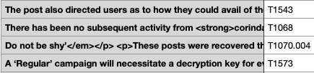

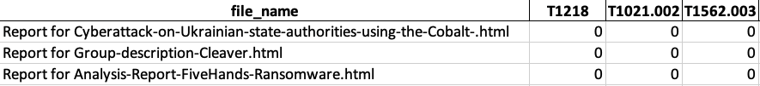
Result
json files → csv files:
All csv files → xlsx file:
with all files and TTPs
Record the # of the labels detected in the specific file
141 unique TTPs
pdf: 109/751, html: 378/3937

Slide 13
Future Work

Slide 14
Future Work
GNN
Do the experiment 2 and 3
Improve the performance of the model (if available)
TRAM
Figure out the reason of low efficiency
Processed the data based on the confidence

Slide 15
Thanks!!

Slide 16
Appendix

Slide 17
Graph Convolutional Network - GCN

Slide 18
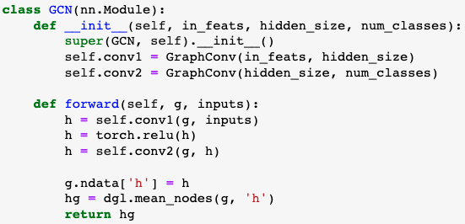
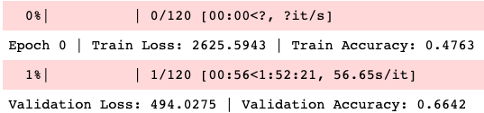
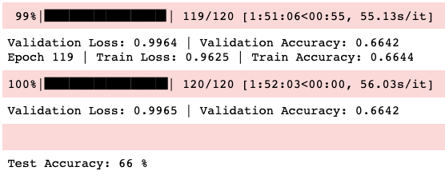
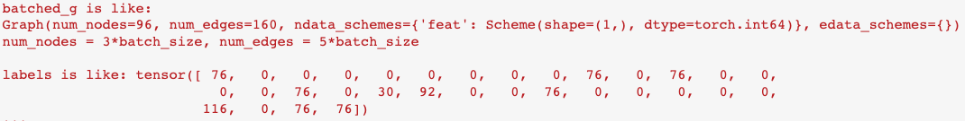
Graph Convolutional Network - GCN
Model:
Result:
Use the old verison of the dataset
Use DGL to be our library
DGL data format:
GAT applied on the old data has the similar result

Slide 19
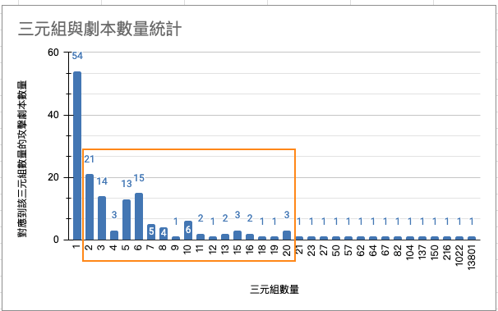
Appendix

