Slide 1
Progess of the Project
Tsung-Min Pai
2023/11/03

Slide 2
Outline
GNN
Over-Sampling
Some Observation – Dimension, Embedding, Model
GraphSMOTE
Future Work

Slide 3
GNN - Oversampling

Slide 4
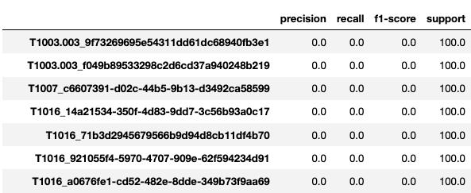

Oversampling
Current Problem:
Can’t predict the edge in the small graphs consist of single triplet

Slide 5




Oversampling
Current Trial: hope to see the result on training dataset
At least let the model overfit first(remember the data with single triplet)
Use data with 320 times single triplet → # of training data = 13657600
Larger hidden dimension → more neurons to remember the data
Hidden_dim = 256
Hidden_dim = 512

Slide 6
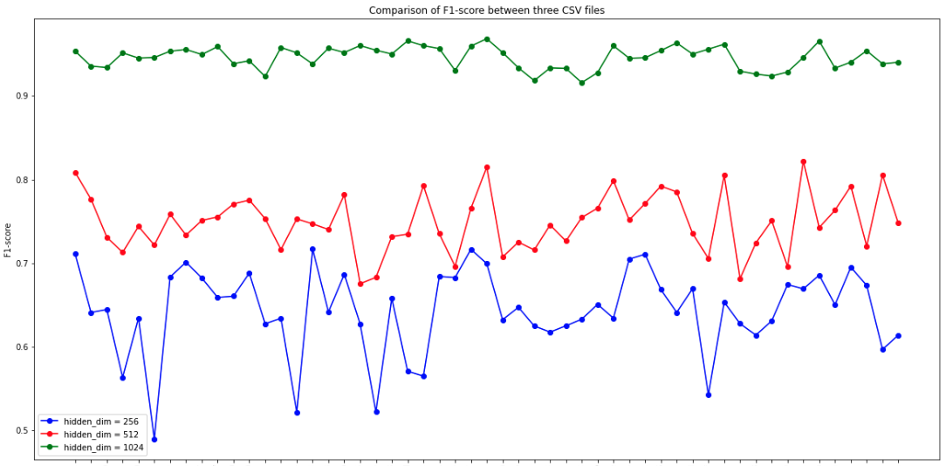
Experiment 3 - Oversampling

Slide 7
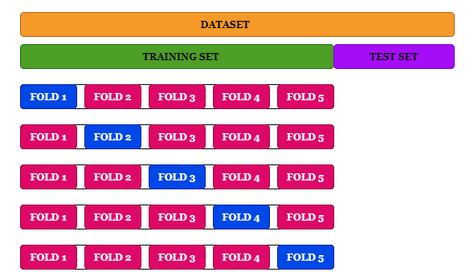


K-Fold Cross Validation
Cross-validation should always be done before over-sampling the data, just as how feature selection should be implemented.
Only by resampling the data repeatedly, randomness can be introduced into the dataset to make sure that there won’t be an overfitting problem.
Training:
Testing:
Notes:
https://www.kdnuggets.com/2017/06/7-techniques-handle-imbalanced-data.html

Slide 8
Thoughts
Try the ensemble
Different GNN
Different hidden dimension
Different embedding
Different model
Different type of model → MLP, RNN, GNN…
Maybe the different can identify the different single triplet class

Slide 9
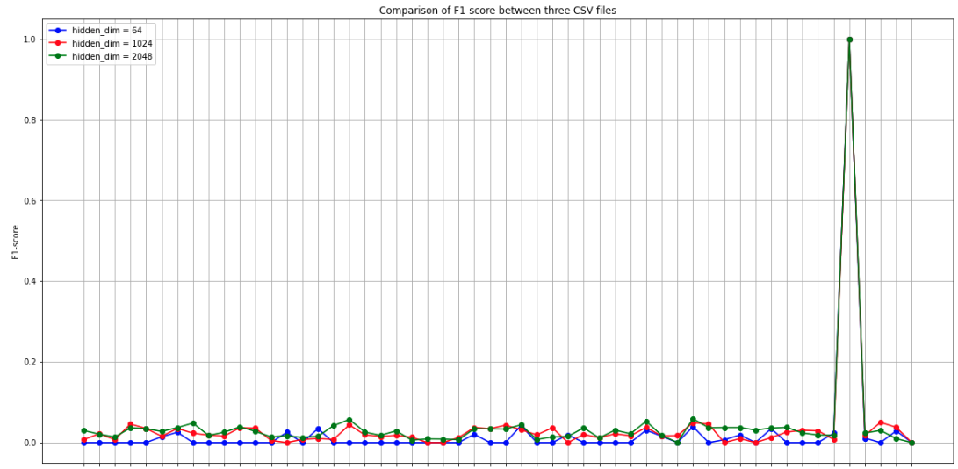
Observation on Different Dimension

Slide 10
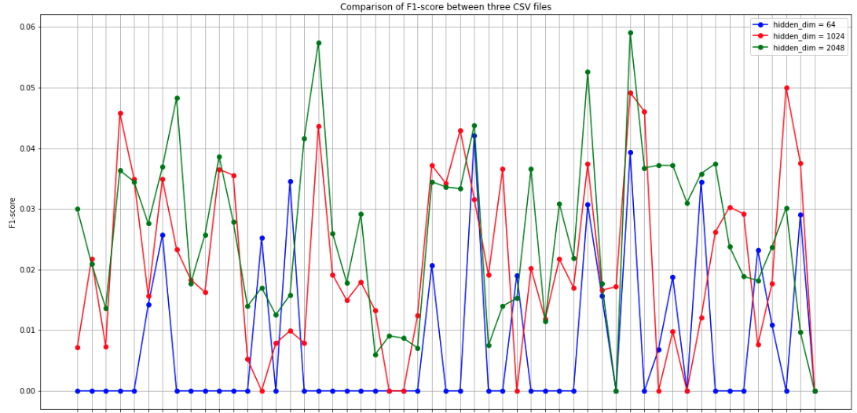

Observation on Different Dimension

Slide 11
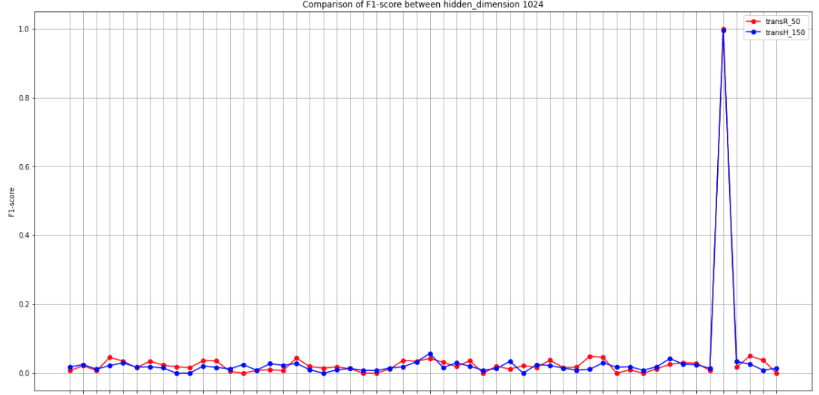
Observation on Different Embedding

Slide 12
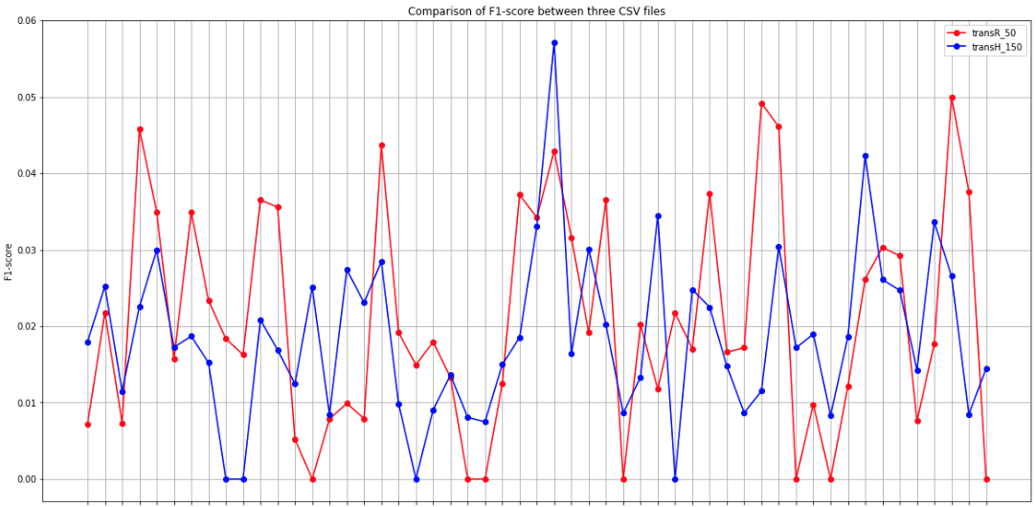

Observation on Different Embedding

Slide 13
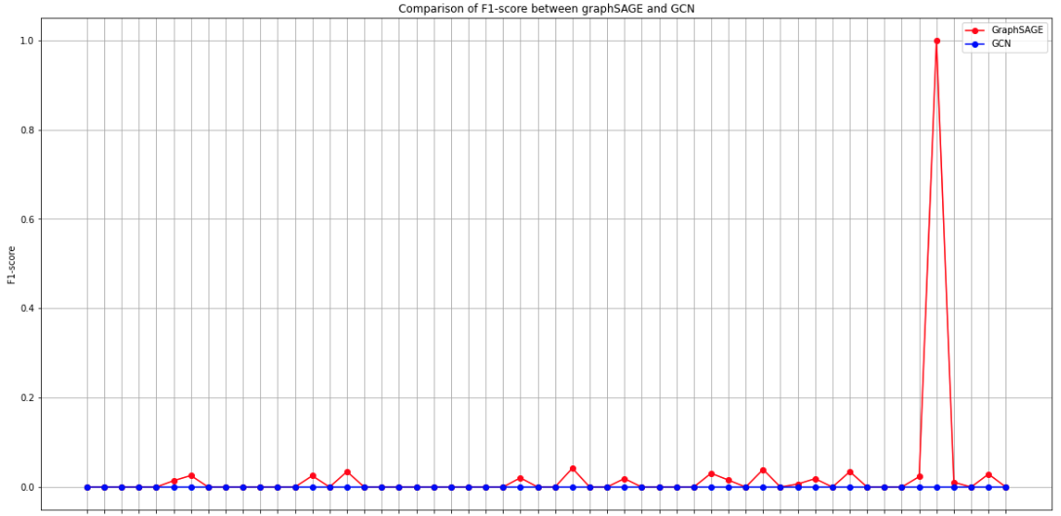
Observation on Different Model

Slide 14
Observation
Noticed that T1562.002_94f always got predicted in all the experiments
What if MLP and RNN can detect different class?
After Euni give me the MLP and RNN model, I’ll observe the results of them
Hidden Dimension do have an effect on the result → but it’s all about from 0 to 0.05
Embedding (transR_50 and tansH_150) seems to have the similar result → try more
My GCN test sucks → try GAT or other GNN model

Slide 15
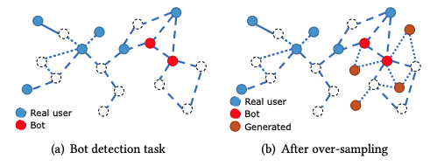
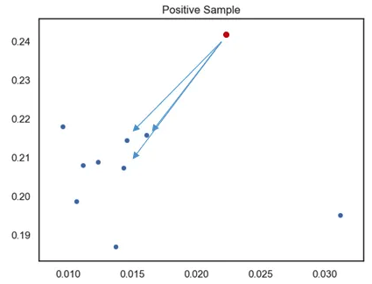
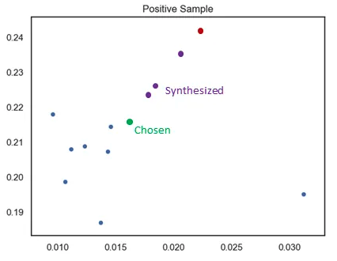
GraphSMOTE
GraphSMOTE: Imbalanced Node Classification on Graphs with Graph Neural Networks
WSDM ’21, March 8–12, 2021, Virtual Event, Israel
Tianxiang Zhao, Xiang Zhang, Suhang Wang
Synthesized Minority Oversampling Technique (SMOTE)
K=3
N=3
Notes:
設定一個採樣倍率 N，也就是對每個樣本需要生成幾個合成樣本
設定一個近鄰值 K ，針對該樣本找出 K 個最近鄰樣本並從中隨機選一個
根據以下公式來創造 N 個樣本

Slide 16
Future Work

Slide 17
Future Work
GNN
Try some other methods to improve the performance of single triplet issue
Figure out why the model can detect the T1562.002_94f
Try to ensemble if the MLP and RNN model’s result are different
Read the GraphSMOTE paper
Try some other embeddings?
Try some other models?
Try some data augmentation methods?
…

Slide 18
Thanks!!

Slide 19
Appendix

Slide 20
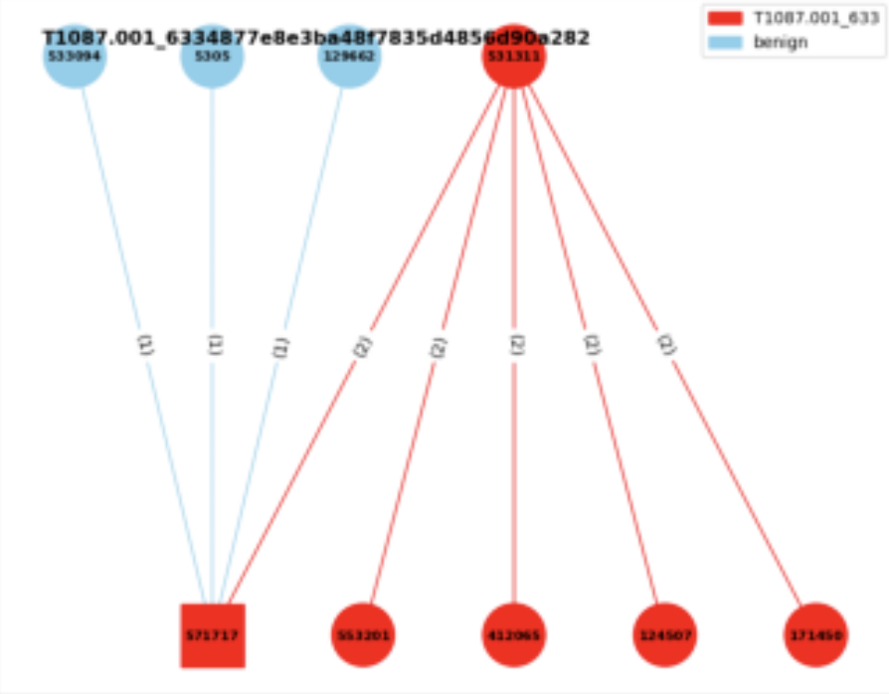
Experiment 3
Experiment 3:
Consider the neighbor benign nodes
Edge classification
Given a graph → label the triplets
with the benign or the specific AP
benign
T1003.001

Slide 21
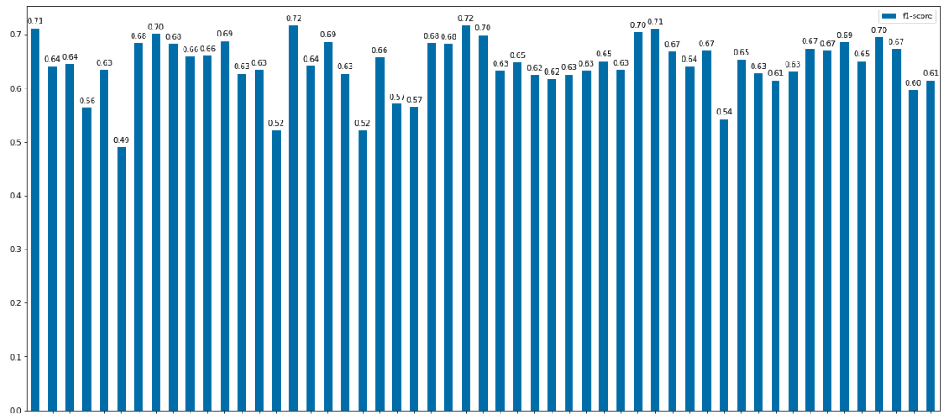
Experiment 3 - Oversampling
Bar Chart of hidden dimension = 256:

Slide 22
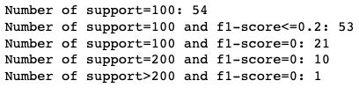





Experiment 3 - Oversampling
Current Trial: Duplicate the data with single triplets → 20, 40, 80, 320 times
20 times
40 times
80 times

Slide 23
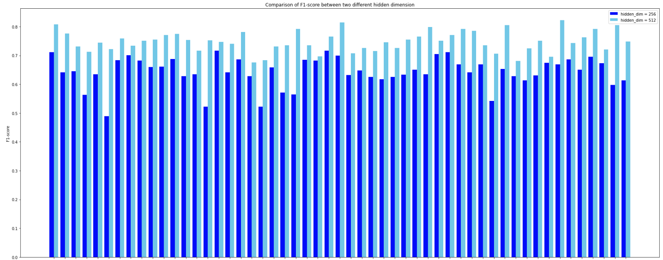
Experiment 3 - Oversampling

Slide 24

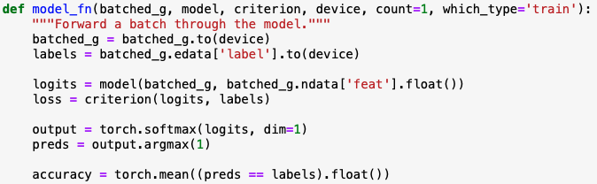
Experiment 3 - Model
Concept from the DGL official website:
Let the dgl graph’s edge data have the attribute: edata[“label”]
Use GraphSAGE model to get the new node embedding
Use MLP model to get the score of the edge
Concatenate these two models
Train the final model

Slide 25
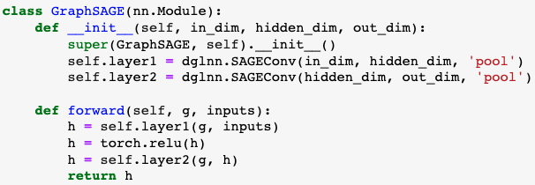
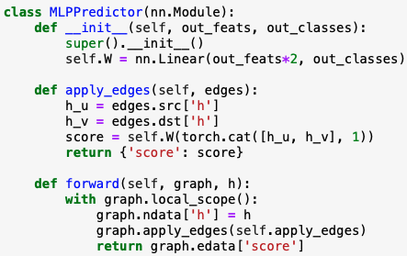
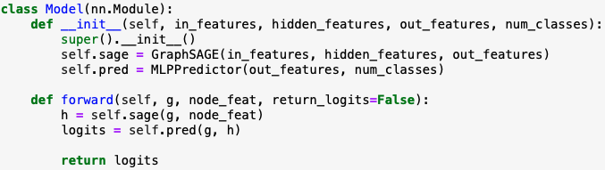
Experiment 3 - Model
Notes:
這個`MLPPredictor`模型是用於邊預測或稱為鏈接預測的。鏈接預測的目的是預測兩個節點之間是否存在邊。這是圖學習中的一個重要任務，被應用於許多領域，例如社交網絡中的好友推薦或蛋白質互作網絡的互作預測。
1. **初始化 (`__init__` 方法)**:
- 定義一個全連接線性層`self.W`，其輸入特徵的大小是 `in_features * 2`。這是因為我們將來源節點`h_u`和目標節點`h_v`的表示向量拼接起來，所以尺寸變為雙倍。
- 輸出的尺寸是 `out_classes`，這對應於邊的類別數量。
2. **apply_edges 方法**:
- 這個方法的作用是為圖中的每一條邊計算一個'score'。這個'score'可以被解釋為邊的類別。
- 它首先從圖中提取來源節點`h_u`和目標節點`h_v`的表示向量。
- 接著，它將這兩個表示向量拼接起來，並通過`self.W`線性層計算'score'。
3. **前向方法 (`forward`)**:
- 接收一個圖和它的節點表示`h`。
- 它將這些節點表示設定為圖的節點數據。
- 使用`apply_edges`方法為圖中的每一條邊計算一個'score'。
- 返回邊的'score'。
總之，`MLPPredictor`使用來源和目標節點的表示計算圖中每一條邊的'score'，這些'score'可以用於邊的預測任務。

Slide 26
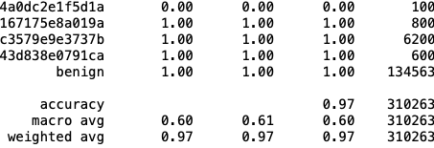
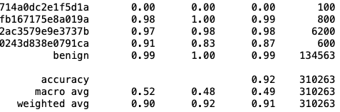
Experiment 3 - Result
Format of the edge labels:
Label 65 is benign
Classification report:
transR_50:
secureBERT_50:
Macro average is similar to previous experiments → won’t be affected by benign
Weighted average is very high since the # of the benign is high(unbalanced) and predictable
TransX family performs better than secureBERT

Slide 27
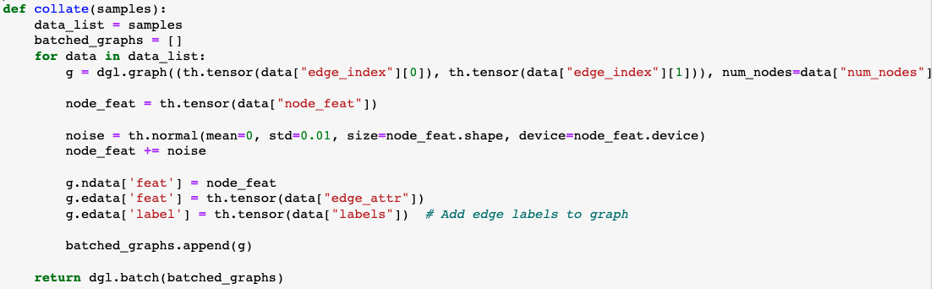

Experiment 3 – Noise
Current Trial 1:
Add the noise to the node feature

Slide 28
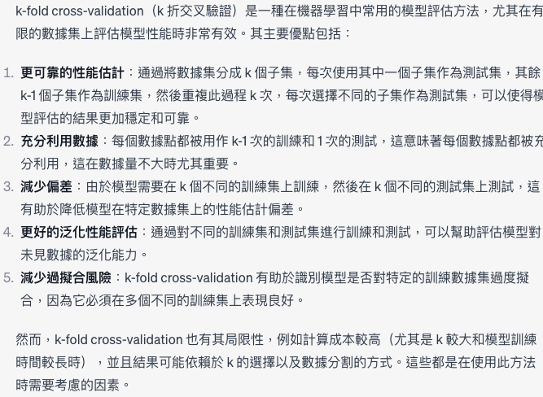
Experiment 3 – K-fold validation

