Slide 1
Progess of the Project
Tsung-Min Pai
2023/10/27
Notes:
hello

Slide 2
Outline
GNN
How to solve the data imbalance problem
Over-Sampling
With K-Fold Cross Validation
GCN model
Future Work

Slide 3
GNN

Slide 4
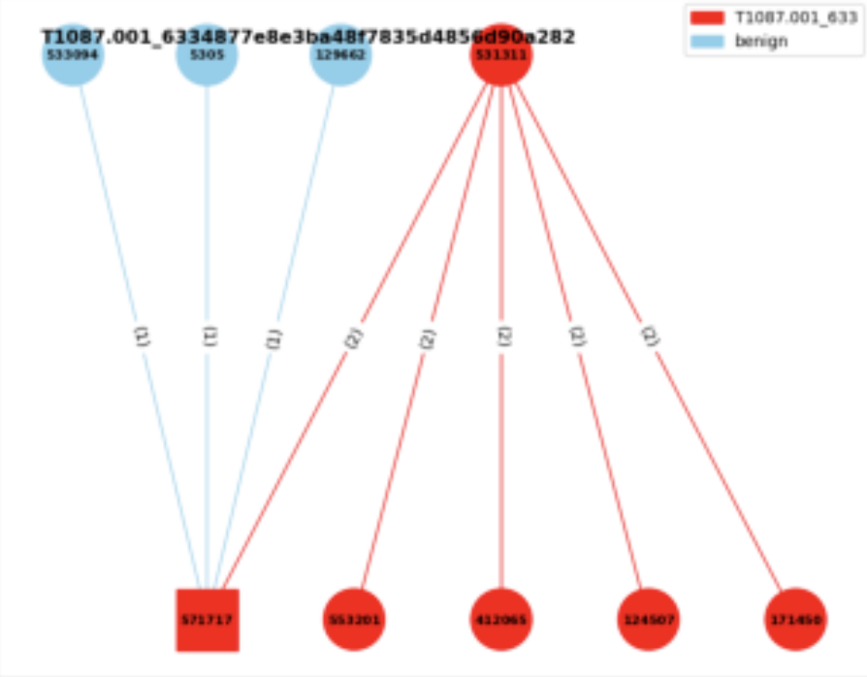
Experiment 3
Experiment 3:
Consider the neighbor benign nodes
Edge classification
Given a graph → label the triplets
with the benign or the specific AP
benign
T1003.001

Slide 5
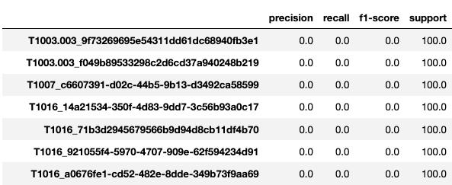

Experiment 3 - Oversampling
Current Problem:
Can’t predict the edge in the small graphs consist of single triplet

Slide 6




Experiment 3 - Oversampling
Current Trial: hope to see the result on training dataset
At least let the model overfit first(remember the data with single triplet)
Use data with 320 times single triplet → # of training data = 13657600
Larger hidden dimension → more neurons to remember the data
Hidden_dim = 256
Hidden_dim = 512

Slide 7
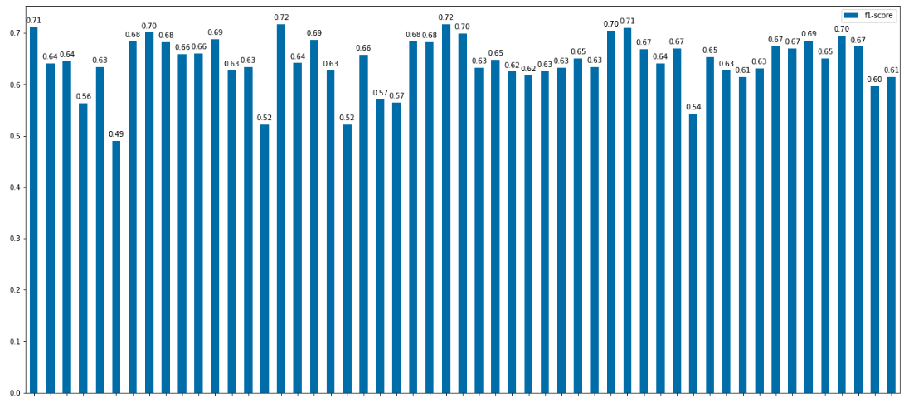
Experiment 3 - Oversampling
Bar Chart of hidden dimension = 256:

Slide 8
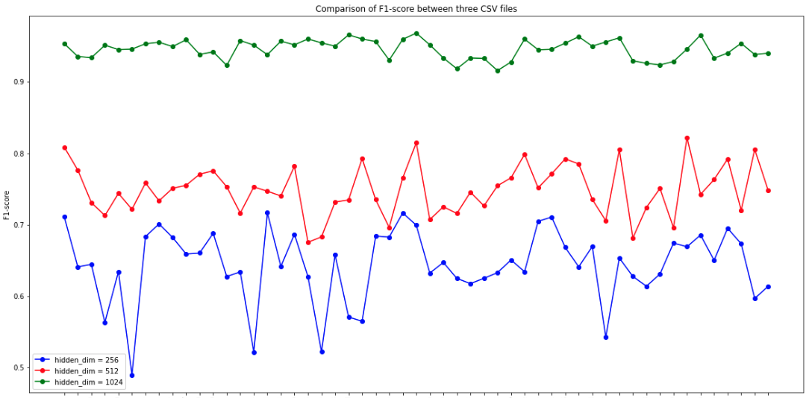
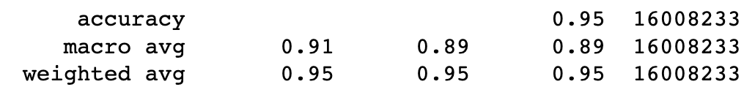
Experiment 3 - Oversampling

Slide 9
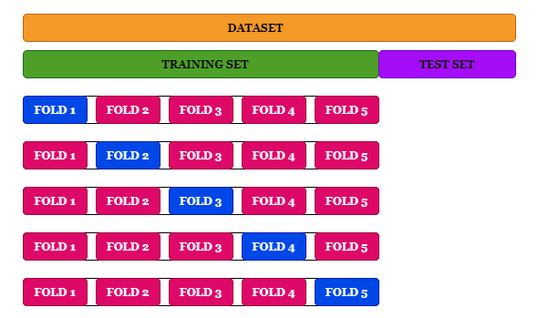
Experiment 3 – K-Fold Cross Validation
Cross-validation should always be done before over-sampling the data, just as how feature selection should be implemented.
Only by resampling the data repeatedly, randomness can be introduced into the dataset to make sure that there won’t be an overfitting problem.
Training is not finished yet
https://www.kdnuggets.com/2017/06/7-techniques-handle-imbalanced-data.html
Notes:
https://www.kdnuggets.com/2017/06/7-techniques-handle-imbalanced-data.html

Slide 10
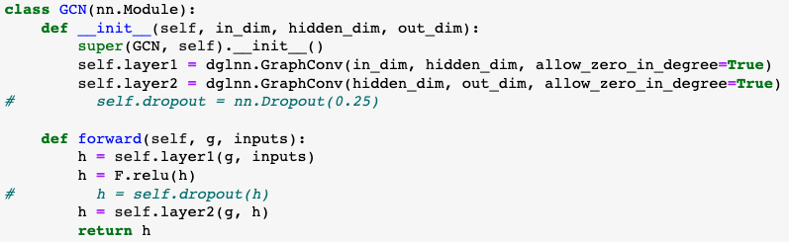
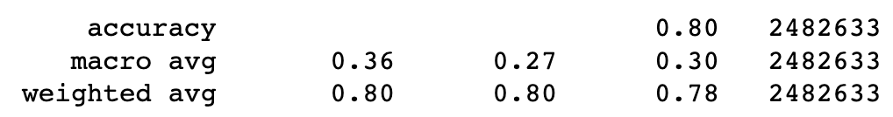
Experiment 3 – GCN model
Maybe a easier model could remember the easier data? (single triplet graph in our case)
Notes:
https://www.kdnuggets.com/2017/06/7-techniques-handle-imbalanced-data.html

Slide 11
Future Work

Slide 12
Future Work
GNN
Try some other methods to improve the performance of single triplet issue
Maybe try some other embeddings?
Maybe try some other models?
Maybe try some data augmentation methods?
…
Could I train a specific model for small graph and then
Decide which model to be used based on the data
Ensemble
…

Slide 13
Thanks!!

Slide 14
Appendix

Slide 15
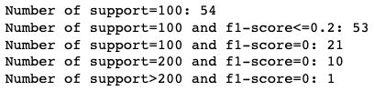





Experiment 3 - Oversampling
Current Trial: Duplicate the data with single triplets → 20, 40, 80, 320 times
20 times
40 times
80 times

Slide 16
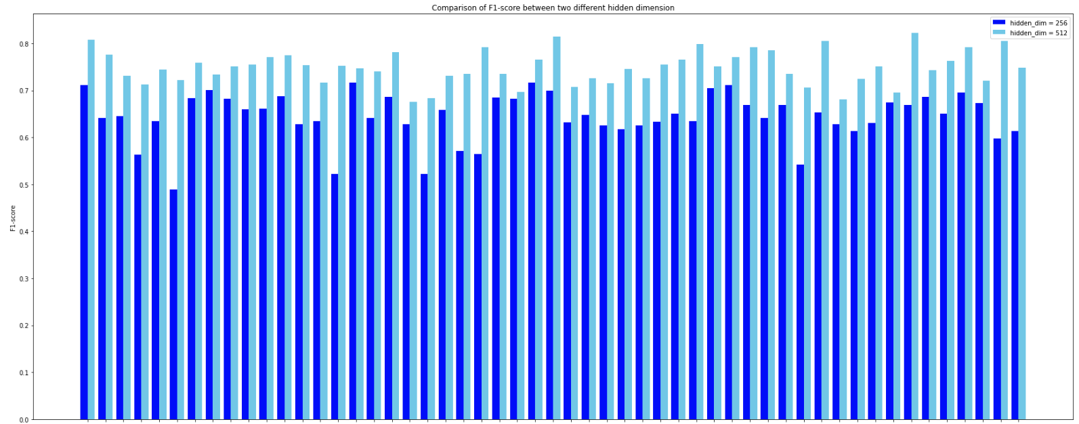
Experiment 3 - Oversampling

Slide 17

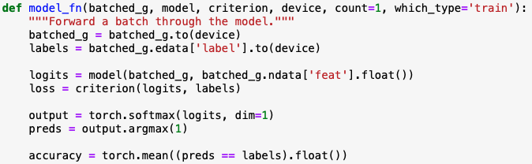
Experiment 3 - Model
Concept from the DGL official website:
Let the dgl graph’s edge data have the attribute: edata[“label”]
Use GraphSAGE model to get the new node embedding
Use MLP model to get the score of the edge
Concatenate these two models
Train the final model

Slide 18
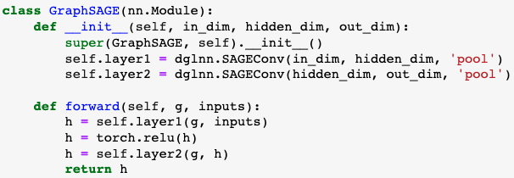
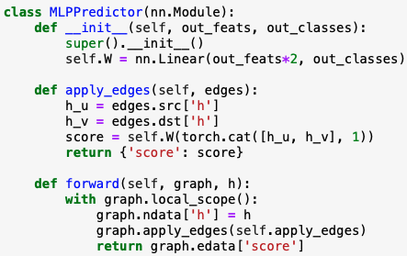
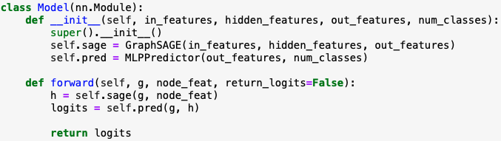
Experiment 3 - Model
Notes:
這個`MLPPredictor`模型是用於邊預測或稱為鏈接預測的。鏈接預測的目的是預測兩個節點之間是否存在邊。這是圖學習中的一個重要任務，被應用於許多領域，例如社交網絡中的好友推薦或蛋白質互作網絡的互作預測。
1. **初始化 (`__init__` 方法)**:
- 定義一個全連接線性層`self.W`，其輸入特徵的大小是 `in_features * 2`。這是因為我們將來源節點`h_u`和目標節點`h_v`的表示向量拼接起來，所以尺寸變為雙倍。
- 輸出的尺寸是 `out_classes`，這對應於邊的類別數量。
2. **apply_edges 方法**:
- 這個方法的作用是為圖中的每一條邊計算一個'score'。這個'score'可以被解釋為邊的類別。
- 它首先從圖中提取來源節點`h_u`和目標節點`h_v`的表示向量。
- 接著，它將這兩個表示向量拼接起來，並通過`self.W`線性層計算'score'。
3. **前向方法 (`forward`)**:
- 接收一個圖和它的節點表示`h`。
- 它將這些節點表示設定為圖的節點數據。
- 使用`apply_edges`方法為圖中的每一條邊計算一個'score'。
- 返回邊的'score'。
總之，`MLPPredictor`使用來源和目標節點的表示計算圖中每一條邊的'score'，這些'score'可以用於邊的預測任務。

Slide 19
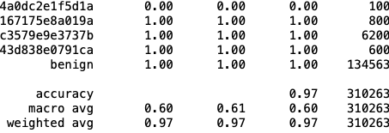
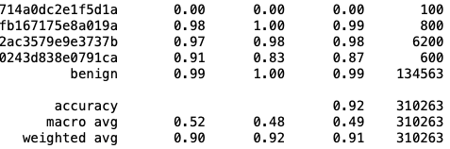
Experiment 3 - Result
Format of the edge labels:
Label 65 is benign
Classification report:
transR_50:
secureBERT_50:
Macro average is similar to previous experiments → won’t be affected by benign
Weighted average is very high since the # of the benign is high(unbalanced) and predictable
TransX family performs better than secureBERT

Slide 20
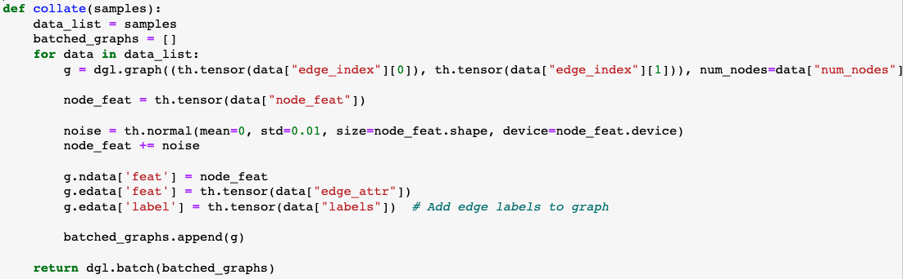

Experiment 3 – Noise
Current Trial 1:
Add the noise to the node feature

Slide 21
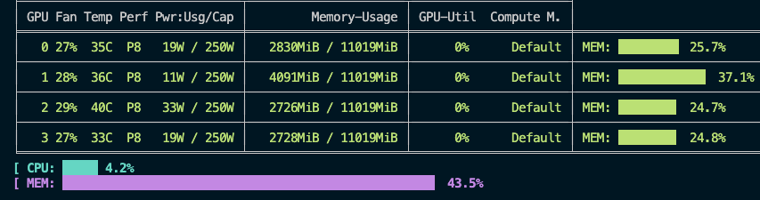
Experiment 3 – Probable Issue
Probable Issue:
While trying repeat 320 times:
→ seems like the computation resource might be a probelm

