Slide 1
Progess of the Project
Tsung-Min Pai
2023/9/16
Notes:
hello

Slide 2
Outline
GNN
Experiment 1 and 2
Experiment 3
Future Work

Slide 3
Experiment 1 and 2

Slide 4
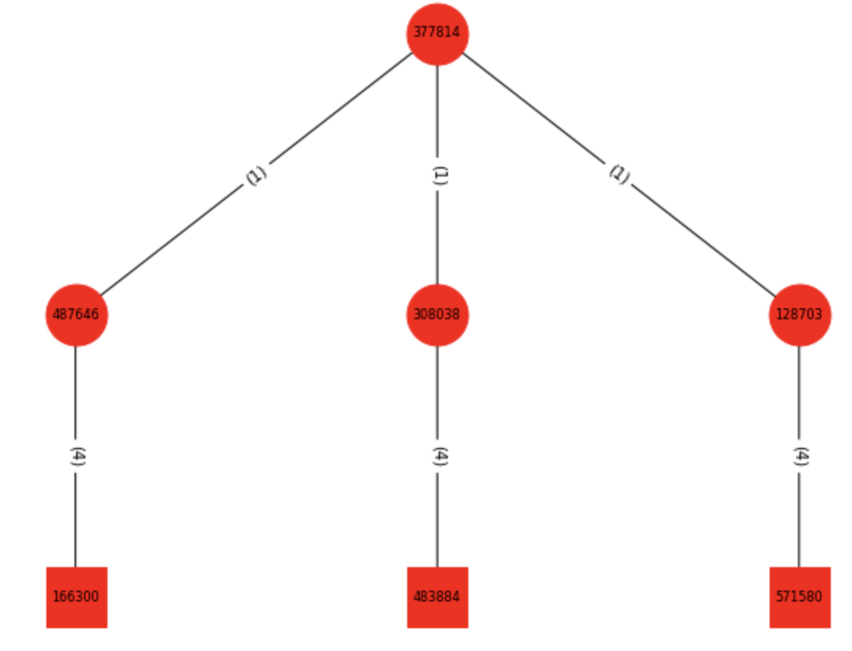
Experiment 1 and 2
Experiment 1:
Dataset is 165 APs with 11 versions of embedding
Graph classification
Experiment 2:
Experiment 1 + benign data
Benign made from benign.txt → 1000 graphs
Graph classification
(Smaple of the graph in exp1 and exp2)

Slide 5
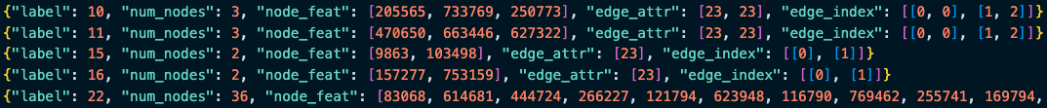

Dataset
Format:
Have 165 APs, each AP has 1000 variation → nodes are different but relations are same
0~99 test, 100~199 validation, 200~999 train → 1:1:8
Use transR_50, transE_50, transH_50, secureBERT… as embedding → 11 versions
secureBERT → dimension = 250, 150, 100, 50

Slide 6
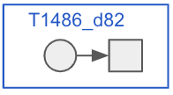
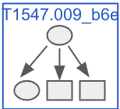
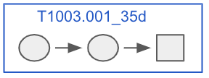
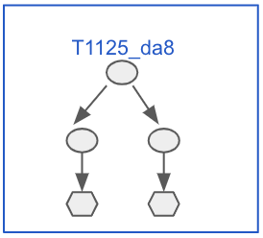
Dataset
Benign graphs for experiment 2:
1. 400: Leaf nodes + their source nodes
2. 300: Leaf nodes + their source nodes with source nodes’ neighbor nodes
3. 200: Leaf nodes + their 2 layer source nodes
4. 100: Leaf nodes + their 2 layer source nodes with source nodes’ neighbor nodes
For version 2 and 4 graphs:
Constrain the # of relation between the same nodes within 8
Constrain the # of the triplets in the graph within 32

Slide 7
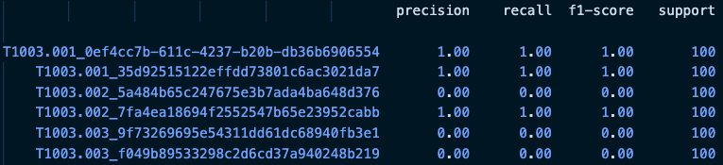
Experiment 1 and 2
Record the training message in a log file
Also record the classification report supportedd by sklearn
Log file:
Classification report:
Similar with the MLP, RNN:
Can barely predict the graph
with only one triplet
Notes:
Precision（精確率）： 也被稱為陽性預測的準確率。對於某個特定類別，精確率是指預測為該類別的樣本中實際屬於該類別的比例。高精確率表示模型在預測該類別時，做出的正確預測比例較高。
Recall（召回率）： 也被稱為靈敏度、真陽性率。對於某個特定類別，召回率是指實際屬於該類別的樣本中被成功預測為該類別的比例。高召回率表示模型能夠有效地檢測出實際屬於該類別的樣本。
F1-Score（F1 分數）： F1 分數是精確率和召回率的加權調和平均數，可以看作是綜合考慮了模型的準確率和能夠檢測出真實陽性的能力。F1 分數越高，表示模型在平衡精確率和召回率方面表現越好。
Support（支持數）： 支持數是指屬於該類別的實際樣本數。這個數字可以幫助你理解模型在進行評估時所基於的統計數據。

Slide 8
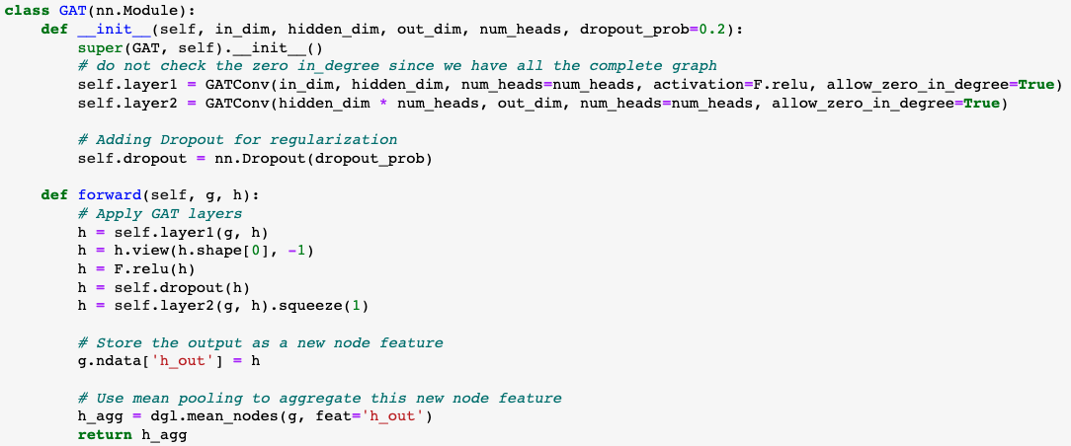
Graph Attention Network - GAT
Model:
Notes:
你定義了一個基於 GAT (Graph Attention Network) 的神經網路模型。GAT 是一種圖卷積神經網路，其中每個節點通過 attention mechanism 而不僅僅是平均鄰居特徵來更新其特徵。
前向方法 (forward):
首先，它通過第一個 GAT 層將輸入特徵 h 轉換成新的特徵。
使用 view 方法來重塑特徵 tensor，使其維度適應多頭注意力的輸出。
使用 dropout 進行正則化。
通過第二個 GAT 層進行另一次特徵轉換。
將這些輸出特徵存儲為新的節點特徵 h_out。
最後，使用平均池化來彙總整個圖的節點特徵，得到一個圖級別的輸出特徵。
view 是 PyTorch tensor 中的一個方法，它允許您重塑 tensor。換句話說，您可以使用它來改變 tensor 的維度和大小，但是內容和數據順序保持不變。

Slide 9
Experiment 1 and 2 with GAT
Total: 25 epochs
Optimizer = AdamW(model.parameters(), lr=5e-4)
Criterion = nn.CrossEntropyLoss()
Batch size = 16
Except secureBERT, all about 35~40% test accuracy
secureBERT family ≈ 12% test accuracy
Experiment 1 and 2 have similar performance
since benign only has 1000 graph → kind of balance
If we make the benign graph much more than AP(real data) → imbalance

Slide 10
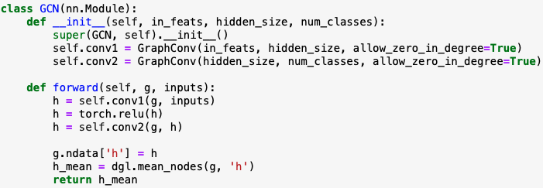
Graph Convolutional Network - GCN
Model:
Since the bad performance (14% accuracy on transH_50 test), I didn’t go any further with GCN

Slide 11
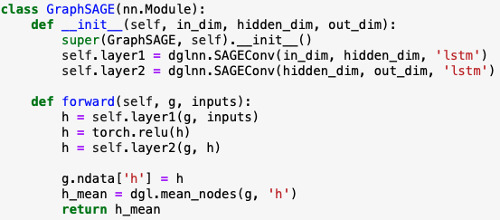
Graph SAmple and aggreGateE - GraphSAGE
Model:
In_dim: dimension of the node embedding
out_dim: # of the classes
Aggregate type: mean, gcn, pool, lstm → performance of lstm is the best but take 5 times of the time in training

Slide 12
Experiment 1 and 2 with GraphSAGE
Total: 25 epochs
Optimizer = AdamW(model.parameters(), lr=5e-4)
Criterion = nn.CrossEntropyLoss()
Batch size = 16
All about 60~62% test accuracy → increase 20% compared to GAT
All secureBERT family ≈ 60% test accuracy
Experiment 1 and 2 have similar performance
since benign only has 1000 graph → kind of balance
If we make the benign graph much more than AP(real data) → imbalance

Slide 13
Experiment 3

Slide 14
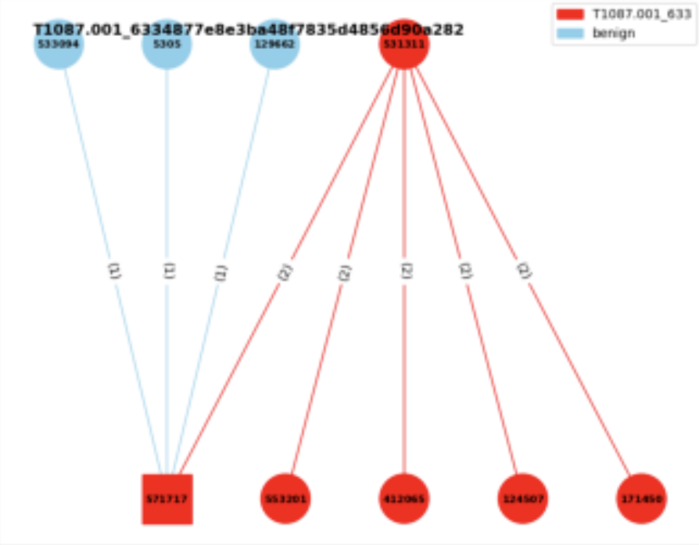

Experiment 3
Experiment 3:
Consider the neighbor benign nodes
Edge classification
I think it’s more like an triplet classification?
Given a graph → label the triplets
with the benign or the specific AP
benign
T1003.001
Source txt file:
a means attack pattern
b means benign

Slide 15
Experiment 3
Concept:
Use the node embedding from the GraphSAGE model
Concatenate with the edge embedding
Train the MLP model to do the triplet classification
Difficulty:
Format of the dataset
Where to concatenate the nodes and the edges
Train the MLP afterward or use it in the same training loop

Slide 16
Dataset
Format in experiment 1 and 2:
Format in experiment 3:
From graph classification to edge classification, which is multi-label classification
# of labels = # of triplets
Haven’t successfully trained → some tensor error

Slide 17
Future Work

Slide 18
Future Work
GNN
Successfully run the experiment 3
Try GCN or different architecture of the model
Improve the performance of the model (if available)

Slide 19
Thanks!!

Slide 20
Appendix

Slide 21
Useful Links
https://zhuanlan.zhihu.com/p/107737824
https://zhuanlan.zhihu.com/p/315800604
https://blog.csdn.net/uncle_ll/article/details/82778750
https://docs.dgl.ai/en/1.1.x/guide_cn/minibatch-edge.html#guide-cn-minibatch-edge-classification-sampler
https://docs.dgl.ai/en/0.8.x/generated/dgl.nn.pytorch.conv.SAGEConv.html
https://docs.dgl.ai/en/0.8.x/generated/dgl.nn.pytorch.conv.GATConv.html

Slide 22

Experiment 3
Total: 25 epochs
Optimizer = AdamW(model.parameters(), lr=5e-4)
Criterion = nn.CrossEntropyLoss()
Batch size = 4

Slide 23
Graph Convolutional Network - GCN

Slide 24
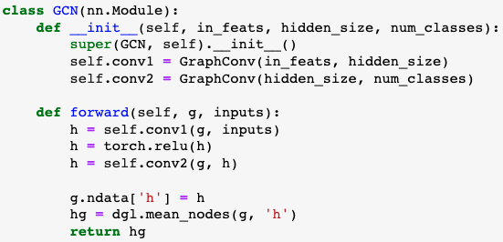
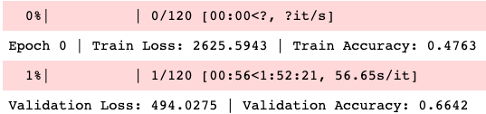
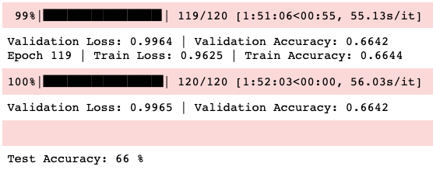
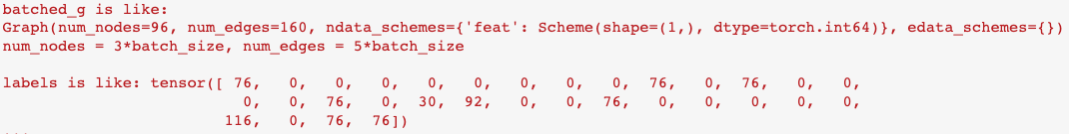
Graph Convolutional Network - GCN
Model:
Result:
Use the old verison of the dataset
Use DGL to be our library
DGL data format:
GAT applied on the old data has the similar result

Slide 25
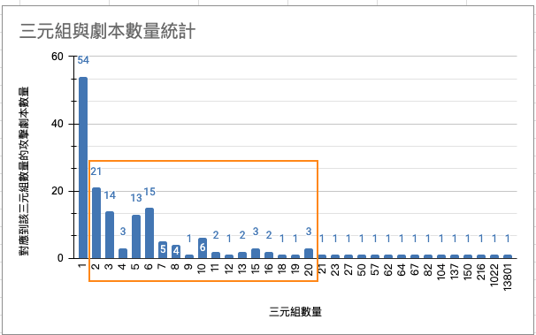
Appendix

