Slide 1
Progess of the Project
Tsung-Min Pai
2023/8/2

Slide 2
Outline
Graph - Data Analysis
Graphormer
TRAM
Future Work

Slide 3
Graph - Data Analysis

Slide 4
Graph - Original
Constructing the directed graph of every Attack Patterns (167 APs)
Connecting the source and the destination
Recording the # of relations with the same source and destination
Exclude T1046_5a4 (1022 triplets) and T1005_720 (13801 triplets)
Final result would contain 165 Aps
Connecting all the related neighbor nodes in a single hop
Labelling them with different color
3 versions: AP itself, without benign, with benign

Slide 5
Graph - Modification
Considering the entity of each nodes → Give each different shapes
Process: circle, Registry: hexagon, File: square, Network: diamond
Lead us to the graph without direction
Many version of the graph:
Plot a big graph contains all nodes
Plot a big graph contains all APs → Subplot 165 APs
A version that show the APs in the order of the total relations in the graph
Show the # of the total relations
Show the nodes’ actual value → ex: C: \Users\ezk
Still has 3 version: AP itself, without benign, with benign

Slide 6
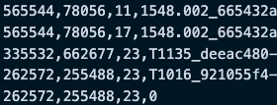



Data
Need to consider the entity of each nodes
Node’s actual value

Slide 7
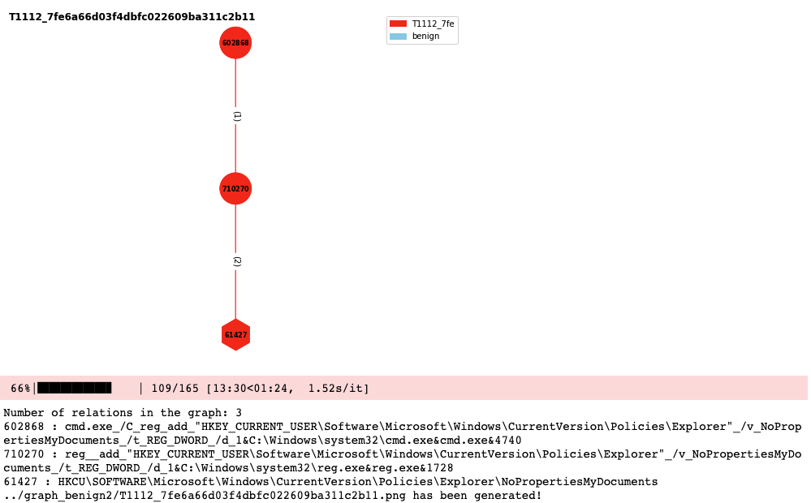
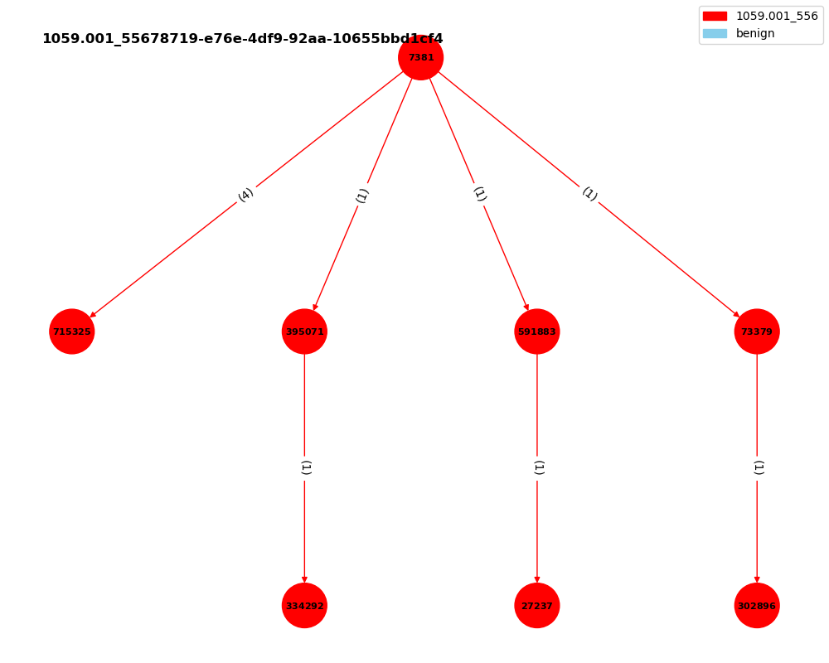
Graph – case I
3 relations
No related APs
No related benign
A lot of case III

Slide 8
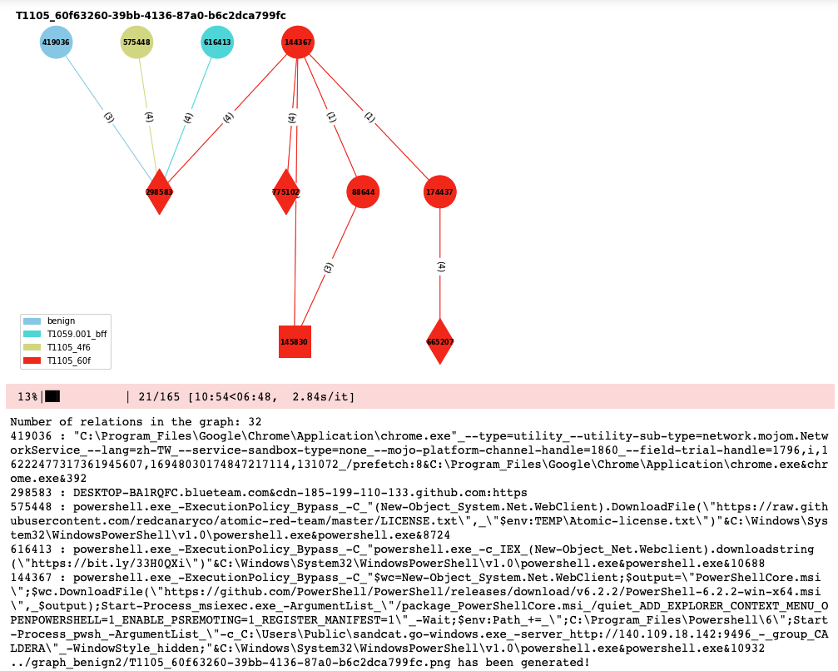
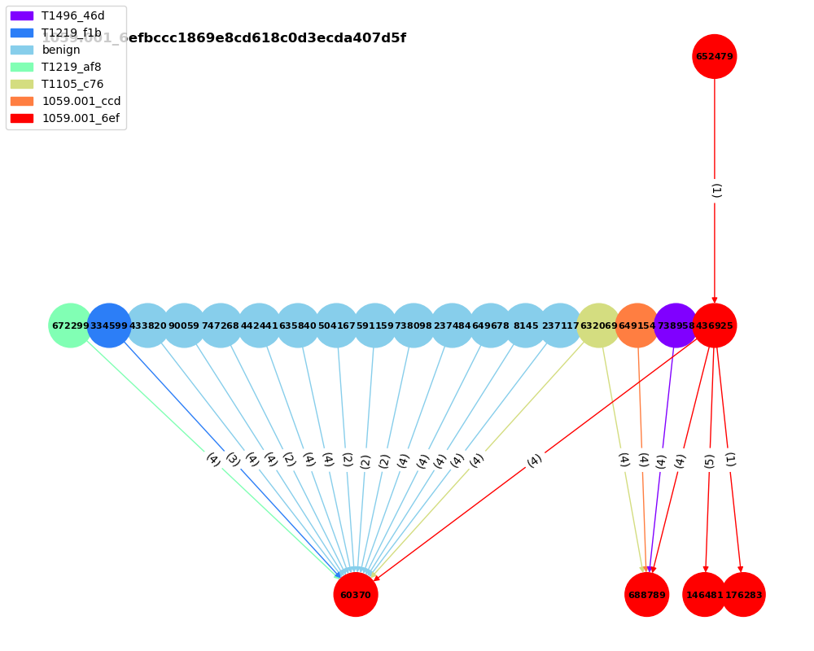
Graph – case II
32 relations
2 related APs
1 related benign

Slide 9
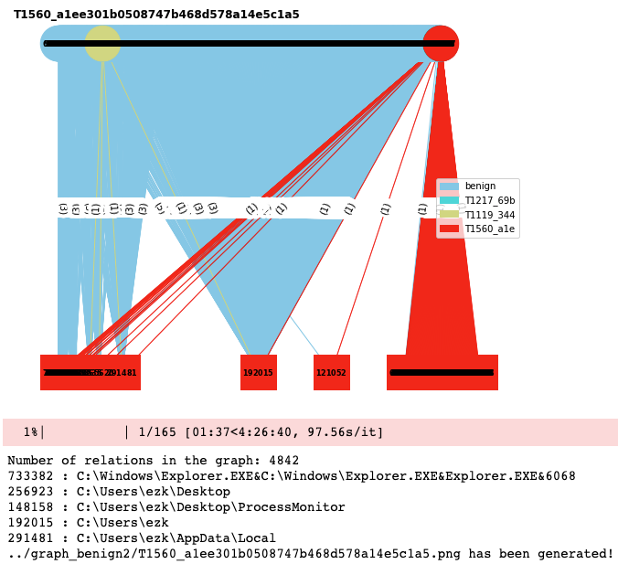
Graph – case III
4842 relations
2 related APs
A lot of related benign
Few case III

Slide 10
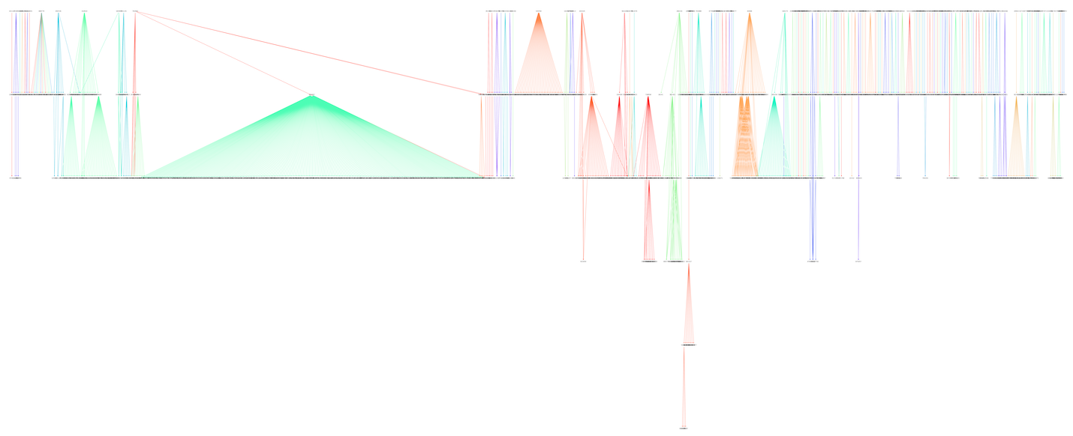
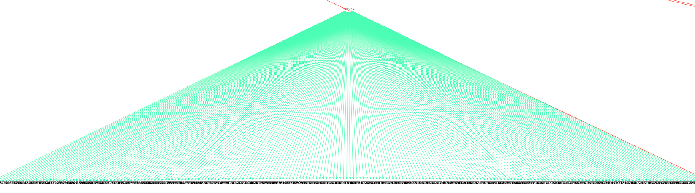
Graph – All Nodes
Node 645067 got a lot of friends !
powershell.exe_-ExecutionPolicy_Bypass_-C_"dir_$env:USERPROFILE_-Recurse_|_Compress-Archive_-DestinationPath_$env:USERPROFILE\T1560-data-ps.zip"&C:\Windows\System32\WindowsPowerShell\v1.0\powershell.exe&powershell.exe&10444

Slide 11
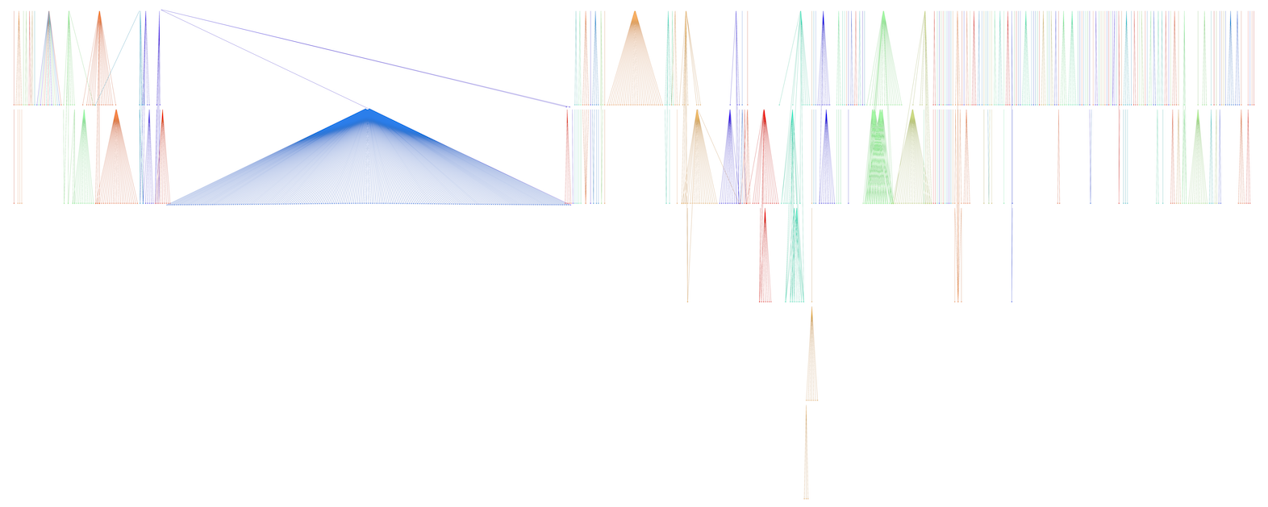
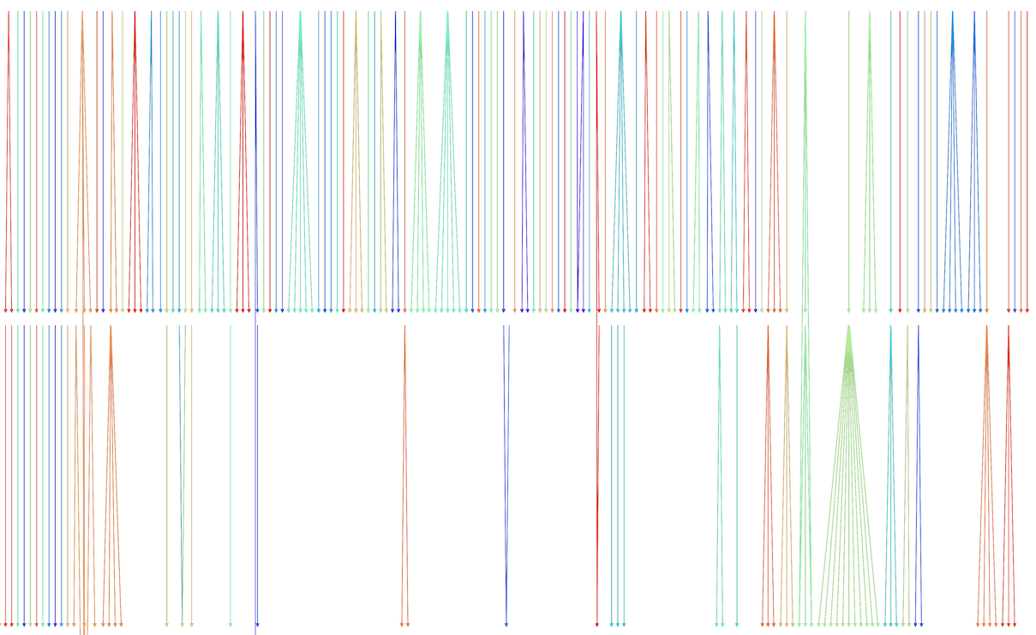
Graph – All Nodes
Most of them do not have a lot of neighbors
Most of the triplets are not correlated

Slide 12
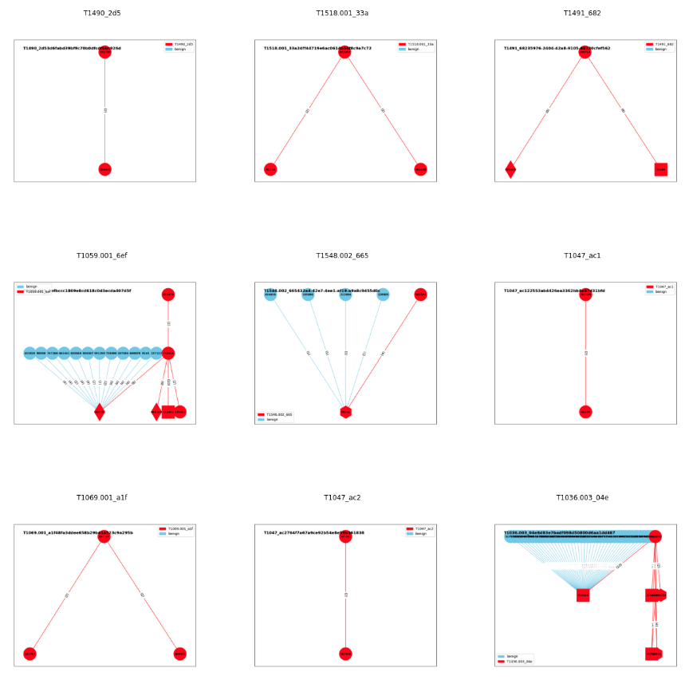
Graph – Subplot 165
165 Aps
29 related to benign(17.5%)
Only consider the AP itself and the related benign
Not consider the related AP like before

Slide 13
Graphormer

Slide 14
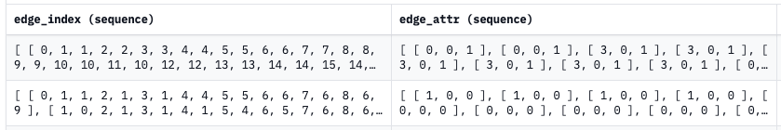
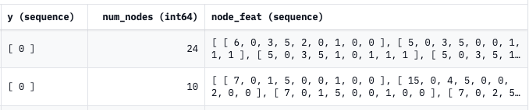
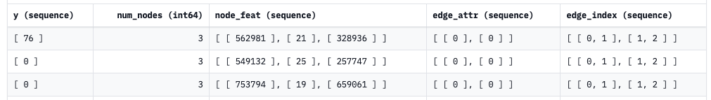
Data Format
Official format (~40k rows):
My format (~50k rows):
Train:Validation:Test = 3:1:1

Slide 15
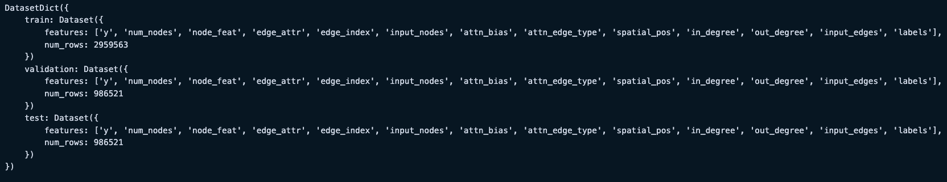
Data Format
My data after preprocessing:
There’s no error here
File "/workdir/home/euni/anaconda3/lib/python3.9/site-packages/transformers/models/graphormer/collating_graphormer.py",
line 112, in __call__ batch["attn_bias"][ix, : f["attn_bias"].shape[0], : f["attn_bias"].shape[1]] = f["attn_bias"]
RuntimeError: The expanded size of the tensor (2) must match the existing size (4) at non-singleton dimension 1.
Target sizes: [2, 2]. Tensor sizes: [4, 4]
Notes:
attn_bias = np.zeros([num_nodes + 1, num_nodes + 1], dtype=np.single) # with graph token
item["attn_bias"] = attn_bias # in our case, it will be 4x4 tensor with element 0

Slide 16
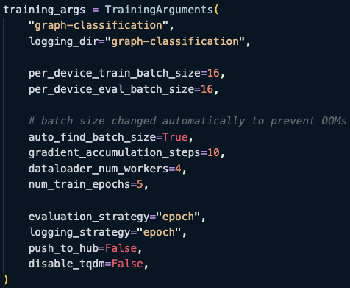
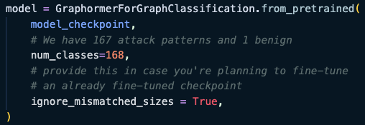
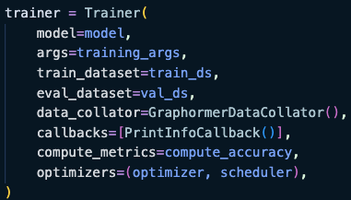
Training Code

Slide 17
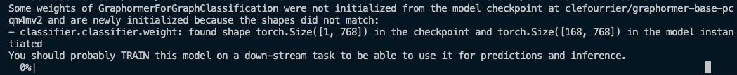
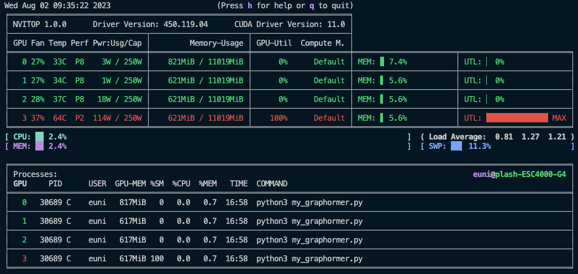

BUG
Still can’t start the training on my customized dataset
Write the training code be myself

Slide 18
TRAM

Slide 19
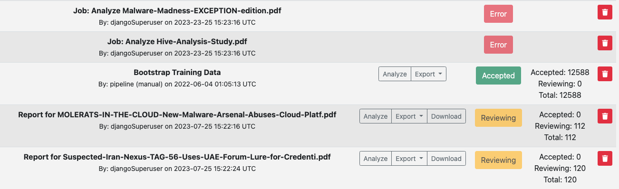
Automation
Successfully uploaded: 111 files
Unsuccessfully uploaded: 19 files
Export part is not successful yet
After export 7 files, it can’t find the element
Try to scroll the web’s page to show the element

Slide 20
Future Work

Slide 21
Future Work
Graph - Data Analysis
Done
Graphormer
Write the trainer(training part)
TRAM
Try to export all the file and transfer them to labeled data

Slide 22
Thanks!!

Slide 23
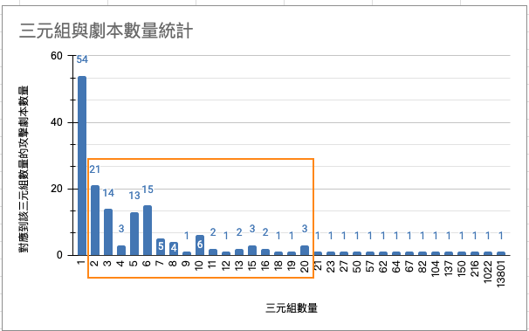
Appendix

