Slide 1
Progess of the Project
Tsung-Min Pai
2023/9/7
Notes:
hello

Slide 2
Outline
GAT
Experiment 1 and 2
Experiment 3
Future Work

Slide 3
Graph Attention Network - GAT

Slide 4
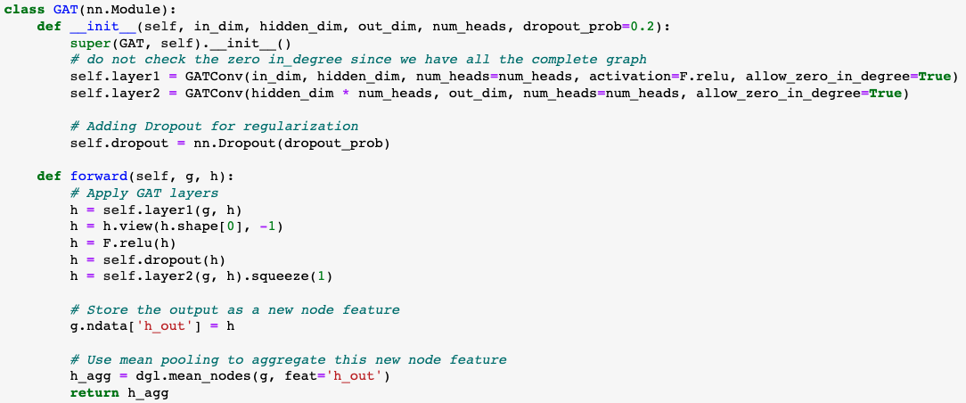
Graph Attention Network - GAT
Model:
Use the new verison of the dataset
Notes:
你定義了一個基於 GAT (Graph Attention Network) 的神經網路模型。GAT 是一種圖卷積神經網路，其中每個節點通過 attention mechanism 而不僅僅是平均鄰居特徵來更新其特徵。
前向方法 (forward):
首先，它通過第一個 GAT 層將輸入特徵 h 轉換成新的特徵。
使用 view 方法來重塑特徵 tensor，使其維度適應多頭注意力的輸出。
使用 dropout 進行正則化。
通過第二個 GAT 層進行另一次特徵轉換。
將這些輸出特徵存儲為新的節點特徵 h_out。
最後，使用平均池化來彙總整個圖的節點特徵，得到一個圖級別的輸出特徵。
view 是 PyTorch tensor 中的一個方法，它允許您重塑 tensor。換句話說，您可以使用它來改變 tensor 的維度和大小，但是內容和數據順序保持不變。

Slide 5
Experiment 1 and 2

Slide 6
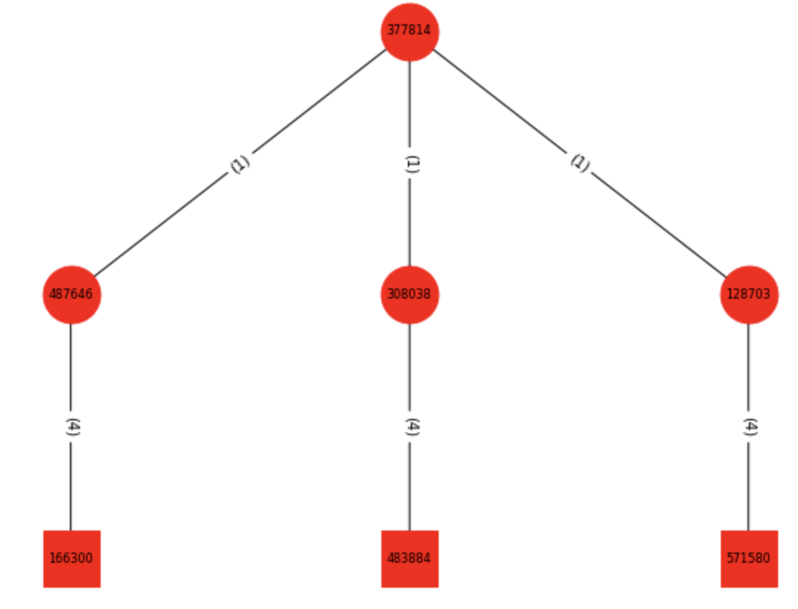
Experiment 1 and 2
Experiment 1:
Dataset is 165 APs with 11 versions of embedding
Graph classification
Experiment 2:
Experiment 1 + benign data
Benign made from benign.txt → 1000 graphs
Graph classification
(Smaple of the graph in exp1 and exp2)

Slide 7
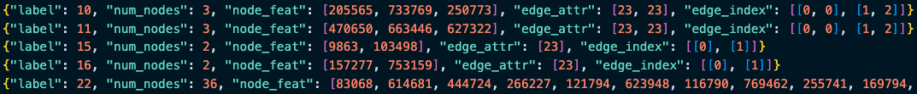

Dataset
Format:
Have 165 APs, each AP has 1000 variation → nodes are different but relations are same
0~99 test, 100~199 validation, 200~999 train → 1:1:8
Use transR_50, transE_50, transH_50, secureBERT… as embedding → 11 versions
secureBERT → dimension = 250, 150, 100, 50

Slide 8
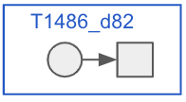
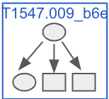
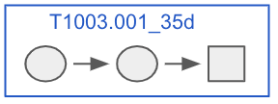
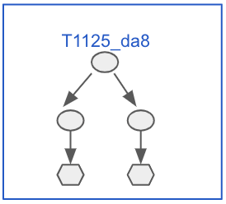
Dataset
Benign graphs for experiment 2:
1. 400: Leaf nodes + their source nodes
2. 300: Leaf nodes + their source nodes with source nodes’ neighbor nodes
3. 200: Leaf nodes + their 2 layer source nodes
4. 100: Leaf nodes + their 2 layer source nodes with source nodes’ neighbor nodes
For version 2 and 4 graphs:
Constrain the # of relation between the same nodes within 8
Constrain the # of the triplets in the graph within 32

Slide 9
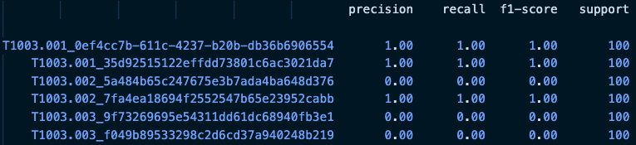
Experiment 1 and 2
Record the training in a log file
Also record the classification report supportedd by sklearn
Give these files to Euni
Log file:
Classification report:
Similar with the MLP, RNN:
More triplets, more accurate
Notes:
Precision（精確率）： 也被稱為陽性預測的準確率。對於某個特定類別，精確率是指預測為該類別的樣本中實際屬於該類別的比例。高精確率表示模型在預測該類別時，做出的正確預測比例較高。
Recall（召回率）： 也被稱為靈敏度、真陽性率。對於某個特定類別，召回率是指實際屬於該類別的樣本中被成功預測為該類別的比例。高召回率表示模型能夠有效地檢測出實際屬於該類別的樣本。
F1-Score（F1 分數）： F1 分數是精確率和召回率的加權調和平均數，可以看作是綜合考慮了模型的準確率和能夠檢測出真實陽性的能力。F1 分數越高，表示模型在平衡精確率和召回率方面表現越好。
Support（支持數）： 支持數是指屬於該類別的實際樣本數。這個數字可以幫助你理解模型在進行評估時所基於的統計數據。

Slide 10
Experiment 1 and 2
Total: 25 epochs
Optimizer = AdamW(model.parameters(), lr=5e-4)
Criterion = nn.CrossEntropyLoss()
Batch size = 4
Except secureBERT, all about 35~40% test accuracy
secureBERT family ≈ 12% test accuracy
Experiment 1 and 2 have similar performance
since benign only has 1000 graph → kind of balance
If we make the benign graph much more than AP(real data) → imbalance

Slide 11
Experiment 3

Slide 12
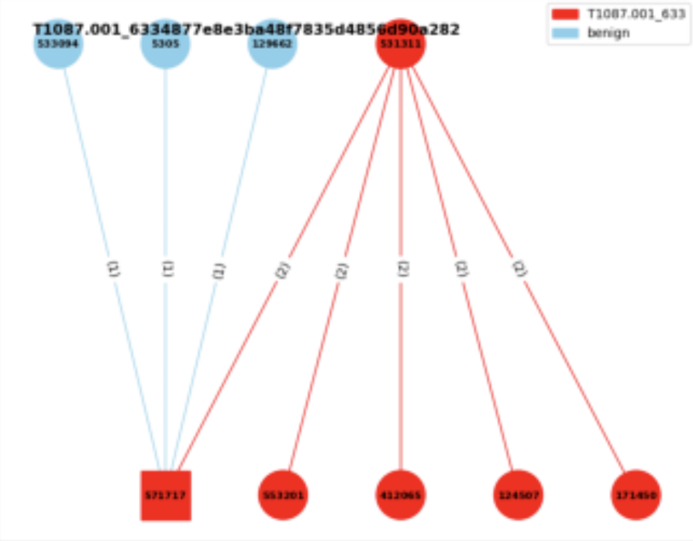

Experiment 3
Experiment 3:
Consider the neighbor benign nodes
Edge classification
I think it’s more like an triplet classification?
Given a graph → label the triplets
with the benign or the specific AP
benign
T1003.001
Source txt file:
a means attack pattern
b means benign

Slide 13
Dataset
Format in experiment 1 and 2:
Format in experiment 3:
From graph classification to edge classification, which is multi-label classification
# of labels = # of triplets
Haven’t successfully trained → some tensor error

Slide 14
Future Work

Slide 15
Future Work
GAT
Successfully run the experiment 3
Try GCN or different architecture of the model
Improve the performance of the model (if available)

Slide 16
Thanks!!

Slide 17
Appendix

Slide 18
Useful Links
https://zhuanlan.zhihu.com/p/107737824
https://blog.csdn.net/uncle_ll/article/details/82778750
https://docs.dgl.ai/en/1.1.x/guide_cn/minibatch-edge.html#guide-cn-minibatch-edge-classification-sampler

Slide 19

Experiment 3
Total: 25 epochs
Optimizer = AdamW(model.parameters(), lr=5e-4)
Criterion = nn.CrossEntropyLoss()
Batch size = 4

Slide 20
Graph Convolutional Network - GCN

Slide 21
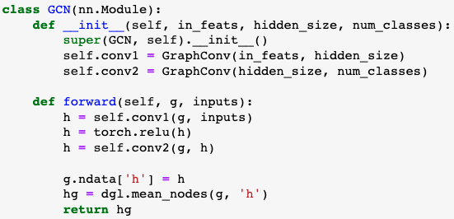
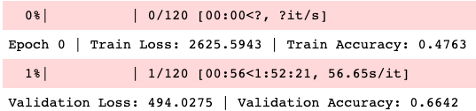
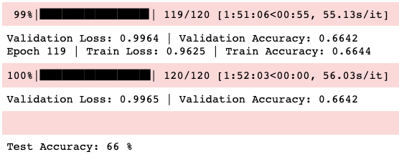
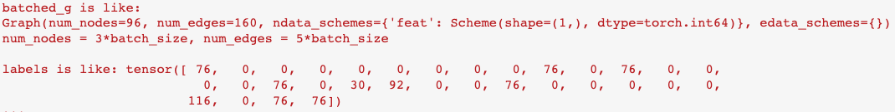
Graph Convolutional Network - GCN
Model:
Result:
Use the old verison of the dataset
Use DGL to be our library
DGL data format:
GAT applied on the old data has the similar result

Slide 22
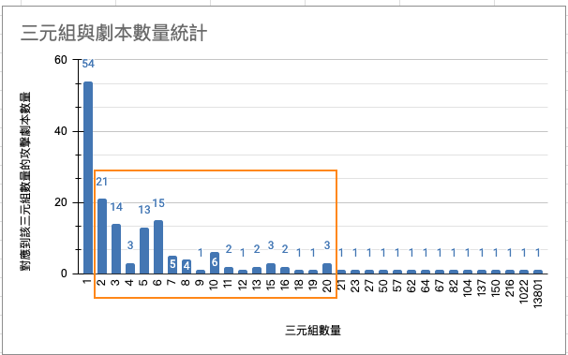
Appendix

