Slide 1
Progess of the Project
Tsung-Min Pai
2023/10/6
Notes:
hello

Slide 2
Outline
GNN
Experiment 3
Future Work

Slide 3
Experiment 3

Slide 4
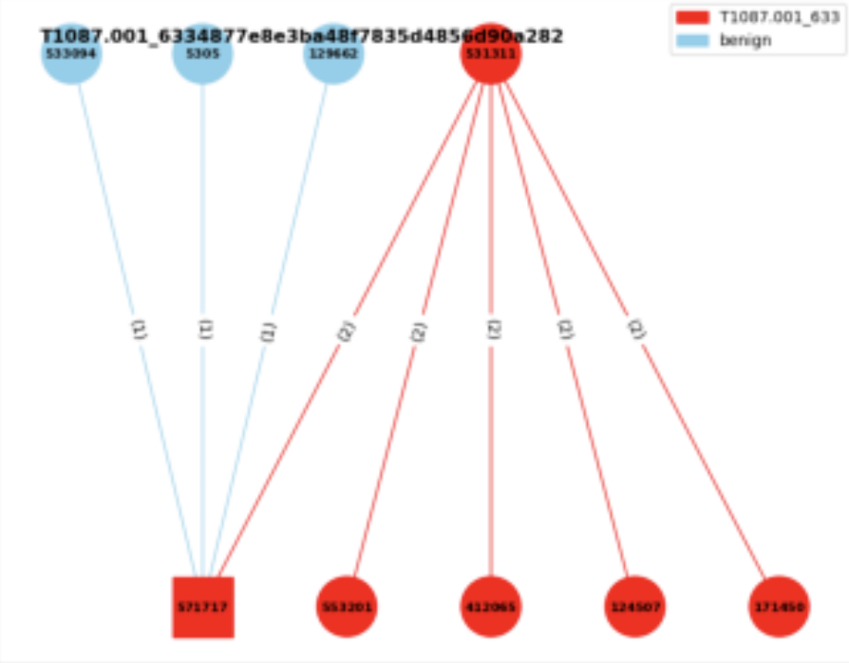
Experiment 3
Experiment 3:
Consider the neighbor benign nodes
Edge classification
Given a graph → label the triplets
with the benign or the specific AP
benign
T1003.001

Slide 5
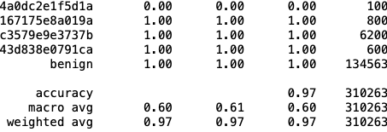
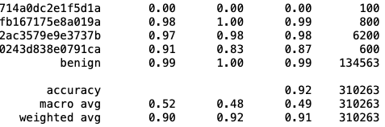
Experiment 3
Format of the edge labels:
Label 65 is benign
Classification report:
transR_50:
secureBERT_50:
Macro average is similar to previous experiments → won’t be affected by benign
Weighted average is very high since the # of the benign is high(unbalanced) and predictable
TransX family performs better than secureBERT

Slide 6
Experiment 1 and 2

Slide 7
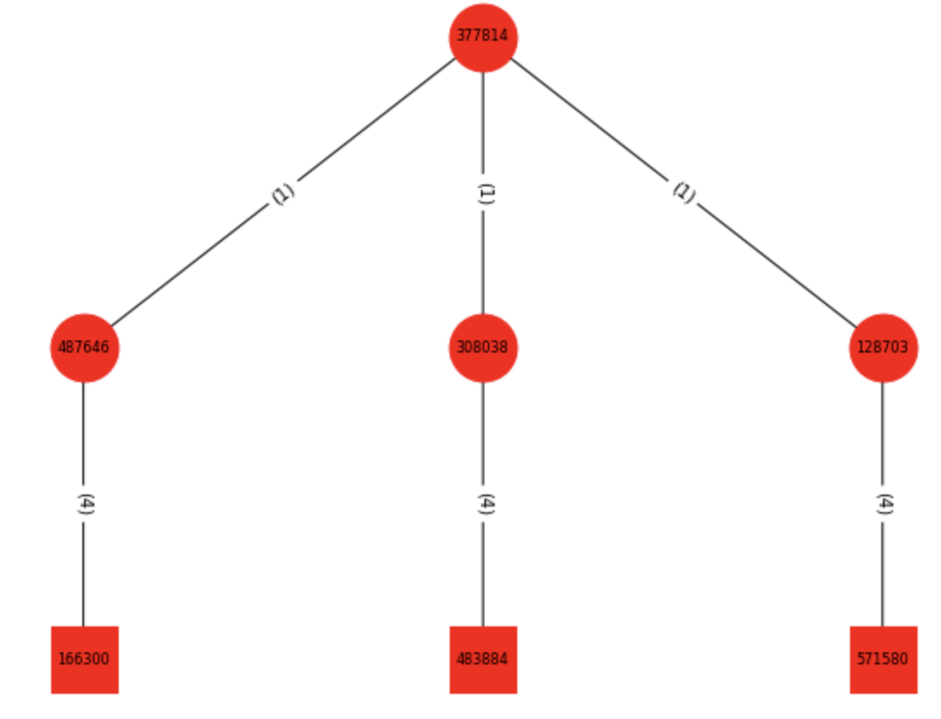
Experiment 1 and 2
Experiment 1:
Dataset is 165 APs with 11 versions of embedding
Graph classification
Experiment 2:
Experiment 1 + benign data
Benign made from benign.txt → 1000 graphs
Graph classification
(Smaple of the graph in exp1 and exp2)

Slide 8
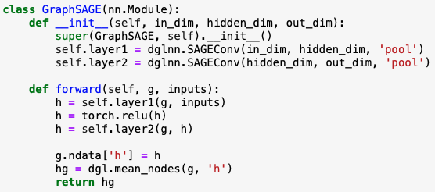
Graph SAmple and aggreGateE - GraphSAGE
Model:
In_dim: dimension of the node embedding
out_dim: # of the classes
Aggregate type: mean, gcn, pool, lstm → performance of pool and lstm are the similar → pool is faster

Slide 9
Experiment 1 and 2 with GraphSAGE
Total: 25 epochs
Optimizer = AdamW(model.parameters(), lr=5e-4)
Criterion = nn.CrossEntropyLoss()
Batch size = 16
All about 62% test accuracy → increase 20% compared to GAT
Experiment 1 and 2 have similar performance
since benign only has 1000 graph → kind of balance
If we make the benign graph much more than AP(real data) → imbalance

Slide 10
Experiment 3

Slide 11
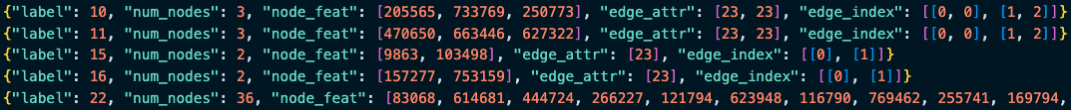

Dataset
Format in experiment 1 and 2:
Format in experiment 3:
From graph classification to edge classification
# of labels = # of edges
Source txt file:
a means attack pattern
b means benign

Slide 12

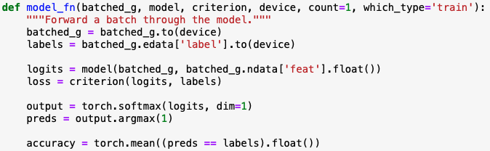
Experiment 3
Concept from the DGL official website:
Let the dgl graph’s edge data have the attribute: edata[“label”]
Use GraphSAGE model to get the new node embedding
Use MLP model to get the score of the edge considering the src and dest nodes
Concatenate these two models
Train the final model

Slide 13
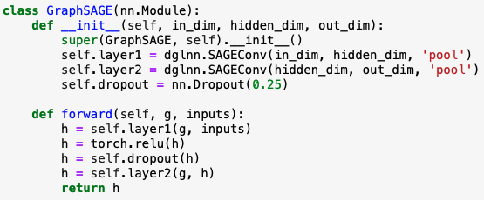
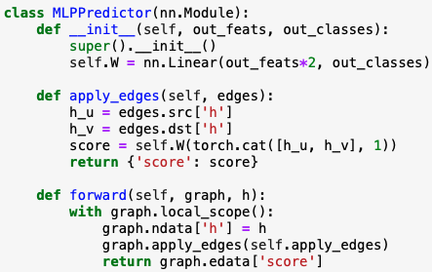
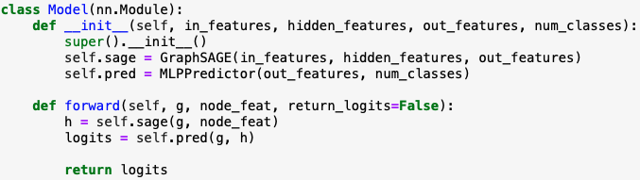
Experiment 3
Notes:
這個`MLPPredictor`模型是用於邊預測或稱為鏈接預測的。鏈接預測的目的是預測兩個節點之間是否存在邊。這是圖學習中的一個重要任務，被應用於許多領域，例如社交網絡中的好友推薦或蛋白質互作網絡的互作預測。
1. **初始化 (`__init__` 方法)**:
- 定義一個全連接線性層`self.W`，其輸入特徵的大小是 `in_features * 2`。這是因為我們將來源節點`h_u`和目標節點`h_v`的表示向量拼接起來，所以尺寸變為雙倍。
- 輸出的尺寸是 `out_classes`，這對應於邊的類別數量。
2. **apply_edges 方法**:
- 這個方法的作用是為圖中的每一條邊計算一個'score'。這個'score'可以被解釋為邊的類別。
- 它首先從圖中提取來源節點`h_u`和目標節點`h_v`的表示向量。
- 接著，它將這兩個表示向量拼接起來，並通過`self.W`線性層計算'score'。
3. **前向方法 (`forward`)**:
- 接收一個圖和它的節點表示`h`。
- 它將這些節點表示設定為圖的節點數據。
- 使用`apply_edges`方法為圖中的每一條邊計算一個'score'。
- 返回邊的'score'。
總之，`MLPPredictor`使用來源和目標節點的表示計算圖中每一條邊的'score'，這些'score'可以用於邊的預測任務。

Slide 14
Experiment 3
Total: 20 epochs
Optimizer = AdamW(model.parameters(), lr=5e-4)
Criterion = nn.CrossEntropyLoss()
Batch size = 16
Aggregate type of Graphsage: pool (but all 4 types have the similar performance in this task)
Have pretty high accuracy at trail of using transR_50 (≈ 93%)
At epoch 3: almost got the final validation accuracy
Still trying to apply to all the 11 version embeddings

Slide 15
Future Work

Slide 16
Future Work
GNN
Finish all 11 version of embedding
Try to break the current limit of accuracy (60%)
TBD…

Slide 17
Thanks!!

Slide 18
Appendix

Slide 19
Useful Links
https://zhuanlan.zhihu.com/p/107737824
https://zhuanlan.zhihu.com/p/315800604
https://blog.csdn.net/uncle_ll/article/details/82778750
https://docs.dgl.ai/en/1.1.x/guide_cn/minibatch-edge.html#guide-cn-minibatch-edge-classification-sampler
https://docs.dgl.ai/en/0.8.x/generated/dgl.nn.pytorch.conv.SAGEConv.html
https://docs.dgl.ai/en/0.8.x/generated/dgl.nn.pytorch.conv.GATConv.html
https://www.modb.pro/db/111133

Slide 20
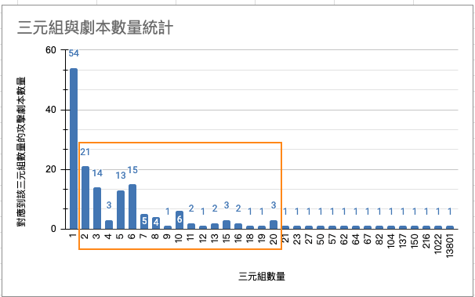
Appendix

