Slide 1
Progess of the Project
Tsung-Min Pai
2023/8/9

Slide 2
Outline
Graph - Data Analysis
GNN
GAT
GCN
TRAM
Future Work

Slide 3
Graph - Data Analysis

Slide 4
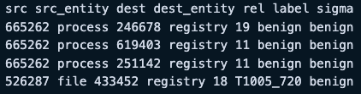
Graph
Considering the entity of each nodes → Give each different shapes
Process: circle, Registry: hexagon, File: square, Network: diamond
Plot a big graph contains 165 APs
Compare the real labels with the predicted labels of Sigma Rule
If matched: red nodes with red solid line
If not matched: half transparent red nodes with black dotted line

Slide 5
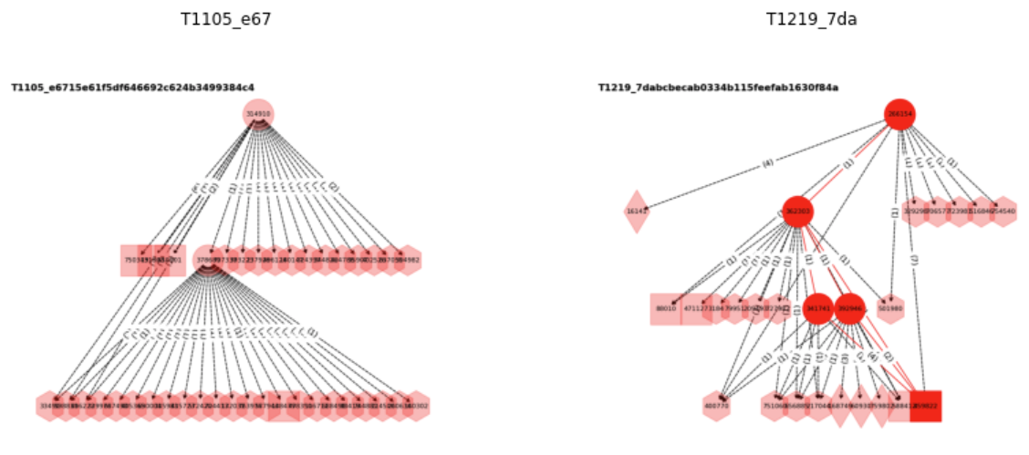
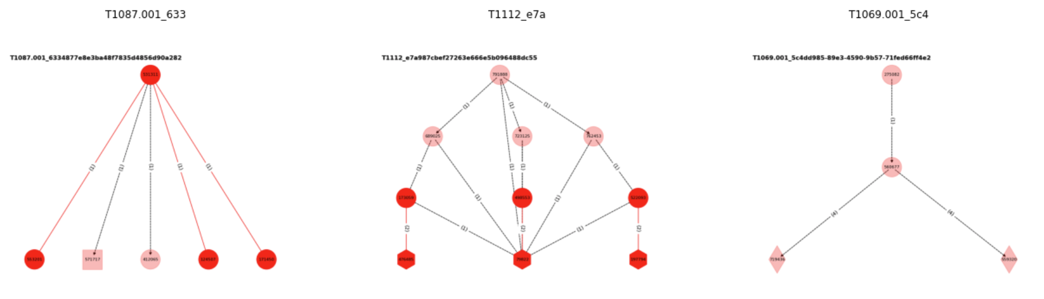
Graph
Many of them are not matched!
Notes:
1. 用 graph_self 的圖畫
2. 之前有用 Sigma 替每個 triplet 標上 TTP，用 Sigma 規則可能會標到一個以上的 TTP
3. Sigma 標到的 TTPs 中，只要有一個與 truth label 的 TTP 一樣，就算標對
4. 這個檔案中，Truth Label 和 Sigma Labels 用空格分開（`http://140.109.19.22:8888/edit/euni_final/Sigma/result_metrics/20230708_all/synthesize/v3`）
5. 原本的圖用虛線，標到的用實線

Slide 6
GNN

Slide 7
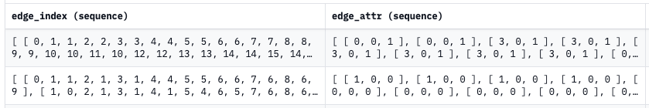
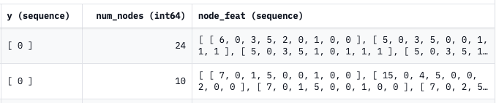
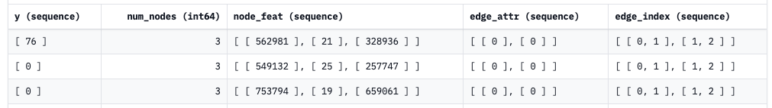
Data Format
Official format (~40k rows):
My format (~50k rows):
Train:Validation:Test = 3:1:1

Slide 8
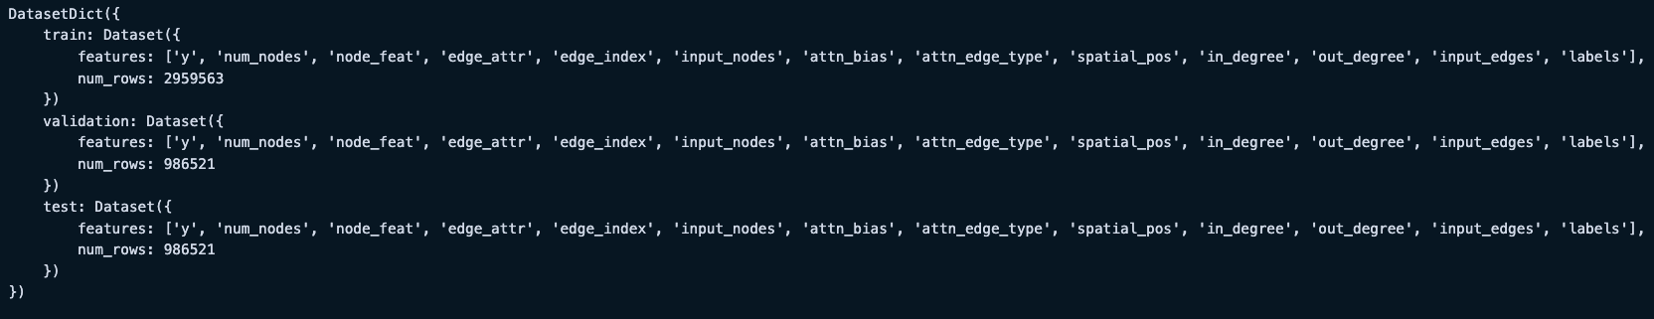
Data Format
My data after preprocessing:
There’s no error here
File "/workdir/home/euni/anaconda3/lib/python3.9/site-packages/transformers/models/graphormer/collating_graphormer.py",
line 112, in __call__ batch["attn_bias"][ix, : f["attn_bias"].shape[0], : f["attn_bias"].shape[1]] = f["attn_bias"]
RuntimeError: The expanded size of the tensor (2) must match the existing size (4) at non-singleton dimension 1.
Target sizes: [2, 2]. Tensor sizes: [4, 4]
Notes:
attn_bias = np.zeros([num_nodes + 1, num_nodes + 1], dtype=np.single) # with graph token
item["attn_bias"] = attn_bias # in our case, it will be 4x4 tensor with element 0

Slide 9
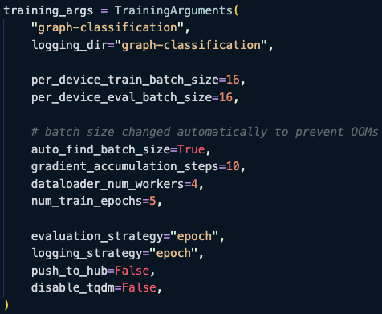
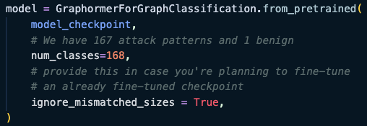
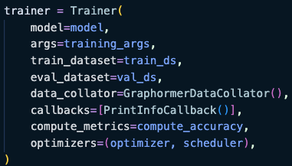
Training Code

Slide 10
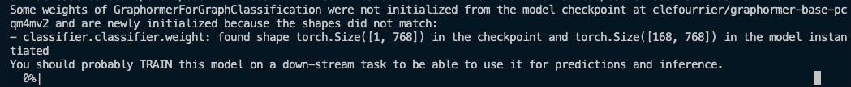
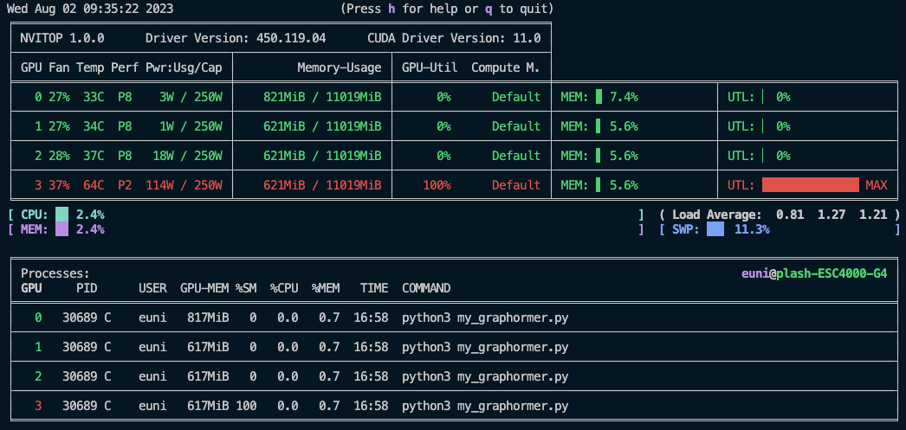

BUG
Still can’t start the training on my customized dataset
Write the training code be myself

Slide 11
TRAM

Slide 12
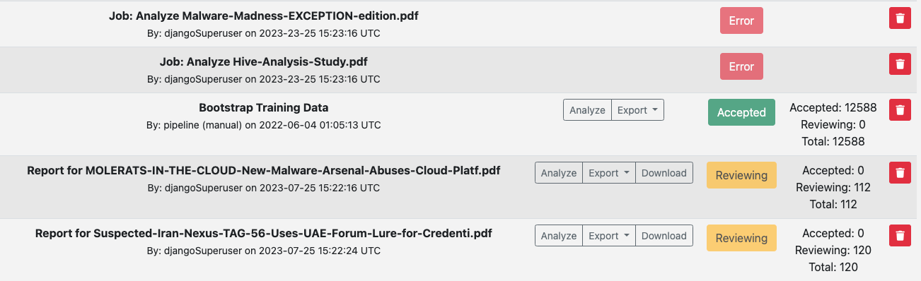

Automation
Successfully upload the pdf files
Successfully export the pdf files
Click 3 times and scroll 1/3 of the window size

Slide 13
Future Work

Slide 14
Future Work
GNN
Successfully train the GAT, GCN
Graphormer
Write the trainer(training part)
TRAM
Try to upload and export HTML files
Transfer them into labeled data

Slide 15
Thanks!!

Slide 16
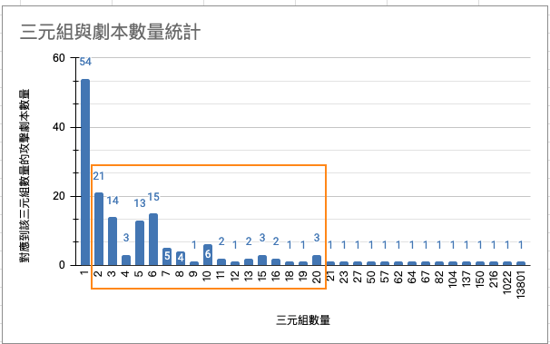
Appendix

