Slide 1
Progess of the Project
Vincent Pai
2023/7/26

Slide 2
Outline
Graphormer
Graph - Data Analysis
TRAM
Future Work

Slide 3
Graphormer

Slide 4
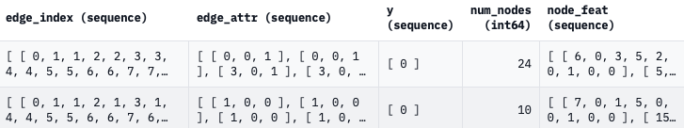
Data Format
A jsonl file:
Edge_index: contains the indices of nodes in edges, stored as a list containing two parallel lists of edge indices
Labels: list or an integer contain the corresponding techniques
Nodes_nums: total number of the nodes
Node_feat: contains the available features of each node (if present)
Edge_feat: contains the available features of each edge (if present)
Notes:
JSONL（JSON Lines）是一種用於存儲和傳輸結構化數據的文本格式。JSONL與JSON（JavaScript Object Notation）非常相似，但它使用每行一個JSON對象的方式來組織數據。
JSONL文件由多行文本組成，每行都是一個獨立的JSON對象。這種結構使得JSONL非常適合處理大型數據集，特別是當每個JSON對象都是獨立的時候。每個JSON對象可以包含不同的鍵值對，以描述數據的屬性。
Node_feat: for example, types (like different atoms in a molecule). Edge_feat: for example, types (like molecular bonds)

Slide 5
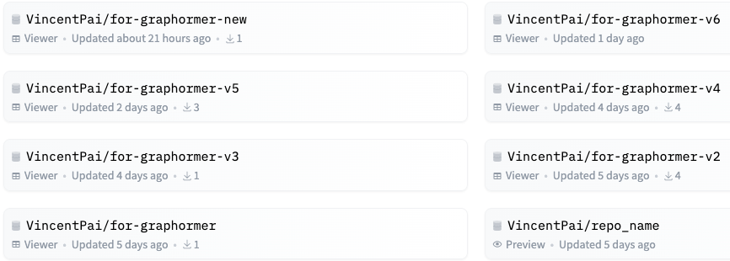
Data Format
Try to input the data with different format → tried 8 versions
My data version2
Notes:
Mapping出問題一堆

Slide 6
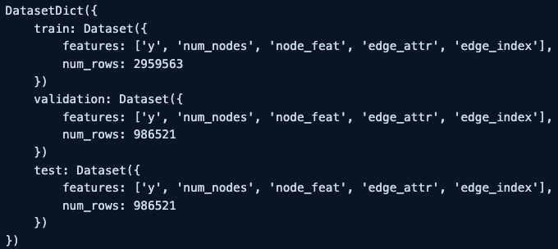
Data Format
Official format:
My last format:
y is label
Train:Validation:Test = 3:1:1

Slide 7
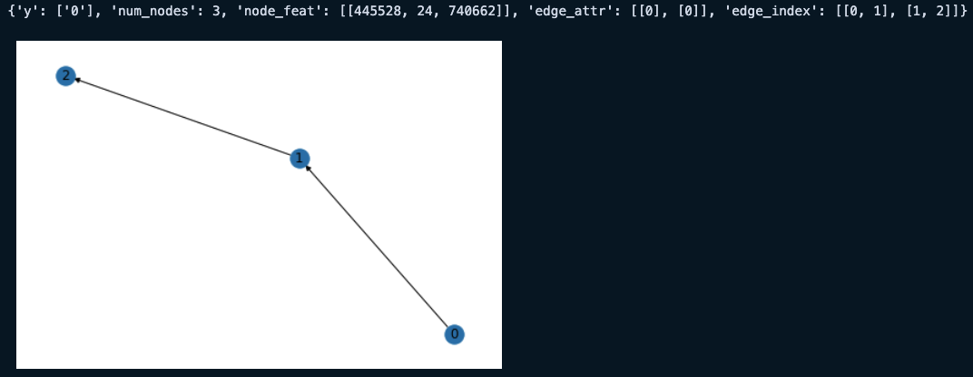
Data Format
My data in a Directed Graph:
Preprocessing

Slide 8
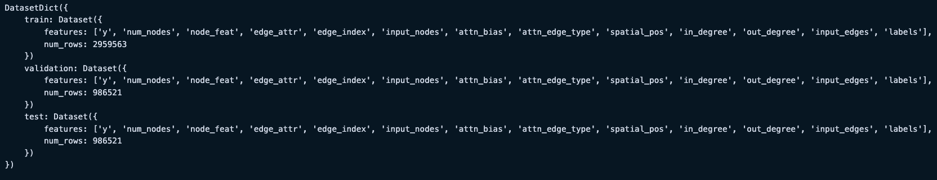
Data Format
My data after preprocessing:
Still has some BUGGGGGGGGs
File "/workdir/home/euni/anaconda3/lib/python3.9/site-packages/transformers/models/graphormer/collating_graphormer.py",
line 112, in __call__ batch["attn_bias"][ix, : f["attn_bias"].shape[0], : f["attn_bias"].shape[1]] = f["attn_bias"]
RuntimeError: The expanded size of the tensor (2) must match the existing size (4) at non-singleton dimension 1.
Target sizes: [2, 2]. Tensor sizes: [4, 4]
Notes:
attn_bias = np.zeros([num_nodes + 1, num_nodes + 1], dtype=np.single) # with graph token
item["attn_bias"] = attn_bias # in our case, it will be 4x4 tensor with element 0

Slide 9
Graph - Data Analysis

Slide 10
Target
Constructing the directed graph of every Attack Patterns (167 APs)
Connecting the source and the destination
Recording the # of relations with the same source and destination
Exclude T1046_5a4 (1022 triplets) and T1005_720 (13801 triplets)
Final result would contain 165 Aps
Connecting all the related neighbor nodes in a single hop
Labelling them with different color

Slide 11
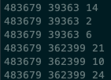
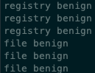
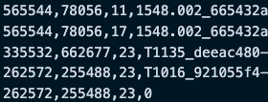
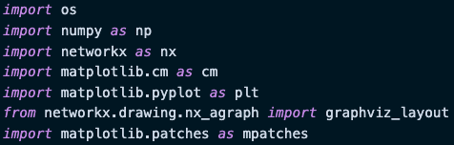
Data Preprocessing
Src, Dest, Rel, Label
Benign → set to 0
Filtering the T1046_5a4 and T1005_720
Packages be used in my graphing.ipynb

Slide 12
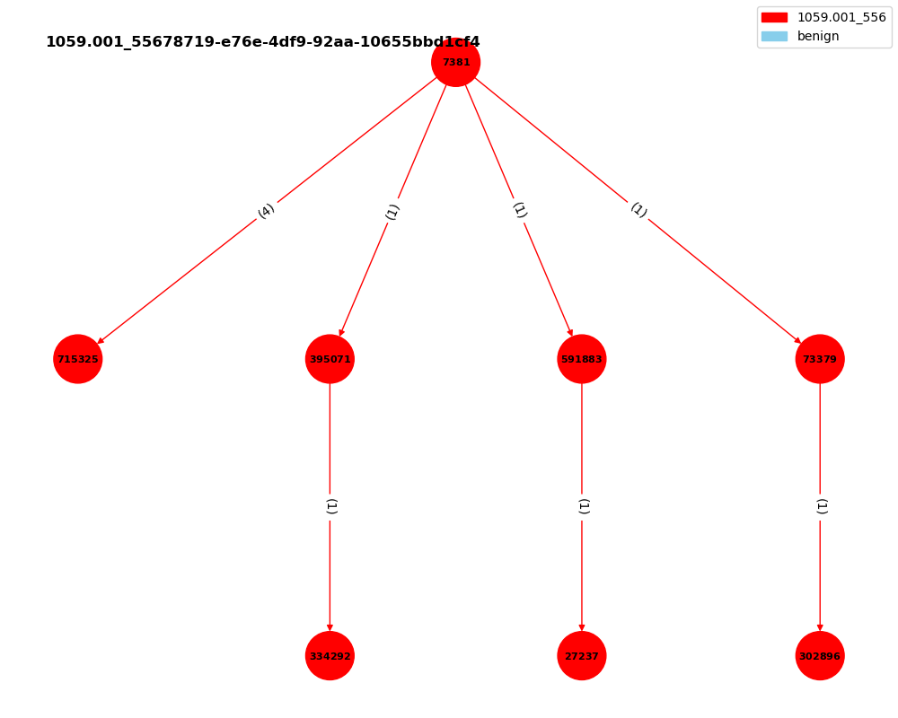
Example 1
Main graph is red
Number on the edges is the # of the relations in the pair
No other related AP nodes
No other related benign nodes

Slide 13
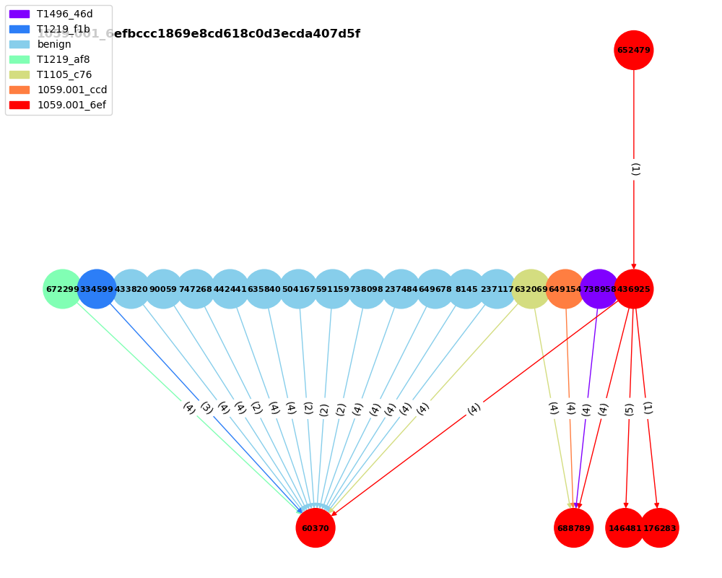
Example 2
Main graph is red
Number on the edges is the # of the relations in the pair
12 related benign nodes
Other 5 related Aps

Slide 14
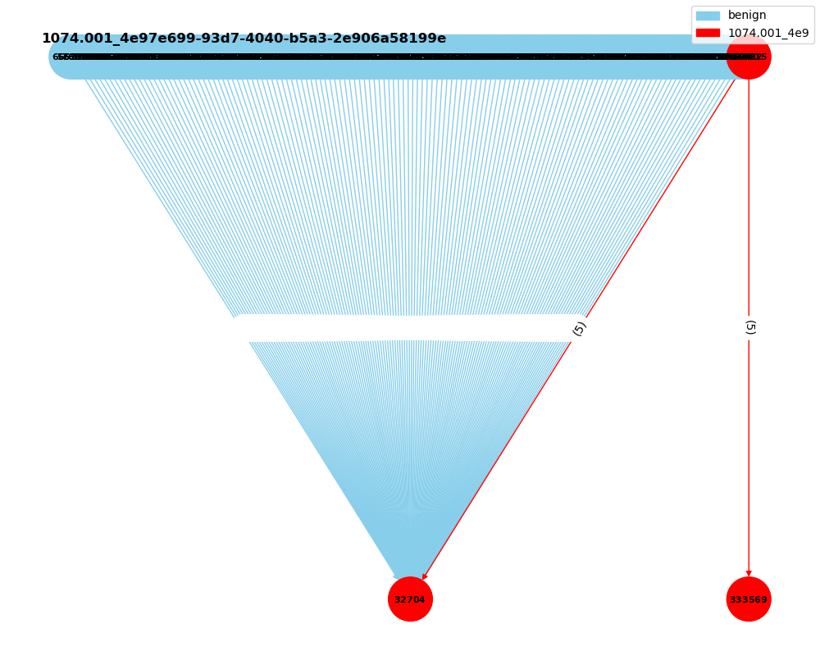
Example 3
Main graph is red
Number on the edges is the # of the relations in the pair
A lot of related benign nodes
No related Aps

Slide 15
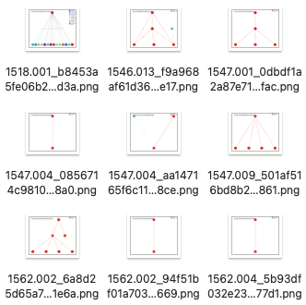
Overall
Many of them have no neighbor nodes.

Slide 16
TRAM

Slide 17
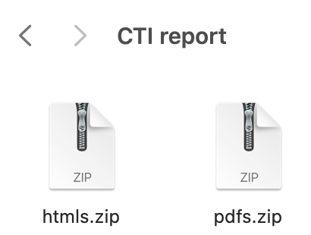
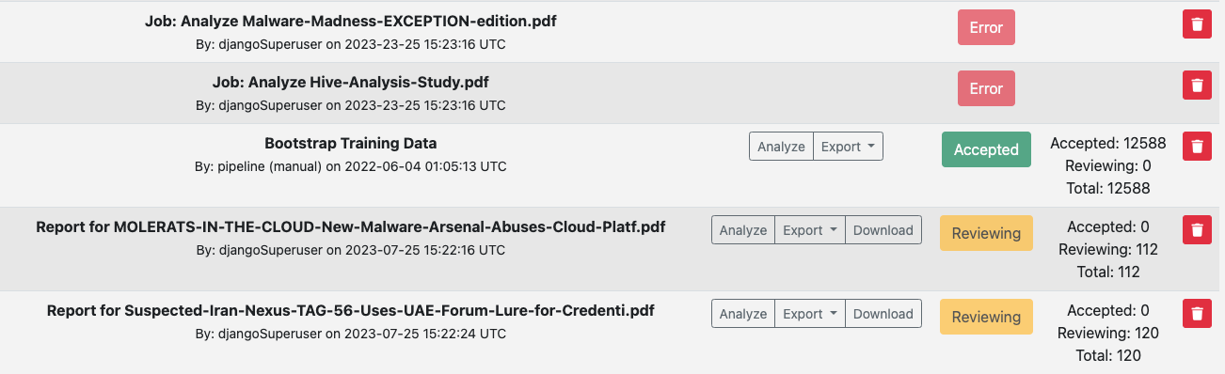
Data Format
PDFs (2.16 GB):
Successfully uploaded: 111 files
Unsuccessfully uploaded: 19 files
Haven’t exported
HTMLs (15.94 GB):
I haven’t tried
Maybe directly try on the USB

Slide 18
Future Work

Slide 19
Future Work
Graph - Data Analysis
Tackle the extreme cases
Trace back to more than one hop (till the end)
Different entity with different shape
Graphormer
Input the data
Train the model
TRAM
Figure out the reasons for the errors
Try to export
Try HTMLs

Slide 20
Thanks!!

