Slide 1
Discussion of the Project
Tsung-Min Pai
2023/12/11

Slide 2
Outline
Issue
Recap
Input Format
Model Design
Observation
Experiments
Oversampling
Change the Dataset
Predict More Labels
DARPA Format

Slide 3
Issue

Slide 4
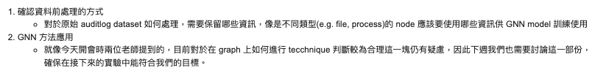
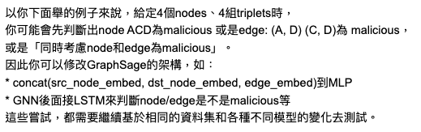
Issue
英仁學長：
黃老師：
benign
B
A
Change apply edge at p9?
Malicious
benign
D
Malicious
C
Still predict the triplet doesn’t it?
Notes:
考慮node type, 不要只考慮uuid。
增加accuracy
試試看不同的 model -->
以後再做 --> 黃老師的部分（一月後）

Slide 5
Recap

Slide 6
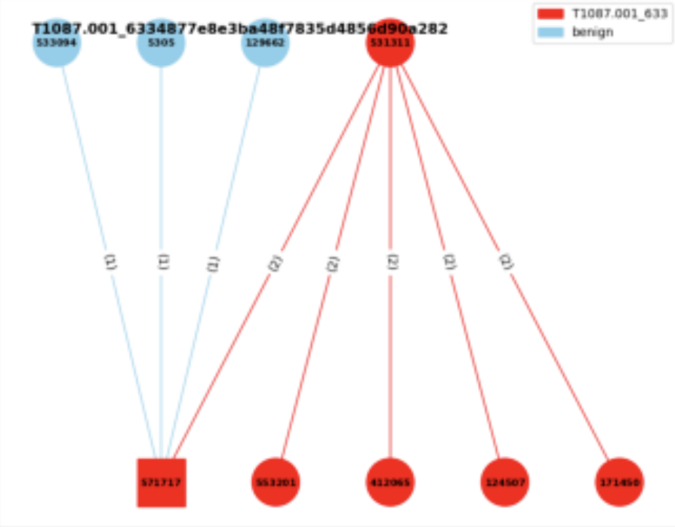
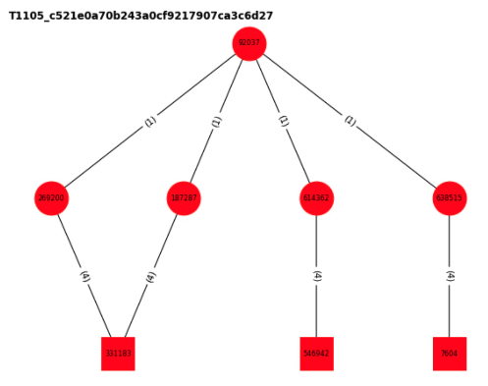

Input Format
Each data is a graph → label the triplets with the benign or the specific AP
Consider the nodes and the edges
benign
T1003.001
Format in experiment 3:
Edge classification
# of labels = # of edges
Source txt file:
a means attack pattern
b means benign
This is the same format how I handle the DARPA dataset now

Slide 7

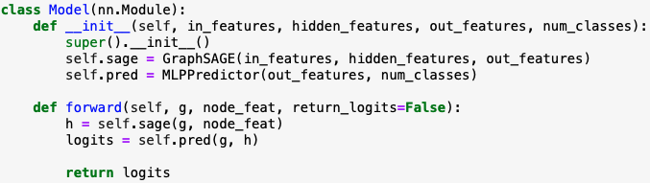
Model Design
Concept from the DGL official website:
Let the dgl graph’s edge data have the attribute: edata[“label”]
Use GraphSAGE model to get the new node embedding
Use MLP model to get the ‘score’ of the edge
Concatenate these two models
Train the final model

Slide 8
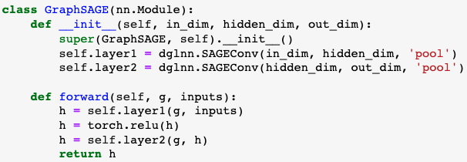
Model Design
Let the dgl graph’s edge data have the attribute: edata[“label”]
Use GraphSAGE model to get the new node embedding
Use MLP model to get the ‘score’ of the edge
Concatenate these two models
Train the final model
Originally is the embedding based on the Trans Family or SecureBert
→ After step2. all the nodes’ embedding would be updated
Notes:
換其他的embedding方法試試看

Slide 9
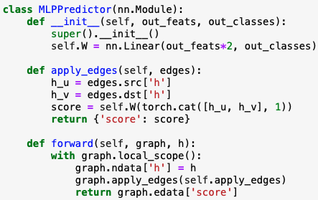
Model Design
Let the dgl graph’s edge data have the attribute: edata[“label”]
Use GraphSAGE model to get the new node embedding
Use MLP model to get the ‘score’ of the edge
Concatenate these two models
Train the final model
Each time would choose an edge and get the source and destination node.
→ Use updated node embedding to ‘score’ the edge
Update the node embedding
Notes:
加上edge embedding -> relation重要
secureBERT 繼續試
改一下 one hot?

Slide 10
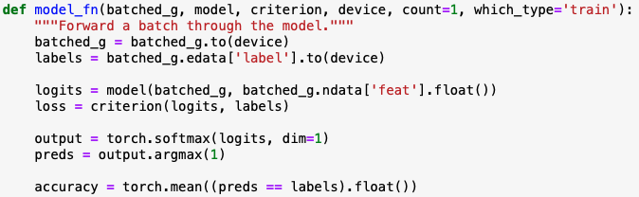
Model Design
Let the dgl graph’s edge data have the attribute: edata[“label”]
Use GraphSAGE model to get the new node embedding
Use MLP model to get the ‘score’ of the edge
Concatenate these two models
Train the final model
Get the new node embedding
Use the new node embedding to predict the edge
Batched graph we feed into the model
I do not use the original edge embedding → may be a problem?
Notes:
這個`MLPPredictor`模型是用於邊預測或稱為鏈接預測的。鏈接預測的目的是預測兩個節點之間是否存在邊。這是圖學習中的一個重要任務，被應用於許多領域，例如社交網絡中的好友推薦或蛋白質互作網絡的互作預測。
1. **初始化 (`__init__` 方法)**:
- 定義一個全連接線性層`self.W`，其輸入特徵的大小是 `in_features * 2`。這是因為我們將來源節點`h_u`和目標節點`h_v`的表示向量拼接起來，所以尺寸變為雙倍。
- 輸出的尺寸是 `out_classes`，這對應於邊的類別數量。
2. **apply_edges 方法**:
- 這個方法的作用是為圖中的每一條邊計算一個'score'。這個'score'可以被解釋為邊的類別。
- 它首先從圖中提取來源節點`h_u`和目標節點`h_v`的表示向量。
- 接著，它將這兩個表示向量拼接起來，並通過`self.W`線性層計算'score'。
3. **前向方法 (`forward`)**:
- 接收一個圖和它的節點表示`h`。
- 它將這些節點表示設定為圖的節點數據。
- 使用`apply_edges`方法為圖中的每一條邊計算一個'score'。
- 返回邊的'score'。
總之，`MLPPredictor`使用來源和目標節點的表示計算圖中每一條邊的'score'，這些'score'可以用於邊的預測任務。

Slide 11
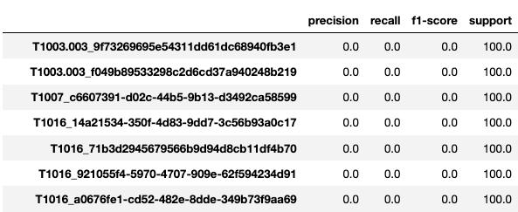

Observation
Current Problem:
Can’t predict the edge in the small graphs consist of single triplet

Slide 12
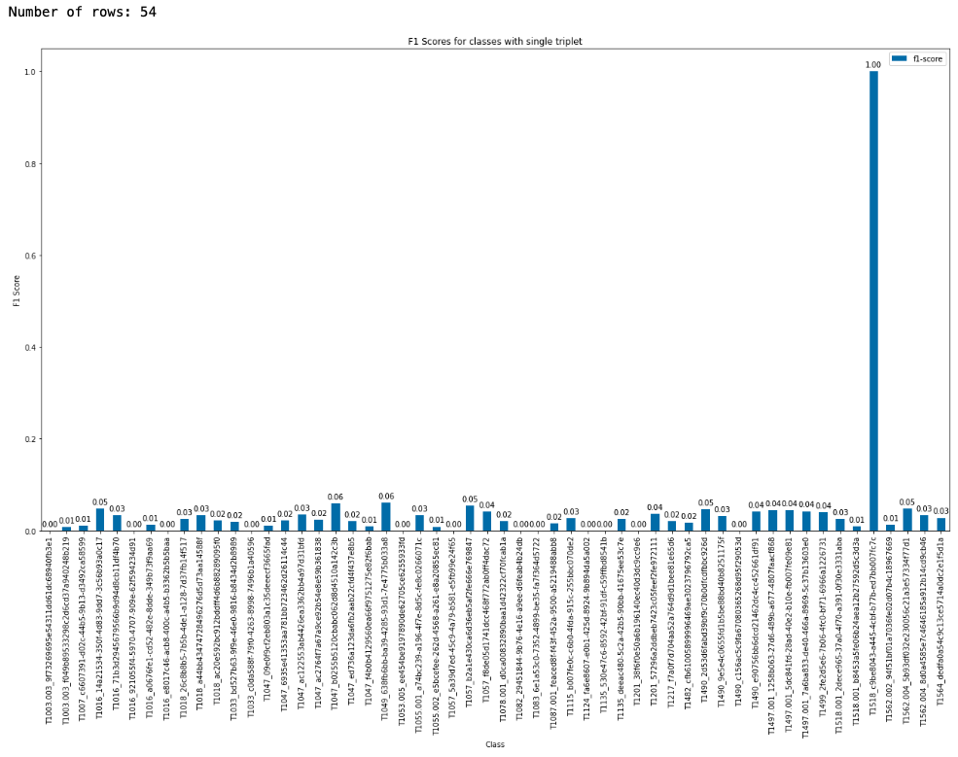
Observation
Prediction of single triplet case:
T1518_c9b (well predicted one)

Slide 13
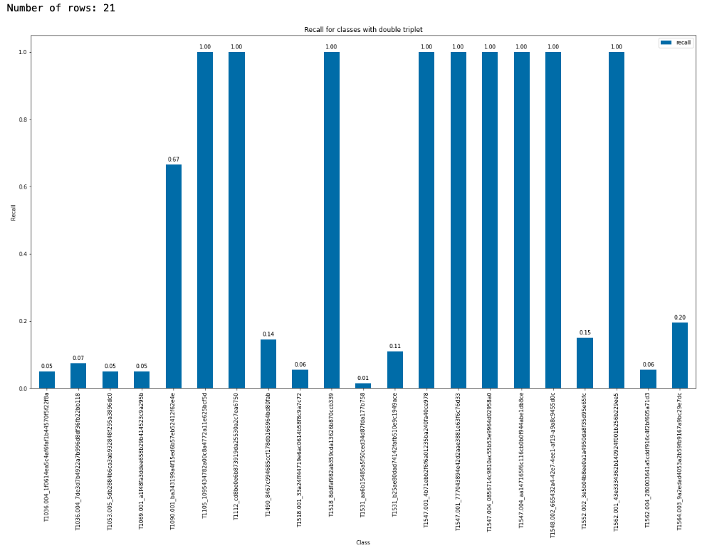
Observation
Prediction of double triplet case:
Notes:
看一下預測好的都是哪一些tactics

Slide 14
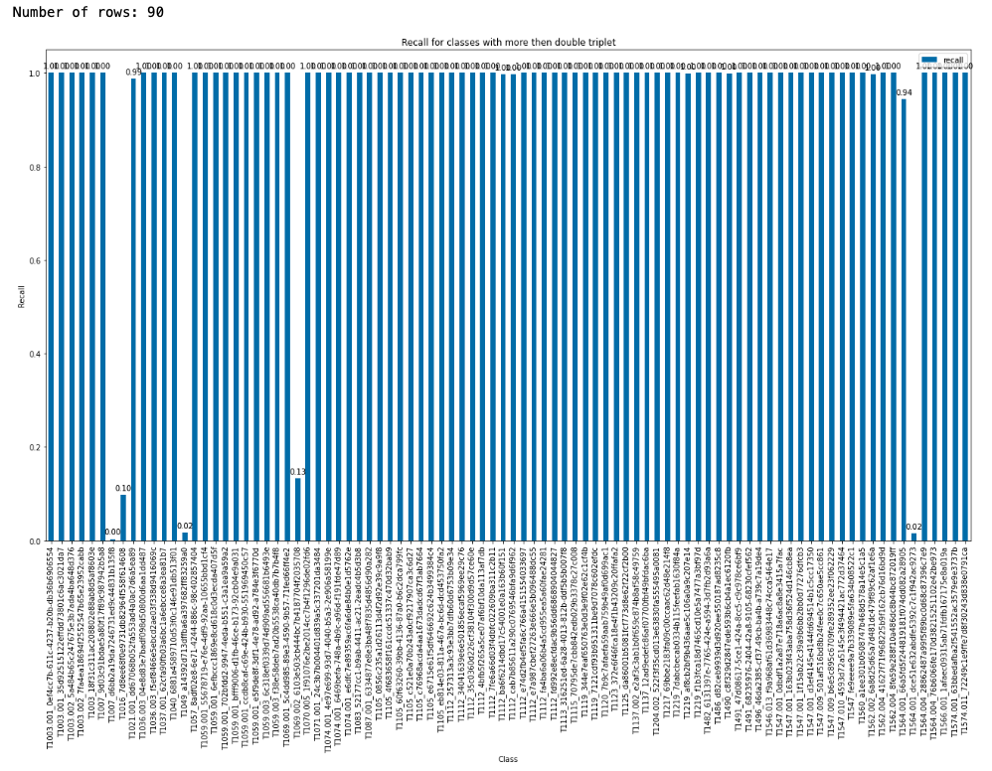
Observation
Prediction of more triplet case:

Slide 15
Experiments

Slide 16
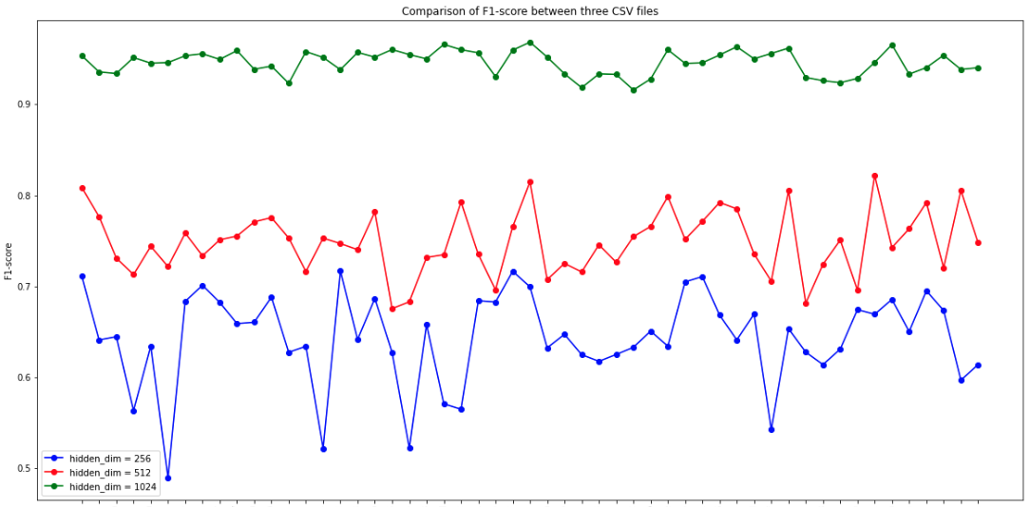
Oversampling
Previous Trial: hope to see the result on training dataset
Use data with 320 times single triplet → # of training data = 13657600
Larger hidden dimension → more neurons to remember the data
Let the model overfit first → Succeed → But not generalized in the testing set
Haven’t try the GraphSMOTE yet

Slide 17
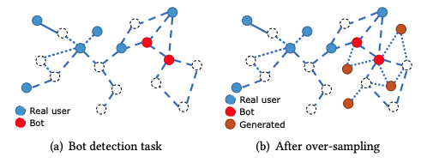
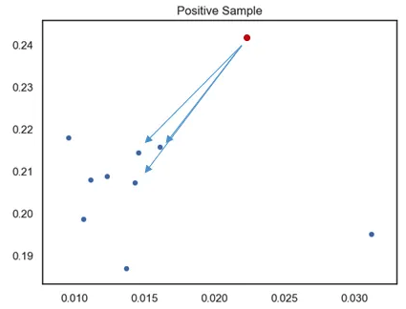
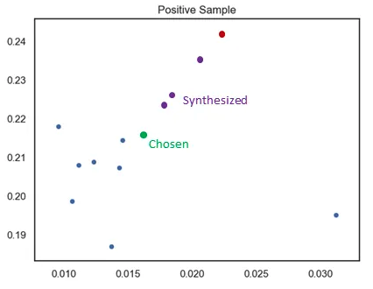
GraphSMOTE
Task:
Synthesized Minority Oversampling Technique (SMOTE)
Used on i.i.d. data
Doesn’t consider the structure of the graph
No edge connection between the nodes
K=3
N=3
Notes:
設定一個採樣倍率 N，也就是對每個樣本需要生成幾個合成樣本
設定一個近鄰值 K ，針對該樣本找出 K 個最近鄰樣本並從中隨機選一個
根據以下公式來創造 N 個樣本

Slide 18
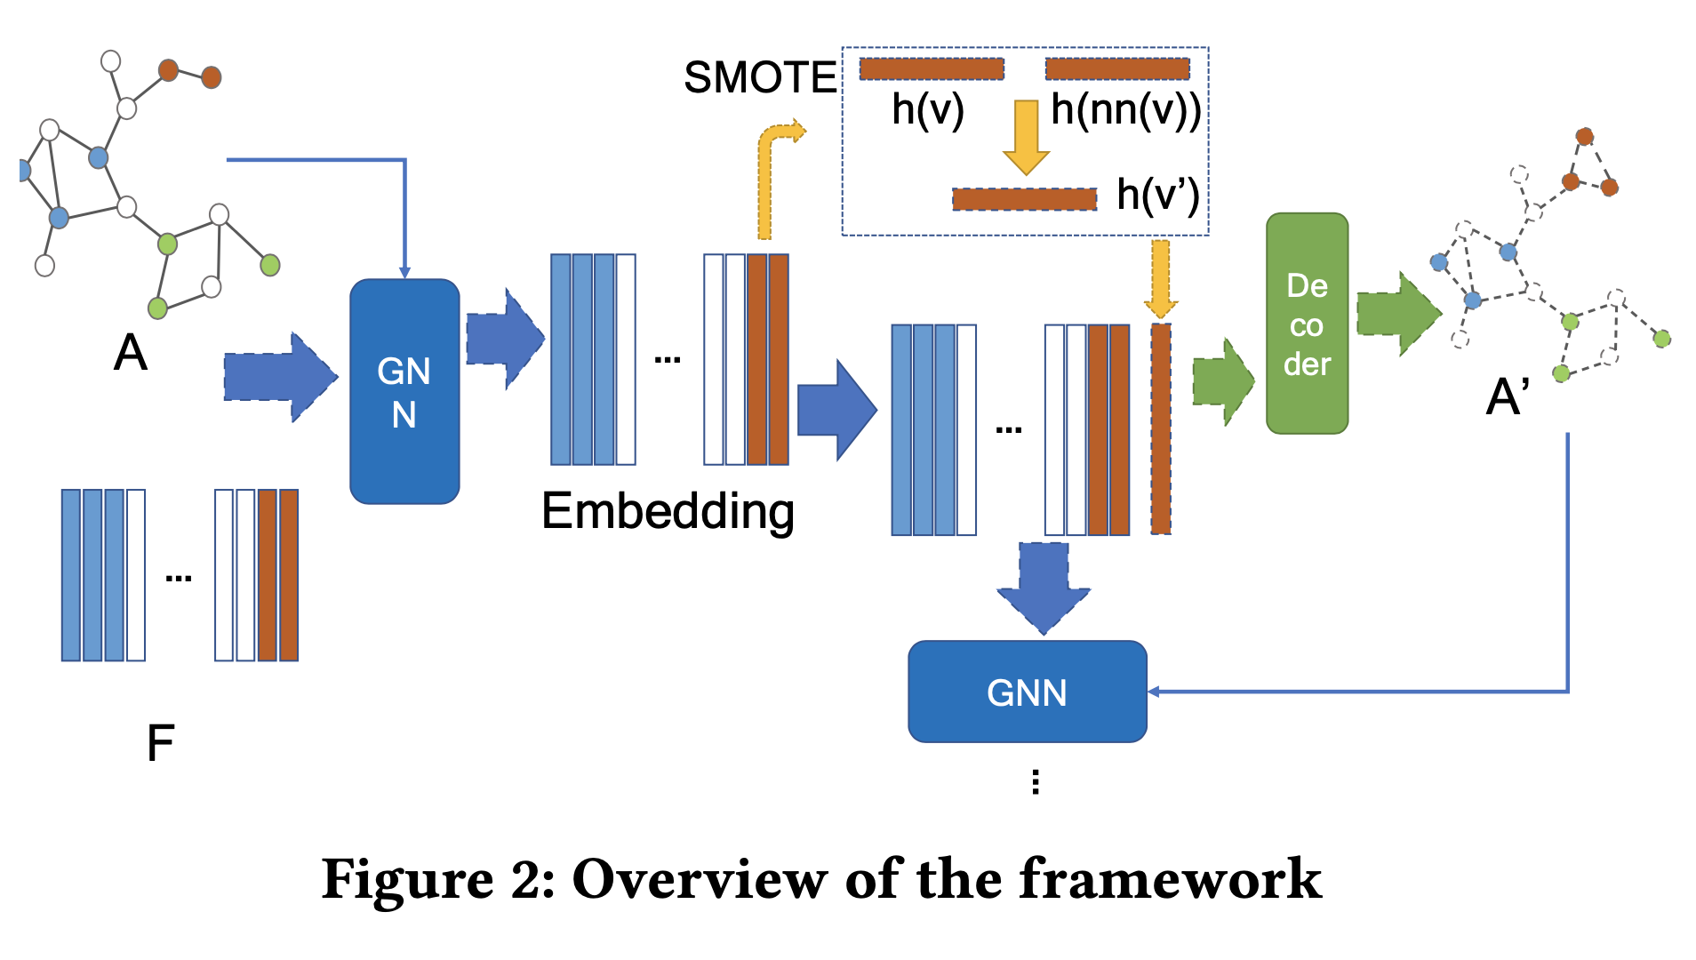
GraphSMOTE
Framework
a GNN-based feature extractor
→ Use GraphSAGE
Synthetic Node Generation
→ Use SMOTE algorithm
Edge Generator
→ weighted inner product decoder
GNN Classifier (downstream task)
Notes:
設定一個採樣倍率 N，也就是對每個樣本需要生成幾個合成樣本
設定一個近鄰值 K ，針對該樣本找出 K 個最近鄰樣本並從中隨機選一個
根據以下公式來創造 N 個樣本

Slide 19
Thought
To observe the real distribution of the prediction
Figure out what the model really predict about
Do some further experiments based on the distribution of the prediction
Remove popular labels
Top3, Top5…
Figure out why the T1518_c9b is so well predicted
So I plot the distribution of the prediction of the single triplet cases:

Slide 20
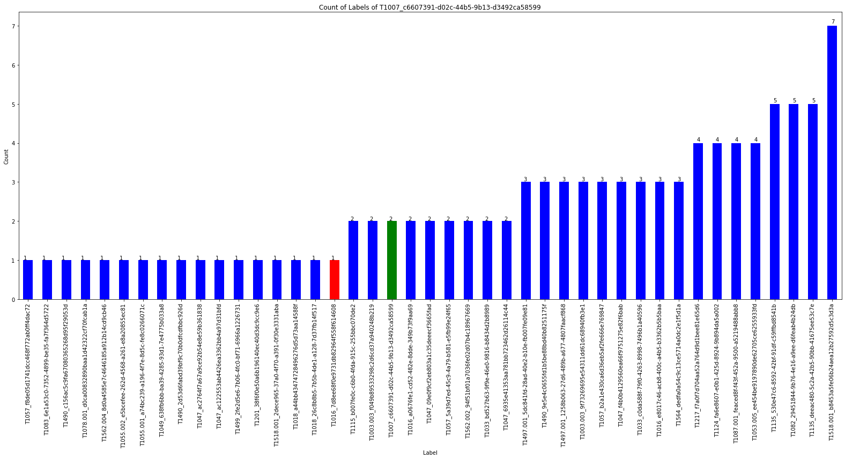
Red: non-single triplet edge
Blue: single triplet edge
Green: itself

Slide 21
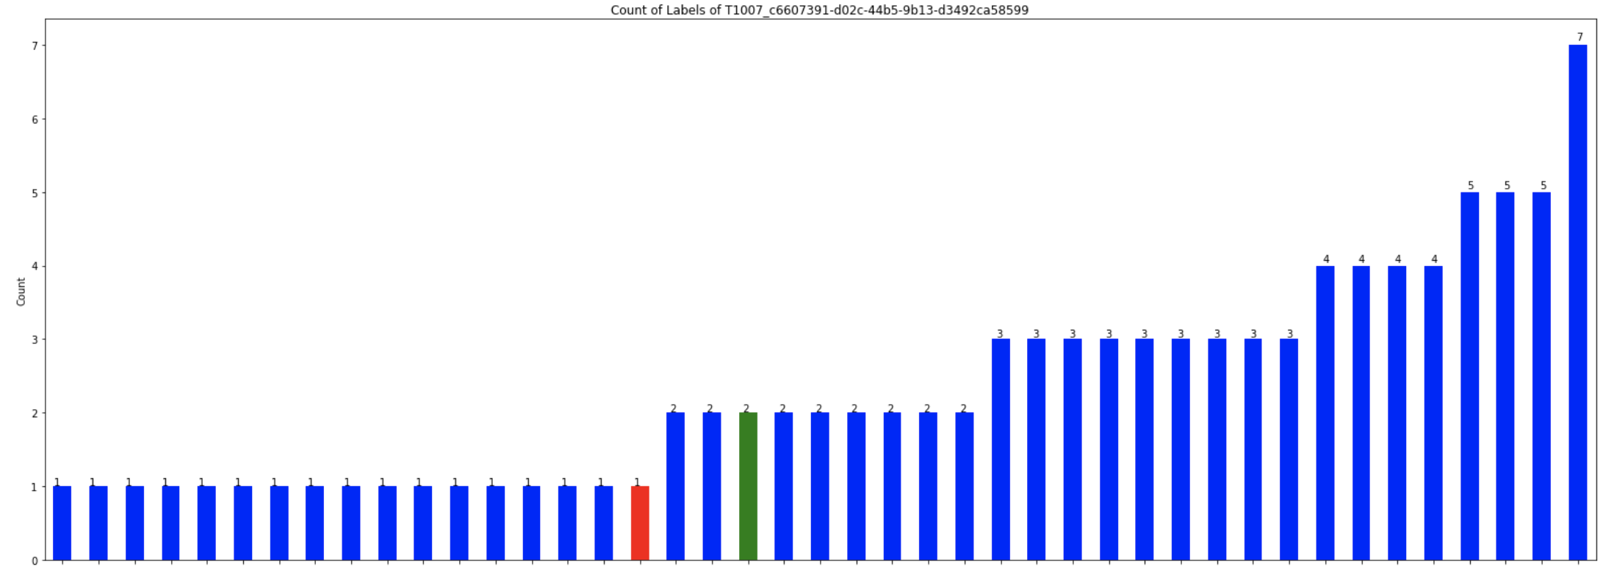
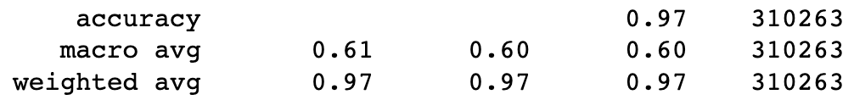
Observation of the Prediction
Use the original training set
The distribution of the prediction is so sparse
Most of the predictions are like this:
Red: non-single triplet edge
Blue: single triplet edge
Green: itself
Labels

Slide 22
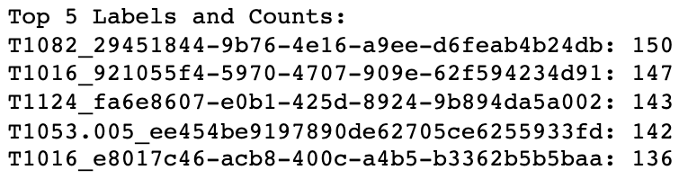
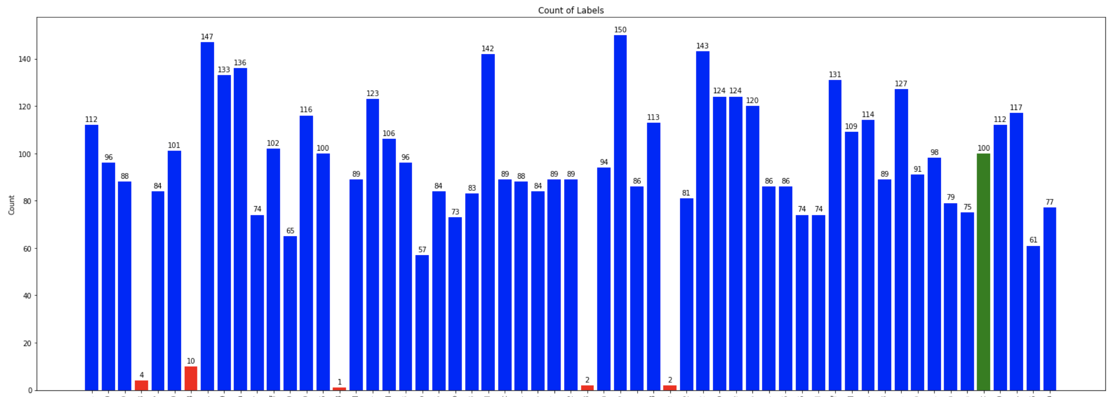
Observation of the Prediction
The # of the predicted labels
T1016
T1047
T1518_c9b (well predicted one)
T1490

Slide 23
Experiment – Change the Dataset

Slide 24
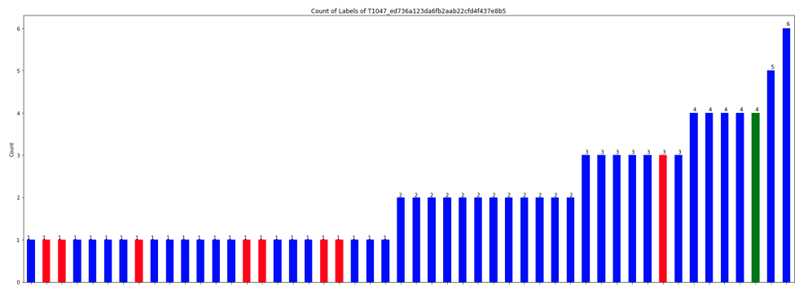

Observation of the Prediction
Remove the TTPs with support > 1000 (Removed 32 TTPs)
The predictions on the single triplet cases are still a mess
Red: non-single triplet edge
Blue: single triplet edge
Green: itself

Slide 25
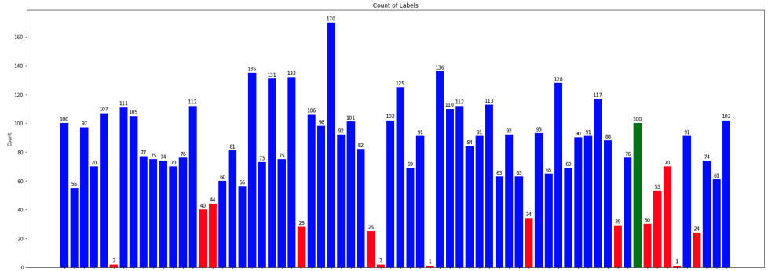
Observation of the Prediction
T1518_c9b (well predicted one)

Slide 26
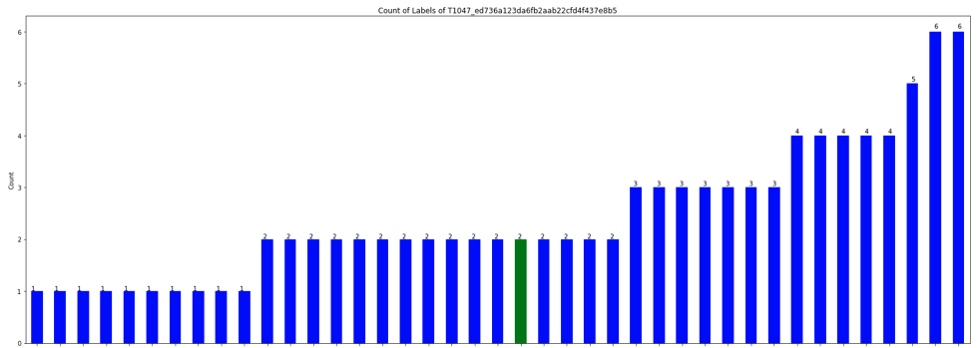

Observation of the Prediction
Only use the single triplet (support=100) cases:
Still messy and even have a worse performance

Slide 27
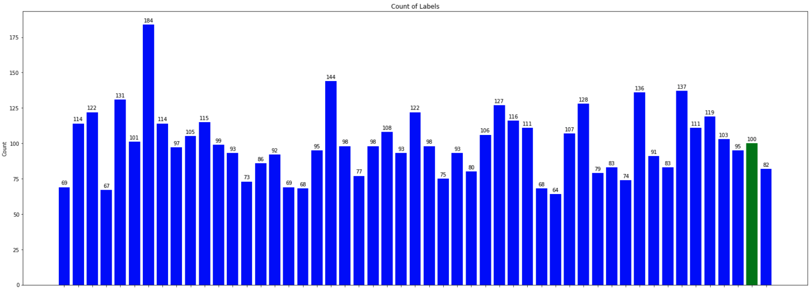
Observation of the Prediction
T1518_c9b (well predicted one)

Slide 28
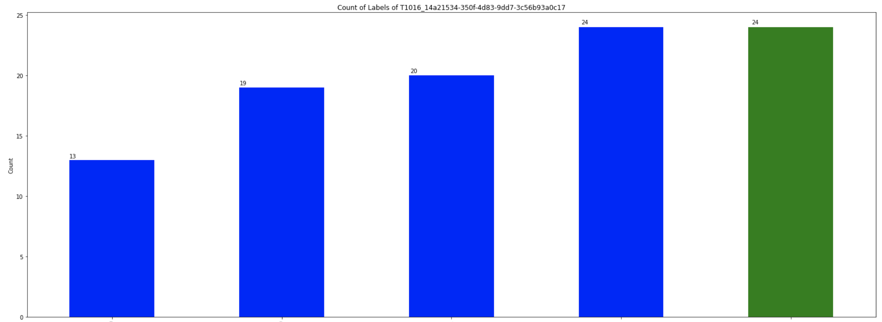
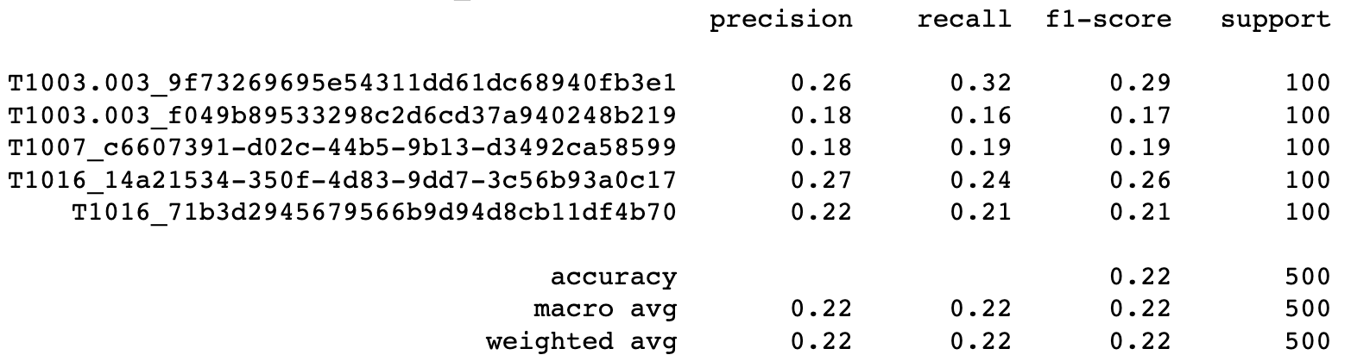
Observation of the Prediction
Dataset only has the 5 single triplet labels

Slide 29
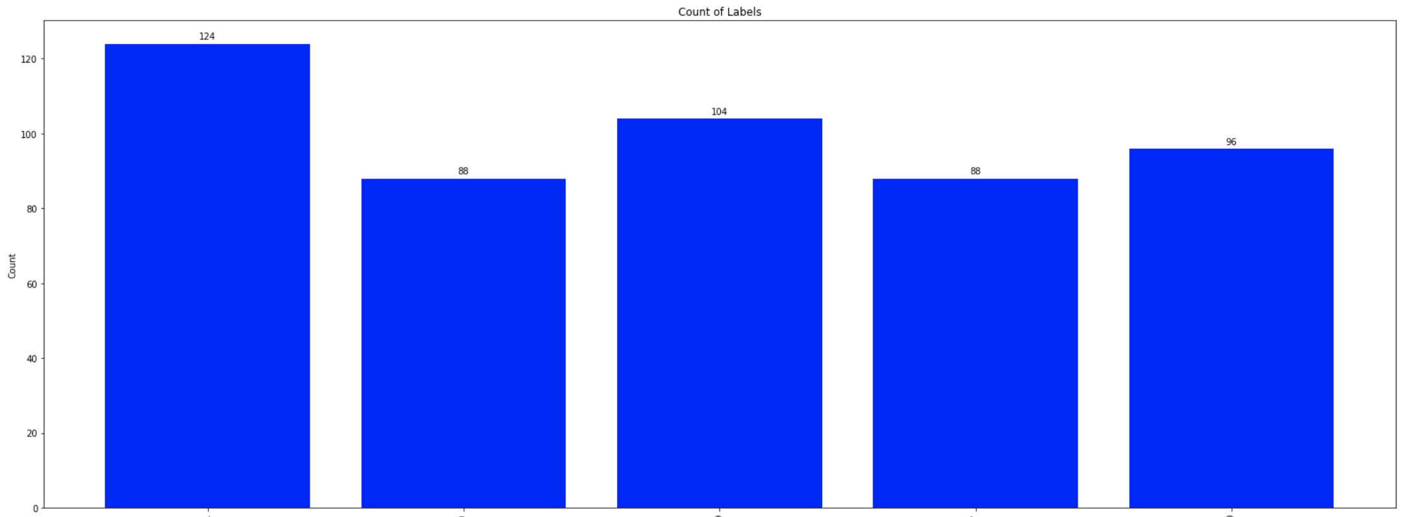
Observation of the Prediction

Slide 30
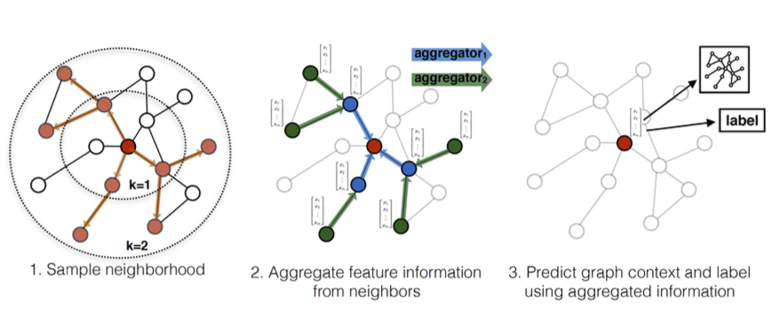
Conclusion
GraphSAGE really have a bad performance on the isolated triplet case
Even training dataset consists of isolated triplet case only
Even training dataset consists of only 5 isolated triplet cases
Possible Reason:
Lack of Neighborhood Information: GraphSAGE aggregates features from a node's local neighborhood to learn its representation. In the case of isolated triplets, each node has very limited neighborhood information (only one neighbor), which restricts the model's ability to learn complex or rich representations
Visual illustration of the GraphSAGE
sample and aggregate approach:

Slide 31
Experiment – Predict More Labels

Slide 32
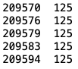


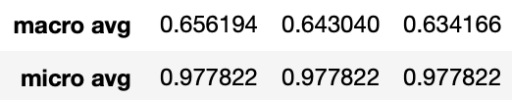
Predict the Top 3
Thought:
The experts can use the DL prediction and combine with their expertise to make the final prediction
Prediction Format:
Predict the top 3 classes of the edge
True: Predicted:
Performance:
Row Label
Row Labels
Previous one:
Notes:
把這邊的triplet predict diagram畫出來 下禮拜報

Slide 33



Predict the Top 5
Prediction Format:
Predict the top 5 classes of the edge
True: Predicted:
Performance:
Row Label
Row Labels
Previous one:
Version of top3:

Slide 34
Experiment – DARPA

Slide 35
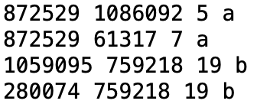
Change the DARPA
Original Format:
{"subj": {"uuid": "F9F5DC58-9431-4519-82CF-2BBFF40796E9", "type": "Subject", "n_attrbiute": {"cmdline": "None", "type": "SUBJECT_THREAD", "pid": 8920}}, "relation": "EVENT_WRITE", "obj": {"uuid": "F5D43721-2AD3-487C-B3DA-0A5D551FAE0D", "type": "FileObject", "n_attrbiute": {"filepath": "\\Device\\HarddiskVolume2\\ProgramData\\Microsoft\\Windows Defender\\Network Inspection System\\Support\\NisLog.txt"}}, "timestamp": 1523295276588000000, "label": "benign"}
Final Format:
Encode the subj uuid, relation, obj uuid and combine them with the label
Keep the mapping information into 2 mapping file
a is attack; b is benign
Successfully run the code → preprocessing the data now
src dest rel label
Notes:
secureBERT有考慮

Slide 36
Future Work
Notes:
1. 跑完MLP, RNN, GNN
知道euni的code
2. realtion -> one hot or other method
concat -> embedding 的長度(768 -> 50...)
edge feature -> 一定要加上去
euni的embedding如何搞的 -> 要看type
-> secureBERT
3. 新的 dataset 如何跑起來

Slide 37
Future Work
benign
A
B
Want the prediction like:
Not just predict the triplet
Predict a series of triplets
Graph classification?
Dataset?
Read the GraphSAGE paper and compare it to the GCN, GAT
Figure out why the model can detect the T1518_c9b (if available?)
Is the label overlap or not overlap at all with other labels
Figure out what the model really predict about
Observe the real data in the original form (before embedding) → overlapping?
Use the Trans Family to get the embedding of the DARPA dataset’s nodes and edges
Malicious
benign
Benign → for these 2 triplets
Malicious → for the whole graph
D
C
Malicious
Notes:
決定是and還是or 就標上attack → 跟老師討論
不要管triplet的限制

Slide 38
Future Work
跑完MLP, RNN, GNN → 知道euni的code怎麼跑
realtion → one hot or other method
concat → embedding 的長度(768 -> 50...)
edge feature → 一定要加上去
euni的embedding如何搞的 → 要看type → secureBERT
新的 dataset 如何跑起來 (2 weeks later)
Notes:
決定是and還是or 就標上attack → 跟老師討論
不要管triplet的限制

Slide 39
Thanks!!

Slide 40
Appendix

Slide 41
Future Work
Run the training of the DAPRA dataset
Read the GraphSAGE paper and present it
Figure out why the model can detect the T1518_c9b (if available?)
Is the label overlap or not overlap at all with other labels
Figure out what the model really predict about
Observe the real data in the original form (before embedding) → overlapping?

Slide 42
GraphSMOTE: Imbalanced Node Classification on Graphs with Graph Neural Networks
WSDM ’21, March 8–12, 2021, Virtual Event, Israel
Tianxiang Zhao, Xiang Zhang, Suhang Wang
{tkz5084,xzz89,szw494}@psu.edu College of Information Science and Technology, Penn State University State College, The USA
https://github.com/TianxiangZhao/GraphSmote
Notes:
Arxiv 引用 190
WSDM 引用193
https://scholar.google.com.tw/scholar?q=Tianxiang+Zhao,+Xiang+Zhang,+Suhang+Wang&hl=zh-TW&as_sdt=0&as_vis=1&oi=scholar

Slide 43
Model Design
Concept from the DGL official website:
Let the dgl graph’s edge data have the attribute: edata[“label”]
Use GraphSAGE model to get the new node embedding
Use MLP model to get the ‘score’ of the edge
Concatenate these two models
Train the final model
For Node Embedding:

Slide 44
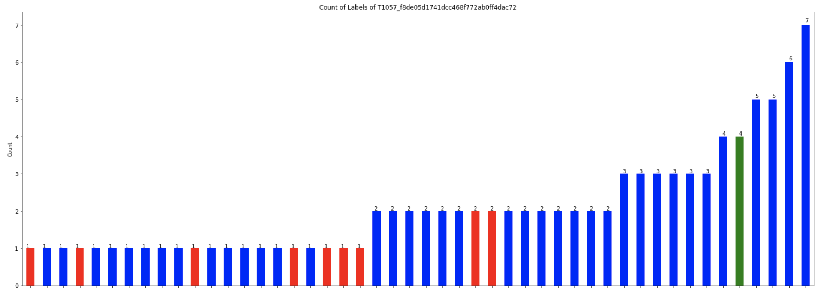
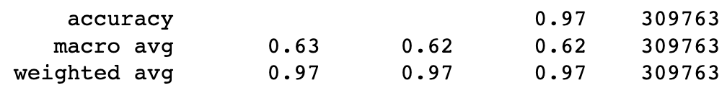
Remove the Popular TTPs
Remove these 5 TTPs from the dataset and then train it again:
More prediction on the non-single triplet case is like this:

Slide 45
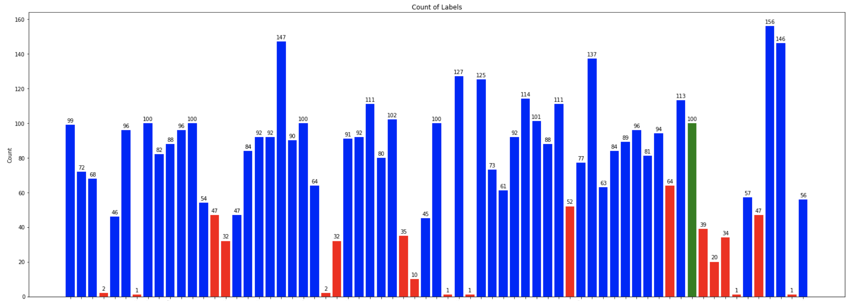
Remove the Popular TTPs
Remove these 5 TTPs from the dataset and then train it again:
The # of the predicted labels

Slide 46
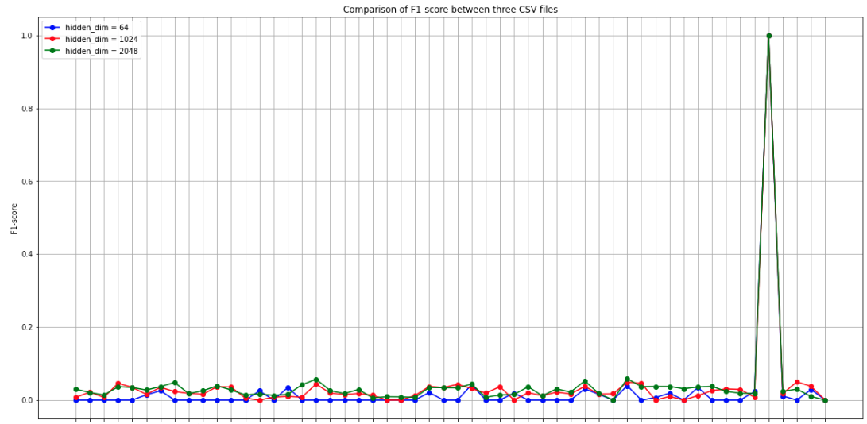
Observation on Different Dimension
T1518_c9b…

Slide 47
Experiment 3
Experiment 3:
Consider the neighbor benign nodes
Edge classification
Given a graph → label the triplets
with the benign or the specific AP
benign
T1003.001

Slide 48
NOTE!!

Slide 49
NOTE of the meeting with Prof. Huang
Want the prediction like:
Demonstrate how I do the classification clearly to the team
Input: whole graph
Prediction: Triplet by triplet
Why GraphSAGE?
Compare to GCN, GAT
What’s the mathematic implementation of the model → paper
benign
B
A
Benign → for these 2 triplets
Malicious → for the whole graph
Malicious
benign
D
Malicious
C

Slide 50
NOTE from Prof. Sun
每次都要再複習一下問題點
Show 以前的數據等等
為何要做現在這個實驗
圖表要清楚一點
X and Y-axis
給的example要是真的有解決那個問題的example

