Slide 1
Paper Review: Vivisecting Mobility Management in 5G Cellular Networks
SIGCOMM 2022
Presenter: Sheng-Ru Zeng

Slide 2
Outline
Ⅰ. Background
Ⅱ. Tools and Methods
Ⅲ. Observations
Ⅳ. Handover Prediction
Ⅴ. Conclusions

Slide 3
Ⅰ. Background

Slide 4
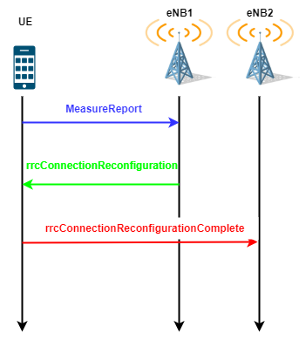
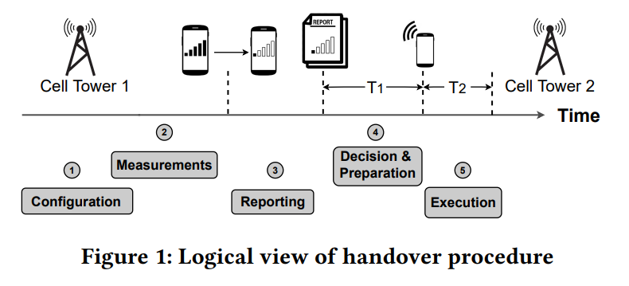
Mobility Management
UE in RRC connected mode use handover (HO) to complete mobility management.

Slide 5
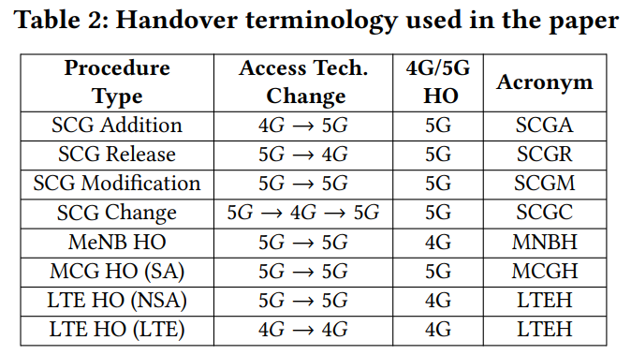
5G Handovers (1/2)
The 5G HOs observed in the paper is similar to our observations on the Taipei MRT.
HO Type | Description
eNB Handover | (eNB1) -> (eNB2)
MN HO with SN unchanged | (eNB1, gNB) -> (eNB2, gNB)
MN HO to eNB | (eNB1, gNB) -> (eNB2)
SN setup | (eNB) -> (eNB, gNB)
SN release | (eNB, gNB) -> (eNB)
SN HO | (eNB, gNB1) -> (eNB, gNB2)

Slide 6
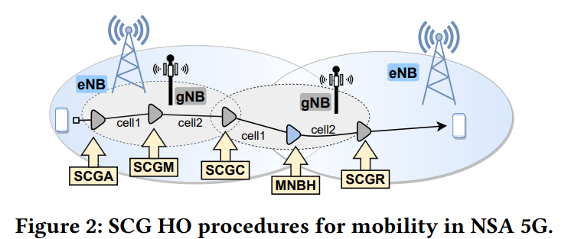
5G Handovers (2/2)
Both LTE eNB and 5G gNB have to handover under NSA architecture, resulting in more frequent handover.

Slide 7
Ⅱ. Tools and Methods

Slide 8
Tools
Tools | Purpose
5G specific APIs (Android TelephonyManager) | Identify the radio band (low-band vs. mmWave), geolocation, radio technology (4G/LTE vs. 5G), ping measurements, etc.
Samsung Galaxy S21 Ultra (S21U) and Samsung Galaxy S20 Ultra (S20U) | 5G UE devices.
Accuver XCAL | Read Qualcomm Diag message. Physical layer radio KPIs (e.g., PCI, RRS values) and RRC (such as HO commands, event configurations, measurement reports, etc.)
Monsoon Power Monitor | Power measurements.

Slide 9
Experiment Test
Application | Method
real-time volumetric video streaming | ViVo [40]
cloud gaming | Steam Remote Play
live video conferencing | Zoom
UDP/TCP Experiments | iPerf
[40] Bo Han, Yu Liu, and Feng Qian. 2020. ViVo: Visibility-aware mobile volumetric video streaming. In Proceedings of the 26th Annual International Conference on Mobile Computing and Networking. 1–13.

Slide 10
Ⅲ. Observations

Slide 11
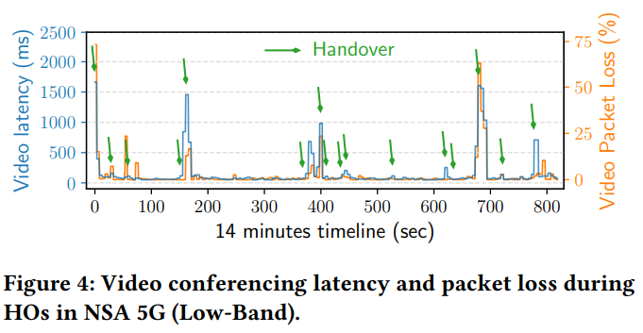
App QoE - Live Video Conferencing
The average latency is 2.26× higher compared to no-handover periods (up to 14.5× higher in the worst case). Likewise, the average packet loss rate increases by 2.24×.

Slide 12
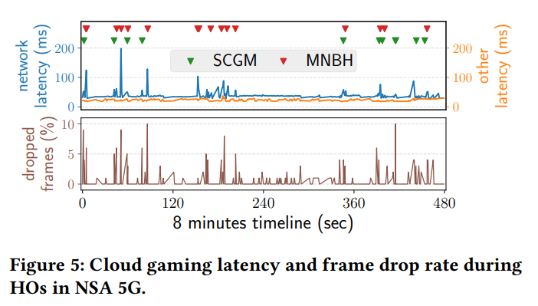
App QoE - Real-time Cloud Gaming
The network latency increases by an average 2.26× (up to 14.5×) during HOs.
SCGM have lower impact on the QoE than NSA-4C HOs, MNBH.
Since SCGM only involves a HO between gNB, whereas MNBH changes the eNB PCell, the QoE degradation of SCGM is relatively less than MNBH.

Slide 13
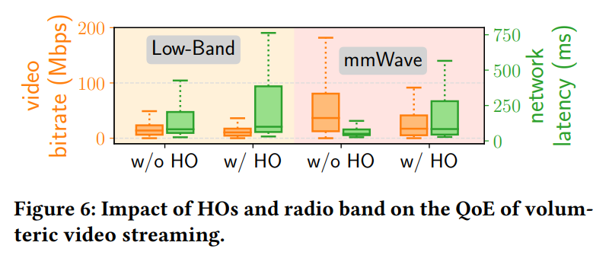
App QoE - Volumetric Video Streaming
Although low-band HOs result in a lower video quality, the degradation is significantly higher for mmWave HOs.
The results suggest that the level of QoE fluctuation under mobility is determined by a combination of HO type, radio access technology, and radio frequency band.

Slide 14
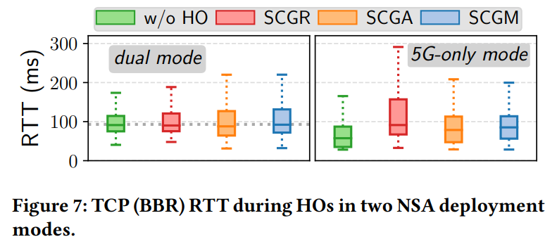
5G-only vs. Dual traffic mode in NSA
A dual mode (MCG Split bearer) splits the traffic across both 4G and 5G; the 5G-only mode employs the 5G interface for all data traffic (SCG bearer).
5G-only mode results in a comparatively lower RTT than dual mode when there is no HO (w/o HO case).
The median RTT does not change significantly during HOs in dual mode, whereas the 5G-only mode does, as 5G-NR HO interruptions do not impact 4G radio.

Slide 15
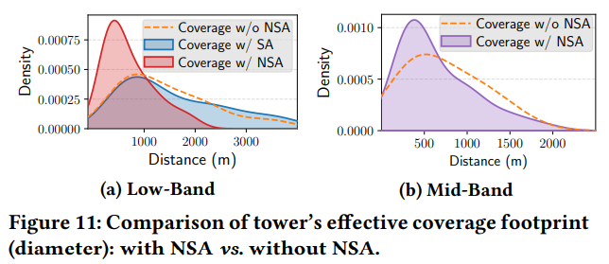
Handover Frequency
NSA 5G HOs are triggered every 0.4 km on average, in contrast to every 0.6 km for 4G HOs. (NSA uses 4G as control plane and 5G as data plane, both NSA-4C and 5G-NR HOs are triggered on the UE.)
SA 5G experiences an HO every 0.9 km.
mmWave 5G sees a HO every 0.13 km, mid-band every 0.35 km, and low-band every 0.4 km.

Slide 16
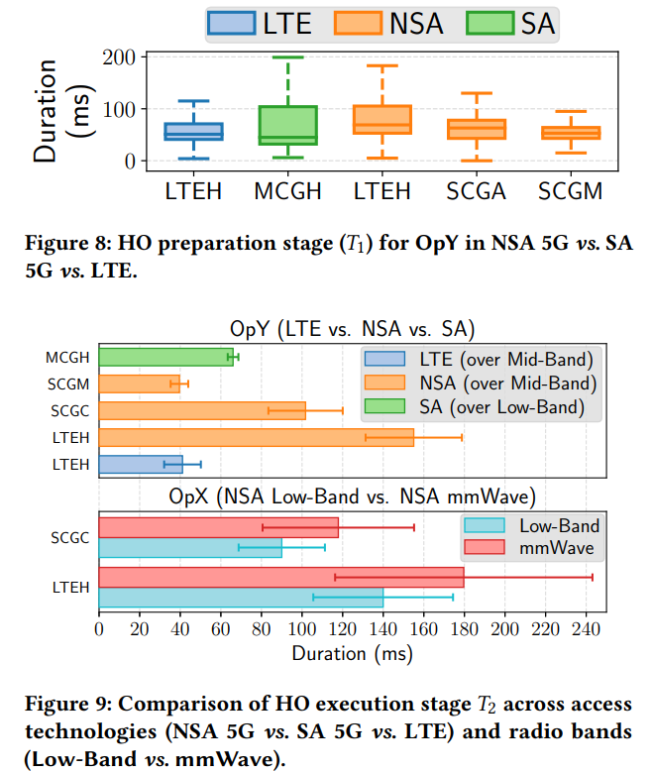
Handover Duration
HO Preparation Stage 𝑇1 accounts for 41% of the overall HO duration in NSA 5G.
SA 5G experiences large variance in the time spent on 𝑇1.
HO Execution Stage 𝑇2 has more direct impacts on upper-layer performance, and it accounts for ∼59%.
NSA 5G leads to a higher 𝑇2 that is 1.4-5.4× compared to LTE.
Within NSA 5G, mmWave band incurs 42∼45 % larger 𝑇2 time than low-band (complex beam tracking, searching, selection, etc.).

Slide 17
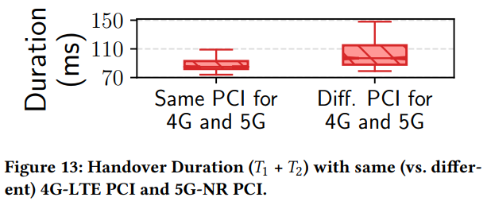
Impact of eNB and gNB Co-location
For NSA HOs where the (origin or destination) gNB and eNB are co-located (PCI not same), their duration is significantly shorter than HOs whose gNB and eNB are not co-located.

Slide 18
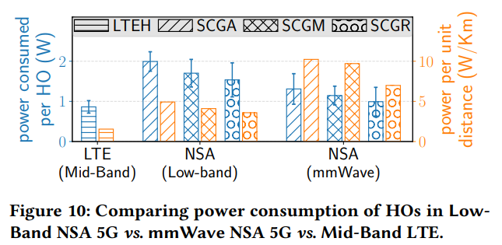
Power Consumption
HOs in NSA 5G consume 1.2-2.3× more energy when compared to HOs in 4G/LTE. (Both 4G and 5G radio are involved in the HO process.)
A single mmWave HO in NSA 5G is 54% more energy efficient than a single low-band HO. This is likely because the improved RACH procedure in mmWave [7].

Slide 19
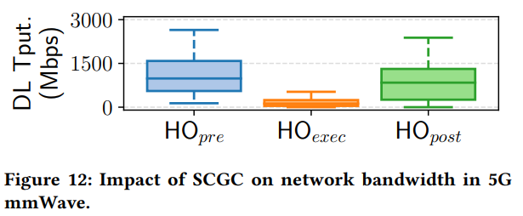
Impact of 5G HOs on Bandwidth
The average post-HO throughput reduces by 14% compared to the average pre-HO throughput.
Explain: NSA 5G does not support direct HOs between gNBs.

Slide 20
Ⅳ. Handover Prediction

Slide 21
Design (1/2)
Measurement Report Prediction
Collect HO event configurations (threshold, offset , time-to-trigger etc.).
Predict future RSRP, RSRQ, SINR by a triangular kernel method[46] of serving and neighbor cells.
Policy-based Handover Logic Learning
The decision Learner learn decision logic, called a pattern, which is a unique sequence of MRs repeatedly triggering a specific type of HO [33, 58].
Increment the support counts of a pattern if an old sequence is observed.
Add a pattern if a new sequence is encountered.

Slide 22
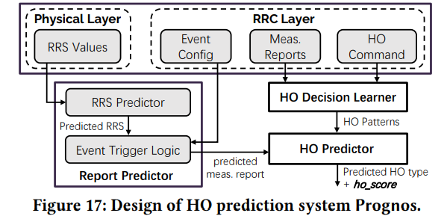
Design (2/2)

Slide 23
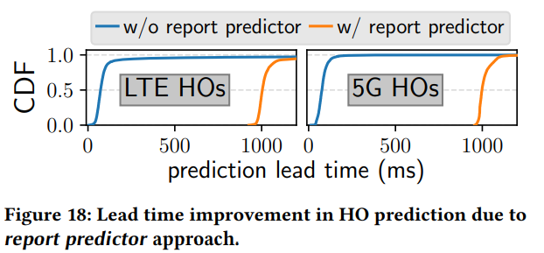
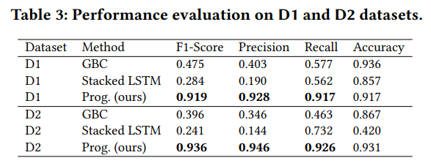
Performance Evaluation
The report predictor module enables us to predict the HO before a MR has been raised.
On average, it allows us to predict HOs 931 ms earlier with a slight 1.2% loss in accuracy.

Slide 24
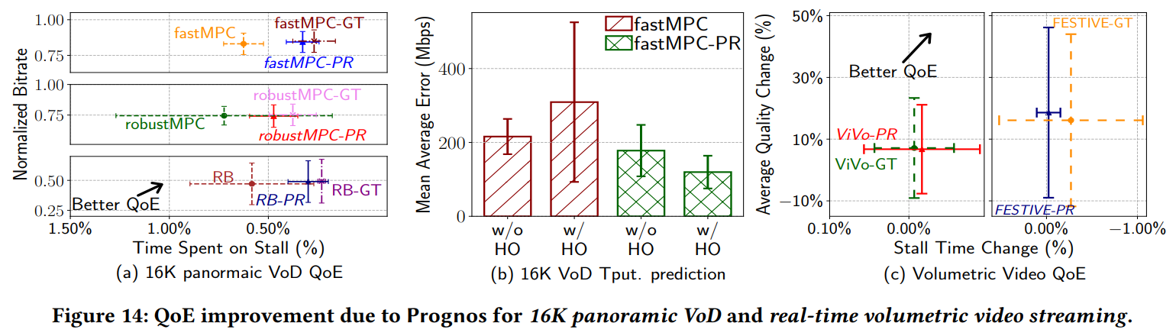
Use Cases
Simulation: collecting bandwidth traces by saturating the downlink channel of a mobile device while driving and feeding these traces into Mahimahi network emulation tool [55].
Modified Rate Adaption Algorithm: correct the throughput prediction generated by their rate adaption algorithms. (scale up or down the predicted throughput by multiplying it with the ℎ𝑜_𝑠𝑐𝑜𝑟𝑒 received from Prognos.)

Slide 25
V. Conclusions

Slide 26
Conclusions
This paper is about 5G SA/NSA, LTE measurement under mobility.
Good statistic chart to present idea and infer the reason of the phenomenon from wireless network knowledge.
According to the appropriate application scenario to design their HO prediction model.

Slide 27
Q&A

