Slide 1

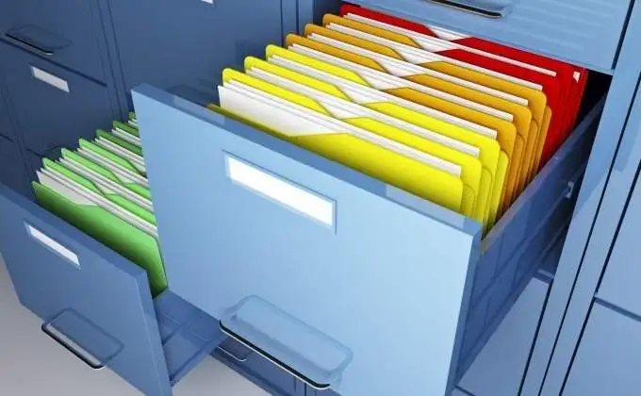
The Aramco Scenario
OMG!!!
1M &
keep growing?
Files: 770 514
Folders: 97 494
17.8 TB currently in use
Employee Name: John Doe aka “The Firefly”. Location: unknow. Date: unknown.

Slide 2


The Solution Blueprint
~ 1:30 min
Full file system scan
Extracting DB model
Bulk Insert
File Manager API
DB
File system event is raised
File System Watcher
is notified
Notify the responsible handler with the event
Extracting and storing DB model
Filtering
Create
Rename
Update
Delete
OnCreate(e)
OnRename(e)
OnUpdate(e)
OnDelete(e)
Skip:
.deleted
.filepart

