Slide 1
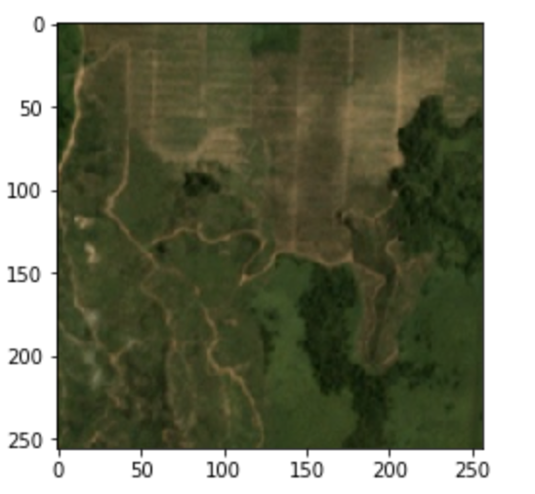
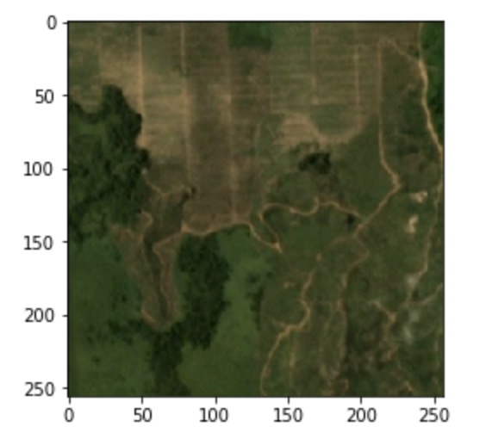
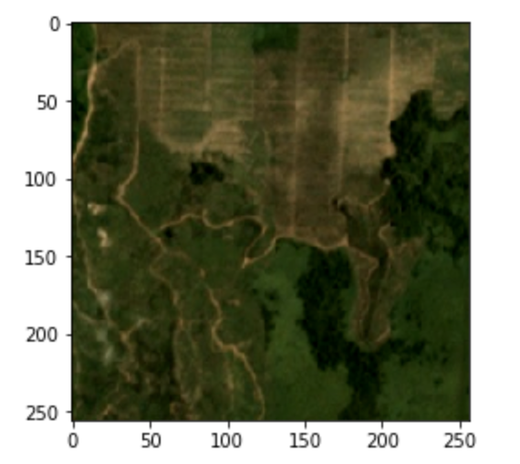
Predict the Presence of Oil palm Plantation in Satellite Imagery
Dataset Description:
15244 labeled satellite images (from Kaggle)
942 labelled “1” (6.19%) and 14302 labelled “0” (93.81%)
Having missing data (all-black images)
Original Images (with oil palm plantation)
Flipped (rand_mirror = True)
Saturation increased

Slide 2
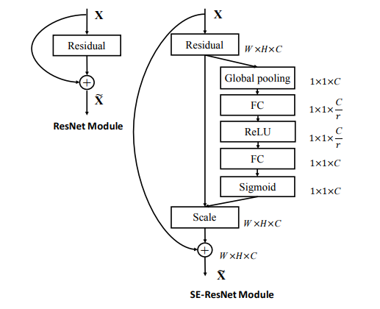
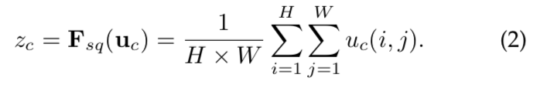
2. Model - Squeeze-and-Excitation Resnet
Goal: Modeling the interdependencies between the channels of its convolutional features
Two steps:
Squeeze: Global Information Embedding
Use global average pooling to generate channel-wise statistics
Excitation: Adaptive Recalibration
Maps the input specific descriptor z to a set of channel specific weights
[2][3] Jie Hu, Li Shen “Squeeze and Excitation Networks,” in CVPR 2018

Slide 3
3. Future Plans
Based on Pre-trained Models:
ResNet
SENet
SE-ResNet
Hyperparameters Tuning
Further Improvement from classification: Segmentation
Locate oil palm plantations and their boundaries
Other transformations and Test Time Augmentation
Perform random modifications to the test set and take the averaged prediction
Team: Ling Xie, Shiyang Ni, Sean Liu, Jiaqi Guo, Hengyi Kou

