Slide 1
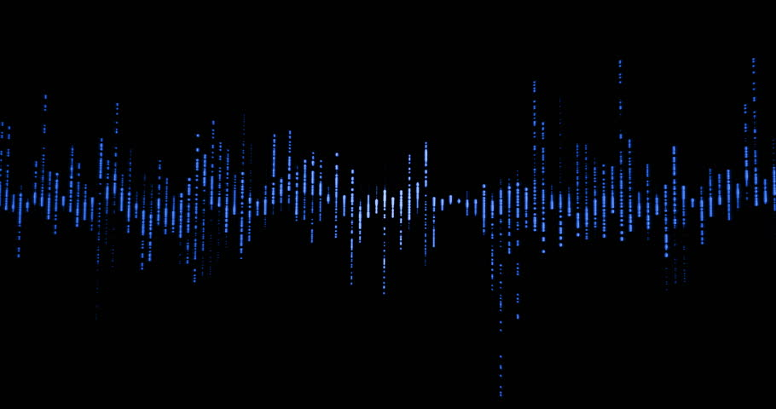
Audio Recovery (Project 11)
Lillian Du, Linda Du, Ryan Liu, Saurav Kadavath
March 5th, 2019
Stat 157

Slide 2
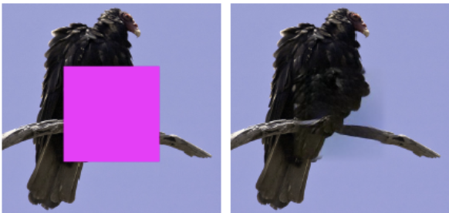
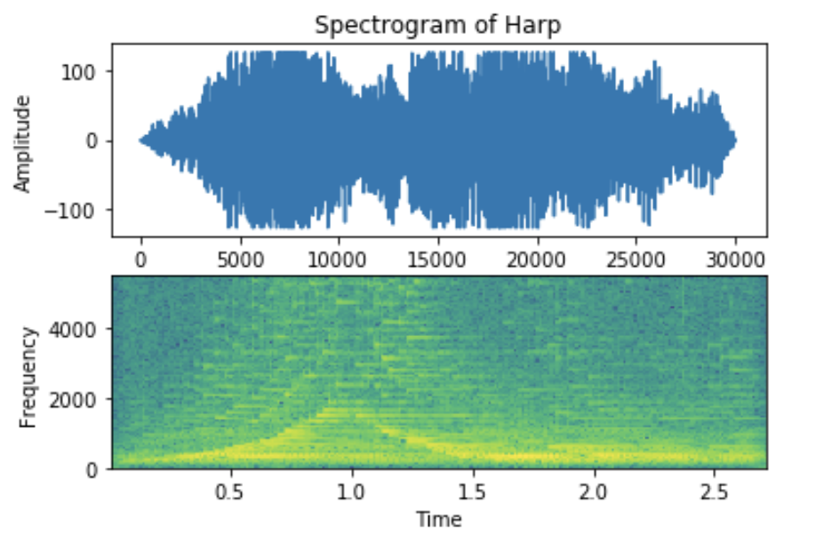
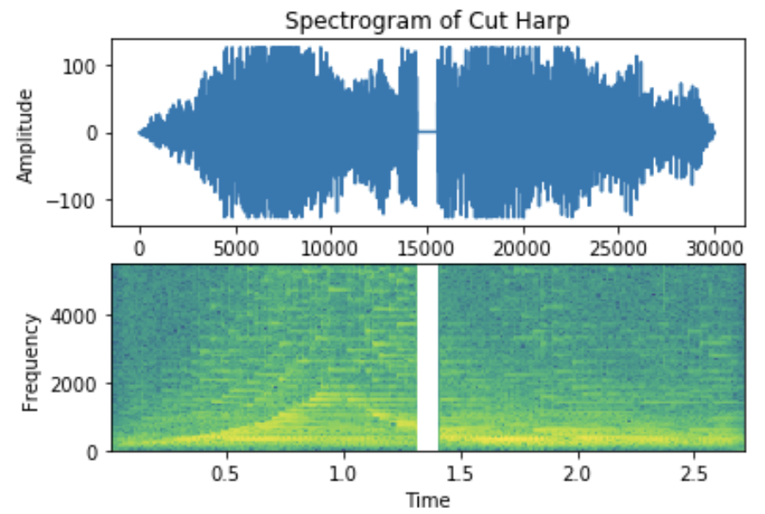
Project Idea: Audio Recovery
Fill in missing samples from an audio clip
Inspiration from neural inpainting: interpolating what belongs in the middle of an image

Slide 3

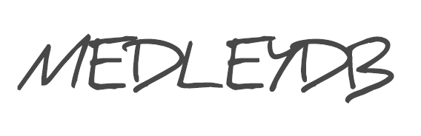
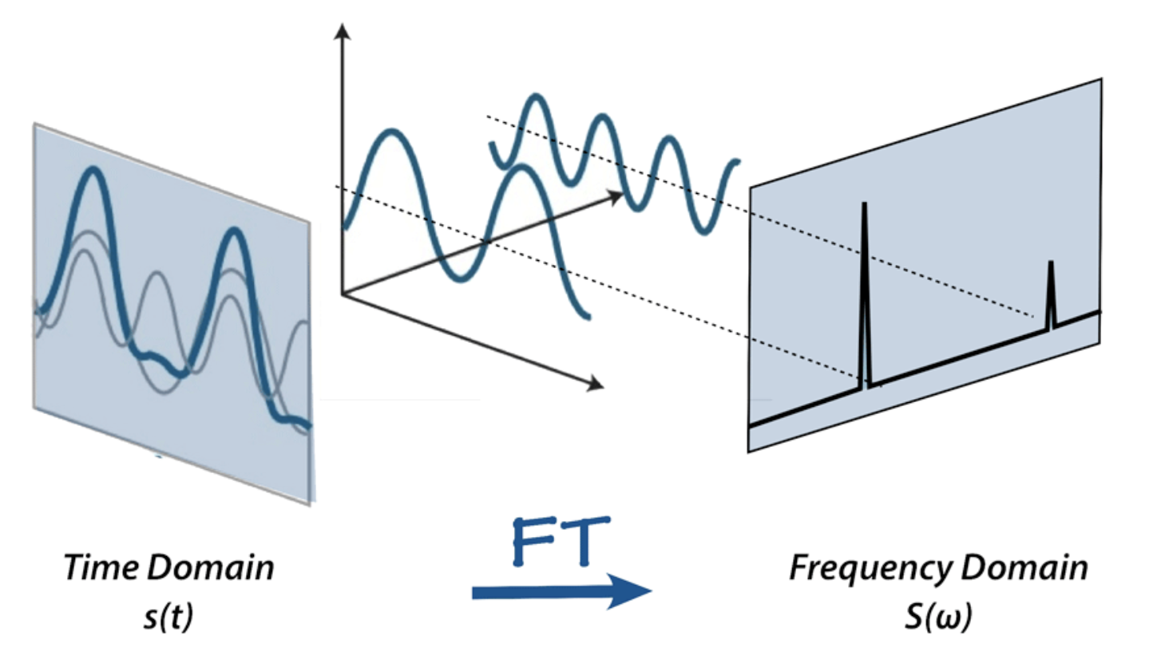
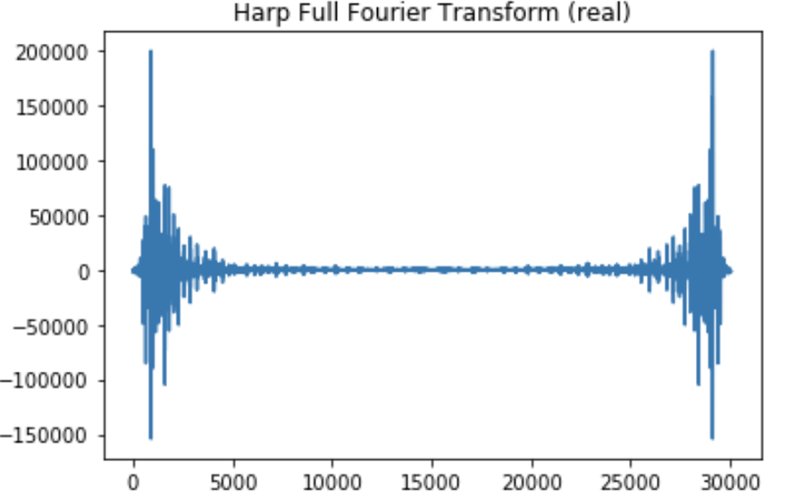
Data Collection and Processing
Collected ~100 GB of open source audio files (Archive.org, MedleyDB2.0)
Preprocessed to create features and labels in a DataLoader object
Trim to equal length, drop middle samples, apply Fourier transform

Slide 4
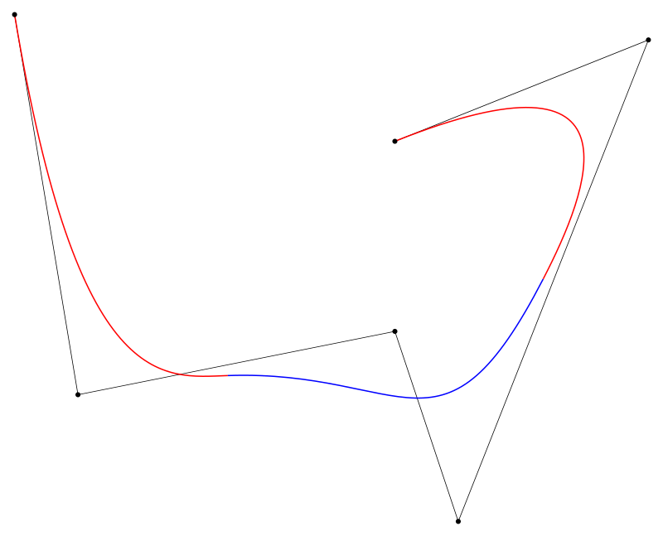
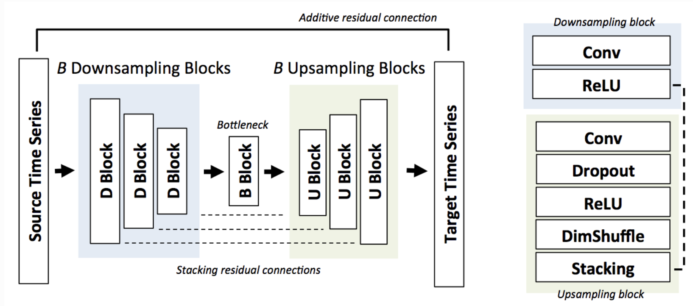
Network Architecture
Basing CNN model off of the diagram below
Using a cubic B-spline to interpolate values (SPLINTER library)
Using signal-to-noise ratio (SNR) and log-spectral distance (LSD) as loss metrics

