Slide 1
Examination of Associative Vocabulary in Internet Language through Word Embedding
Yoon Sung Hong, Eric Sung, Jemima Shi, Cheol Ho Jang

Slide 2

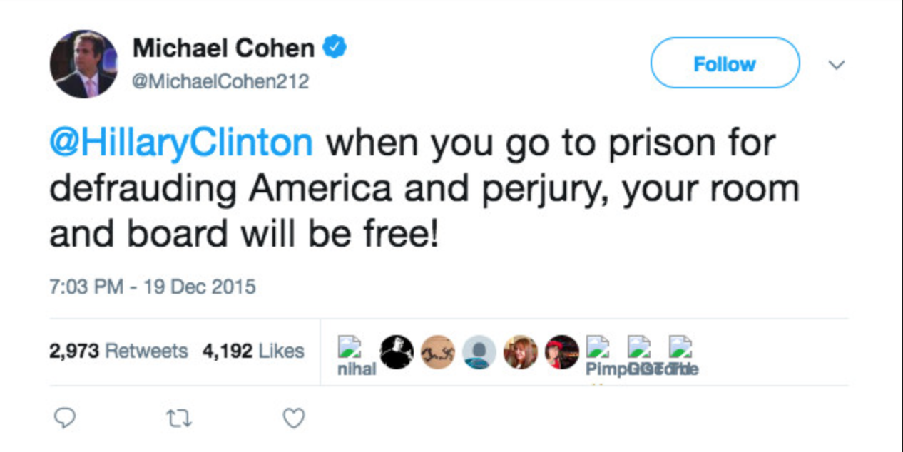

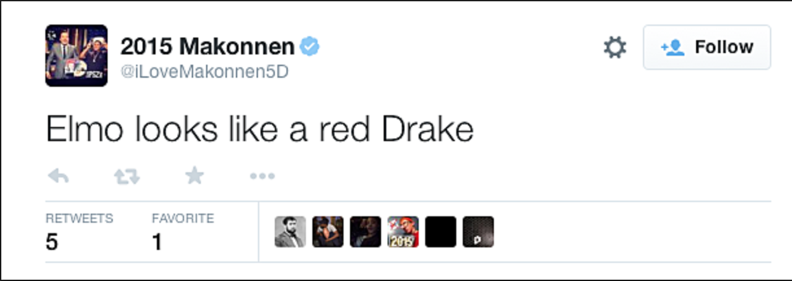
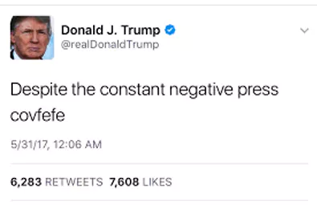

Introduction and Background
Word embedding (Mikolov et al., 2013) provides a new and unique way of dealing with many neural language processing (NLP) problems.
Use word embedding to analyze language association on Twitter.
Twitter hosts many news, opinion, and entertainment posts and appropriately captures the zeitgeist of our internet-savvy and always-connected generation.
Create meaningful connections between our findings and real-life contexts such as politics.
Notes:
ERIC, JEMIMA

Slide 3
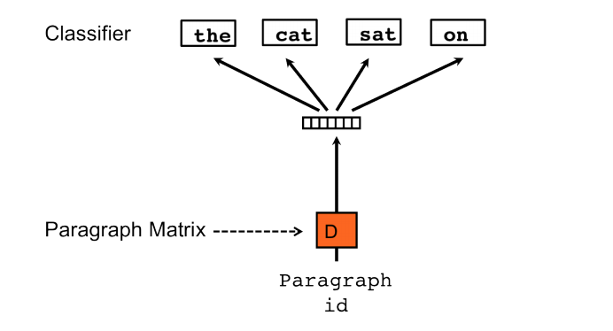
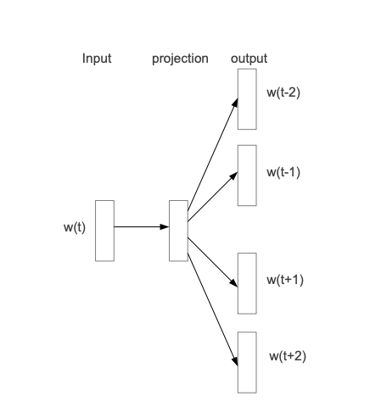
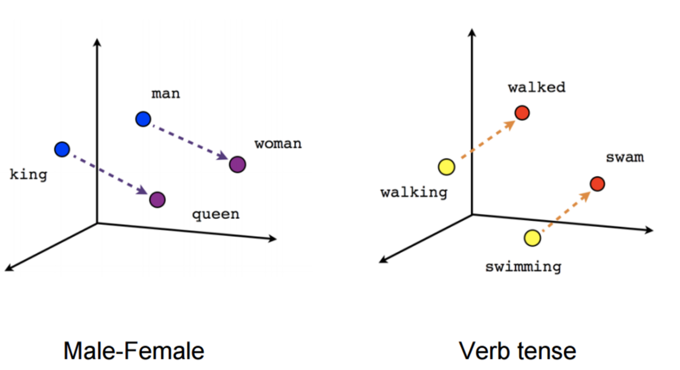
Proposed Approaches
The word vector space can be clustered through methods such as hierarchical clustering and k-means clustering to find prominent topics conveyed in the world of twitter
Two levels - word level, tweet level
We can artificially create clusters/dictionaries by selecting specific words and finding the words closest in meaning to those selections in our word vector space
Notes:
YOON SUNG

Slide 4
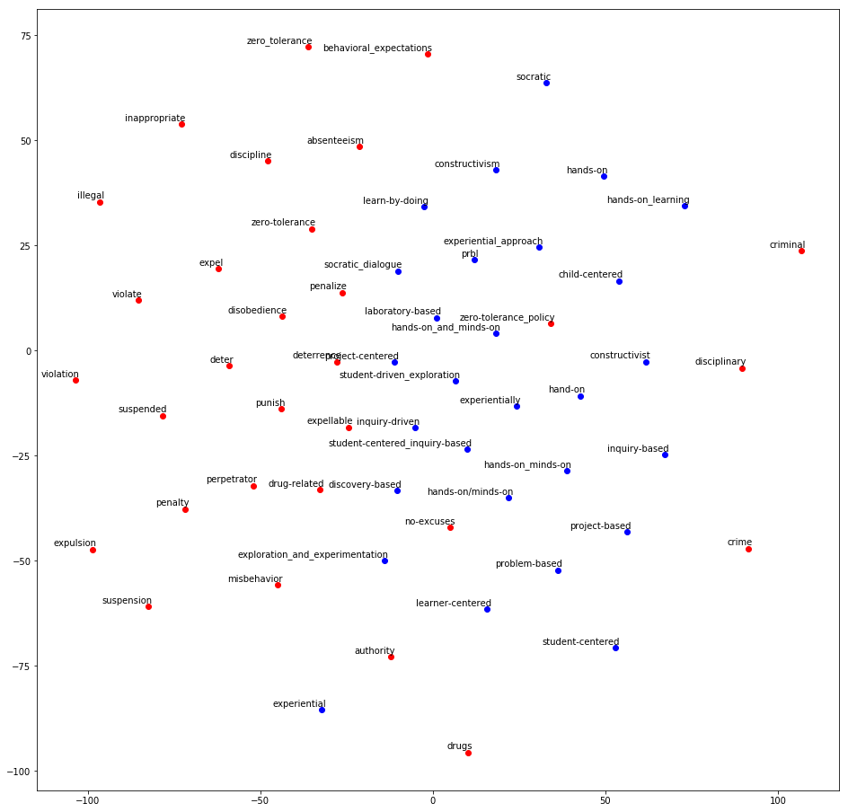
Visualization
t-SNE 2-dimensional plot of word embeddings space, colored by two model-generated dictionaries of inquiry-based learning and discipline-based learning.
Final goal: New dictionary of words with respect to their implementation within Twitter. Currently focusing on political spectrum but the same methodologies can be extended to other domains.
Notes:
CJ
Dimensionality reduction
Go over the big idea right at the end

