Slide 1
Progress Report
Hsiao-Yu Chiang
Xiaoya Li
Ganyu “Bruce” Xu
Pinshuo Ye
Zhanyuan Zhang

Slide 2
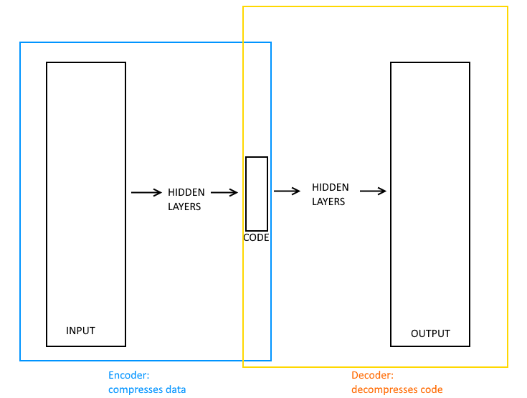
Autoencoder
Notes:
Autoencoder is an unsupervised neural network that learns dimension reduction and reconstruction from low-dimensional representation
Deepfake is an application of autoencoder that trains two autoencoders and connect the output of one encoder to the input of the other decoder
Deepfake lacks measurement of face swapping quality: introduce a discriminative network and form a Generative Adversarial Network

Slide 3
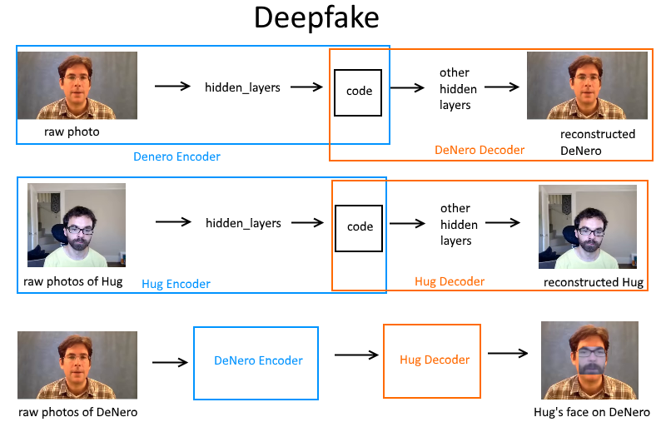
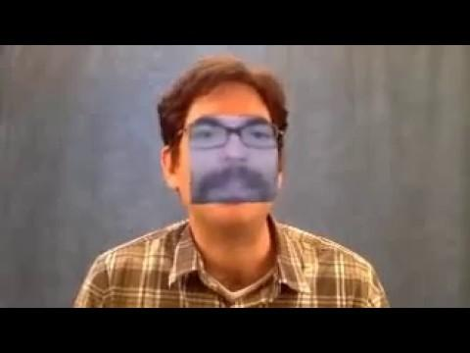

Slide 4
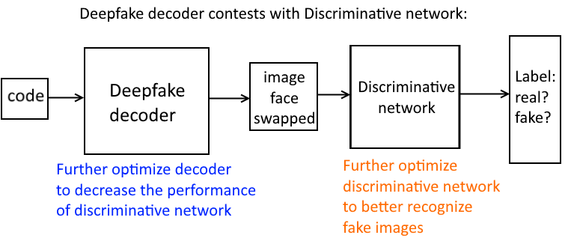
Beyond faceswapping
Notes:
Lack quantitative measurement of face swap quality
Train a second disciminative network to tell if a image is “fake”
Combine deepfake with discriminative network to form Generative Adversarial Network (GAN)

Slide 5
References
https://en.wikipedia.org/wiki/Autoencoder
https://en.wikipedia.org/wiki/Generative_adversarial_network
https://github.com/deepfakes/faceswap

