Slide 1
STAT 157 - Project #20
Project Midterm Presentation
Enrique L., Frank C., Shukre A.
March 5, 2019

Slide 2
Measuring Amazon Product Reviews Helpfulness
Motivation
Understanding what goes into making a product review ‘helpful’
Plan
We will consider various learning algorithms to predict the helpfulness of a review
Application
Inform users and give suggestions on how to improve reviews prior to submission
Give companies an understanding of what users are looking

Slide 3

Literature Review
Metrics of Helpfulness:
# of Votes Helpful / # of Votes Total
Manually code the helpfulness of reviews as good, fair and bad
Unvoted Reviews - make a predicted result based on features
Content & Context Analysis:
Readability - Flesch Reading Ease Index

Slide 4
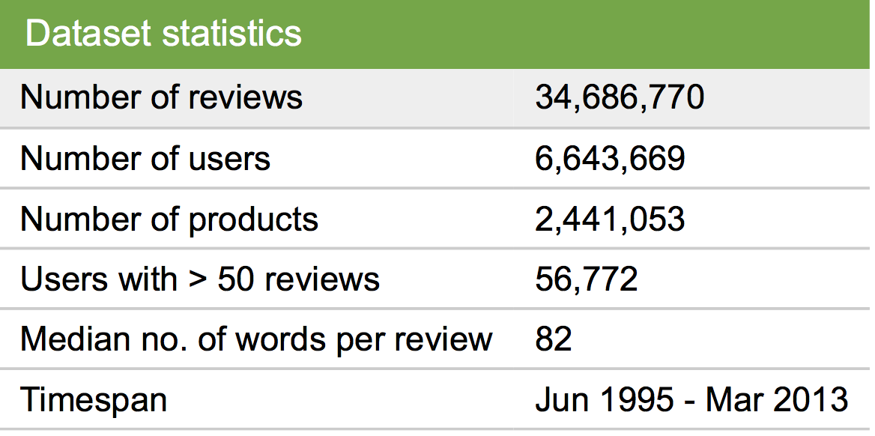
The Data - Amazon Reviews
https://snap.stanford.edu/data/web-Amazon.html
product/title: title of the product
product/price: price of the product
review/userId: id of the user
review/profileName: name of the user
review/helpfulness: fraction of users who found the review helpful
review/score: rating of the product
review/time: time of the review (unix time)
review/summary: review summary
review/text: text of the review

