Slide 1
STAT 157 - Midterm Presentation
Using Tacotron to Talk
Kyle Nguyen | Kyle Cho | Joanne Chen | Minjune Hwang | Han Song
March 5, 2019

Slide 2
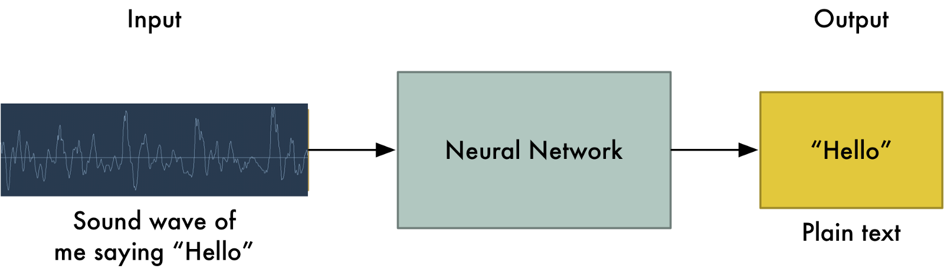
What is Tacotron?
End-to-end generative text-to-speech model
Synthesizes speech from characters
Speech recognition model
<text, audio> pairs to train the model from scratch with random initialization
does not rely on linguistic and acoustic features as inputs
rely solely on audio examples paired to their transcripts
Notes:
Natural Language Processing (NLP) is a subfield of Artificial Intelligence that is focused on enabling computers to understand and process human languages, to get computers closer to a human-level understanding of language. Natural language processing has many sub fields within it corresponding to the various areas of writing and speech. Our research is focused within speech recognition.
As demonstrated below, NLP models take in inputs of sound wave data to train neural nets to detect what exactly is being said. For project, we will be doing the reverse by using Tacotron. In other words, we will generate audio files with the input text in our project.

Slide 3

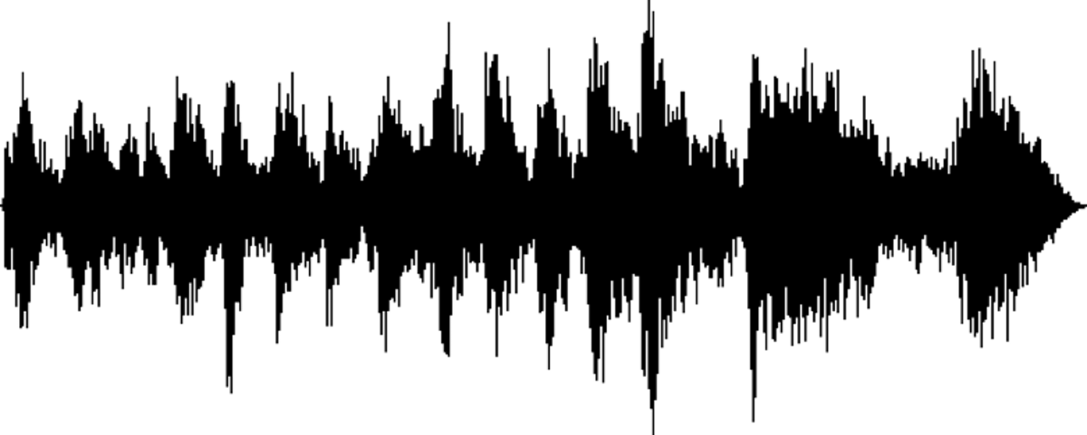
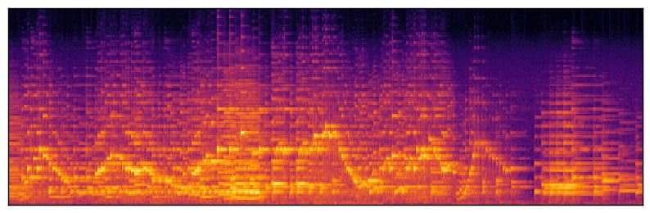
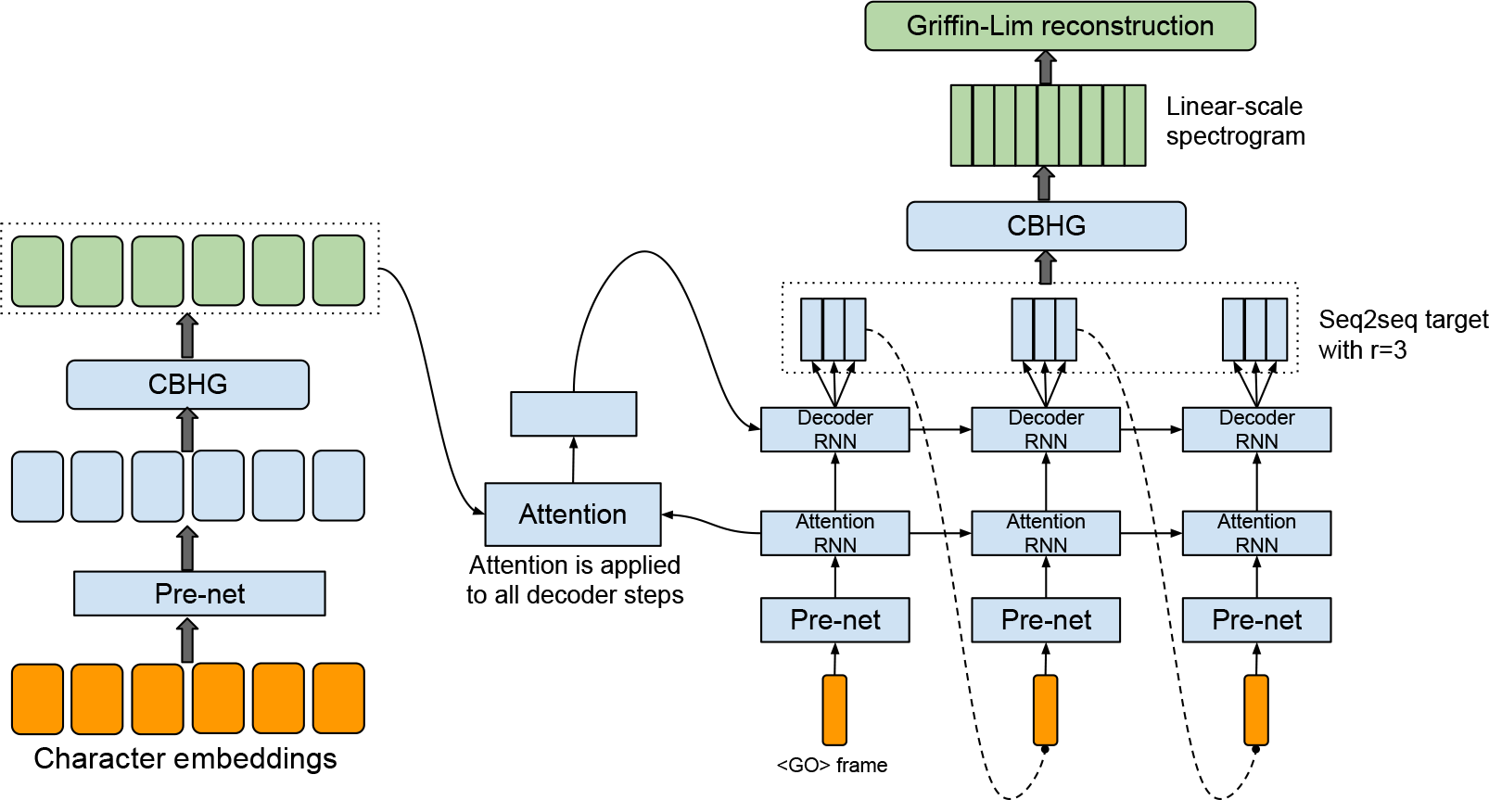
Pipeline
.
.
.
np.array
(“Announcements!”, )
.
.
.
.wav
Vocoder
(Griffin-Lim)
.wav
A n n o u n . . .

