Slide 1
BACKGROUND & MOTIVATION
Developed AI results in popular bots-controlled accounts
WE WOULD LIKE TO
Politicians use bots in twitter to do propaganda campaign
Restaurants’ owners use bots to rate their own restaurants higher scores and write down more positive comments on Yelp.
Bots issues are not just time-consuming, but could do harm to people’s benefits seriously
Develop a less expensive process of detecting whether an account or a tweet is bots-controlled
To help users save time and be aware of fake information.
Preliminary Literature Review
Currently, bot-detection is approached by: data analytics, surprised learning, and unsupervised learning.
high cost of data collection
time-consuming

Slide 2
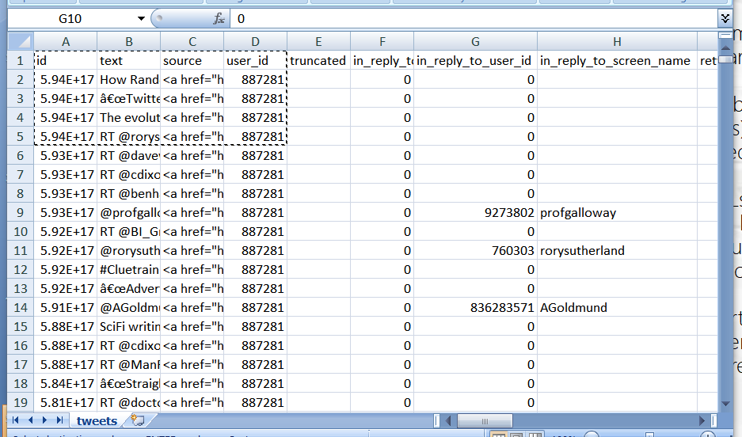
Dataset
.
Dataset 1: Twitter
From a group of researchers from Indian Institute of Technology
The same dataset they use for their research on the application of Contextual LSTM models.
Already well-preprocessed
Includes genuine accounts and different types of social spambots.
Also contains some metadata to improve the analysis.
Dataset 2: Facebook
From a group of researchers from Harvard
Web page addresses (URLs) that have been shared on Facebook.
URLs are included if shared by at least 20 unique accounts, and shared publicly at least once
Starting January 1, 2017 and ending about a month before the present day.
Columns Included:
Id; text; source; user_id; truncated; in_reply_to_status_id; in_reply_to_user_id; in_reply_to_screen_name; retweeted_status_id; geo; place…

Slide 3
Methodology
Data processing
clean data
handle missing values
Tokenizer
slice the sentences into words
form a string of tokens for each piece of data
Pre-trained model
use pre-trained model to explore what model we should use
Neural Network
Use LSTM, an NLP model to train the data
Metadata and content
use both content and metadata, together with the LSTM, train the data
Finalize our model
test the accuracy of it.

