Slide 1
IMU-Group 2
05.09.2025

Slide 2
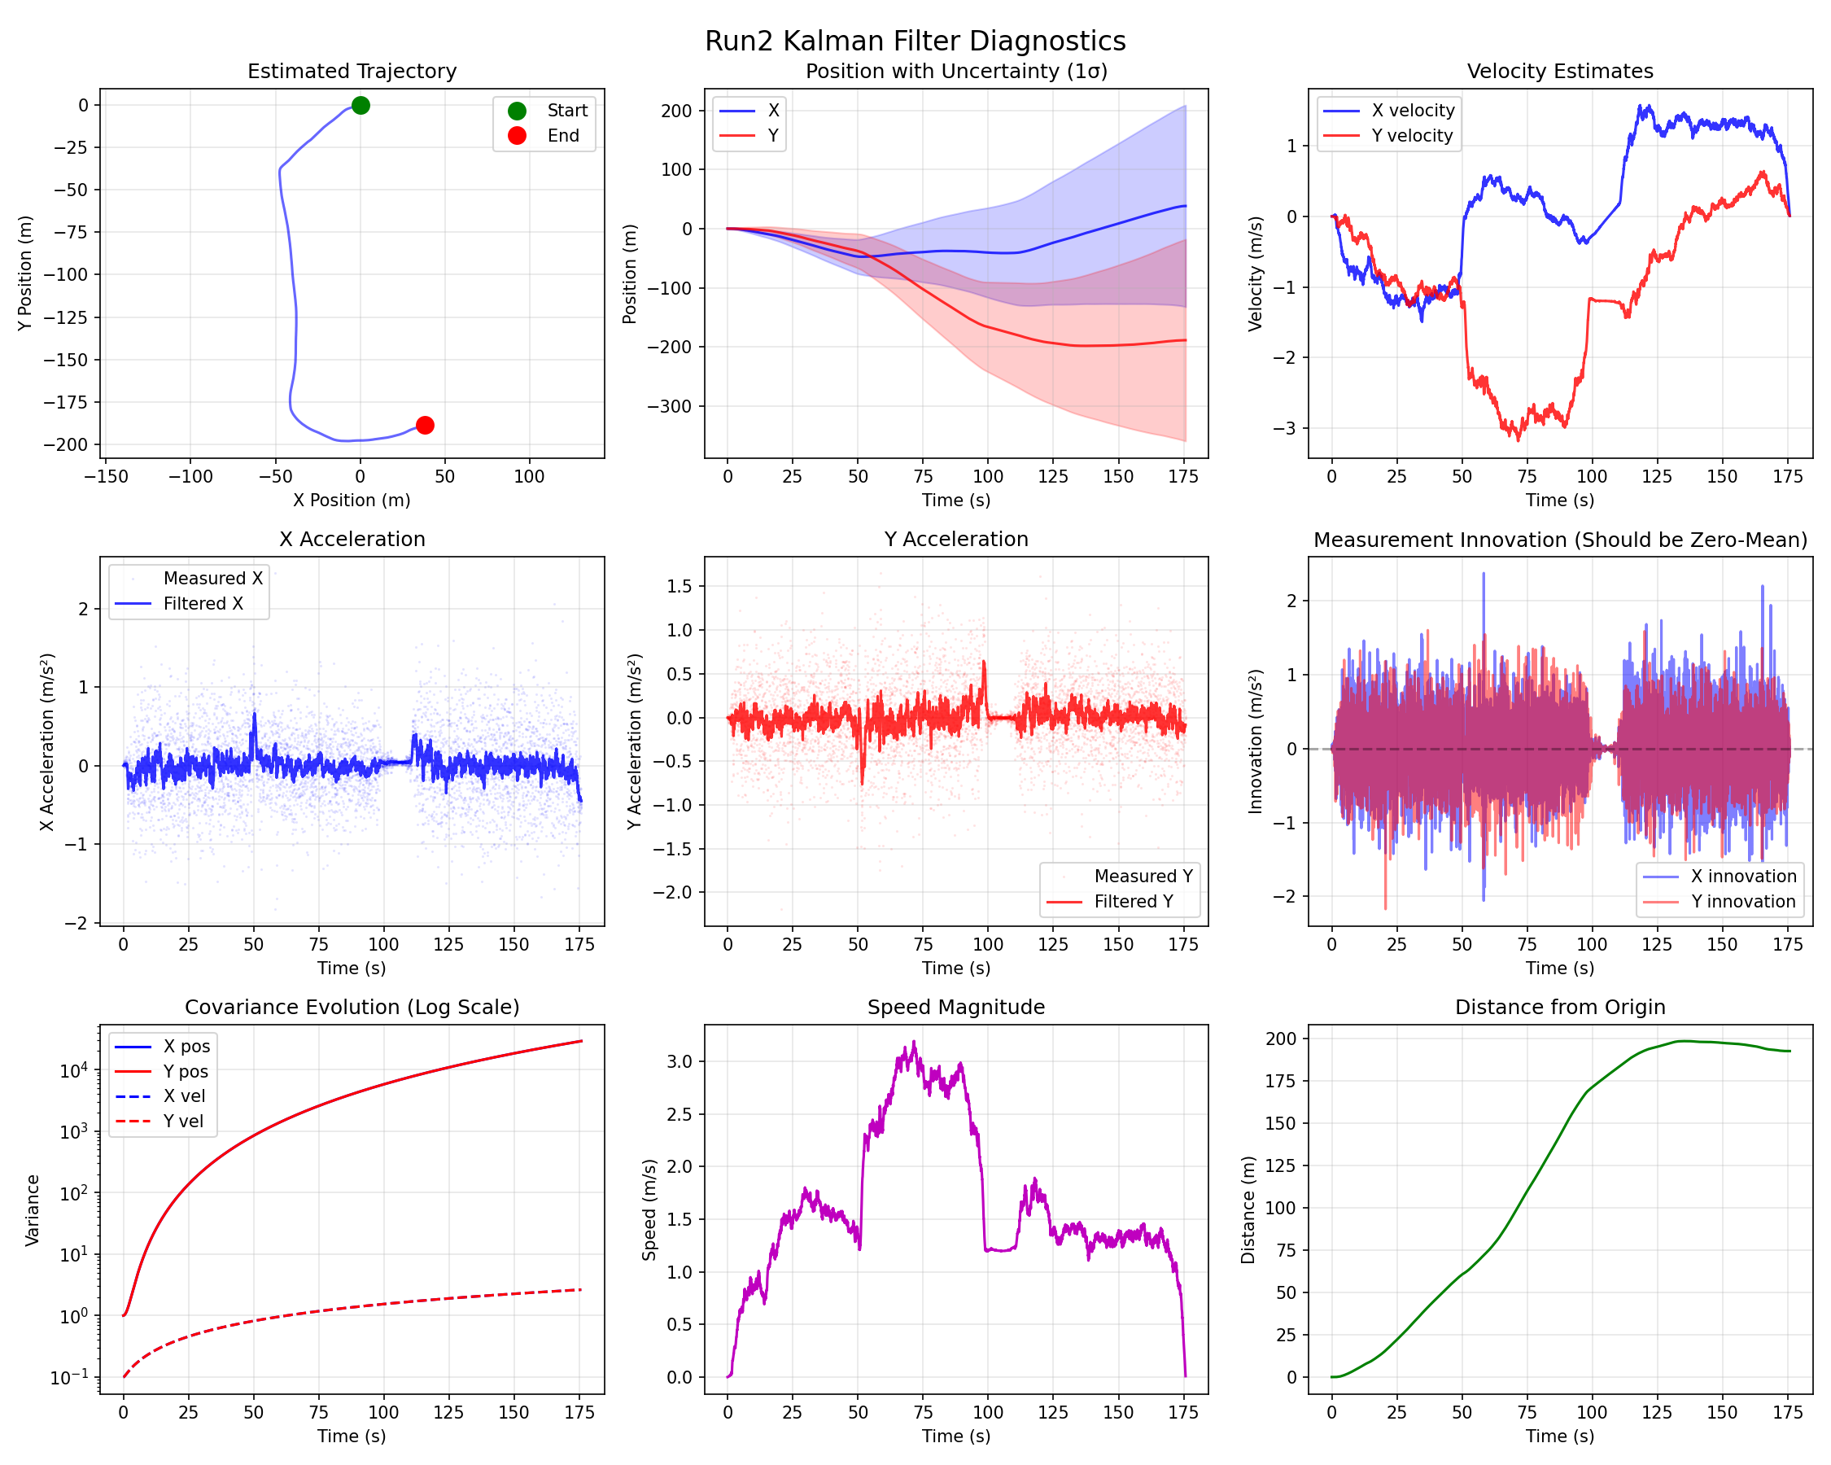

Slide 3
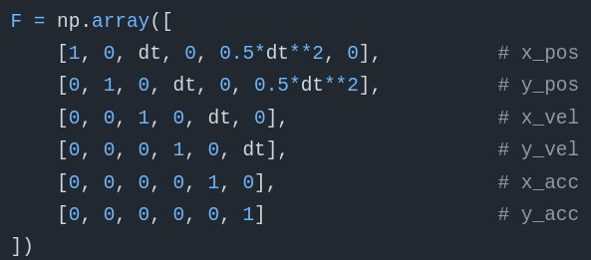
Linear model
Kalman filter

Slide 4
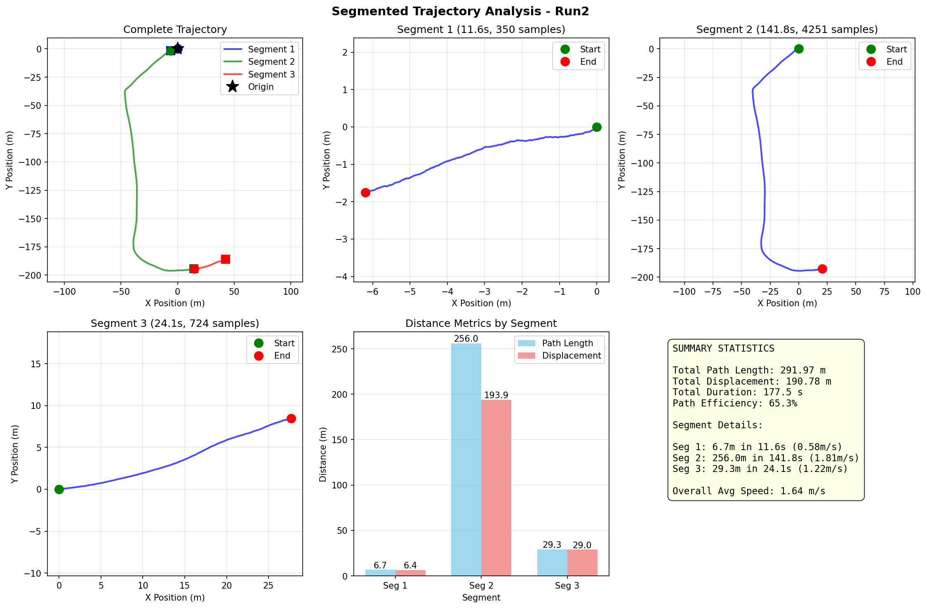

Slide 5
