Slide 1
Comparison of Random Vector Bayesian and RFS Filter, with Regard of Data Association and Update for Target Tracking
Jianan Liu
Derimis Tech., Gothenburg, Sweden

Slide 2
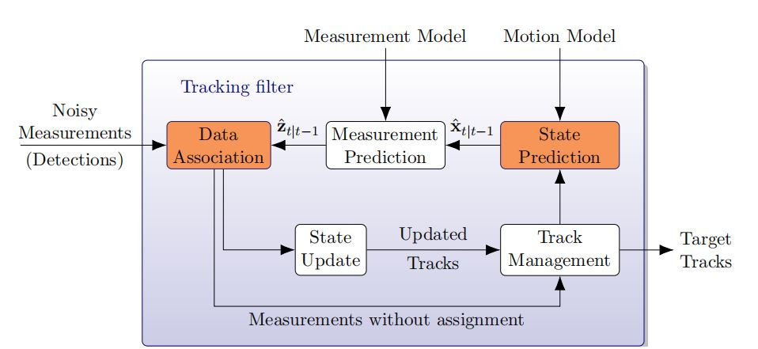
Traditional Point Target Tracker using Random Vector based Bayesian Filter
State prediction & update is performed by using Bayesian filter(e.g. Kalman, EKF, Particle Filter, etc.)
Data association is performed by random vector based Bayesian filter(e.g. GNN, JPDA.)

Slide 3
Data Association Problem
Assuming at most one detection could be originated from one target. Which detection(e.g. the geometry center of estimated instance from instance segmentation module) should be used to update which target’s position at current time frame?
There are many possible hypotheses.
Detection 1
Detection 2
Target 1
Target 2
Detection 3

Slide 4
Data Association Problem
An arrow denotes one single target hypothesis(a possible target-detection association pair).
All the single target could occur at current time frame(at same time) form a global hypothesis.
The ellipitic denotes the gating area, the detections outside the gating area of the target can not be originated from that target.
Detection 1
Detection 1
Detection 1
Detection 2
Detection 2
Detection 2
Target 1
Target 1
Target 1
Target 2
Target 2
Target 2
Detection 3
Detection 3
Detection 3
Global hypothesis 1
Global hypothesis 2
Global hypothesis 3

Slide 5
Data Association using Global Nearest Neighbor(GNN)

Slide 6
GNN
Go through all the global hypotheses at current time frame exhaustivity.
Assign weight(the likelihood probability such global hypothesis may be happened, e.g. using Mahananobis distance) for each global hypothesis
Detection 1
Detection 1
Detection 1
Detection 2
Detection 2
Detection 2
Target 1
Target 1
Target 1
Target 2
Target 2
Target 2
Detection 3
Detection 3
Detection 3
Detection 1
Detection 1
Detection 1
Detection 2
Detection 2
Detection 2
Target 1
Target 1
Target 1
Target 2
Target 2
Target 2
Detection 3
Detection 3
Detection 3
0.5
0.2
0.3

Slide 7
GNN
Select the global hypothesis with the minimum total cost(e.g. Mahananobis distance, likelihood probability) as only association and perform update step according to this.
Maximum Likelihood(ML) Approach. No Bias, High Variance.
Detection 1
Detection 2
Target 1
Target 2
Detection 3
0.5

Slide 8
Data Association using Probabilistic Data Association (PDA)

Slide 9
PDA
Go through all the single target hypotheses at current time frame exhaustivity.
Detection 1
Detection 1
Detection 1
Detection 2
Detection 2
Detection 2
Target 1
Target 1
Target 1
Target 2
Target 2
Target 2
Detection 3
Detection 3
Detection 3
Detection 1
Detection 2
Target 1
Target 2
Detection 3

Slide 10
PDA
Assign weight directly(the likelihood probability such single target hypothesis may be happened, e.g. calculate according to Gaussian likelihood pdf) for each single target hypothesis within the same target.
Detection 1
Detection 1
Target 1
Target 1
The two single target hypotheses for target 1
0.7
Detection 3
0.3
Detection 2
Detection 2
Target 2
Target 2
0.6
Detection 3
0.4
Detection 3
The two single target hypotheses for target 2

Slide 11
PDA
Then treat the weight for each single target hypothesis within the same target as marginal association probability. Update every target by using all the possible single target hypotheses for it with marginal association probability.
This is obvisouly not a suitable approach to perform update, cause such operation basically allow same detection can be associated to different targets at same time.
Detection 1
Detection 1
0.7
Detection 2
Detection 2
Target 1
Target 1
0.6
0.3
Target 2
0.4
Target 2
Detection 3
Detection 3

Slide 12
Data Association using Joint Probabilistic Data Association (JPDA)

Slide 13
JPDA
Go through all the global hypotheses at current time frame exhaustivity.
Assign weight(the likelihood probability such global hypothesis may be happened, e.g. using Gaussian likelihood pdf) for each global hypothesis
Detection 1
Detection 1
Detection 1
Detection 2
Detection 2
Detection 2
Target 1
Target 1
Target 1
Target 2
Target 2
Target 2
Detection 3
Detection 3
Detection 3
Detection 1
Detection 1
Detection 1
Detection 2
Detection 2
Detection 2
Target 1
Target 1
Target 1
Target 2
Target 2
Target 2
Detection 3
Detection 3
Detection 3
0.5
0.2
0.3

Slide 14
JPDA
Calculate the marginal association probability of every single target hypothesis by summing over weights of all the global hypotheses which contain a particular single target hypothesis, for each target.
Detection 1
Detection 1
Detection 2
Detection 2
Target 1
Target 1
Target 2
Target 2
Detection 3
Detection 3
0.5 + 0.3 = 0.8
0.2
Detection 1
Detection 1
Detection 2
Detection 2
Target 1
Target 1
Target 2
Target 2
Detection 3
Detection 3
0.5 + 0.2 = 0.7
0.3

Slide 15
JPDA
Update every target by using all the possible single target hypotheses for it with normalized marginal association probability.
Minimum Mean Squared Error(MMSE) Approach. Biased, Low Variance.
Detection 1
Detection 1
0.8
Detection 2
Detection 2
Target 1
Target 1
0.7
0.2
Target 2
0.3
Target 2
Detection 3
Detection 3

Slide 16
Data Association using Probability Hypothesis Density(PHD)

Slide 17
PHD
Go through all the single target hypotheses at current time frame exhaustivity.
Detection 1
Detection 1
Detection 1
Detection 2
Detection 2
Detection 2
Target 1
Target 1
Target 1
Target 2
Target 2
Target 2
Detection 3
Detection 3
Detection 3
Detection 1
Detection 2
Target 1
Target 2
Detection 3

Slide 18
PHD
Use every single target hypothesis to update corresponding target.
Detection 1
Target 1
Target 1
Target 1
Target 2
Target 2
Target 2
Detection 3
Detection 3
Detection 2
Target 1
Target 2

Slide 19
PHD
Such update strategy and results assigning a weight(e.g. an existing probability of such updated target) corresponds to every updated target.
Target 1
Target 1
Target 2
existence probability: 0.7
existence probability: 0.3
existence probability: 0.4
Target 2
existence probability: 0.9

Slide 20
PHD
All the targets with existence probability higher than a threshold(e.g. 0.5) will be remained and others will be deleted.
Simple to implement, but not theoretically gurantee the correctness.
Target 1
Target 1
existence probability: 0.7
Target 2
Target 2
existence probability: 0.9

Slide 21
Data Association using Poisson Multiple Bernoulli Mixture (PMBM)

Slide 22
PMBM
Go through all the global hypotheses at current time frame(which are generated from several global hypotheses remained from previous time frame. We will see the details later.) exhaustivity.
Assign weight(the likelihood probability such global hypothesis may be happened, e.g. using Gaussian likelihood pdf) for each global hypothesis
Detection 1
Detection 1
Detection 1
Detection 2
Detection 2
Detection 2
Target 1
Target 1
Target 1
Target 2
Target 2
Target 2
Detection 3
Detection 3
Detection 3
Detection 1
Detection 1
Detection 1
Detection 2
Detection 2
Detection 2
Target 1
Target 1
Target 1
Target 2
Target 2
Target 2
Detection 3
Detection 3
Detection 3
0.5
0.2
0.3

Slide 23
PMBM
Select the best K global hypotheses with the minimum total cost(e.g. calculate according to Gaussian likelihood pdf) as possible associations.
Perform the update step still by only using the best global hypothesis(e.g. the one with weight = 0.5), but propagate both ones into next time frame as prior hypothesis to generate more global hypotheses from each.
Detection 1
Detection 1
Detection 1
Detection 2
Detection 2
Detection 2
Target 1
Target 1
Target 1
Target 2
Target 2
Target 2
Detection 3
Detection 3
Detection 3
0.5
0.2
0.3
Use this one to perform update step
Propagate both ones into next time frame as prior hypotheses.

Slide 24
PMBM
For next time frame, the number of global hypotheses will be more.
Here are global hypotheses at current frame based on prior hypothesis 1
Detection 1
The prior hypothesis 1 from last frame
Detection 2
Target 1
The 3 global hypotheses at current frame are generated based
on the prior hypothesis 1 from last frame
Detection 1
Detection 3
Detection 1
Detection 3
Detection 1
Detection 3
Target 1
Target 1
Target 1
Target 2
Target 2
Target 2
Detection 2
Detection 2
Detection 4
Detection 2
Detection 4
Detection 4

Slide 25
PMBM
Here are global hypotheses at current frame based on prior hypothesis 2
Detection 1
Detection 2
The prior hypothesis 2 from last frame
Target 1
Target 2
Detection 3
The 2 global hypotheses at current frame are generated based
on the prior hypothesis 2 from last frame
Detection 1
Detection 3
Detection 1
Detection 3
Target 1
Target 1
Target 2
Target 2
Detection 4
Detection 2
Detection 4
Detection 2

Slide 26
PMBM
Thus there are 5 global hypotheses in total for next time frame, which are generated from 1st and 2nd remaining global hyotheses as prior knoweldge, for this example.
Data association approach in PMBM, similar to MHT filter, is a multi-time frame based global hypotheses generation strategy, leads to Maximum A Postierior(MAP) Approach by using prior knowledge from previous time frame.

Slide 27
Performance Comparison

Slide 28
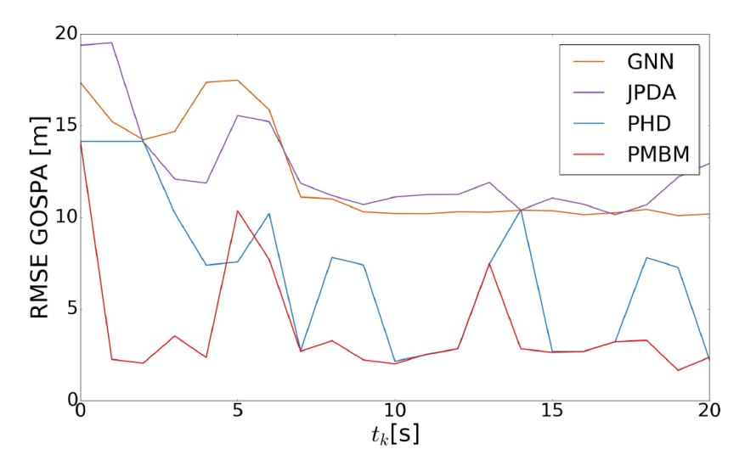
Performance Comparison
Random Vector Bayesian Filters(GNN, JPDA) v.s. RFS Filters(PHD, PMBM)

