Slide 1
Report On Indian Spice Brands
Name : - Sujit Prasad Roll No :- 26
Course :- BBA Year :- 2nd
Enrollment No:- LNCABBA11027 Sem :- 4th

Slide 2
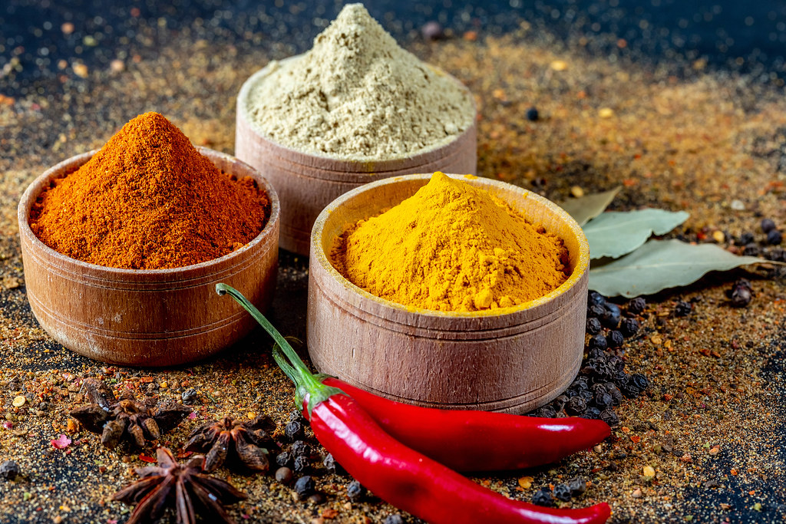
Indian Kitchen Spices
Know the seasoning brands, bolster your health
This Photo by Unknown Author is licensed under CC BY

Slide 3

LNCT University
Certificate
This is to certify that the project report entitled Indian Brands of Kitchen Spices, submitted to department of Bachelor of Business Administration, LNCT University, in partial fulfilment for the award of degree of Bachelors in Business Administration, is a record bonified work carried out by Mr. Sujit Prasad, Roll No LNCABBA11027 under my supervision and guidance under my provision from
28/04/2022 to 09/05/2022.
All help received by my teacher has been duly acknowledged.
No Part of this report has been submitted elsewhere for award of any degree.

Slide 4
Acknowledgement
I would like to express my special gratitude and appreciation to all those who gave me the possibility to complete this report. Special thanks is due to my supervisor Miss. Deeksha Dange whose help, stimulating suggestions and encouragement helped me in all time of fabrication process and writing this report. I also sincerely thanks for the time spent proof reading and correcting my many mistakes.
I would much like to acknowledge the efforts of staffs in the library, who gave me a permission to use all the necessary books in the library for learning about market analysis.

Slide 5
Preface
As a part of MBA Curriculum and in order to gain practical knowledge in the field of management, we are required to make a report on “Best Brands of Indian Spices”. The Basic Objective behind doing this project report is to get knowledge tools of different tools of marketing.
In this project report we have included various concepts, effects and implications regarding the best masala brands of the country.
This report also includes extensive study and analysis of the Indian spice market and it’s export.
Doing this project report helped us to enhance our knowledge regarding the work in to the attitude of consumer towards the different brands of spices that we get in our country as well as the consumers response to the local available masalas.
This project has also made us realize about the importance of camaraderie and team work and role of devotion towards work.

Slide 6
Contents
Contents | Page No
Introduction | 07
Market Analysis a. Pictorial Representation | 08 09
3. Important Brands of Indian Spices | 10
4. Data Collection | 11
5. Profiles of Organisation | 12
6. Details of Organisation | 13 - 18
7. Data Interpretation and Analysis | 19 - 20
8. Conclusion | 21
9. Review Literature | 22
10. Reference | 23

Slide 7
Introduction
As often said the way to happier life resides in a healthy food, but ultimately the healthy food that is cooked is solely due to the spices that we use in our households. Studies have shown that not only eating healthy fruits and vegetables are but the qualities of seasoning used is also influential in maintaining sound health.
India is a land of diverse culture and traditions. With over 138 crore people leaving in this holy land, there has to be a blend of spices. The Indian spices not only contain the flavour from Kashmir but also are mingled with the seasonings from the south. Indians love to blend the foods and test new varieties.
Indian known as to be home of species, boasts to a long history of trading with ancient civilisations of Rome and China. But today, Indian species are most sought after globally, given their exquisite aroma, texture and medicinal value.
Here comes the opportunity for the Indian Spice market and it’s brands to deliver quality product to various parts of the country keeping it fresh and as effective as possible in entirely different part of the country.

Slide 8
Market Analysis
With such vast population in the country, India has the largest domestic species market in the world. Traditionally, species in the country hav e been grown in small land holdings with organic farming, our country have become the largest consumer and exporter of the spices. Our country produces about 75 of 109 varities listed by the Indian Organisation of Standardisation(ISO) which accounts for half the global trading spices.
Such a huge market cap and potential has attracted many players in this industry. In today’s scenario there are well established brands in the country and the traditional approach of cultivating species in small land holdings are diminishing gradually.
This is all supported by the data that Exports of India reached 8, 57, 400 tonnes worth US $2.25 billion in financial year 2020.

Slide 9
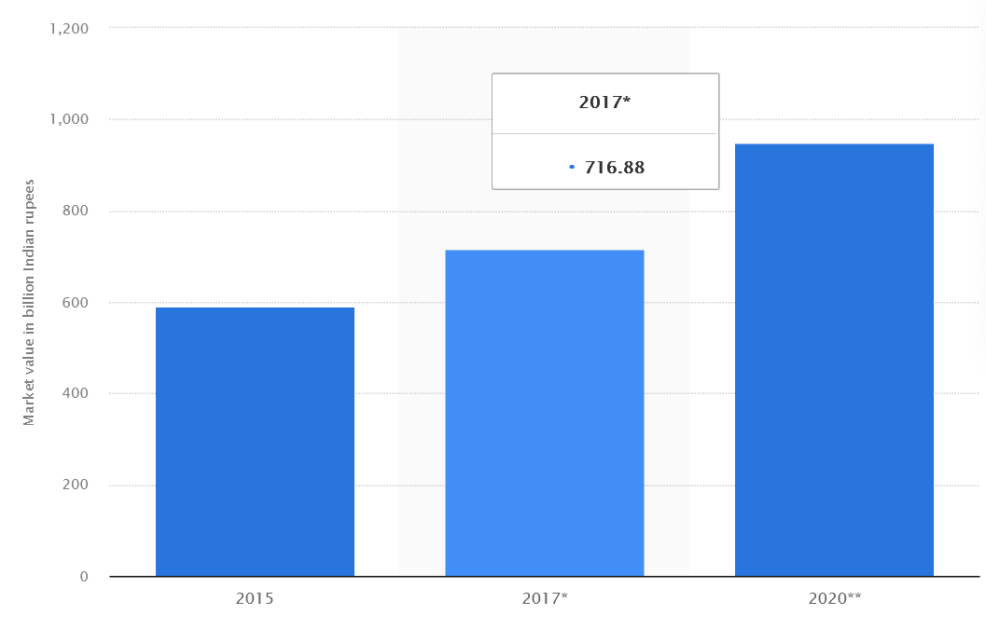
Spice Market Analysis

Slide 10
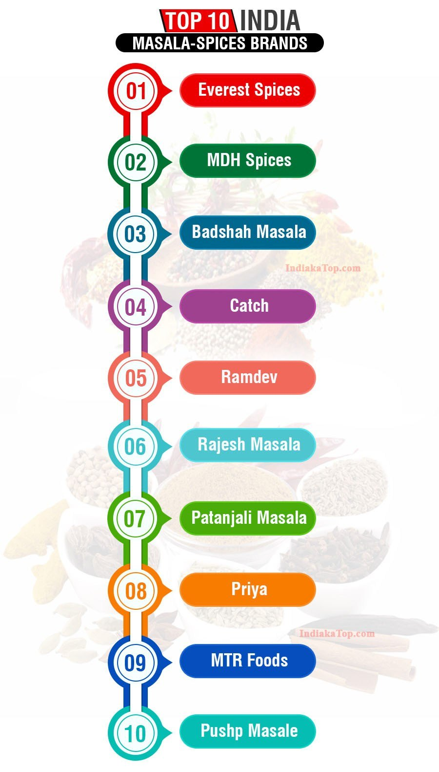
Important Brands of Indian Species
Despite being one of the most competitive markets in our country
with ample of local players and company in the state level. The
market’s has several companies. Despite this, few companies few have
stood out against all odds and have been able to become the powress
of every home-maker.
Here’s a list of all the top brands that we all consume in our day to day life. In this
Study we would focus our study in top 5 companies analysing their profiles.

Slide 11
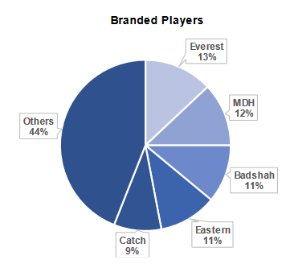
Data Collection
Since, top 10 players comprise 50% of the market thus there’s room for ample growth.
The shift towards the branded spices have increased thus branded players hold regional leadership.
This branded market provides immense opportunity to grow and make mark in the already huge unorganized market.
The space has very strong interest and rapid growth due to shift in branded players.
The branded players have also shifted their focus on blended species as well as ready to eat curries, etc.

Slide 12





Profiles of Organisation
Everest Masalas :- Founded in 1981 by Vadilal Shah, Everest Spices are the largest brand of spices in India. With more than 40 blends,Everest has conquered the markets of the Middle East, theUS, New Zealand, Singapore, Australia as an Exporter.
MDH Masals :- Mahashian Di Hatti, popularly known as MDH is one of the leading producer, exporter and distributor of spice mixtures and ground spices. Mahashay Chuni Lal Gulati established MDH in 1919.
Badshah Masalas :- Badshah Masala was founded Shri Ramanlal J. Jhaveri & family in the year 1958.Badshah Masala has over 45 products available in India and internationally providing three categories - Spice Blends, Ground Spice & Asafoetida.
Eastern Masalas:- Eastern Condiments is a Bengaluru-based spice brand, and is one of the top spice exporters. Set up by ME Meeran in1989, Eastern manufactures spices,masalas,blended spice powders, pickles and rice-based products under the Eastern brand.
Catch Masalas :- Catch was launched in 1987, and their first products were sprinklers for Indian and International tables- salt and pepper

Slide 13
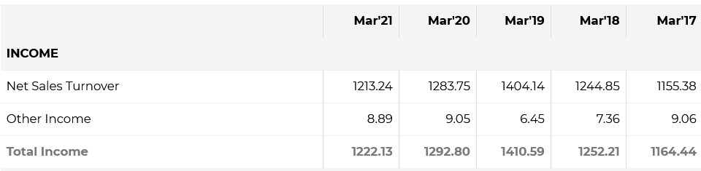
Details of Organisations
Everest – Known for their quality and trust of various customers around the world. It is India’s largest selling spice brand with more than 45 varieties of spices and masalas to offer. They are top spice manufacturers in india who also sell globally in 58 other countries besides Indiaa. They are one of the biggest masala companies that have been in the business for around 50 year’s now.
Ever wondered what could be the best feature of Everest masalas that people tend to consume It more?
The competitive age that Everest enjoys over it’s other commpetitors is, their best spelling spice that is “Aamchur”. They are in over 58 countries giving them foreign exposure.
Analysis of Sales of the Company – The data has been provided by economic times.

Slide 14
Interpretation Of Everest Masalas:-
In the data provided by economic times we see in the financial years from 2017 has increase kin both the number of goods produced and the total income of the company.
It is not surprising to see that despite the pandemic and lockdown, neither have the sales been down nor have the total income of the company have taken a significant hit.
Can you figure out why there is only a slight dip in sales and income in the financial year 2019- 2020?
Since, the spices are necessity of any household people had to purchase them irrespective of their economical condition. Thus, the sales of the company has not taken a significant hit during the covid period.

Slide 15
MDH Masals – Don’t we all remember the grandpa that comes in the advertisement of MDH. This company offers a variety of spices packed and delivered from 10g to 500g packs. You can’t deny the fact that we all can still play the MDg tag line “ Asli Masale Sach Sach”. With an aim to reduce the work of a home-maker who used to spend considerable time in grinding the spices by hand. The company was started in 1919. It offers variety of blended and single species making it one of the most famous masala brands in India.
Distinctive Features from Competitors
Initially when started, it used hand- ground masalas but till present day, the company has switched to power machines in order to meet the enormous demands and also reduce the cost of making of the spices in order to improve their margins. These have led to MDH growth over the years.

Slide 16
Other Brands -
Catch Masalas –
With the culinary hisstor that india has and the diversity and cultures that the country has, there are hundred of dishes that were innovated ove time in our country. All these would not have been possible without the perfect blend of spices and masala that our people have invented over the years. As important it is for an Indian household to have a spice box, it is more important to have the perfect blend. Catch, speaks for it’s quality and has evoved to be Inndia’s top 10 spice brands in less than 10 years.
Distinction between It’s Peers: Catch not only catches it’s customers in the spices but also provides amazing product ranges like cooking pastes , whole spices, grinders, etc. this has helped the company to grow exponentially.
Badshah Masalas –
Badshah Masala has been in the industry for over six decades and stands to be one of the biggest masala companies in India. Experience a unique blend of ambrosial flavors that offer an authentic Indian masala mix. Now it's easy to get the same hotel-like taste at home but in a better and healthier way.
Distinction between It’s Peers - Besides selling some amazing spices, Badsha masala also sells Kesari milk masala and premix tea that you can check out on their website.

Slide 17
Other Brands
Rajesh Masalas –
Be it chili powder or coriander powder, you name it, you will find it. They are equipped with automatic plants and machinery that enable the processing and packaging of spices in the right and hygienic way. This makes it stand as one of the best masala brands in India. Their ingredients are thoroughly tested for quality, purity, and rich taste.
Distinction from it’s peers - Rajesh masala sells their products through sachets and also in various quantity boxes. You can check out for them on their website.
Ramdev Masalas –
Ramdev masalas have been in the industry since 1965 and are manufacturers and exporters of Indian spices. They are also one of the most famous masala brands in India. You can find basic spices, blended spices, four different varieties of hing, and many other options too on their website.
Distinction from it’s peers - One can also check out Instant Mixes from Ramdev Masala. Besides, they also have an amazing range of snacks.
Priya Masalas –
The house of Priya offers a wide range of products. The most prominent of them all is their rage of masalas. A part of Ramoji Group, Priya Masalas stands as one of the top masala company in India. Right from Hyderabadi Dum Biryani Masala to Amchur to Pulao Masala, they have got an extremely wide range of masalas to offer at super affordable prices
Distinction from It’s peers -Priya masala also has amazing pickles. It has always been one of the best-selling products of this brand.

Slide 18
Other Brands
Patanjali Masale –
Patanjali masalas are top masala manufacturers in India and offer an array of products. Coming from an ayurvedic source, each of the masalas is carefully created and blended at the right temperature to keep the goodness intact.
Distinction from it’s peers -Besides spices, Patanjali also sells other ayurvedic-based products that provide amazing health benefits. Thus they advertise to sell ayurvedic masalas which are even good for health
Pushp Masale –
They are also one of the leading spice brands in India. Be assured of pure spices when your shop from Pushp masalas. They contain an eccentric blend of Indian spices that are perfect to compliment your culinary skills. Pushp Masale constantly strives to work in making sure only the best of the quality reaches countless Indian homes.
Distinction from it’s peers – The production unit of these company is it’s advantage where the company produces 200 metric tonnes in a single day
MTR Masalas –
MTR Masala is another top masala brand in India that has been in the industry for a very long time. They blend authentic Indian spices at the right temperature and quantities to bring out the perfect taste. Their masalas are also top-selling masalas in India that gain popularity for their taste and packaging.
Distinction from it’s peers - MTR offers a variety of blends besides just spices. They manufacture ready-to-eat range, beverages, vermicelli, pickles, and dessert mixes.

Slide 19
Data Interpretation And Analysis
From the data colleted in this survey, we will be evaluating the following two factors:-
1. The future prospects of the Indian spice market.
2. The brands which have gained the most trust in our country.
Future Prospects – As the value of Indian market of spices has kept onn increasing in the previous years with a valuation of a thousand billlionn inndian rupees, the market seems far from it’s boom stage. With still more than 44% market captured by local players the brands will aim to diminish the numbers.
As the country develops, the standard oflivinng of countrymen increases this, persuades them to use branded products(Veblen Effect). Due to this we feel the 44% will decline and our spice market will prosper more inn the coming years.
Also the branded players are shifting their focus on ready to use products which will be the catalyst in this growth because with development their will be little time for an individual to cook and if he gets a ready to make product, the consumer will definitely will be persuaded which will decline the 44% bracket.
With this we see an upper side in the Indian spice market and also room for new players in the years to come by.

Slide 20
The Brands with most trust
It’s evident from the survey as MDH is the oldest brand of our country started in 1919. It occupies 12% of the Indian spice market which is second only to Everest.
The largest brand of the country with enormous trust from it’s consumers is Everest capturing 13% of the Indian Market in Spices segment.
Badshah and eastern both occupy 11% of the spices market in our country.
All of them are followed by a company which has grown a lot in recent years and has cemented 9% of spices market in India in about 10 years. The company’s marketing and advertising strategies were phenominal which have lead to such an exponential growth of the brand in the country.

Slide 21
Conclusion
The above data highlight the current global scenario of spice industry along with the contribution of Indian Spices and the Indian spice exporters in the market. India is already a superpower in the spice industry as people continue to love and consume Indian spices on a large scale, however, there is still to work more when it comes to energy and resources.
Besides the raw spices, India is also famous for some of the delicious blended spices like Paani Puri Masala, Chicken Masala, Garam Masala which gives the dishes the Indian flavours.
The Indian spices bring the diversity in the dish as the India experiences the diversification among the different cultures of people.
Indian produces some of the evergreen spices that are never going to go out of fashion and taste.

Slide 22
Review Literature
The Indian spice market has grown rapidly and will continue to do so in the coming years.
There’s has been a shift in psychology of Indians and they have started the consumption of branded spices rather than the local ones.
Despite the shift, it is minor and still 44% of the market is dominated by local players. In the years to comeby the, surely there will be more people shifting owing to decrease in the 44% bracket.
India is the largest exported of spices all over the world, surpassing China.
The Indian market has been developing ready to use spices which has been lucrative for the Indian households in recent years.
With time Catch Masalas has been the fastest growing spices brand inn the country occupying 9% of the total market in less than 10 years.
MDH has been the oldest brand in the country. We all still remember the tagline – “MDH masala, sach sach”. It started in 1919 and has been there ever since.
Catch is the largest brand in the country with a total of 14% market holding.
Badshah masalas is mumbai based company with 11% market cap of the Indian spice Market.
Eastern Masalas is Bengaluru based company and is one of the most proficient exporter of spices in the county. Not only in export the company occupies a market cap of 11% in the Indian spice market.
The Indian spice market though has branded players but still 44% of the market is unorganised thus there’s room for entry and growth of new players.
The Indian spices market is highly competitive with local and various major brands.
The exports from our country is bound to increase in the years to follow.
With the point of view of investment spice market is a prominent one in the years to follow. The most proficient investors are heavily invested the spice making business which looks greener than ever before.

Slide 23
References
• https://www.livemint.com/companies/news/high-investor-interest-to-spice-up-branded-condiments-space-11580751247283.html
• https://www.business-standard.com/article/companies/sunrise-foods-eyes-strategic-sale-valuation-pegged-at-rs-2-500-crore-119101700905_1.html
• https://www.statista.com/topics/4672/spices-market-in-india/
• https://www.ibef.org/exports/spice-industry-indias.aspx
• https://www.indianspices.com/statistics.html
• https://www.industryarc.com/Report/7475/spices-market-analysis.html
• https://www.businesswire.com/news/home/20170621006221/en/Study-Indias-Spices-Market-2017---Market
• http://www.walkthroughindia.com/grocery/top-12-best-masala-spices -brands -in-india/
https://economictimes.indiatimes.com/industry/cons-products/food/eastern-condiments-promoters-look-to-sell-majority- stake/articleshow/71176894.cms?from=mdr#:~:text=Set%20up%20by%20ME%20Meeran,ready%2Dto%2Dcook%20items.
• https://www.statista.com/statistics/622673/spice-production-by-type-india/

