Slide 1
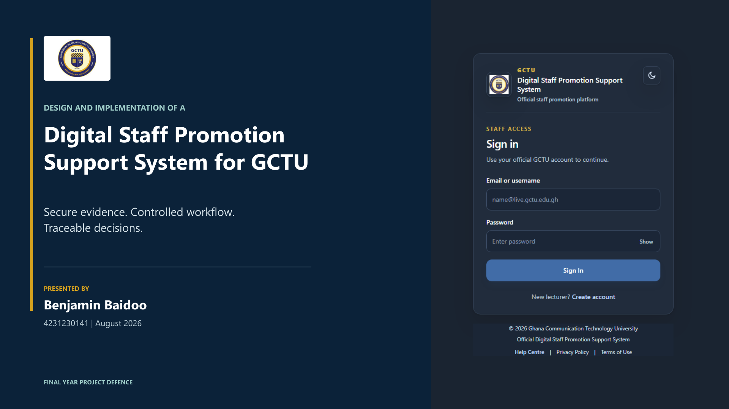
Notes:
Introduce the title, name, and scope in under 30 seconds. State that the project supports academic promotion decisions from evidence submission to final-outcome recording.

Slide 2
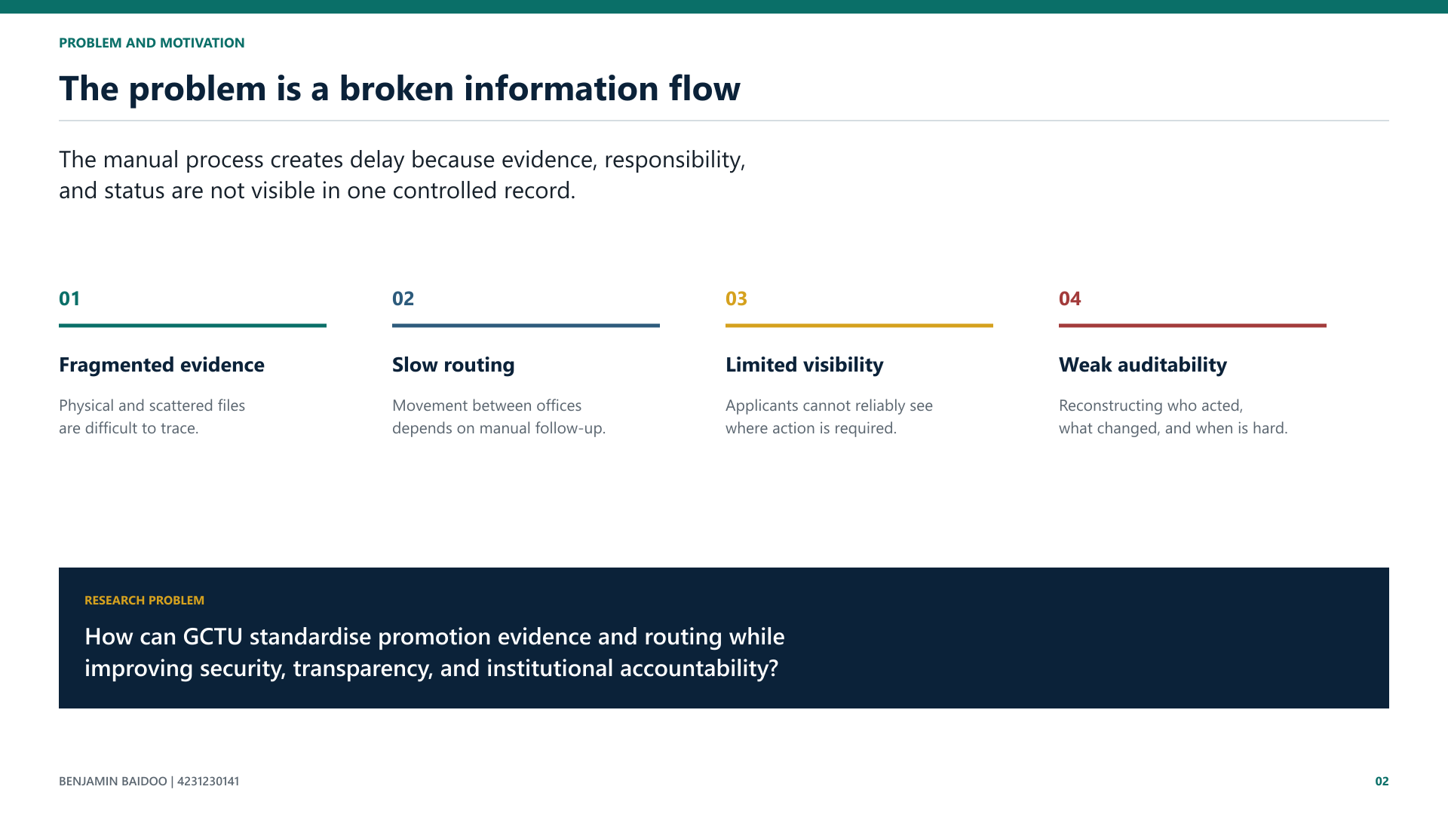
Notes:
Explain that the research problem is not merely the absence of a website. It is the absence of a consistent, secure, and auditable information flow.

Slide 3
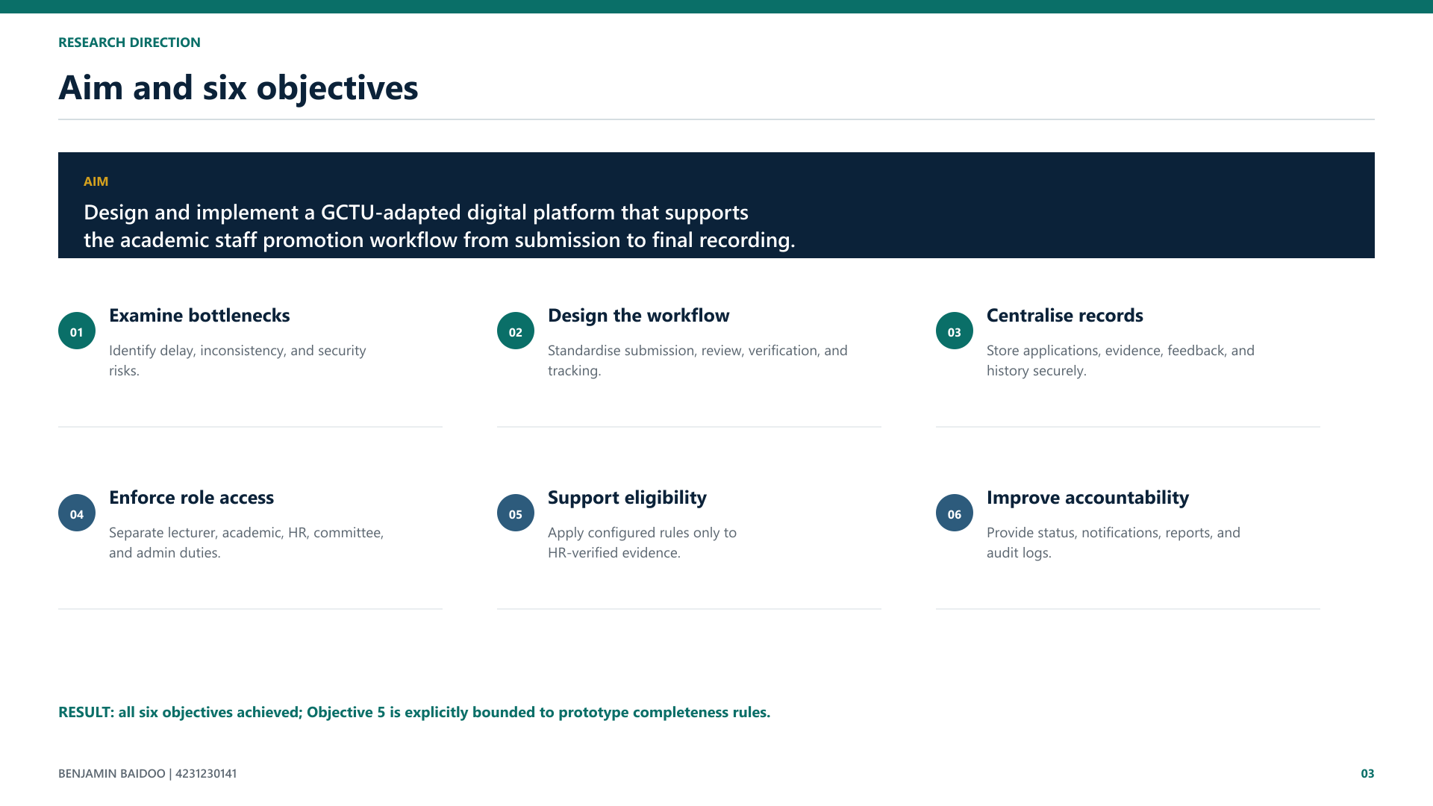
Notes:
Summarise the six objectives without reading them word for word. State that all were achieved and that eligibility was achieved within the declared prototype scope.

Slide 4
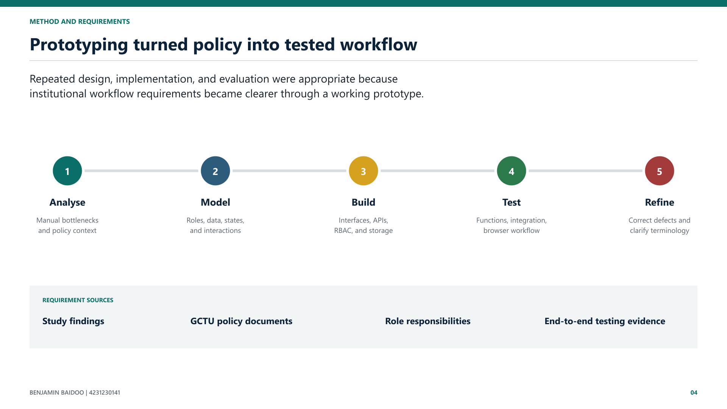
Notes:
Justify prototyping. Mention that the full running workflow exposed a scoring defect that code inspection alone had not revealed. Use the exact Chapter 3 sample figures only if asked.

Slide 5
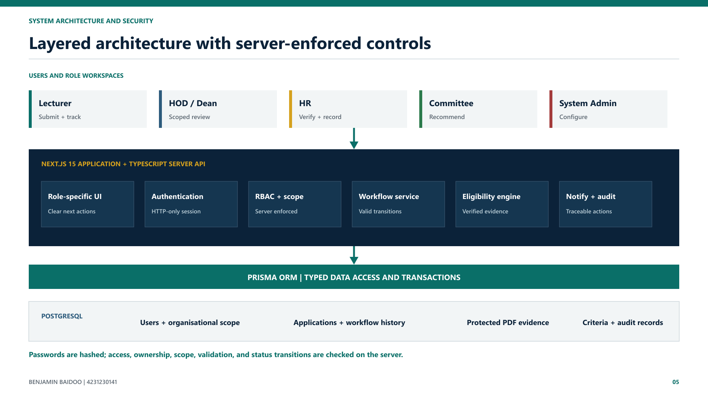
Notes:
Move from role workspaces to the Next.js application and TypeScript API, then through Prisma to PostgreSQL. Explain that server-side access, scope, ownership, validation, and workflow rules enforce security.

Slide 6
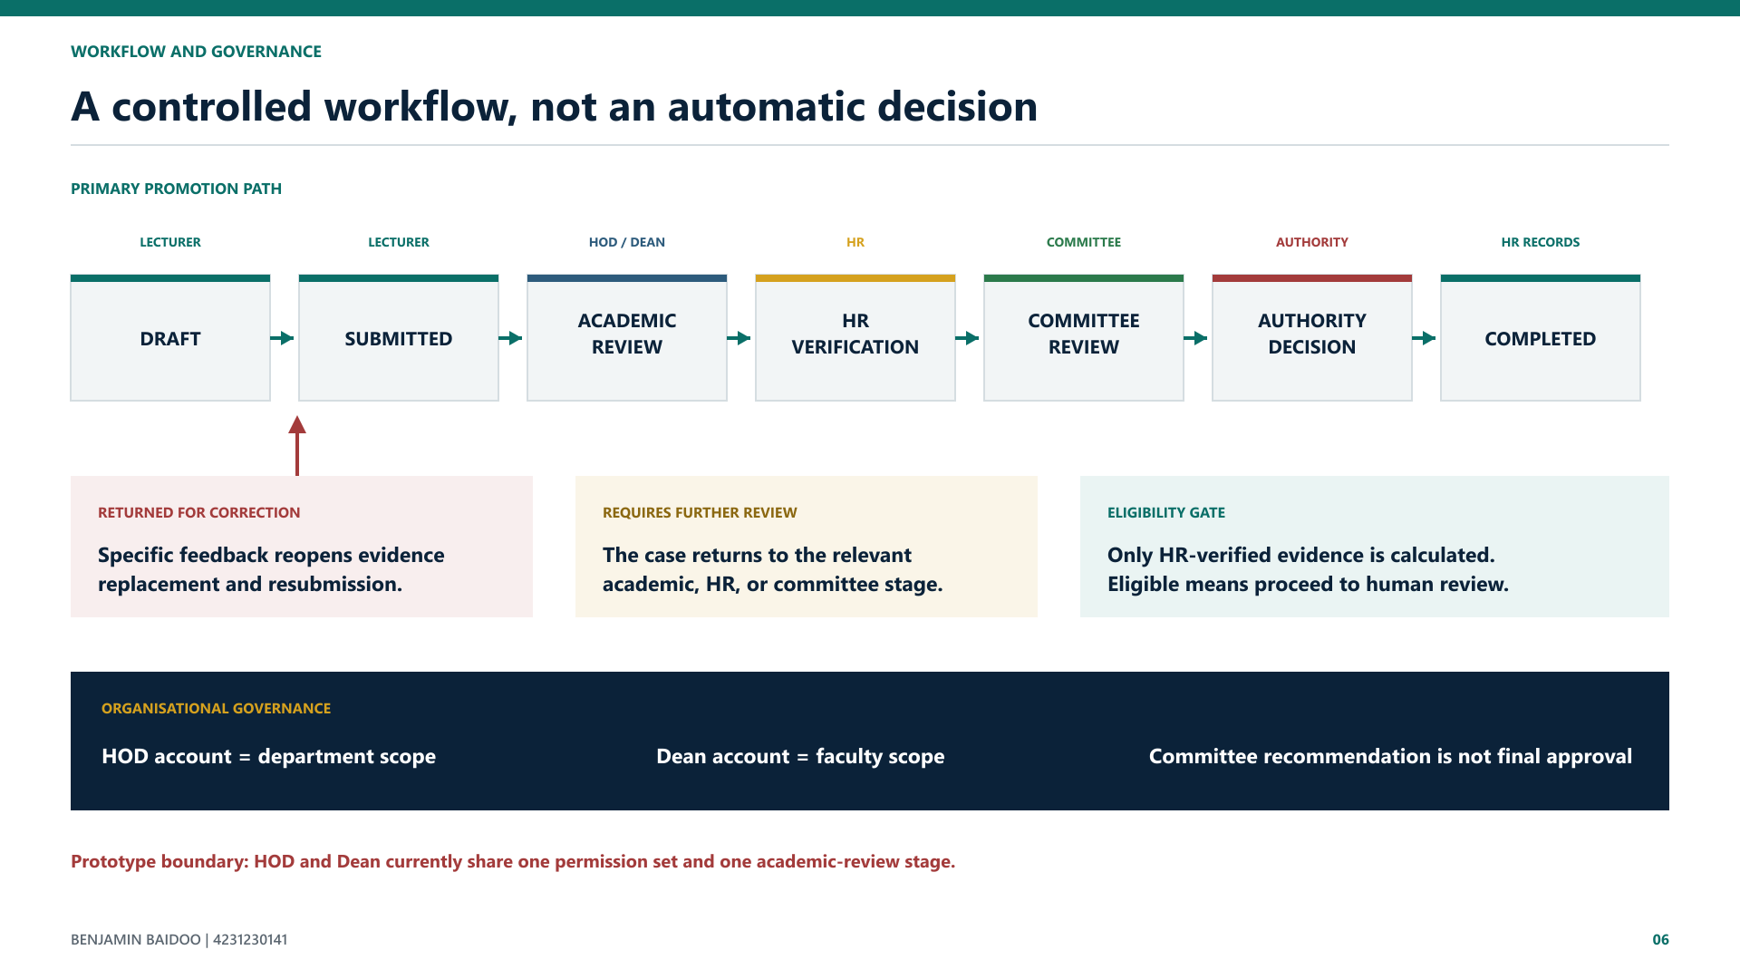
Notes:
Narrate the seven primary stages, then the correction and further-review loops. Explain department scope for HOD, faculty scope for Dean, and that committee recommendation is separate from authority approval.

Slide 7
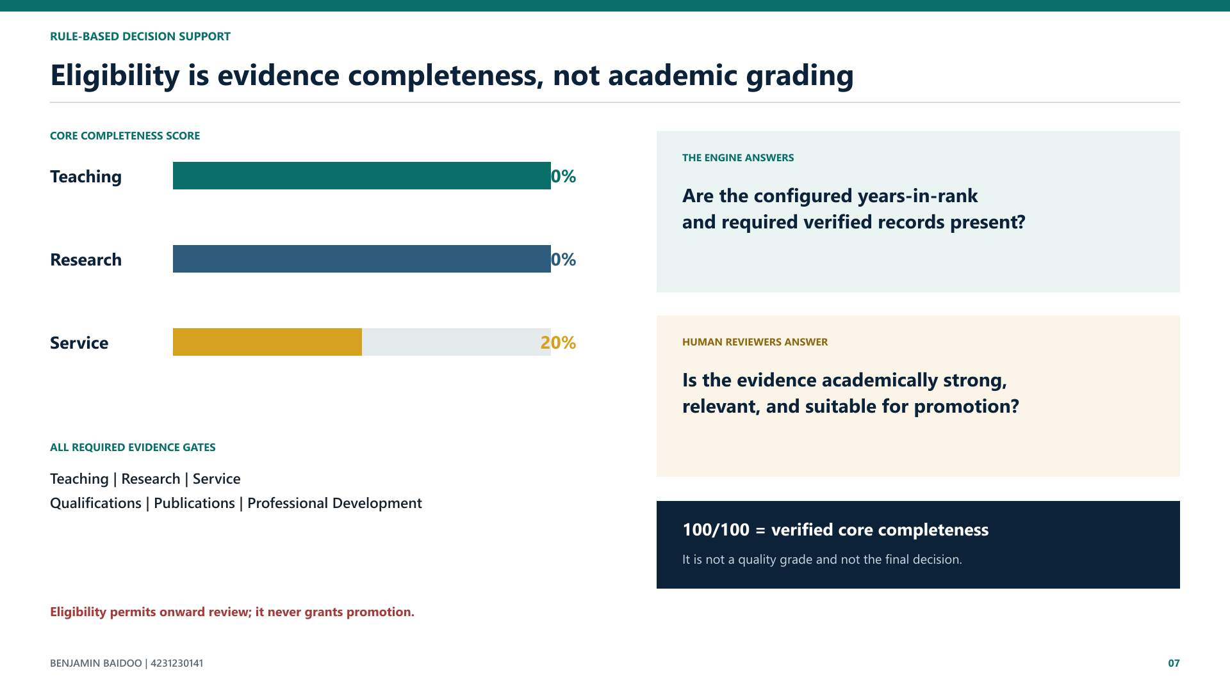
Notes:
Explain the 40-40-20 core completeness model and the six required evidence gates. Protect the distinction between completeness, eligibility, qualitative merit, and final decision.

Slide 8
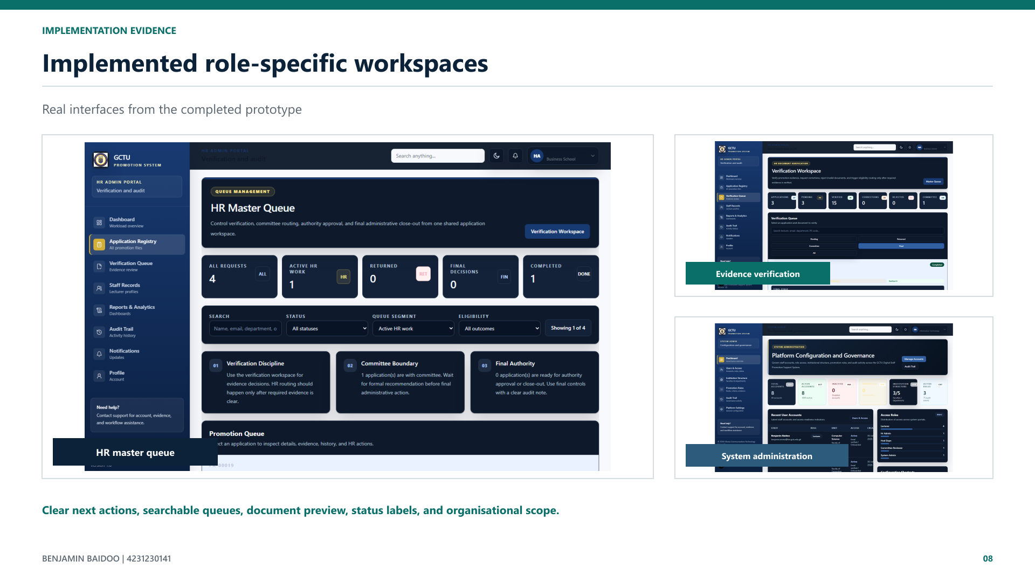
Notes:
Let the screenshots prove the implementation. Name the queue, document preview, criteria and structure management, and clear role-specific next actions. Do not describe every control.

Slide 9
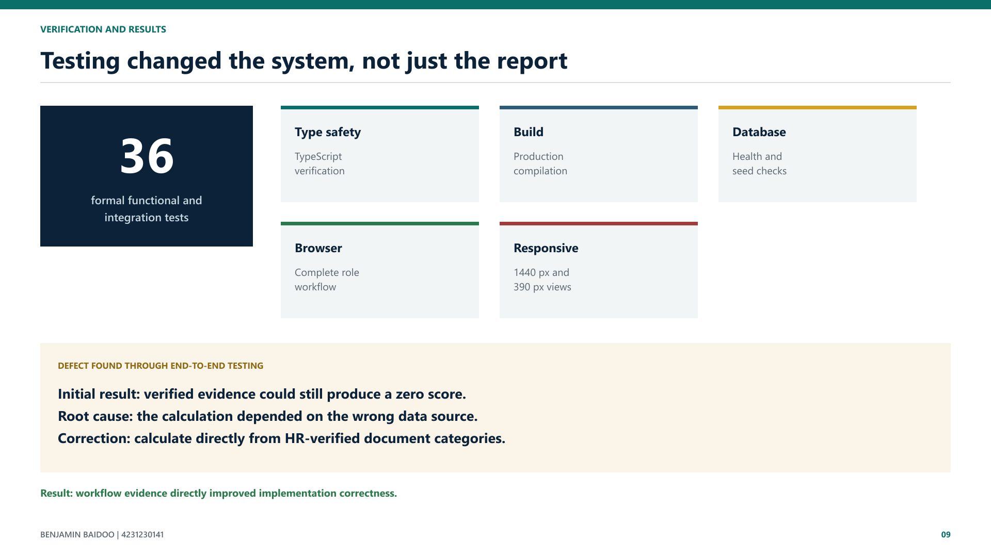
Notes:
State the test layers. Use the zero-score defect as the strongest evidence for prototyping and end-to-end testing. Explain the correction without drifting into code-level detail.

Slide 10
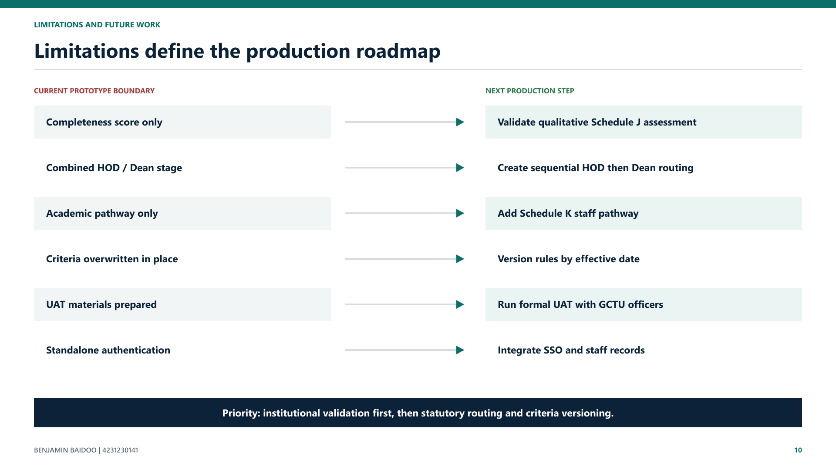
Notes:
State limitations plainly. Emphasise that formal UAT and institutional validation come before production deployment, followed by sequential routing and versioned criteria.

Slide 11

Notes:
Deliver the final three contributions, protect the decision-support boundary, and transition directly to the controlled Benjamin Baidoo demonstration.

