Slide 1


Presented by:
Ivann Aureus
Ulan Baigaskin
Ravan Gajievi
Hash + salt,
done properly
Web authentication security with Argon2id
01

Slide 2

Introduction & project objectives
Objective 1
Objective 2
Team roles
Secure authentication using Argon2id password hashing
Backup authentication, credential reset and centralized revocation
Builder, Breaker and Writer
02

Slide 3
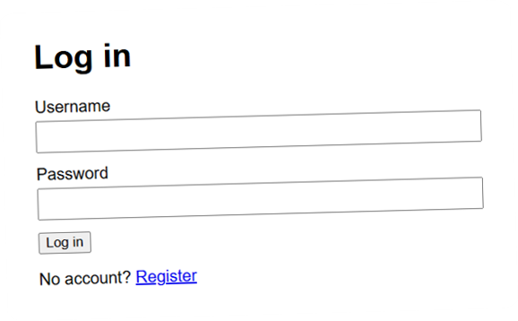
How it is built
System Architecture
01
02
03
04
Python Flask web application
SQLite database for users, sessions and recovery records
Browser-based registration, authentication and administration
Server-side authentication and session validation
03
Notes:
The browser is untrusted: password rules, rate limits and session checks all run in Flask. SQLite stores only hashes of passwords, backup codes, reset tokens and session tokens. The screenshot is our login page.

Slide 4
Password security
Password Security: Argon2id
Passwords are stored as salted Argon2id hashes
64 MiB
3
4
Unique salts: identical passwords never give identical stored hashes
memory
iterations
parallel lanes
Memory-hard hashing raises the cost of offline guessing
Verification reads the parameters stored with the hash
04
Notes:
The screenshot is the real output of check.py: m=65536 (64 MiB), t=3 iterations, p=4 lanes, then the salt and the hash. Our crack.py test showed Argon2id is about 46,000 times slower to guess than plain SHA-256 (T17). Because the parameters live in the hash string, they can be raised later.

Slide 5
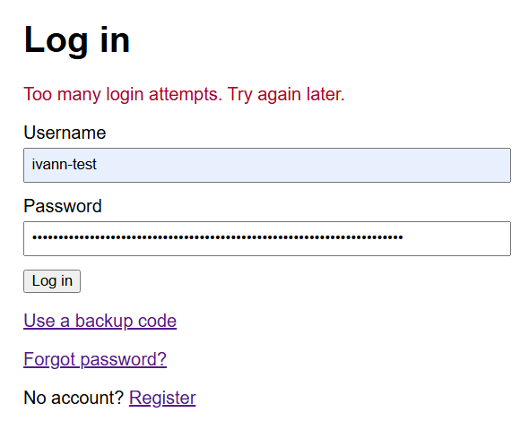
01
Login rate limiting reduces brute-force attempts
Login protection
Authentication &
Session Protection
02
Generic authentication errors reduce username enumeration
03
Fresh session tokens are generated after successful login
04
Secure, HttpOnly and SameSite=Lax cookie attributes
05
CSRF protection and server-side session invalidation
05
Notes:
The screenshot is PT-08: the sixth wrong try gets "Too many login attempts". Limits: the 6th wrong try in a minute from one IP, or the 11th in an hour on one account, gets HTTP 429. Unknown usernames still run one Argon2id check, so timing does not give them away. The cookie is __Host-sid; sessions expire after 30 minutes idle or 8 hours in total. Logout deletes the session on the server (T7, PT-12).

Slide 6
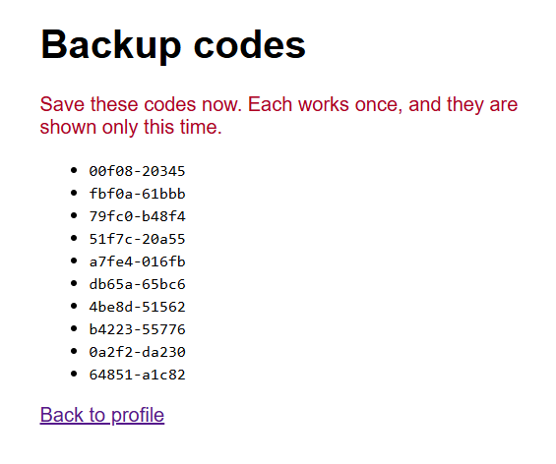
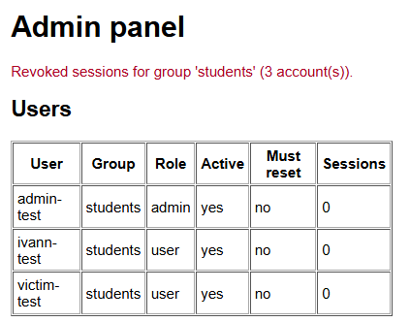
The full task
Recovery & Centralized
Administration
For users
10
single-use backup authentication codes
30
minutes until a reset token expires
→
a password reset invalidates existing sessions
For administrators
01
Revoke sessions or force credential resets, for one user or a whole group
02
Every action requires administrator reauthentication
03
Every action is written to the audit table
06
Notes:
Top right: the ten backup codes, shown only once; only their Argon2id hashes are stored. Bottom right: the admin panel after revoking the whole students group, three accounts with zero sessions (PT-17). Reset tokens are single use and only their SHA-256 is stored. Every admin action goes into the audit table.

Slide 7
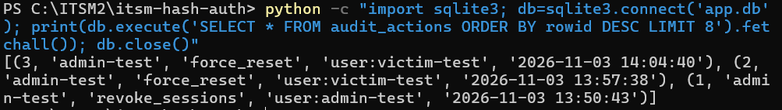
Penetration test · Ivann Aureus
20/20
Independent
Security Testing
tests passed within their scope
Scenarios
Scope
Tools
PT-01 to PT-20, run independently
Authentication, recovery, authorization, session management
Windows 11 VM, browsers, DevTools, PowerShell, SQLite
Found in PT-15: a possible duplicate administrator action, two force resets in the audit log
07
Notes:
Ivann tested the finished app on 3 November 2026 without having written the code. "Within their scope" means each test proves only the attack it tried. The PT-15 issue needs the admin role, the admin password and a CSRF token, so another user cannot trigger it. Fix: redirect after every admin POST.

Slide 8
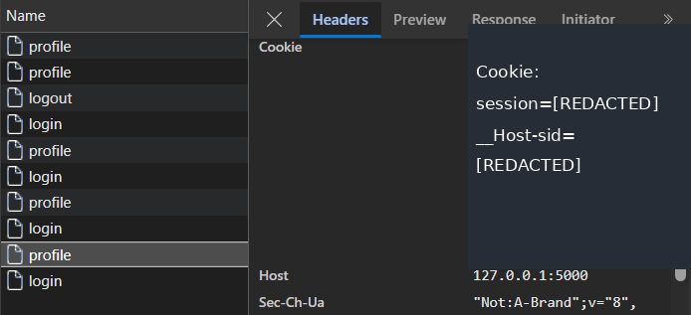
Live pentest
Live Pentest: Authentication & Session Security
Objective: evaluate authentication protection and session security through three penetration tests.
PT-08 Login rate limiting
PT-12 Session replay
PT-17 Group revocation
Six failed logins; the sixth must return HTTP 429
Capture the session cookie, log out, try to reuse it
Admin selects Revoke sessions, Whole group
Expected: extra logins are rate-limited, logged-out sessions are rejected, revoked sessions stop working.
08
Notes:
Screenshots are from Ivann's original runs. Before running live: debug mode off, test accounts ready, DevTools open on the Application tab. For PT-17, have two or three accounts from the same group logged in, ideally in different browsers.

Slide 9
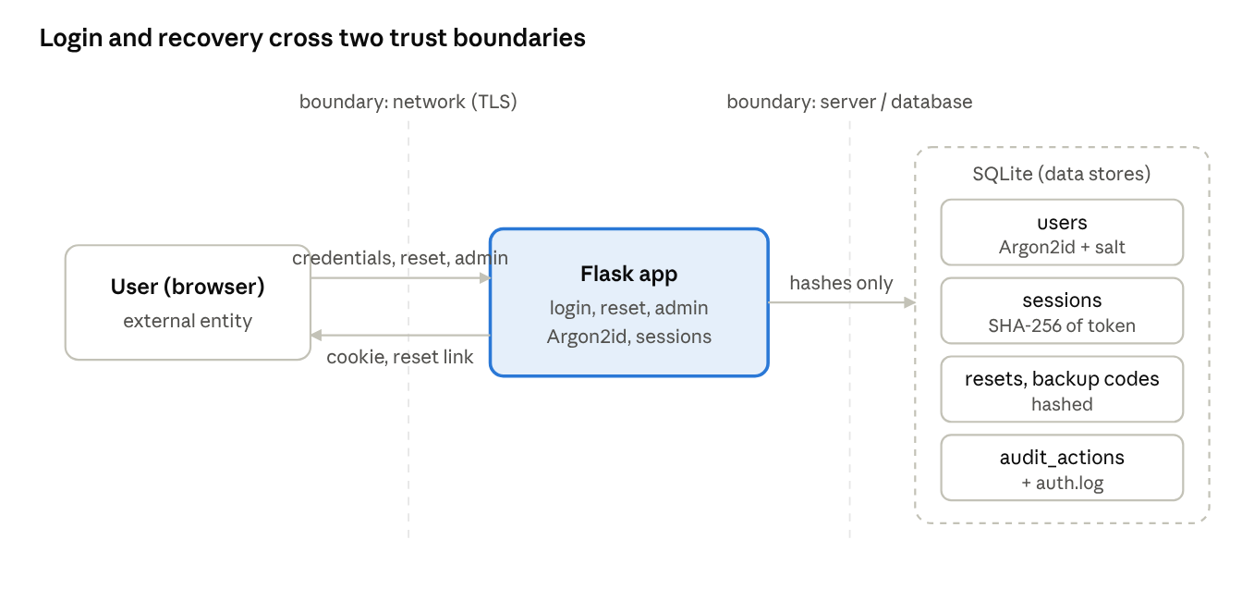
Threat model
STRIDE Threat
Modeling
S
Spoofing
T
Tampering
R
Repudiation
Password guessing and account impersonation
Session modification and forged requests
Denial of sensitive actions; audit logs answer it
Proof: T5, T8 · PT-02, PT-09
Proof: T13, T14 · PT-11, PT-18
Proof: T15 · PT-15
I
Information disclosure
D
Denial of service
E
Elevation of privilege
Database and credential exposure
Login flooding
Unauthorized administration
Proof: T1, T17 · PT-20
Proof: T8, T9 · PT-08
Proof: T22 · PT-05, PT-14
09
Notes:
The diagram is Figure 19 from the report: login and recovery cross two trust boundaries, the network (which needs TLS) and the server/database boundary (only hashes cross it). Defences: Spoofing - Argon2id, rate limits, generic errors, dummy hash. Tampering - server-side sessions, cookie flags, CSRF tokens. Repudiation - auth.log and the audit table. Information disclosure - only hashes stored. Denial of service - rate limits and a 16 KB request cap. Elevation - admin role check plus admin password per action. The Proof line on each tile names the tests whose screenshots are in the report.

Slide 10
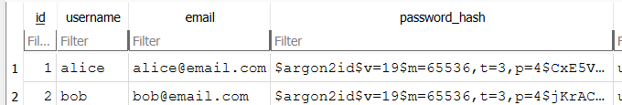
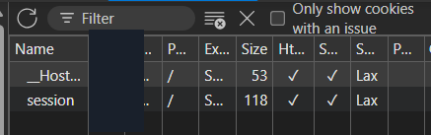
V6
Authentication: password policy and login protection
Checklist
OWASP ASVS 5.0
Security Assessment
01
Argon2id provides memory-hard password storage
T1: alice and bob share a password, but the salts differ
V7
Session management: secure sessions and revocation
02
The checklist marks each control as met, partly met or out of scope
03
Independent penetration tests support selected compliance claims
PT-18: __Host-sid with HttpOnly, Secure and SameSite=Lax
10
Notes:
Left: our three statements. Right: one piece of evidence per chapter. V6 - the users table shows two accounts with the same password but different Argon2id salts (test T1). V7 - DevTools shows the session cookie flags (PT-18). Gaps we report openly: V6.2.6 is partly met (masked field, no show-password button) and V6.2.12, the breached-password check, is not met; it is a Level 2 item.

Slide 11
Conclusion
Overall
Security Impact
& Conclusion
These features improve security when properly protected, although they expand the attack surface.
Argon2id
Backup authentication
strengthens password protection against offline guessing
improves account recovery but adds authentication risk
Credential reset
Centralized revocation
stays controlled through single-use, time-limited tokens
supports incident response by ending compromised sessions
11
Notes:
This answers the full task's question. Every addition is a new way into an account, so each got the same protection as the login: hashing, single use, expiry, rate limits and audit. The weakest link left is the email account behind the reset link. Thank the audience and take questions.

