Slide 1

Breadth-first search!
Algorithm for traversing or searching tree

Slide 2


Turing’s AI!
Bazhenov Shakarim
Baigazy Ramazan
Tanatov Aidar
Mukhtarbayev Marat
Nurlybek Saktagan

Slide 3
1. Introduction
What is Breadth-first search algorithm?

Slide 4
Breadth-first search!
Breadth-first search is an algorithm for traversing or searching tree or graph data structures. It starts at the tree root, and explores all of the neighbor nodes at the present depth prior to moving on to the nodes at the next depth level. It uses the opposite strategy of depth-first search, which instead explores the node branch as far as possible before being forced to backtrack and expand other nodes.
running time complexity: O(V+E)
memory complexity is not good: BFS stores lots of references
Worst-case performance O(|V|+|E|)=O(b^{d})
Worst-case space complexity O(|V|)=O(b^{d})

Slide 5
BFS Implementation process

Slide 6

2. Analysis
Time, Space Complexity and Completeness of BFS

Slide 7
Analysis
Time complexity
Space complexity
Completeness
The time complexity can be expressed as O(|V|+|E|), since every vertex and every edge will be explored in the worst case. |V| is the number of vertices and |E| is the number of edges in the graph. Note that O(|E|) may vary between O(1) and O(|V|²), depending on how sparse the input graph is.
When the number of vertices in the graph is known ahead of time, and additional data structures are used to determine which vertices have already been added to the queue, the space complexity can be expressed as O(|V|), where |V| is the number of vertices.
In the analysis of algorithms, the input to breadth-first search is assumed to be a finite graph, represented explicitly as an adjacency list, adjacency matrix, or similar representation. However, in the application of graph traversal methods in artificial intelligence the input may be an implicit representation of an infinite graph.

Slide 8
What are some more important practical uses of BFS?
Minimum Spanning Tree or shortest path
Peer to peer networking
Crawler for search engine
Social network websites - to find people with a given distance k from a person using BFS till k levels.

Slide 9
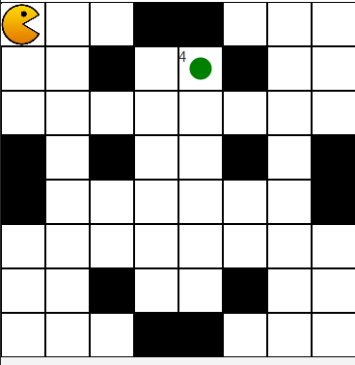
Example
Imagine we have a graph in the form of a uniform cellular maze. And there we have Pacman for which every 5 seconds food appears to which he must reach. We have to write an algorithm for finding the shortest path. Pacman should not go beyond the graph and not cross obstacles (black squares)
Let’s open this project!

Slide 10
Thanks!

