Slide 1
GeoData WS2023-2024<Group-K>
<Kabir Baig>, <matno1>

Slide 2
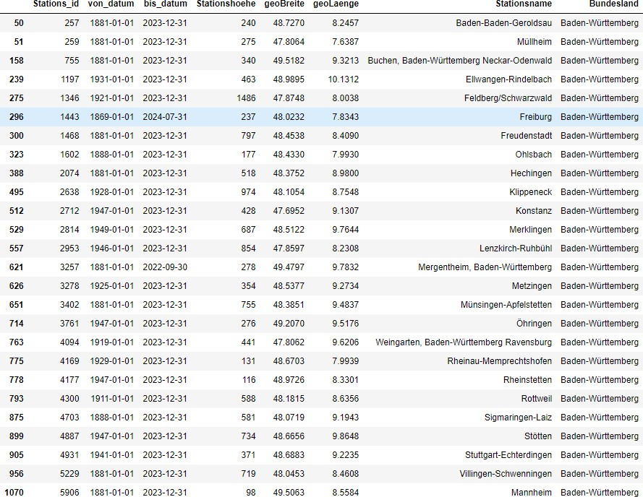
1. Warming Stripes (Sub- Task : 1.1)
Steps taken:
Step 1: Loaded the station description file using Pandas.
Step 2: Applied filters to select stations located
specifically in the Baden-Württemberg region.
Step 3: Further filtered the stations to include only those that are currently active and began recording data before 1950.
Step 4: The filtered data was then saved in an Excel file filtered_stations_Baden_Wurttemberg.xlsx.
This resulted in a final set of 26 stations meeting the criteria, which were used in subsequent steps.

Slide 3
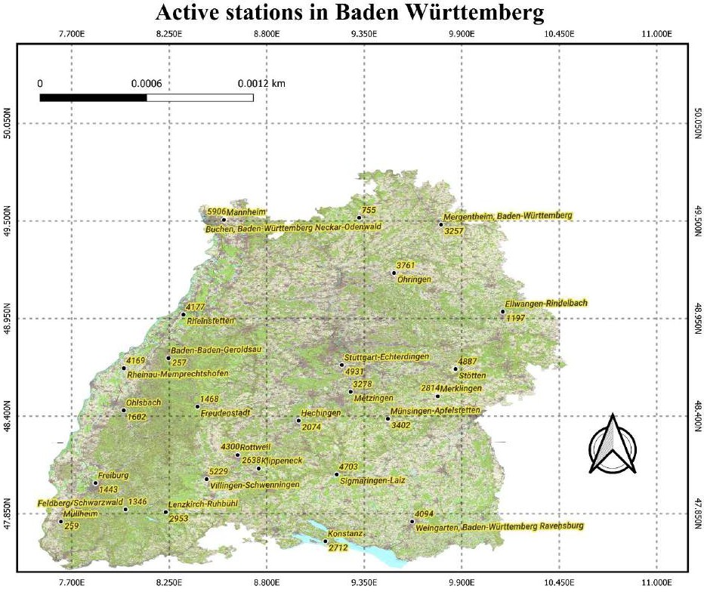
1. Warming Stripes (Sub- Task : 1.2)
Steps taken:
Step 1: Converted the filtered station data into a GeoDataFrame using Geopandas, which allowed us to handle geographic data.
Step 2: Reprojected the data into the EPSG:25832 coordinate system, which is commonly used for mapping in Europe, particularly in Germany.
Step 3: Saved the stations as a geopackage file (stations_BW.gpkg), which contains geospatial data and is compatible with QGIS.
Step 4: Opened the geopackage in QGIS and loaded the Baden-Württemberg WMS service as the base map.
Step 5: Designed the map to include labels for each station, showing both the station name and ID for clarity.

Slide 4
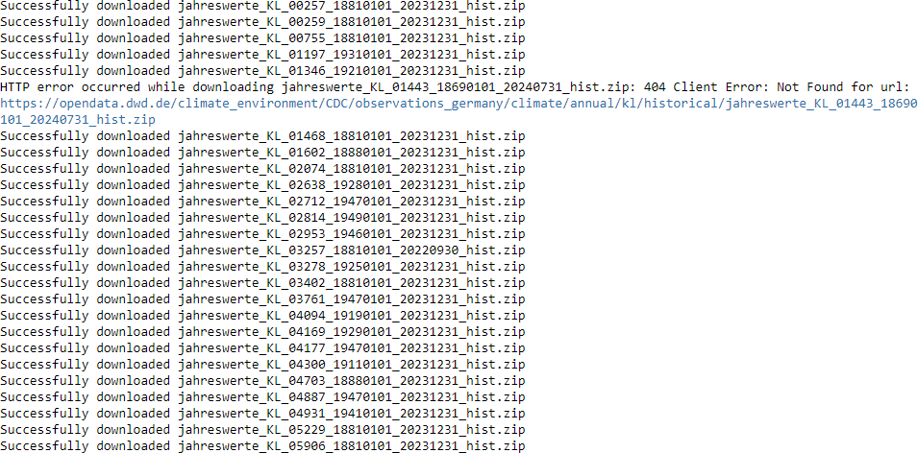
1. Warming Stripes (Sub- Task : 1.3)
Steps taken:
Step 1: Established an FTP connection to the DWD open data portal where historical temperature data is stored.
Step 2: Constructed a script that iterated over the list of selected station IDs (from Sub-Task 1.1) and downloaded the corresponding data files.
Step 3: Each data file was saved locally, and the data was extracted and cleaned to ensure consistency.
Step 4: The temperature data for all stations was then merged into a single dataset, which was ready for further analysis in Sub-Task 1.4.

Slide 5
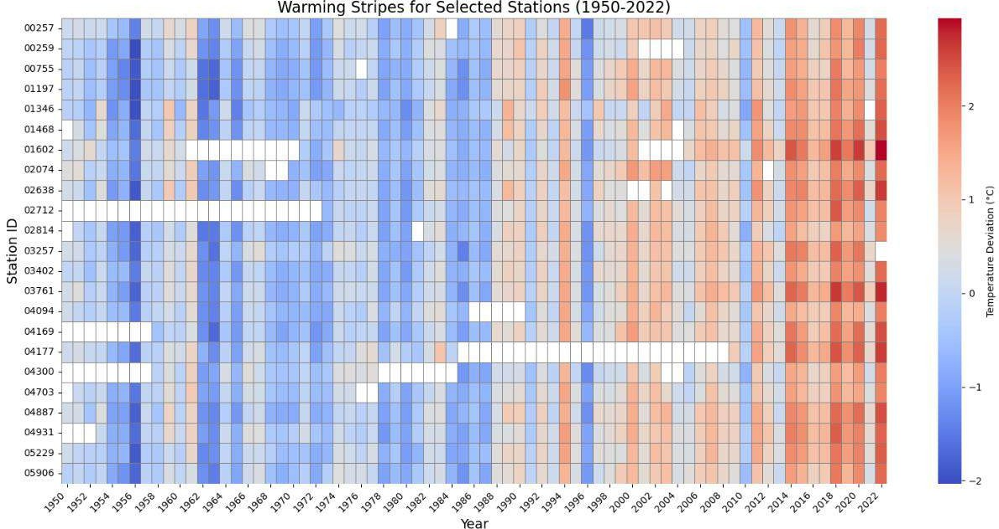
1. Warming Stripes (Sub- Task : 1.4)
Steps taken:
Step 1: For each station, we calculated the reference temperature by averaging the temperatures between 1971 and 2000.
Step 2: Calculated the deviation of each year's temperature from the reference value. Positive deviations indicate warmer years (shown in red), and negative deviations indicate cooler years (shown in blue).
Step 3: Used the Seaborn library to generate a heatmap where each stripe represents a year, and the color represents the deviation from the reference temperature.
Step 4: The final plot visualizes warming and cooling trends for each station from 1950 to 2022, giving a clear picture of climate change in the region.

Slide 6
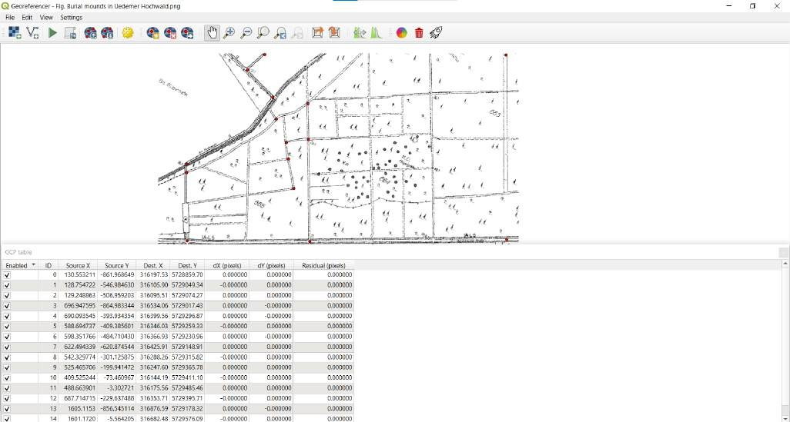
2. Digitization: Burial Mounds in Uedemer Hochwald (Sub- Task : 2.1)

Slide 7
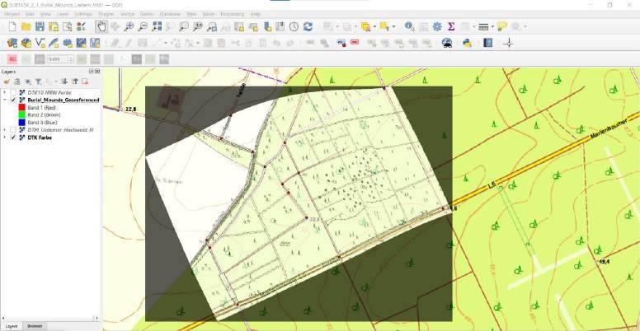
2. Digitization: Burial Mounds in Uedemer Hochwald (Sub- Task : 2.1)
Steps taken:
Step 1: Loaded the historical burial mounds map into QGIS.
Step 2: Identified control points (forest trails, roads, and junctions) that are clearly visible both on the map and on the DTK10 topographic layer.
Step 3: Used QGIS’s Georeferencer tool to align the burial mounds map to real-world coordinates. Added the georeferenced map back to the project with EPSG:25832 projection.

Slide 8
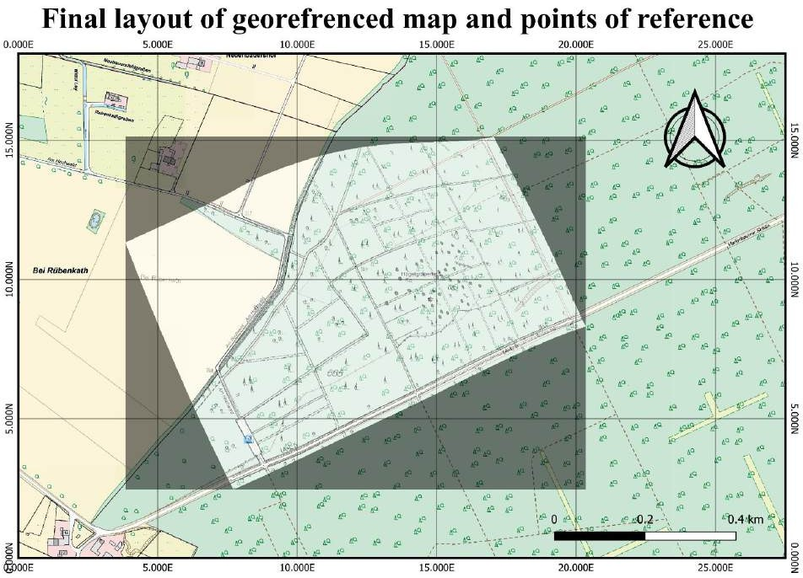
2. Digitization: Burial Mounds in Uedemer Hochwald (Sub-Task : 2.1)
Judgement:
The georeferencing process was highly accurate, as confirmed by the proper alignment of key landmarks like crossroads and forest trails. This ensures that further analyses of the burial mounds are based on reliable geospatial data.

Slide 9
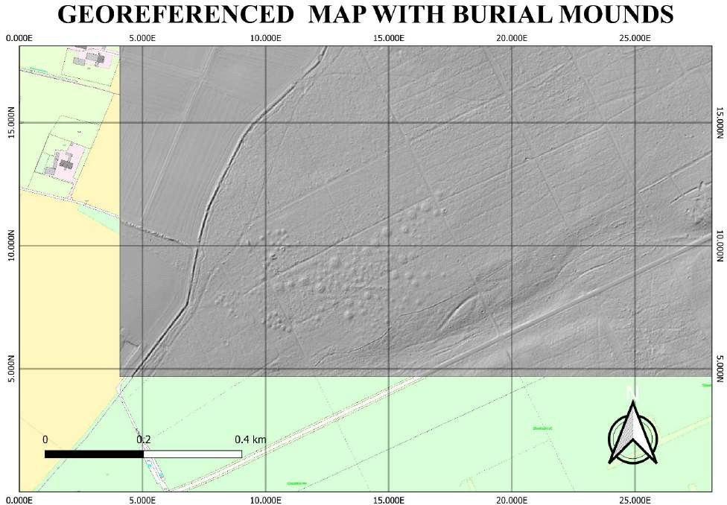
2. Digitization: Burial Mounds in Uedemer Hochwald (Sub-Task : 2.2)
Steps taken:
Step 1: Created a hillshade model from the DTM layer using QGIS.
Step 2: Overlaid the georeferenced burial mounds map onto the hillshade model.
The burial mounds map was made semi- transparent for better visual comparison with the terrain.
Step 3: Analyzed the burial mound positions in relation to the topography visible in the hillshade model.

Slide 10
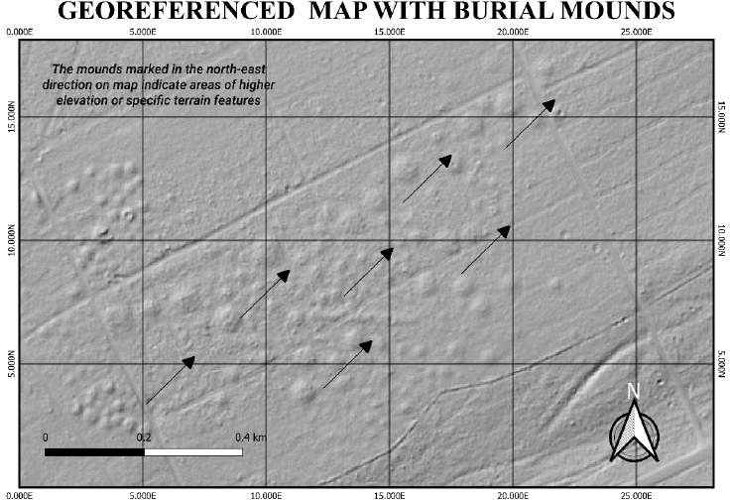
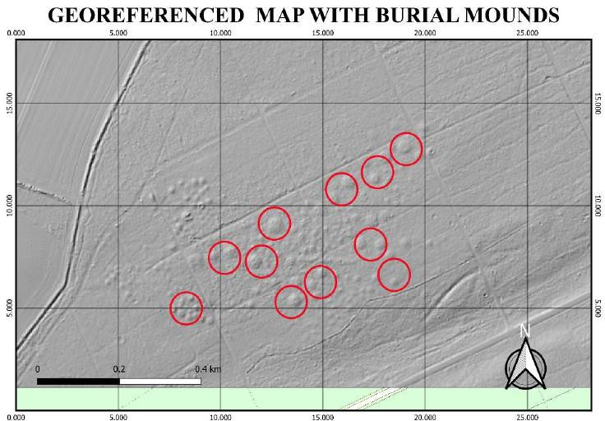
2. Digitization: Burial Mounds in Uedemer Hochwald (Sub-Task : 2.2)
Judgement:
The burial mounds appear prominently in the hillshade model, indicating that the mounds were properly georeferenced in Sub-Task 2.1. The comparison with the terrain demonstrates that these mounds correspond to real topographical features.

Slide 11
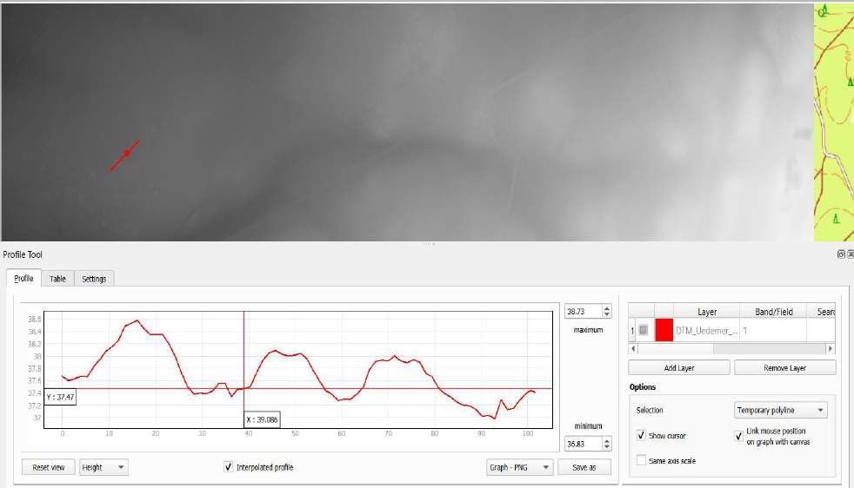
2. Digitization: Burial Mounds in Uedemer Hochwald (Sub-Task : 2.3)
Steps taken:
Step 1: Used the Profile Tool in QGIS to draw lines across the burial mounds and measure the elevation profiles.
Step 2: Recorded and analyzed the elevation profiles to calculate the relative heights of the mounds compared to their surroundings.
Step 3: Visualized the elevation profiles in graphs for better understanding of the height variations.

Slide 12
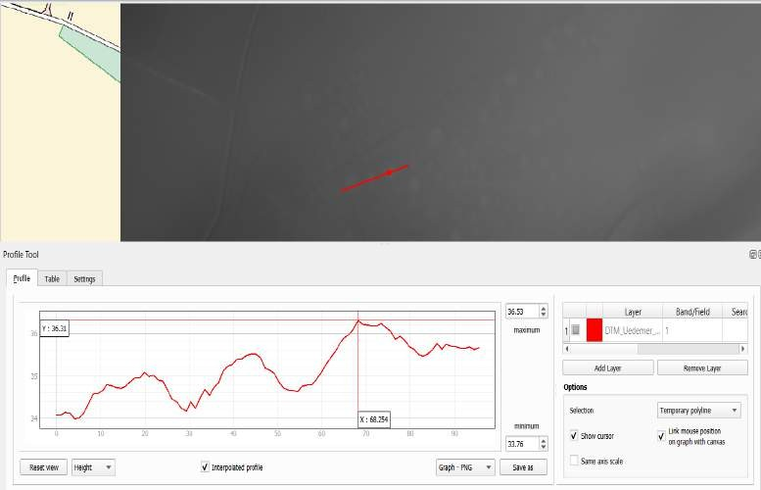
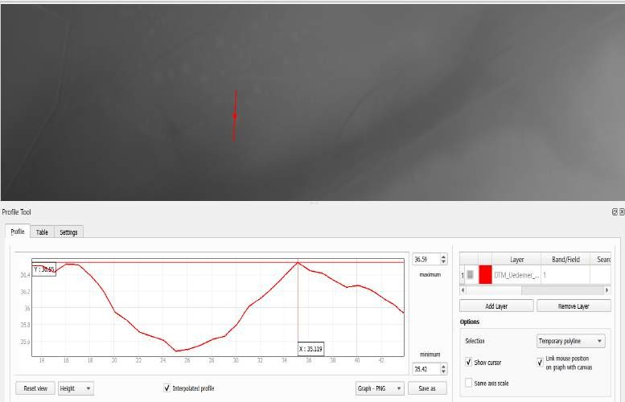
2. Digitization: Burial Mounds in Uedemer Hochwald (Sub-Task : 2.3)
Judgement:
The elevation differences measured between the mounds and their surrounding environment confirm that these structures were intentionally raised, likely for ceremonial or burial purposes. The mounds are distinct, man-made features in the landscape.

Slide 13
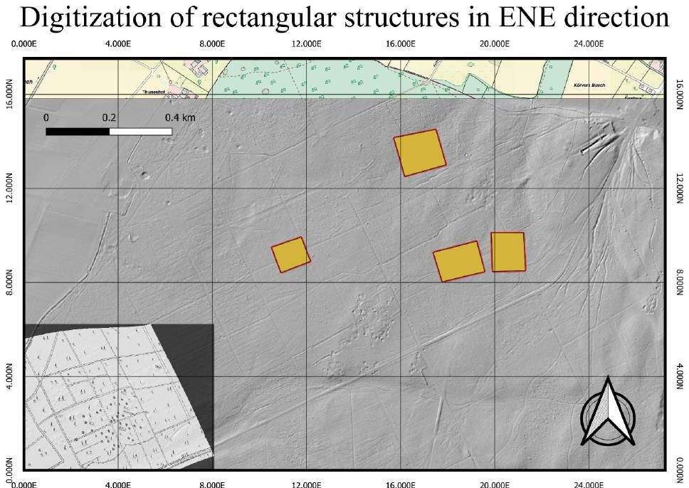
2. Digitization: Burial Mounds in Uedemer Hochwald (Sub-Task : 2.4)
Steps taken:
Step 1: Analyzed the hillshade model to locate faint rectangular patterns, likely remnants of ancient structures or terrain modifications.
Step 2: Digitized these structures in QGIS by creating polygons around the visible patterns.
Step 3: Saved the digitized structures in a geopackage for further analysis or visualization.

Slide 14
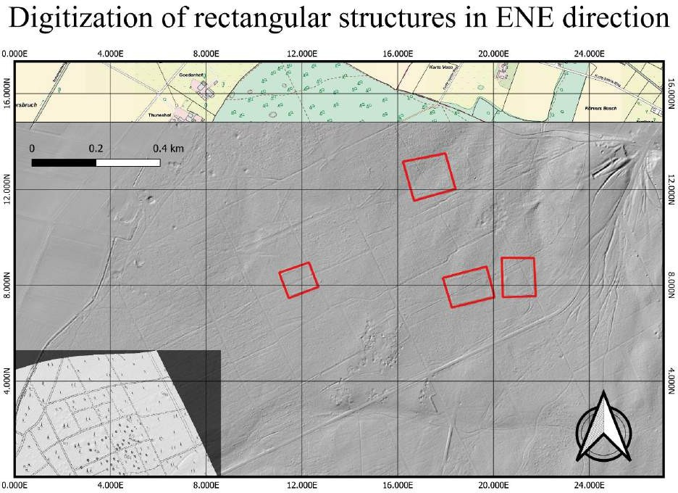
2. Digitization: Burial Mounds in Uedemer Hochwald (Sub-Task : 2.4)
Judgement:
These rectangular structures are likely ancient remains of settlements or enclosures.
Their size and alignment suggest purposeful human construction, rather than natural terrain formations.

Slide 15
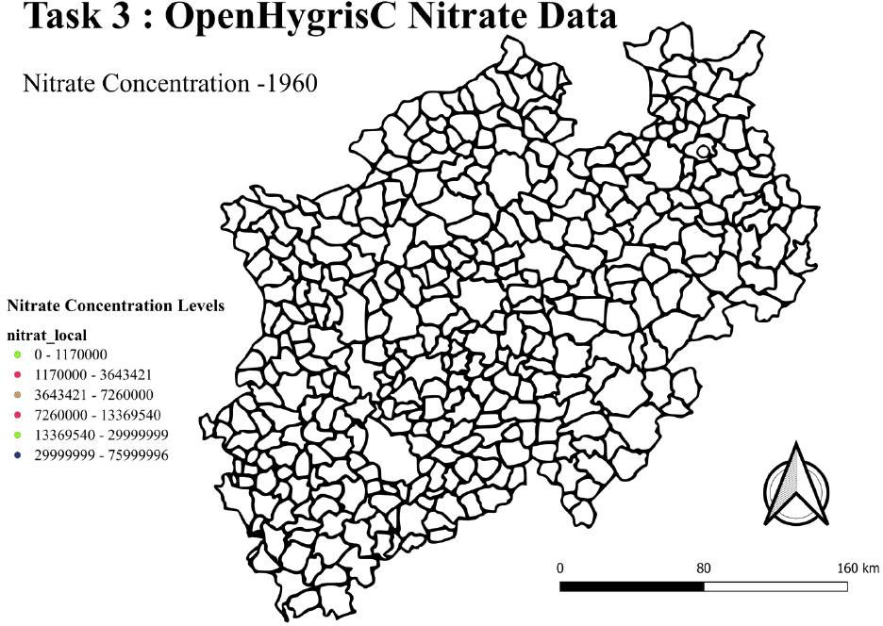
3. OpenHygrisC Nitrate Data: Create a Movie with the QGIS Temporal Controller Connected to PostgreSQL / PostGIS
Explanation:
In the question, we were asked to observe the time-varying nitrate concentration data. The temporal analysis shows increasing nitrate concentration levels in many areas, particularly in agricultural regions, reflecting the effects of fertilizer use and other industrial activities. This visualization highlights the importance of monitoring groundwater quality over time.
Visit this link for Nitrate Concentration Animation

Slide 16
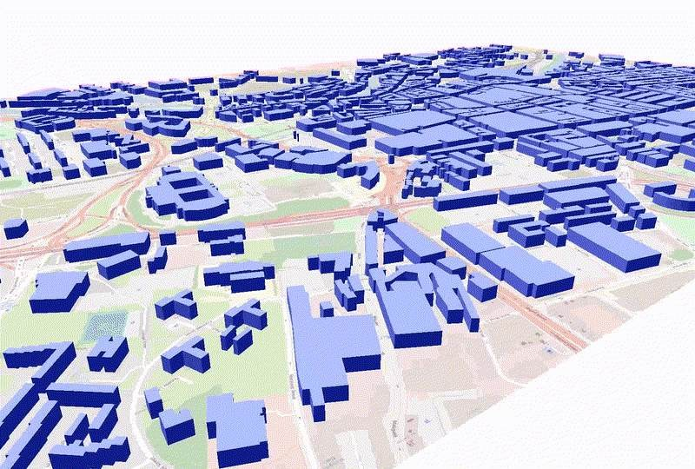
4. 3D Map Creation and Animation Using QGIS and Python
Explanation:
The 3D map was constructed by using the building footprint shapefiles and extruding them vertically based on the attribute data for building heights. The animation created from this 3D map shows various perspectives of the city's structures, offering a clearer understanding of the spatial arrangement and vertical dimensions of the buildings.
Visit this link for 3D Map Animation

Slide 17
<matno>: Your Personal View
Biggest challenges?
Task 3
Lessons learned?
Examples provided in education show examples, but visualising data from the real world is much more challenging and can require a lot of processing and cleaning before analysis.
Whatever you want to say related to course, …

Slide 18
<matno>: Self-Assessment, Part 1 (give short answers)
What is your role in the group?
Managed all tasks.
Which (sub)tasks are you responsible for?
I have worked on all task.
With whom have you been cooperating?
---

Slide 19
<matno>: Self-Assessment, Part 2
(On a scale from 1 (poor) to 5 (very good))
What is your personal knowledge gain?
5
How do you rate your commitment?
5
How difficult is your task?
5

