Slide 1
Support Vector Machine (SVM) Algorithm

Slide 2
Support Vector Machine (SVM) is a supervised machine learning algorithm used for classification and regression tasks. While it can handle regression problems, SVM is particularly well-suited for classification tasks.
SVM aims to find the optimal hyperplane in an N-dimensional space to separate data points into different classes. The algorithm maximizes the margin between the closest points of different classes.

Slide 3
Terminology
Hyperplane: A decision boundary separating different classes in feature space, represented by the equation wx + b = 0 in linear classification.
Support Vectors: The closest data points to the hyperplane, crucial for determining the hyperplane and margin in SVM.
Margin: The distance between the hyperplane and the support vectors. SVM aims to maximize this margin for better classification performance.
Kernel: A function that maps data to a higher-dimensional space, enabling SVM to handle non-linearly separable data.
Hard Margin: A maximum-margin hyperplane that perfectly separates the data without misclassifications.
Soft Margin: Allows some misclassifications by introducing slack variables, balancing margin maximization and misclassification penalties when data is not perfectly separable.
C: A regularization term balancing margin maximization and misclassification penalties. A higher C value enforces a stricter penalty for misclassifications.

Slide 4
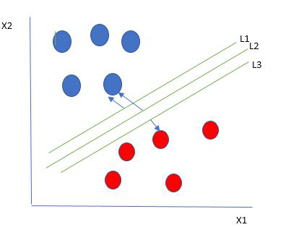
The key idea behind the SVM algorithm is to find the hyperplane that best separates two classes by maximizing the margin between them. This margin is the distance from the hyperplane to the nearest data points (support vectors) on each side.
The best hyperplane, also known as the “hard margin,” is the one that maximizes the distance between the hyperplane and the nearest data points from both classes. This ensures a clear separation between the classes. So, from the above figure, we choose L2 as hard margin.

Slide 5
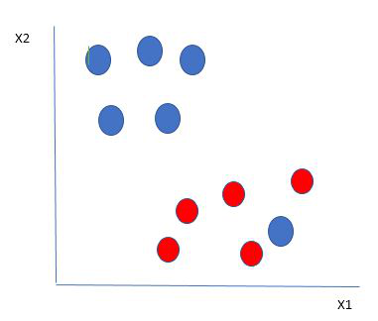
The blue ball in the boundary of red ones is an outlier of blue balls. The SVM algorithm has the characteristics to ignore the outlier and finds the best hyperplane that maximizes the margin. SVM is robust to outliers.

Slide 6
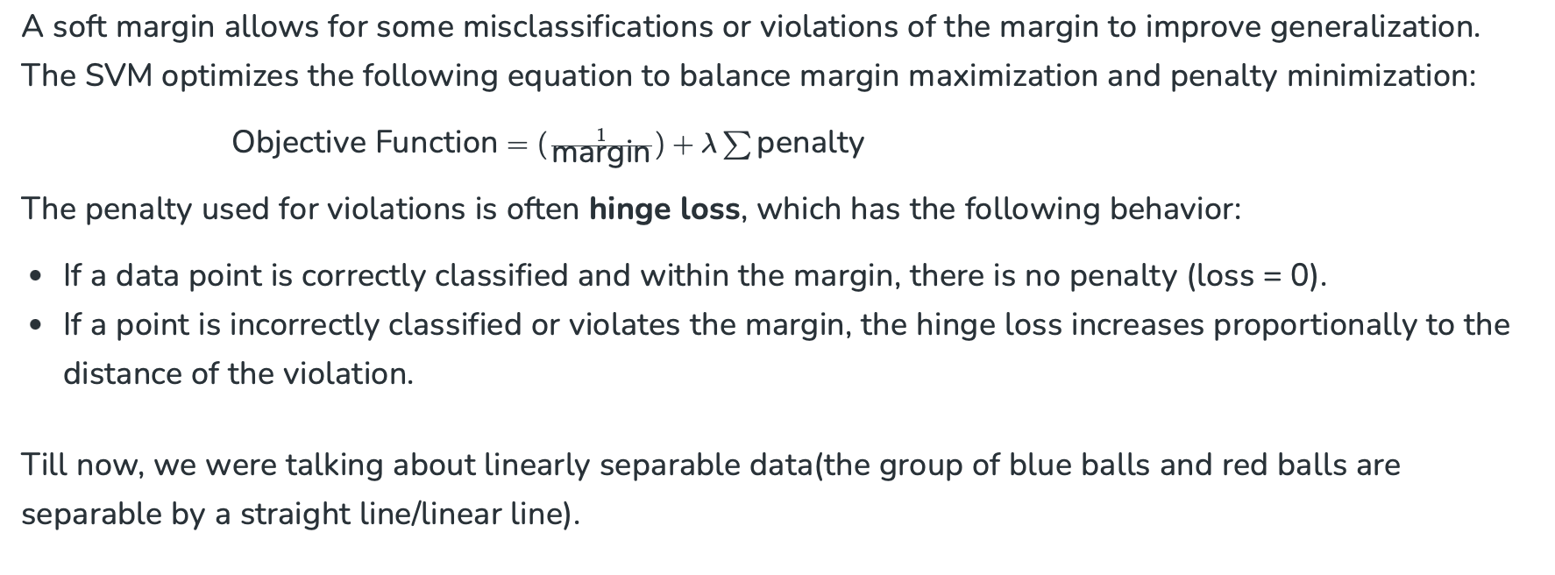
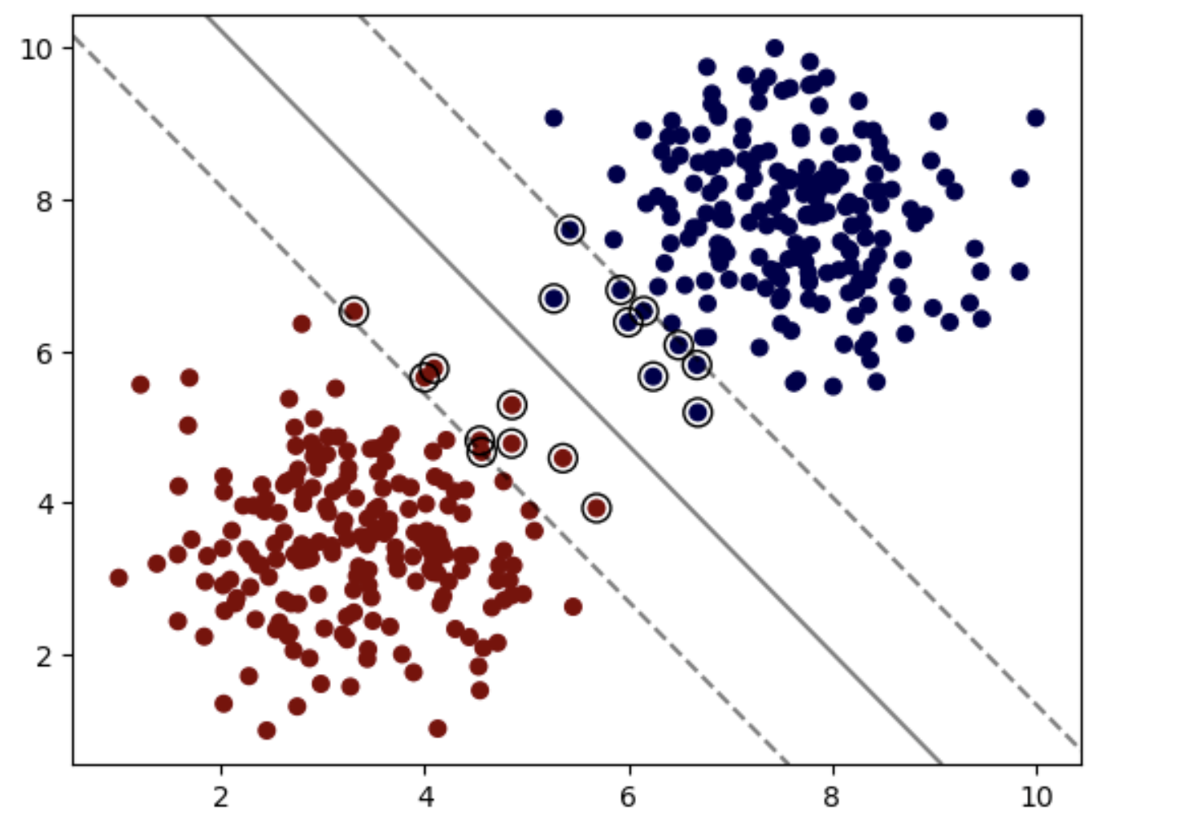

Slide 7
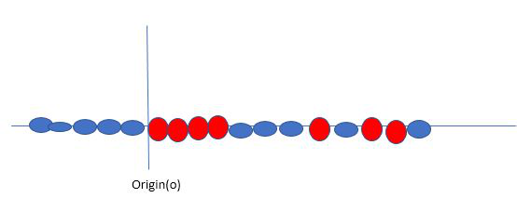
not linearly separable data
When data is not linearly separable (i.e., it can’t be divided by a straight line), SVM uses a technique called kernels to map the data into a higher-dimensional space where it becomes separable. This transformation helps SVM find a decision boundary even for non-linear data.

Slide 8
A kernel is a function that maps data points into a higher-dimensional space without explicitly computing the coordinates in that space. This allows SVM to work efficiently with non-linear data by implicitly performing the mapping.
For example, consider data points that are not linearly separable. By applying a kernel function, SVM transforms the data points into a higher-dimensional space where they become linearly separable.
Linear Kernel: For linear separability.
Polynomial Kernel: Maps data into a polynomial space.
Radial Basis Function (RBF) Kernel: Transforms data into a space based on distances between data points.

Slide 9
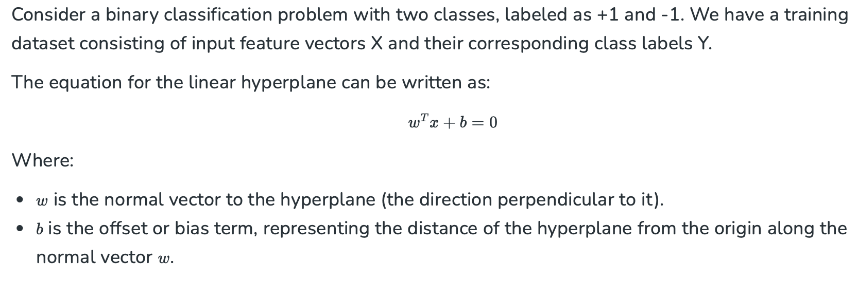
Mathematical Computation: SVM

Slide 10
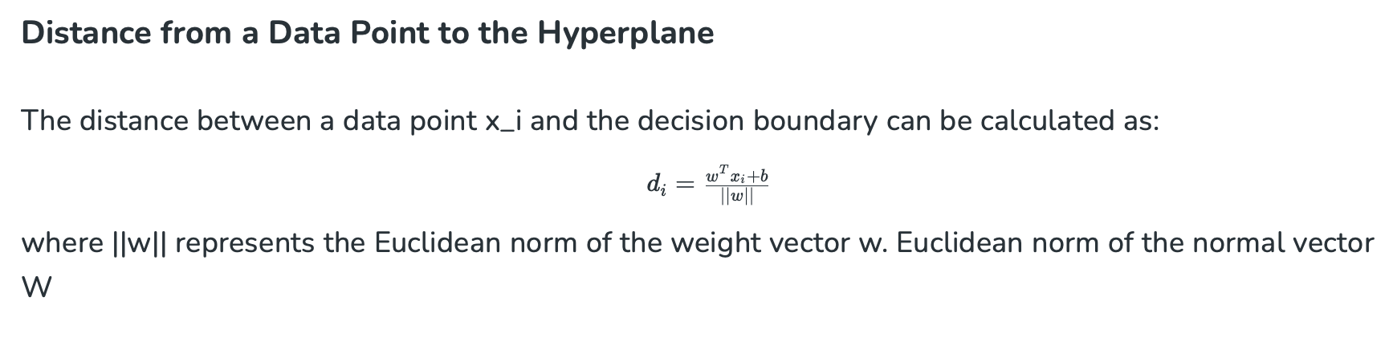

Slide 11
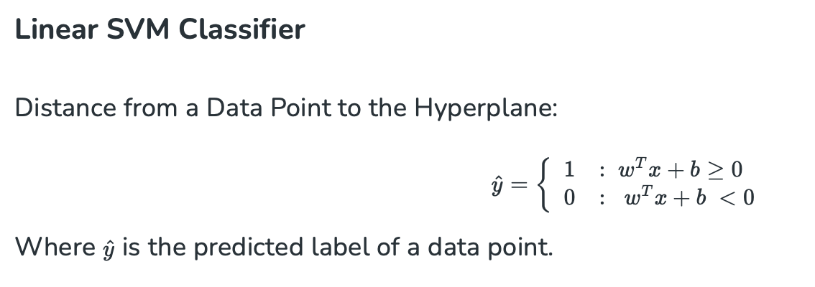

Slide 12
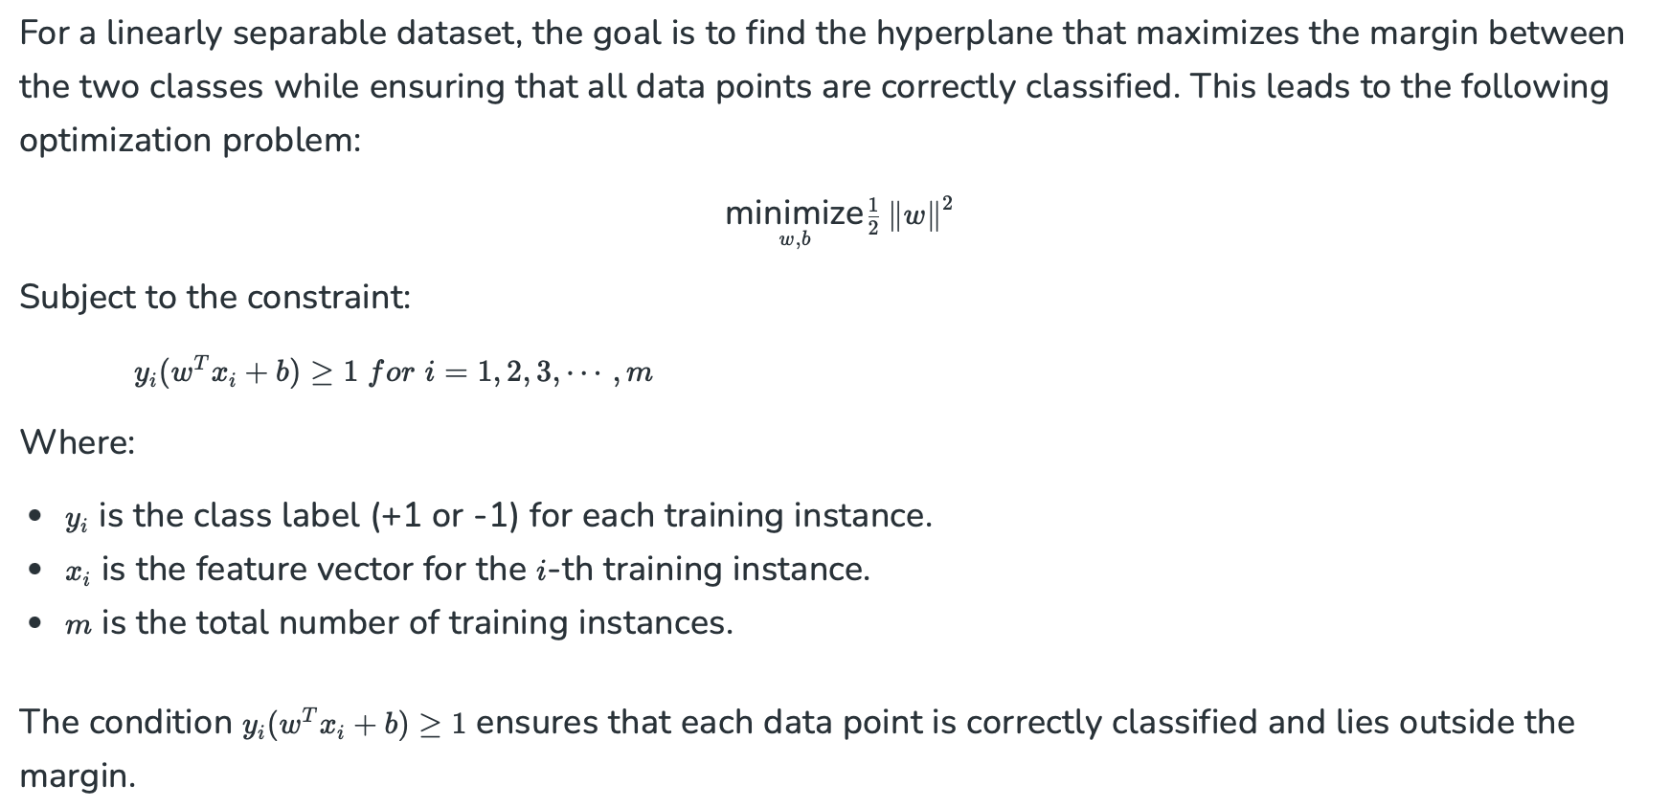

Slide 13
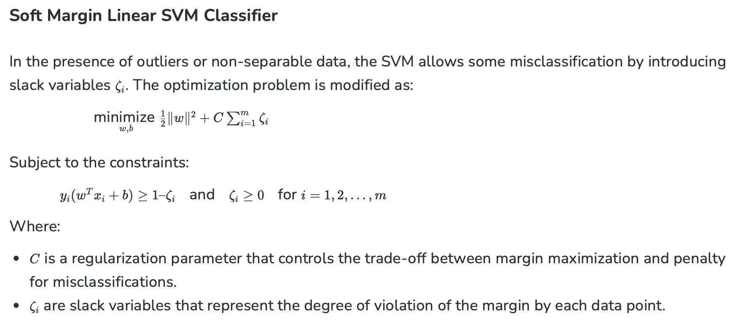

Slide 14
Types of Support Vector Machine
Linear SVM: Linear SVMs use a linear decision boundary to separate the data points of different classes. When the data can be precisely linearly separated, linear SVMs are very suitable. This means that a single straight line (in 2D) or a hyperplane (in higher dimensions) can entirely divide the data points into their respective classes. A hyperplane that maximizes the margin between the classes is the decision boundary.
Non-Linear SVM: Non-Linear SVM can be used to classify data when it cannot be separated into two classes by a straight line (in the case of 2D). By using kernel functions, nonlinear SVMs can handle nonlinearly separable data. The original input data is transformed by these kernel functions into a higher-dimensional feature space, where the data points can be linearly separated. A linear SVM is used to locate a nonlinear decision boundary in this modified space.

