Slide 1
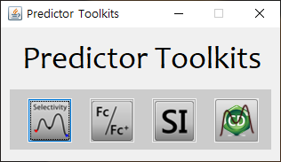
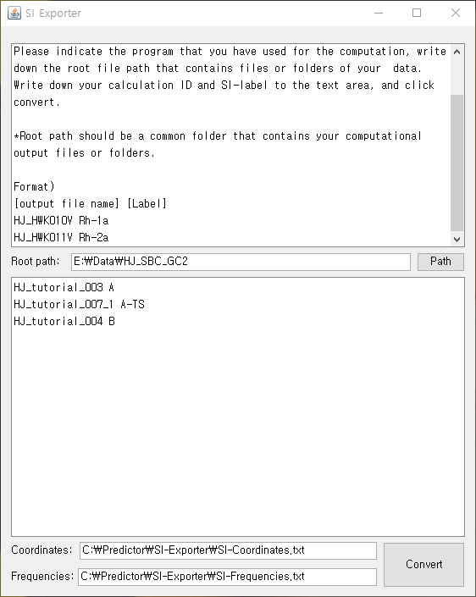
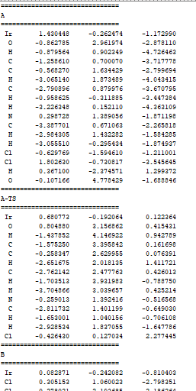
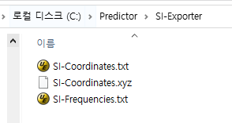
Exporting Cartesian Coordinates
Step 0. Launch Predictor Toolkits.
Step 1. Click “SI-Exporter”.
Step 2. Fill in the proper root directory that contains your computational results.
Step 3. Fill in the [output file name] [label] that will be seen in your combined xyz file.
Step 4. Check the directory for XYZ exportation, and click “Convert” button.
(1)
(2)
(3)
(4)

Slide 2
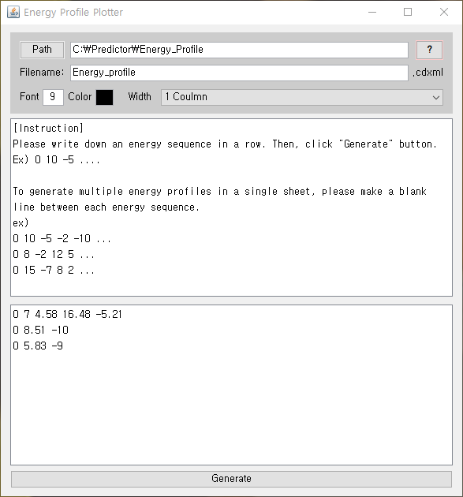
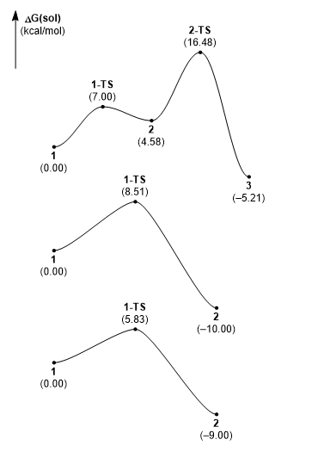
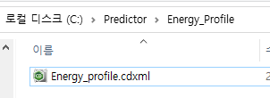
Automatic generation of energy profiles
Step 0. Launch Predictor Toolkits.
Step 1. Click “Energy profile plotter”.
Step 2. Fill in the proper energy sequences.
➔ Energy sequence should be in a row.
➔ Multiple energy sequences will give multiple energy profiles
Step 3. Click “Generate” button.
(1)
(2)
(3)

