Slide 1
APARTMENT FINDER
HOUSING PEOPLE SINCE JANUARY 2021

Slide 2
Contents
Problem Statement
Proposed Solution
Entity Relationship Diagram
Database Objects
Project Flow
Useful Reports
Team Members
LET’S DEMO

Slide 3
Problem statement
User may switch the account from normal to premium and vice-versa, which will be difficult to track manually.
Unable to retrieve all the listings proposed by a particular user, since users and listings are stored in separate files.
Multiple users are signing-up with the same username and it is difficult to prevent this by manually searching the existing usernames. This causes data inconsistency.
Difficult to find the deal proposed by a user for one of his/her listing details manually.

Slide 4
Proposed solution
Specific listings are marked as premium, which would mean that customers with a subscription ID are allowed access to those listings. They can also unsubscribe at any time they choose.
The database design will help to link the Users and Listings with the help of a FOREIGN KEY in this case which will be the POSTER ID key which will act as a bridge table and connect users to listings and a smooth data flow and consistency.
All the users will be provided with a CUSTOMER-ID, where ID being the primary key hence giving every user a unique number. The database clearly shows that in the customer table that as soon as you register you would be provided with a key.
In the design there is a separate table for the tags where the users can change the tags as well as rent according to their need and change to their convenience.

Slide 5
Diving into specifics
DATABASE OBJECTS, their relationships and the data flow
Notes:
Consider talking about:
School and university
Project management
Civil and military construction and industry infrastructure
Computer software
State project

Slide 6
TABLE LIST
STATE
CITY
STREET
TAGS
ADDRESS
POSTER
AREA
LEASE_TYPE
PROPERTY_TYPE
MANAGEMENT
LISTING
LISTING_STATUS
LISTING_TAGS
CUSTOMER_TYPE
CUSTOMER
SUBSCRIPTIONS
COMPLAINTS
QUERY
OFFER

Slide 7
Public view LIST
ADDRESS_LIST
CUSTOMER_TYPE_LIST
PROPERTY_TYPE_LIST
LEASE_TYPE_LIST
USER_LISTINGS
USER_PREMIUM_LISTINGS
ADDRESS_<customer>
CUSTOMER_<customer>
ADDRESS_<poster>
MY_LISTINGS_<poster>
POSTER_<poster>

Slide 8
Procedure, package & TRIGGER list
WELCOME
CUSTOMER_SIGNUP
POSTER_SIGNUP
CUSTOMER_ACTIONS
POSTER_ACTIONS
LISTING_OPERATIONS.ADD_LISTING
LISTING_OPERATIONS_DELETE_LISTING
PREMIUM_SIGNUP
ABANDON_PREMIUM
QUESTION
COMPLAINT
LISTING_STATUS_TRIGGER

Slide 9
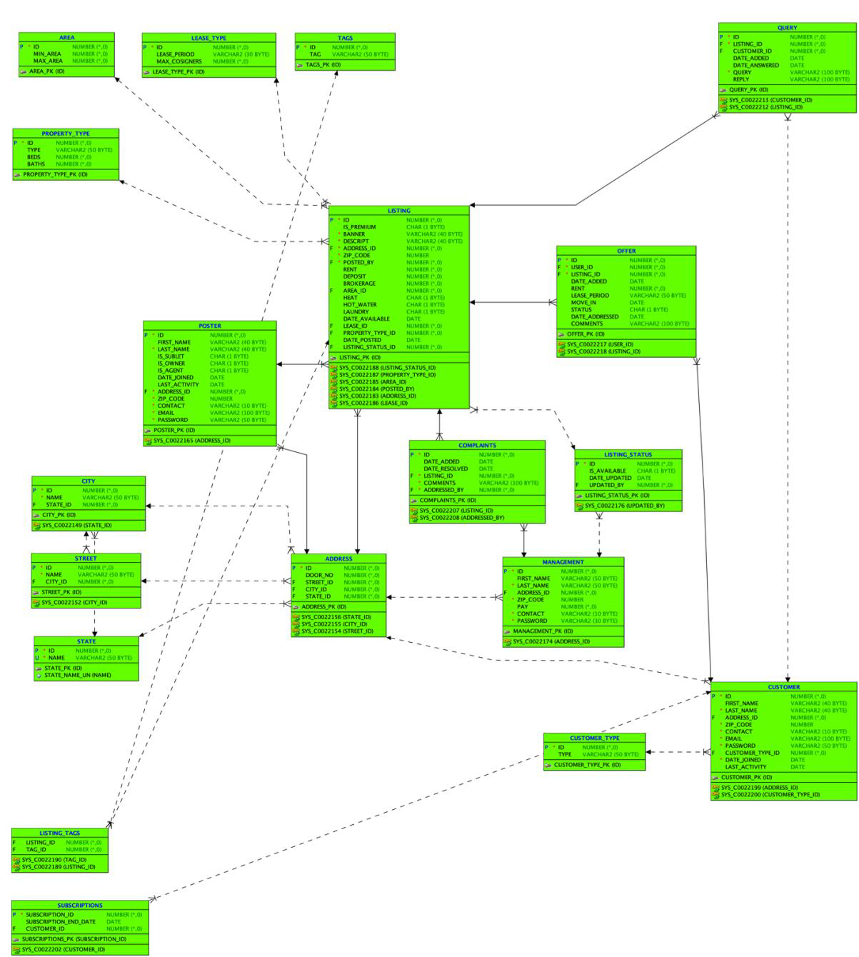
ER diagram

Slide 10
Project flow
Start with user VISITOR
Sign on as a Customer and a Poster
As a Poster, create premium and non premium postings
As a customer, view non premium postings. Then sign up for premium account and view premium postings
An exhaustive list of views, procedures and reports for user assistance

Slide 11
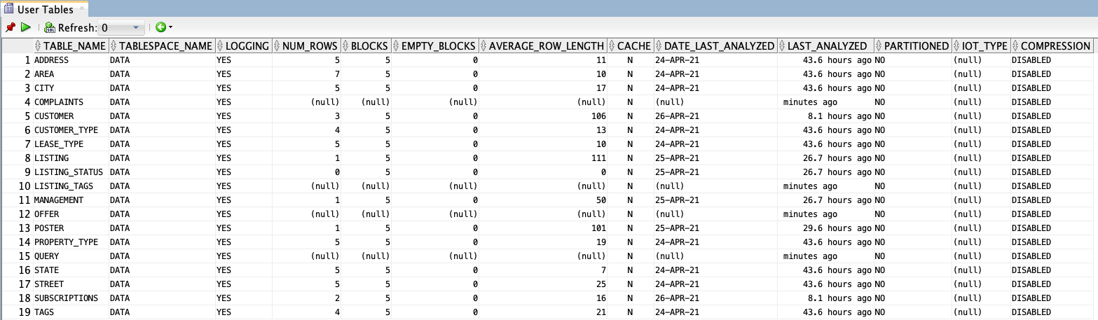
USEFUL REPORTS
Reports->Data Dictionary Reports->Table->User Tables

Slide 12
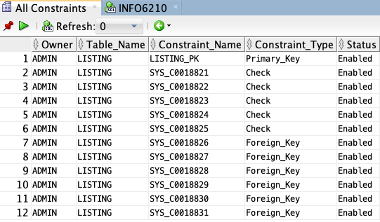
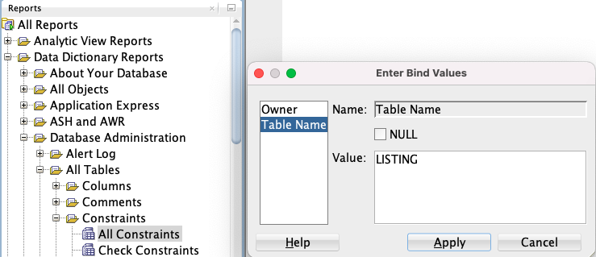
USEFUL REPORTS
Reports->Data Dictionary Reports->Database Administration -> Constraints ->All Constraints

Slide 13
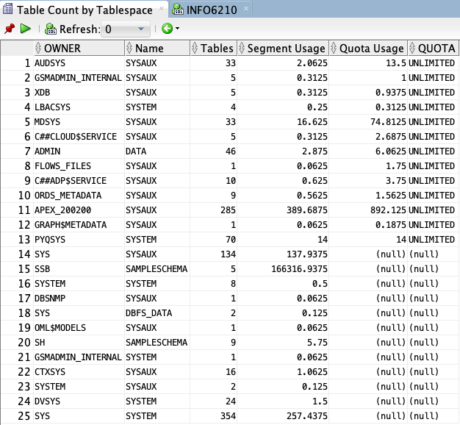
USEFUL REPORTS
Reports->Data Dictionary Reports->Database Administration -> Storage -> Table Count by Tablespace

Slide 14

USEFUL REPORTS
Reports->Data Dictionary Reports->Database Administration -> Sessions -> Active Session Counts

Slide 15
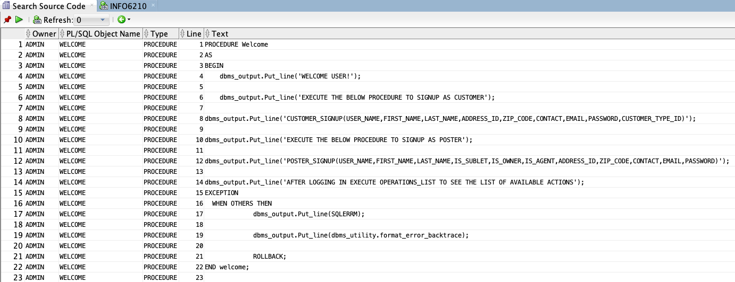
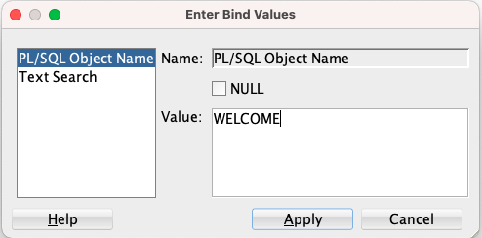
USEFUL REPORTS
Reports->Data Dictionary Reports->Database Administration -> PLSQL -> Search Source Code

Slide 16
YOURS TRULY
Sunit Bail : 001577432
Rochak Nath :001563060
Ravinder Rao Madhavaram : 001541885
Nikhil Nethaji Reddy Mallepally : 001541881

Slide 17
LET’S DEMO

