Slide 1

Unit 16 – Procedural Programming
with Ben Read

Slide 2
AIMS & OBJECTIVES
Comprehend the function and usage of single and multi-dimensional arrays
Analyse code examples to determine their optimal usage
Partake in a self-paced tutorial to revise concepts covered in this session

Slide 3
ARRAYS
An array is a group (or collection) of data of the same type. For example an int array holds the elements of int types while a float array holds the elements of float types.

Slide 4
WHY DO WE NEED ARRAYS?
Consider a scenario where you need to find out the average of 100 integer numbers entered by a user.
In C, you have two ways to do this:
Define 100 variables with the integer data type and then code 100 scanf() operations to store the entered values in the variables, and then calculate the average of them.
Have a single integer array of 100 elements to store all the values. Use a loop to save all the entered values in the array, one at a time, and then calculate the average.

Slide 5
HOW TO DECLARE AN ARRAY
An array can be any data type, e.g. double, float, long, etc.
int num[35]; //An integer array with 35 elements
char ch[10]; //An array of 10 characters

Slide 6
ACCESSING AN ARRAY’S ELEMENTS
You can use array subscript (or index) to access any element stored in an array. Subscript starts with 0 which means arr[0]
represents the first element in the array arr.
As the first element is 0, not 1, when referencing elements you must always remember to subtract 1 from the element you wish to access, e.g.
arr[3] contains the fourth element in the arr array

Slide 7
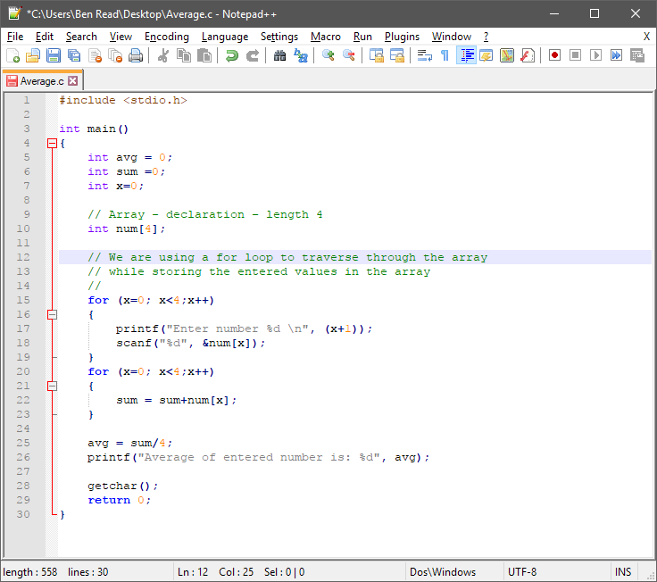

Slide 8
INPUTTING DATA
for (x=0; x<4;x++)
{
printf("Enter number %d \n", (x+1));
scanf("%d", &num[x]);
}
Here we are iterating the array from 0 to 3 because the size of the array is 4. Inside the loop we are displaying a message to the user to enter the values. All the input values are stored in the corresponding array elements using the scanf() function.

Slide 9
OUTPUTTING DATA
for (x=0; x<4;x++)
{
printf(“number[%d]\n”, num[x];
}
A loop is used here to output each element of the array, sequentially

Slide 10
INITIALISING AN ARRAY
In the previous example we declared an array and then the values were initialised later via user input. However, you can also initialise (define) an array when you declare it –
int arr[10] = {1, 2, 3, 4, 5};
OR
int arr[] = {1, 2, 3, 4, 5};
In the first example, an array of ten integer elements is semi-populated with data. You do not have to define all of your elements but they will contain random data until they are defined.
In the second example an array of undefined size is populated with data. This initialises it as an array of exactly five elements.

Slide 11
MEMORY REPRESENTATION
The representation of a[4] in memory looks like this -
a[0][0] | a[0][1] | a[0][2] | a[0][3]
82206 | 82210 | 82214 | 82218
Memory locations for the array of elements
Memory addresses are actually represented in hexadecimal, e.g. 82206 = 1411E, however, it’s simpler to represent them as integer for this example in order to show element sizes and contiguous locations. An integer is 4 bytes, or 32 bits, of data so each integer array element takes up 4 memory locations.

Slide 12
2D ARRAYS
An array of arrays is known as a 2D array. The two-dimensional array in C is also known as a matrix. A matrix can be represented as a table of rows and columns. It is, in essence, a list of one-dimensional arrays. To declare a 2D array called ‘a’ of 3 rows and 4 columns you would enter:
int a[3][4];
Which would look like this –
It’s important to remember that rows are always declared before columns
a[0][0] | a[0][1] | a[0][2] | a[0][3]
a[1][0] | a[1][1] | a[1][2] | a[1][3]
a[2][0] | a[2][1] | a[2][2] | a[2][3]

Slide 13
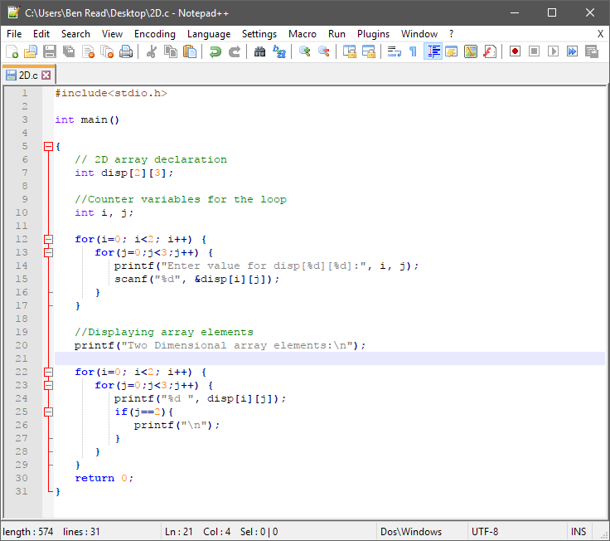

Slide 14
INITIALISING 2D ARRAYS
There are two ways to initialise a two-dimensional array during declaration –
int a[2][4] =
{
{1, 2, 3, 4},
{5, 6, 7, 8}
};
OR
int a[2][4] = {1, 2, 3, 4, 5, 6, 7, 8};
Both methods are valid, however, the first method is far more readable because you can visualise the table of rows and columns for easier reference.
Note in the first example that the comma is outside of the statement block of the top row of data.

Slide 15
INITIALISING 2D ARRAYS
When we initialised the one dimensional array we did not have to define its size as long as we defined its contents. This is not the case with 2D arrays as you must ALWAYS specify the size of the second dimension, or number of columns, even if you are defining its elements during declaration.
Here are some examples –
//Valid declaration
int abc[2][2] = {1, 2, 3 ,4 };
Valid declaration
int abc[][2] = {1, 2, 3 ,4 };
Invalid declaration – you must specify second dimension
int abc[][] = {1, 2, 3 ,4 };
//Invalid because of the same reason mentioned above
int abc[2][] = {1, 2, 3 ,4 };

Slide 16
INPUTTING DATA INTO 2D ARRAYS
Because 2D arrays contain two subscripts ( [] ), in order to enter data into them we now need to use two loops, e.g.
for(i=0; i<5; i++)
{
for(j=0;j<4;j++)
{
printf("Enter value for abc[%d][%d]:", i, j);
scanf("%d", &a[i][j]);
}
}

Slide 17
CONCEPTUAL MEMORY REPRESENTATION
Here the array a[5][4] has been represented as a table, or matrix, with each element labelled -
1st Subscript
a[0][0] | a[0][1] | a[0][2] | a[0][3]
a[1][0] | a[1][1] | a[1][2] | a[1][3]
a[2][0] | a[2][1] | a[2][2] | a[2][3]
a[3][0] | a[3][1] | a[3][2] | a[3][3]
a[4][0] | a[4][1] | a[4][2] | a[4][3]
2nd Subscript
Remember that the subscript starts with zero so a[0][0] is the first element of the array

Slide 18
ACTUAL MEMORY REPRESENTATION
The representation of a[5][4] in memory looks more like this -
a[0][0] | a[0][1] | a[0][2] | a[0][3] | a[0][4] | a[1][0] | a[1][1] | a[1][2] | a[1][3] | … | a[5][4]
82206 | 82210 | 82214 | 82218 | 82222 | 82226 | 82230 | 82234 | 82238 | … | 82286
Memory locations for the array of elements
Remember, memory addresses are actually represented in hexadecimal, e.g. 82206 = 1411E, however, it’s simpler to represent them as integer for this example in order to show element sizes and contiguous locations. Elements are stored in order based on the first subscript. An integer is 4 bytes, or 32 bits, of data so each integer array element takes up 4 memory locations.

