Slide 1

Unit 16 – Procedural Programming
with Ben Read

Slide 2
AIMS & OBJECTIVES
Differentiate between the three types of loop
Analyse code examples to determine their optimal usage
Partake in a self-paced tutorial to revise concepts covered in this session

Slide 3
TYPES OF LOOP
When programming, you will find many situations where you need to repeat a single statement, or group of statements, until a condition is met, e.g. read all files of a directory, send mail to all employees one after another, etc. In C programming these kind of tasks are handled by looping statements.
A Looping statement defines a set of statements which are likely to need iterating. These statements are repeated with the same or different parameters a set number of times. Looping statements are also known as iterative or repetitive statements.
C supports three looping statements –
for
while
do...while

Slide 4
FOR LOOP
The For loop is an entry controlled looping statement. It is used to repeat a set of statements until a condition is met.
Looping statements whose condition is checked prior to the execution of their body are called entry controlled loops.
Syntax –
for(variable-initialization ; condition ; variable-update)
{
// Body of for loop
}

Slide 5
PARTS OF A FOR LOOP
Any repetition contains two important parts - What to repeat and the number of repetitions. Variable-initialization, condition and variable-update define the number of repetitions and the body of the loop defines what to repeat.
Variable-initialization contains the loop counter variable initialization statement/s. It defines the starting point of the repetition or loop.
Condition contains Boolean expressions and works like if…else. If the Boolean expression is found to be true then the body of the loop will execute, otherwise it will terminate.
The Body of the loop specifies what to repeat and contains a set of statements.
Variable-update contains a the loop counter update statement, either increment or decrement.

Slide 6
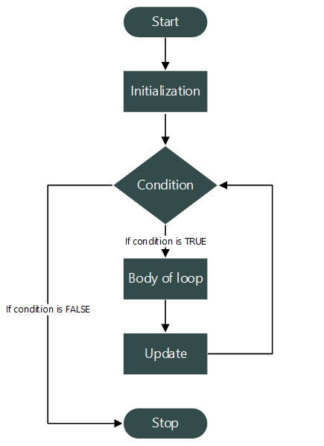
FOR LOOP

Slide 7
EXAMPLE OF A FOR LOOP
This example prints the numbers 1 through 10 –
//C program to print natural numbers from 1 to 10.
#include <stdio.h>
int main()
{
// Declare loop counter variable
int count;
// Run a loop from 1 to 10
for(count=1; count<=10; count++)
{
// Print current value of count
printf("%d ", count);
}
return 0;
}

Slide 8
WHILE LOOP
The for loop is easy to implement if you know the start and end position of your loop counter. However, you may come across a situation where you only know when to terminate the loop. For example – reading instructions from the user until terminated manually, waiting for a client connection until connected or cancelled, reconnecting to the server until connected, etc.
A while loop is an entry controlled looping construct. We use while loops to repeat sets of statements when the number of iterations are not known prior to its execution. It provides the flexibility to define the loop without the need for initialisation and update components.
Syntax –
while(condition)
{
//Body of while loop
}

Slide 9
PARTS OF A WHILE LOOP
Unlike the for loop, while does not contain initialisation and update parts. It contains only two parts – condition and body.
Condition is a Boolean expression evaluating an integer value. It is similar to if…else and defines the loop termination condition.
The Body of the while loop contains a single or set of statements to repeat.
The variable-initialisation and variable-update sections are still required, however, you a free to place them wherever you think appropriate. Best practice indicates that counter variables should be placed just before the start of the loop, with the update part just before the end.

Slide 10
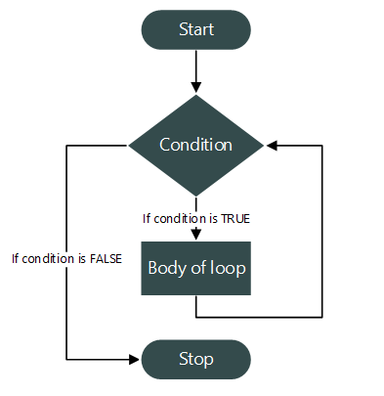
WHILE LOOP

Slide 11
EXAMPLE OF A WHILE LOOP
This example also prints the numbers 1 through 10 –
//C program to print the numbers 1 – 10 using a while loop.
#include <stdio.h>
int main()
{
// Declare and initialise loop counter variable
int n = 1;
//Loop condition
while(n <= 10)
{
//Body of loop
printf("%d ", n);
//Update the loop counter
n++;
}
return 0;
}

Slide 12
DO…WHILE LOOP
The do…while loop is distinct from the other two types because it is an exit controlled looping statement. Do...while loops are used when there is a need to check the condition after the loop has already run once.
A do…while loop is an exit controlled looping statement. We use do…while loops when the body of the loop is required to execute at least once, e.g. a program which needs to validate user input. The loop will run until the user inputs something valid, once only if the first input is correct or over and over if they repeatedly make a mistake.
Syntax –
do
{
//Body of while loop
}
while(condition);

Slide 13
PARTS OF A DO…WHILE LOOP
Similarly to while, the do…while loop contains two parts – the body and the condition.
The loop condition is a Boolean expression evaluating an integer value. If the condition is found to be true then the loop repeats, otherwise it terminates.
The Body of the loop contains a single or set of statements to repeat.
Similar to while, you can put the loop counter variable-initialisation statement before the loop and the variable-update just before the end.
Note that when writing do…while loops, unlike the other loop types, a semi-colon is required at the end.

Slide 14
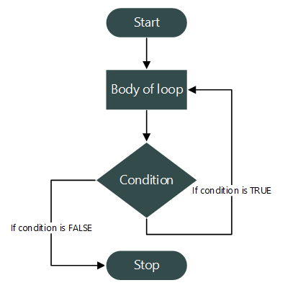
DO…WHILE LOOP

Slide 15
EXAMPLE OF A DO…WHILE LOOP
Once again, the example prints the numbers 1 through 10 –
//C program to print the numbers 1 – 10 using a do…while loop.
#include <stdio.h>
int main()
{
// Declare and initialise loop counter variable
int n = 1;
do
{
//Body of loop
printf("%d ", n);
//Update the loop counter
n++;
}
//Loop condition
while(n <= 10);
return 0;
}

Slide 16
DIS/HOMEWORK
Complete a report on the importance of modularity in Procedural Programming

