Slide 1

Unit 16 – Procedural Programming
with Ben Read

Slide 2
AIMS & OBJECTIVES
Review the Assignment 4 Brief
Examine various testing methods for use in the assignment
Commence work on Assignment 4

Slide 3
BLACK BOX TESTING
Testing WHAT the software is supposed to do (not how it does it)
Action | Expected Result
Pressing “Right Trigger” | Gun Fires
Pressing “A” | Player Character Jumps
Clicking Left Thumbstick while moving | Player Character Sprints
… | …

Slide 4
PLANNING YOUR BLACK BOX TESTING
Devise a test plan:
1) List of all the requirements/features to test.
e.g.
Main Menu
Displaying Options
Character Selection
Attacking
Damage Resolution
Game Conclusion
Replay Game
…
etc.

Slide 5
PLANNING YOUR BLACK BOX TESTING
Detail how you will test each requirement/feature:
MENU – Test for correct Usage:
User Enters 1
User Enters 2
User Enters 3
MENU – Test for incorrect Usage:
User Enters Any Other Number
User Enters Presses Any Other Key
…
, etc.

Slide 6
PLANNING YOUR BLACK BOX TESTING
Put it all in a handy chart:
ID | Feature | Test | Expected Result | Actual Result | Action
1 | Main Menu | User Inputs “1” | Instructions Displayed | Instructions Displayed
2 |  | Mash Keyboard | “Please enter valid input” displayed | Game Crashes | Error in input processing creating broken input choice – fixed
2 - Retest 1 |  | Mash Keyboard | “Please enter valid input” displayed | “Please enter valid input” displayed

Slide 7
EVIDENCE OF DEBUGGING
Application working as expected:
Do a complete playthrough, taking screenshots at each stage
Evidence of Debugger Usage:
Breakpoints
Stepping through code (F7)
Stepping INTO code (Shift + F7)
Watches window usage
Variables changing as code is executed
Variables being changed manually in the window to test code
Call Stack Usage
USE SCREENSHOTS!

Slide 8
WHITE BOX TESTING
Based on Black Box Testing results.
Test HOW the software works (algorithms/calculations, etc)
Algorithm / Function | Expected Result
FillTable() | Provided 2D array is filled with random integers.
“Calculating Odds” algorithm | Generate a random number between 0 and 99, stores in global variable
Cap Rotation algorithm | Takes input (degrees value), caps input between -180 and +179 and returns result.
… | …

Slide 9
COMBINE WHITE BOX AND BLACK BOX
Black Box chart:
ID | Feature | Test | Expected Result | Actual Result | Action
1 | Main Menu | User Inputs “1” | Instructions Displayed | Instructions Displayed
2 |  | Mash Keyboard | “Please enter valid input” displayed | Game Crashes | White-box test menu input code (see chart WB1)
2 - Retest 1 |  | Mash Keyboard | “Please enter valid input” displayed | “Please enter valid input” displayed

Slide 10
WHITE BOX TESTING
Encountered a problem with Black Box Testing?
Devise a whitebox test to find problem and fix:
ID | Algorithm/Code | Test Description | Result | Action
WB1-1 | getInput() | Filled input array with random characters | Data Stored OK
WB1-2 | processInput() | Passed garbage data | Crashes – generates invalid pointer | Check for invalid pointer
WB1-2 retest | processInput() | Passed garbage data | “Invalid input” var returned. Input loop restarts | Fixed

Slide 11
UNIT TESTING
Test your code with given values –
Either by hand or by writing a small piece of code that feeds values into your algorithms and compares results to a preplanned “answers” sheet.
Compare actual output with expected output.
Fix where necessary.
If a fix is necessary, repeat the unit test.

Slide 12
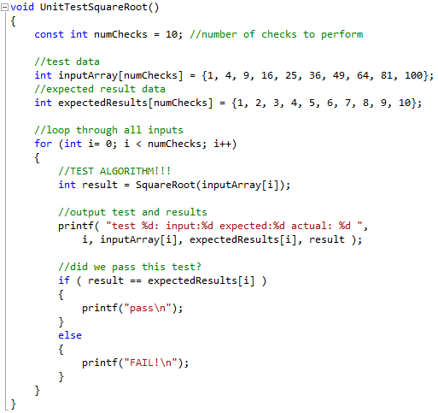
UNIT TESTING

Slide 13
UNIT TESTING
SquareRoot()
ID | Test Input | Expected Output | Actual Output | Action
SR1 | TestBatch1 | 10 passes | 10 passes
SR1 | TestBatch2 | 10 passes | 1 pass | code capping result to 1
SR1-1 | TestBatch2 | 10 passes | 10 passes

Slide 14
FURTHER TESTING METHODOLOGIES
Integration Testing -
Individual “Units” are combined and tested as a group
System Testing -
Complete System is tested – used to check compliance with specific requirements, e.g. memory consumption, resource drain, etc.
Acceptance Testing -
Does the software fulfil all requirements, i.e. customer/business requirements, task brief, etc.

