Slide 1
UNIT 15 – Object oriented programming
With ben read

Slide 2
Aims & objectives
Analyse the use of Structures in C/C++
Review methods of creation and utilisation of your own structures
Review the week’s techniques via a self-paced tutorial

Slide 3

structures
C/C++ arrays allow you to define variables that combine several data items of the same kind, but structure is another user defined data type which allows you to combine data items of different kinds.
Structures are used to represent a record - suppose you want to keep track of your books in a library. You might want to track the following attributes about each book −
Title
Author
Subject
Book ID

Slide 4
Defining a structure
To define a structure, you must use the struct statement. The struct statement defines a new data type, with more than one member, for your program. The format of the struct statement is this −
struct [optional structure tag]
{
member definition;
member definition;
...
member definition;
} [one or more optional structure variables];

Slide 5

Defining a structure
The structure tag is optional and each member definition is a normal variable definition, such as int i; or float f; or any other valid variable definition. At the end of the structure's definition, before the final semicolon, you can specify one or more structure variables but it is optional. Here is the way you would declare the Book structure −
struct Books
{
string title;
string author;
string subject;
int book_id;
} book;

Slide 6
Accessing a structure
To access any member of a structure, we use the member access operator (.) The member access operator is coded as a period between the structure variable name and the structure member that we wish to access. You would use the struct keyword to define additional variables of the structure type.
Following is an example to explain usage of structure −

Slide 7
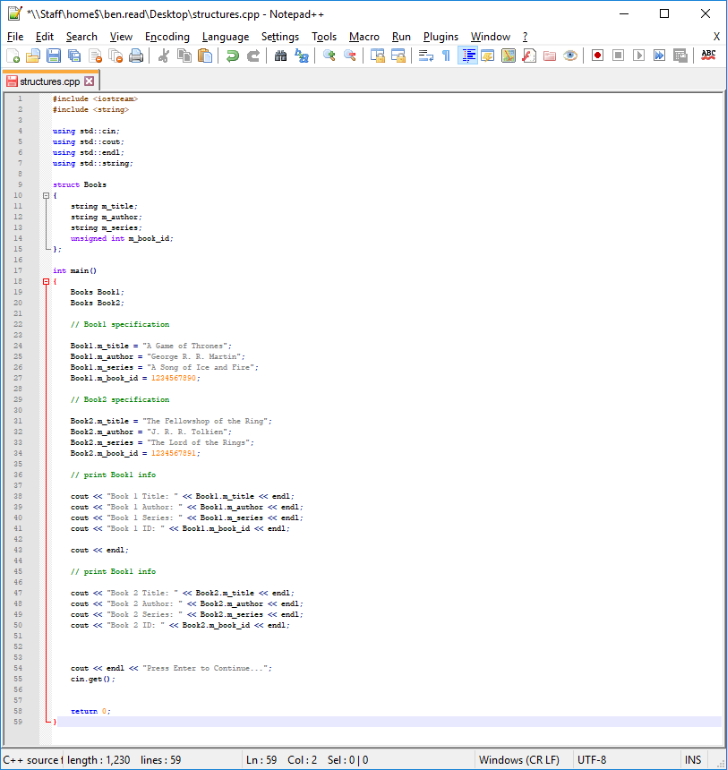

Slide 8
Structures as function arguments – Call BY VALUE
You can pass a structure as a function argument in a very similar way to passing any other variable. You would access structure variables as shown in the above example −
void printBook(struct Books book)
printBook(Book1)
void printBook(struct Books book)
{
cout << "Book title : " << book.title <<endl;
cout << "Book author : " << book.author <<endl;
cout << "Book subject : " << book.subject <<endl;
cout << "Book id : " << book.book_id <<endl;
}

Slide 9
Structures as function arguments – Call BY REFERENCE (A)
Calling by reference uses pointers. There are two methods to achieve the same results. We will cover these in the next class −
void printBook(struct Books *book)
printBook(&Book1)
void printBook(struct Books *book)
{
cout << "Book title : " << book->title <<endl;
cout << "Book author : " << book->author <<endl;
cout << "Book subject : " << book->subject <<endl;
cout << "Book id : " << book->book_id <<endl;
}

Slide 10
Structures as function arguments – Call BY REFERENCE (B)
Calling by reference uses pointers. There are two methods to achieve the same results. We will cover these in the next class −
void printBook(struct Books &book)
printBook(Book1)
void printBook(struct Books &book)
{
cout << "Book title : " << book.title <<endl;
cout << "Book author : " << book.author <<endl;
cout << "Book subject : " << book.subject <<endl;
cout << "Book id : " << book.book_id <<endl;
}

