Slide 1

Unity 3D
Bailey Fenzl
November 10, 2016

Slide 2
What is Unity?
- A game engine, in a similar light to Source, Unreal, CryEngine, etc.
- Free for the most part (ie you have to have a license to remove the Unity Splash Screen)
- Supported on Windows, Mac (there’s also an experimental Linux build)

Slide 3
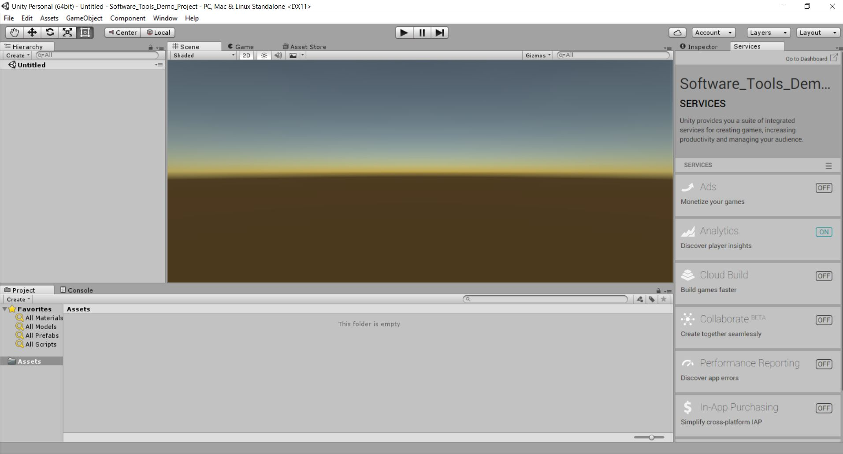
The UI

Slide 4
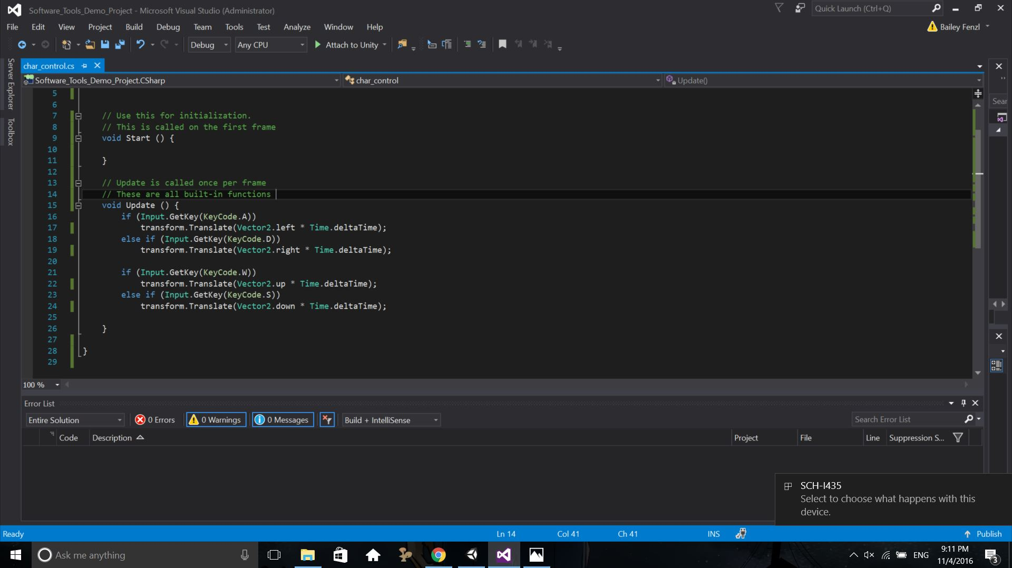
Code UI (Visual Studio)

Slide 5
History of Unity
First version launched in 2005, at Apple’s worldwide developer conference
The main development focus is towards making a powerful game engine with high-end features that’s accessible
This has lead to Unity being popular with independent developers
Most recent release is Unity 5.4

Slide 6
Comparison with other engines
Unity is marketed towards independent game developers
Unlike a lot of engines, Unity is good for developing both 2D and 3D games
Unity also has a very large asset store, where you can get assets, typically at a reasonable price
Relatively easy to use
Support to a multitude of platforms, including: PS4, XBox One, WiiU, 3DS, PC, Mac, Linux, and more

Slide 7

Use of Unity
Ohio University’s game dev association’s go-to engine
Games Build in Unity:
Kerbal Space engine
Temple Run
Hearthstone: Heroes of Warcraft

Slide 8

A Brief Tutorial: Making a Character Controller
Character Controller: A script that allows the user to control a player
This is Frank. We’re going to make a character controller for him

Slide 9
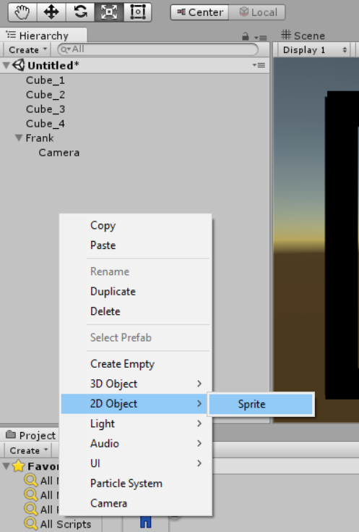
Brief Tutorial: Adding a game object
The Hierarchy section: This is a list of all your game objects
To add another object, right click, and in the menu, select the object that you want to add

Slide 10
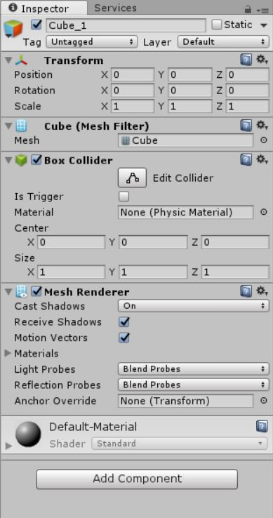
Brief Tutorial: The Inspector
The inspector can be viewed by clicking on any of the listed game objects
This shows all of the properties of that object, including colliders, transformations, and attached scripts

Slide 11
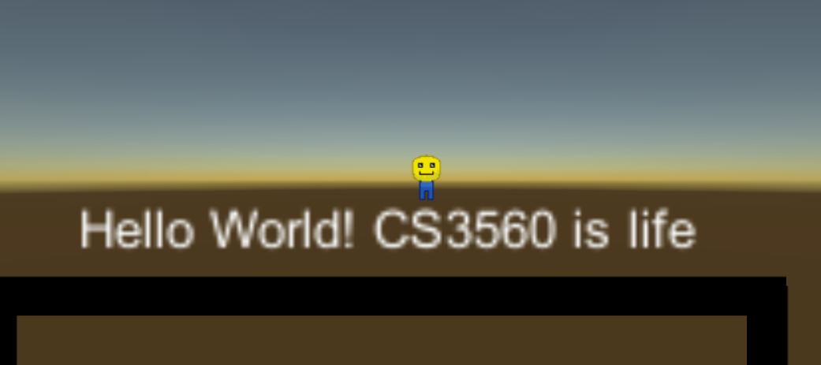
Brief Tutorial: Hello World
Unity also makes it fairly easy to add text to the screen
You can add it in the same way that you add game objects to the game, and you can modify the text in the inspector

Slide 12
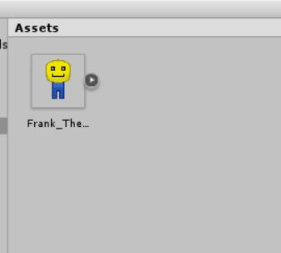
Brief Tutorial: Assets
Assets are things like artwork, music, and sprites that give your game life.
While Unity has built-in basic shapes that you can manipulate, the vast majority of assets will have to be imported

Slide 13
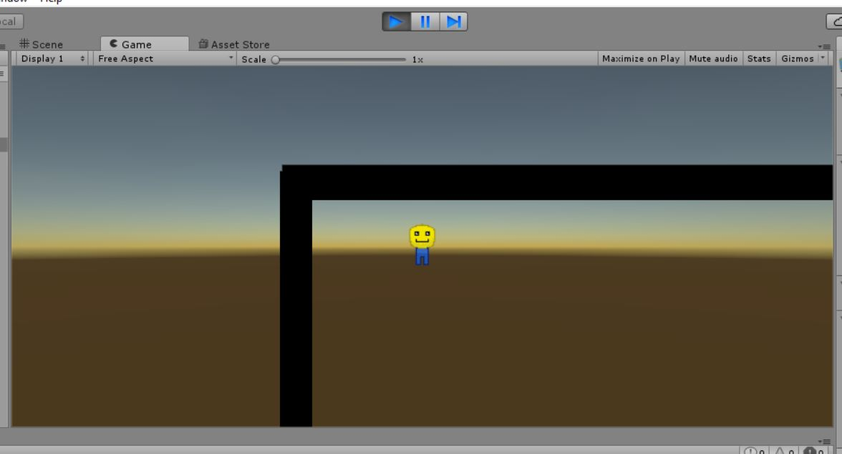
Brief Tutorial: Game view
The gameview window is where you can run your game
Not to be confused with the scene window, where you can just view your scene from a more objective view

Slide 14
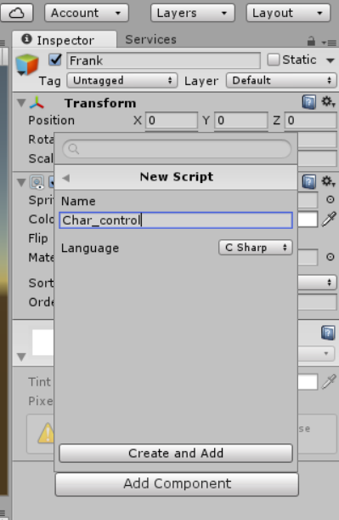
Brief Tutorial: Adding a Script
You can add scripts to be attached to an object by selecting “Add Component” in the inspector view
Unity supports two languages for scripting: C# and JavaScript

Slide 15
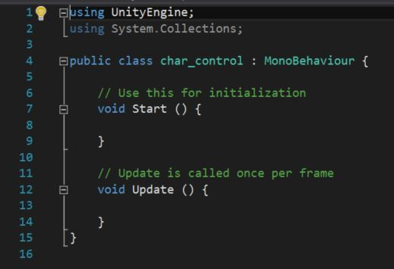
Brief Tutorial: The base script
This is what a C# script looks like when it’s first initiated
Unity has a lot of built in functions, which can pose a bit of a learning curve when you first start coding, However, the website does have a massive tutorial base to ease the learning process

Slide 16
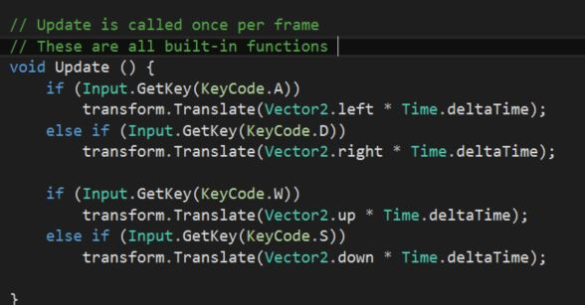
Brief Tutorial: A Basic Character Controller Script
Here’s a script for a simple character controller. It manipulates the object that it’s attached to. In this case, attaching this script to Frank will allow you to control him

Slide 17
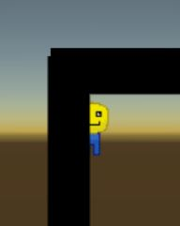
Brief Tutorial: He Moves! and Colliders
With this controller, Frank will be able to walk around in 4 directions with wasd controls.
As a side note, this frame that it put around the level is redundant, and Frank will clip through it.
Why is this the case? You have to add a collider to the boxes

Slide 18
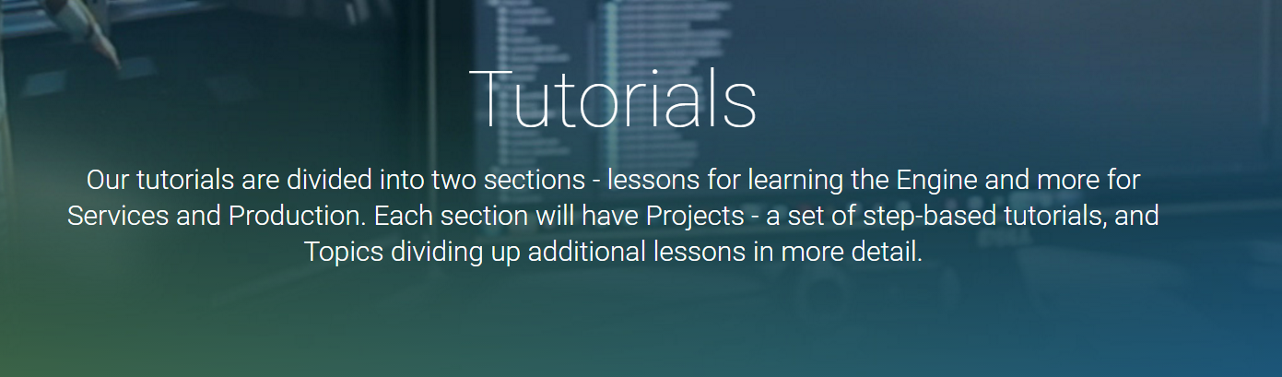
Other tutorial resources
https://unity3d.com/learn/tutorials
Unity also provides it’s own tutorial base
If you ever want to learn Unity, I would highly recommend using it for reference

Slide 19
Summery
Unity is a great, whether you’re a novice or experience with game dev
It’s build to be all-purpose
Has a steep learning curve, but is overall simple to use with plenty of resources to learn

Slide 20
Resources and Other links
Tutorials: https://unity3d.com/learn/tutorials
History of Unity: https://seraphinacorazza.wordpress.com/2013/02/14/history-of-the-unity-engine-freerunner-3d-animation-project/
Comparison with Other Engines: http://blog.digitaltutors.com/unity-udk-cryengine-game-engine-choose/
Github containing Unity Project of this tutorial: https://github.com/BaileyFenzl/Software_Tools_Unity_Demo/settings

