Slide 1
NBA Analytics Automation Platform
Process Optimization, Cloud Integration & KPI Reporting Automation
Dilland Bailey, M.S.
Technology & Process Optimization
5/09/2026
Notes:
Today I’ll be presenting a project that originally started as an NBA analytics dashboard designed to compare player salaries against player impact metrics.
As the project evolved, it became much more than dashboard development. I began focusing on workflow inefficiencies, automation opportunities, cloud integration, reporting scalability, and overall process optimization.
Throughout this presentation, I’ll walk through the business problem, requirements gathering, technology evaluation, workflow redesign, system architecture, automation strategy, and the operational impact of the final solution.

Slide 2
Executive Summary
This project began as an NBA analytics dashboard designed to compare player salaries against on-court impact and identify high-value performers. As the project evolved, I expanded it into a broader technology and process optimization initiative focused on automating reporting workflows and improving operational efficiency.
To support scalable analytics and reduce manual processes, I designed and implemented an automated cloud-integrated pipeline using Python, Azure, and Power BI. The solution automated data ingestion, standardized transformation workflows, centralized processed datasets in cloud storage, and enabled KPI-driven reporting through automated dashboard refreshes.
Notes:
This project began as a Power BI dashboard designed to evaluate NBA player value through salary-versus-impact analysis.
As the reporting workflow expanded, several operational inefficiencies became apparent, including repetitive manual data preparation, inconsistent refresh workflows, duplicate player handling, and scalability limitations.
To address these challenges, I designed and implemented an automated cloud-integrated analytics pipeline using Python, Azure, and Power BI.
The solution automated ingestion, standardized transformations, centralized cloud storage, and enabled KPI-driven reporting through automated refresh workflows.
Although the dataset focused on NBA performance data, the architecture and workflow strategies were intentionally designed to mirror real-world enterprise reporting and business technology environments.

Slide 3
Executive Summary (Cont.)
The project demonstrates competencies in:
Process mapping & workflow optimization
Requirements gathering & solution evaluation
ETL automation & cloud orchestration
Business intelligence & KPI reporting
Systems integration & operational analytics
Although the dataset focused on NBA performance data, the workflows and architecture were designed to mirror real-world enterprise reporting and business technology environments.
Notes:
This project began as a Power BI dashboard designed to evaluate NBA player value through salary-versus-impact analysis.
As the reporting workflow expanded, several operational inefficiencies became apparent, including repetitive manual data preparation, inconsistent refresh workflows, duplicate player handling, and scalability limitations.
To address these challenges, I designed and implemented an automated cloud-integrated analytics pipeline using Python, Azure, and Power BI.
The solution automated ingestion, standardized transformations, centralized cloud storage, and enabled KPI-driven reporting through automated refresh workflows.
Although the dataset focused on NBA performance data, the architecture and workflow strategies were intentionally designed to mirror real-world enterprise reporting and business technology environments.

Slide 4
Identifying Workflow Inefficiencies
The original analytics workflow relied heavily on repetitive manual processes to collect, clean, transform, and report NBA statistical data. While functional at a small scale, the process introduced several operational inefficiencies that limited reporting consistency, scalability, and refresh reliability.
Key Challenges Identified
Repetitive manual data preparation
Inconsistent dashboard refresh workflows
Duplicate/traded-player record handling
Fragmented reporting processes
Limited scalability for larger datasets
Slower reporting turnaround times
Increased risk of human error
As the project expanded, it became clear that the workflow required a more scalable and automated solution capable of supporting standardized reporting, centralized data management, and repeatable analytics processes.
Notes:
As the project grew, I shifted focus from simply building a dashboard to analyzing the reporting workflow itself.
The original process relied heavily on repetitive manual effort across multiple stages of ingestion, transformation, validation, and reporting.
Several workflow inefficiencies became apparent, including inconsistent refresh processes, fragmented reporting steps, duplicate traded-player records, slower reporting turnaround times, and increased operational dependency on manual tasks.
This analysis ultimately created the foundation for redesigning the workflow into a more scalable and automated reporting process

Slide 5
Business & Functional Requirements Gathered
Automate data ingestion and refresh workflows
Standardize data transformation processes
Centralize processed datasets in cloud storage
Support scalable KPI-driven reporting
Reduce manual operational dependency
Improve reporting consistency and reliability
Support repeatable analytics workflows
Notes:
After identifying the operational inefficiencies, I approached the project from a business analysis perspective by defining both business and functional requirements for the redesigned workflow.
Some of the key business requirements included reducing manual operational effort, improving reporting consistency, centralizing processed datasets, and supporting scalable KPI-driven reporting.
The functional requirements focused more specifically on automating ingestion workflows, standardizing transformations, validating datasets, enabling automated refreshes, and supporting repeatable analytics processes.
This stage was important because it shifted the project from a dashboard initiative into a broader business technology and workflow optimization effort.

Slide 6
SaaS & Solution Evaluation
Requirement | Selected Solution | Reason
Automated data ingestion | Python ETL | Flexible transformation logic
Centralized storage | Azure Blob Storage | Scalable cloud storage
Workflow orchestration | Azure Data Factory | Automated scheduling & pipeline control
KPI reporting | Power BI | Interactive analytics & DAX modeling
Data transformation | pandas + Power Query | Standardized transformation workflows
To support these requirements, multiple technologies and workflow approaches were evaluated based on scalability, automation capabilities, reporting integration, and operational fit.
This analysis ultimately led to the redesign of the workflow into a scalable cloud-integrated business intelligence pipeline.
Notes:
Once the requirements were defined, I evaluated different technologies and workflow approaches based on scalability, automation capabilities, operational fit, and reporting integration.
Python was selected for ETL automation because it provided flexible transformation and data-cleaning capabilities.
Azure Blob Storage was selected to centralize processed datasets in cloud storage, while Azure Data Factory supported workflow orchestration and automated refresh scheduling.
Power BI was selected as the reporting platform due to its DAX modeling, Power Query integration, and KPI visualization capabilities.
This evaluation process helped ensure the final architecture aligned with both the technical and operational requirements of the workflow.

Slide 7
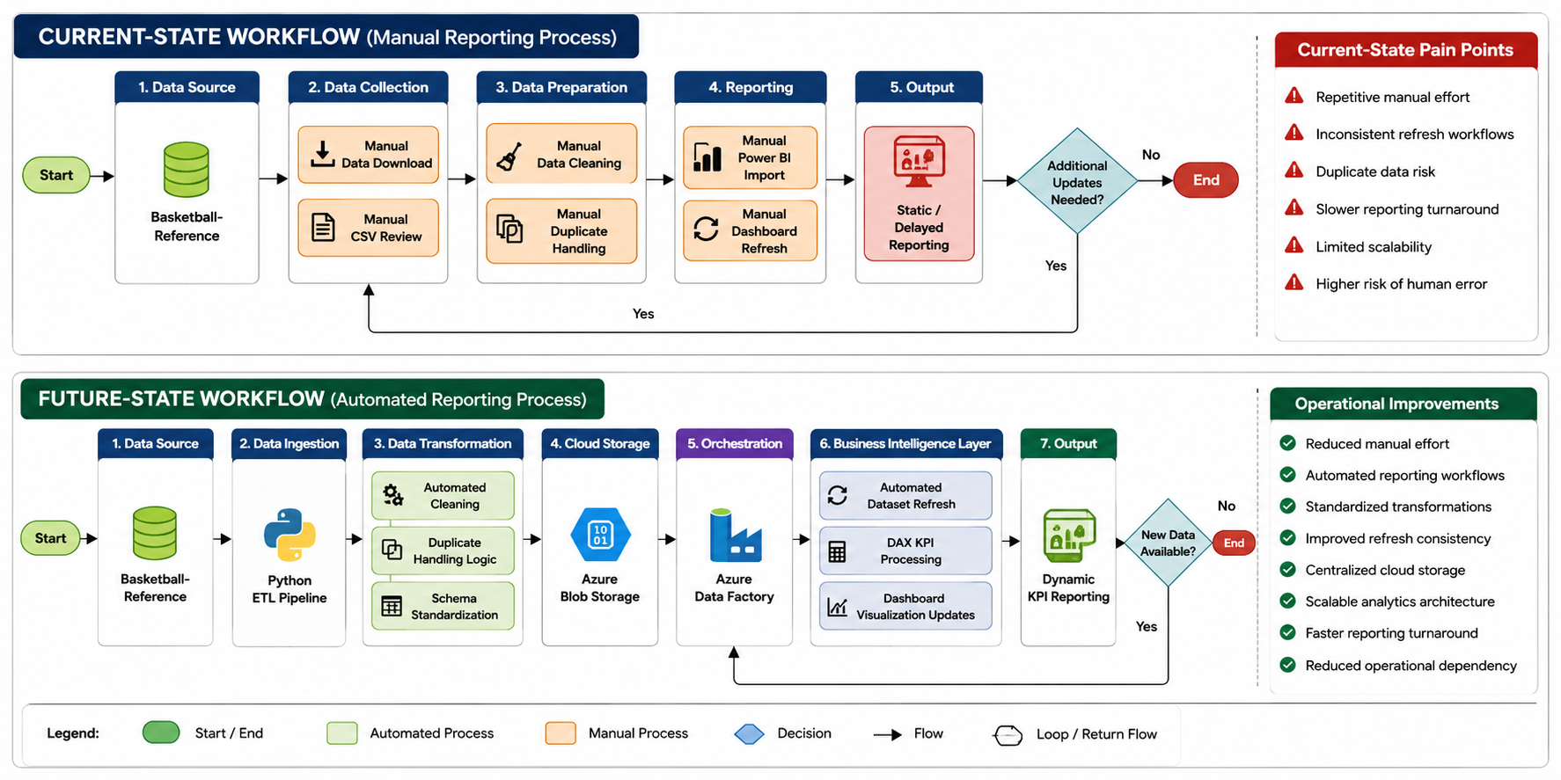
Current-State vs Future-Sate Workflow
Notes:
These diagrams compare the original current-state workflow against the redesigned future-state automated workflow.
The current-state process relied heavily on manual ingestion, transformation, duplicate handling, and dashboard refreshes, which created operational inefficiencies and scalability concerns.
The future-state workflow redesigned the process into an automated cloud-integrated pipeline using Python, Azure services, and Power BI.
This redesign significantly improved reporting
consistency, reduced manual operational dependency, centralized data management, and enabled scalable KPI-driven reporting workflows.

Slide 8
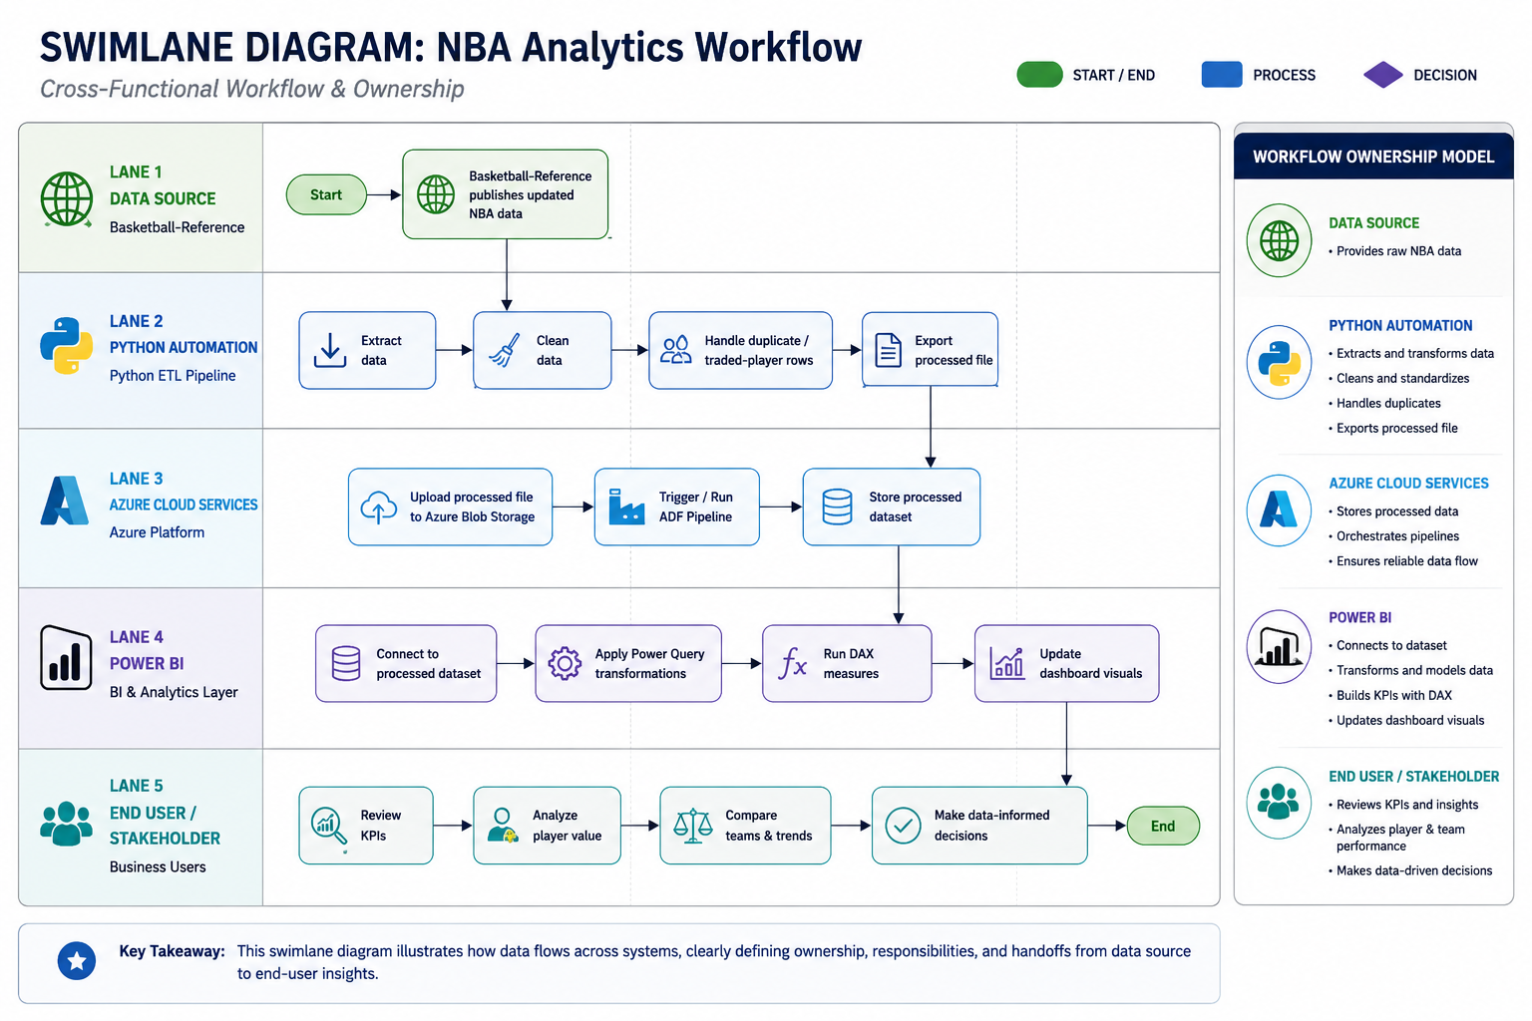
Cross-Functional Workflow Ownership
Notes:
This swimlane diagram was created to model workflow ownership and system responsibilities across the analytics lifecycle.
Rather than focusing only on technical implementation, I wanted to visualize how responsibilities moved between systems, automation layers, cloud services, reporting platforms, and end users.
The diagram demonstrates how the workflow supports ingestion, orchestration, reporting, and ultimately stakeholder consumption of KPI-driven analytics outputs.
This helped reinforce the project from a business operations and systems perspective rather than only a technical perspective.

Slide 9
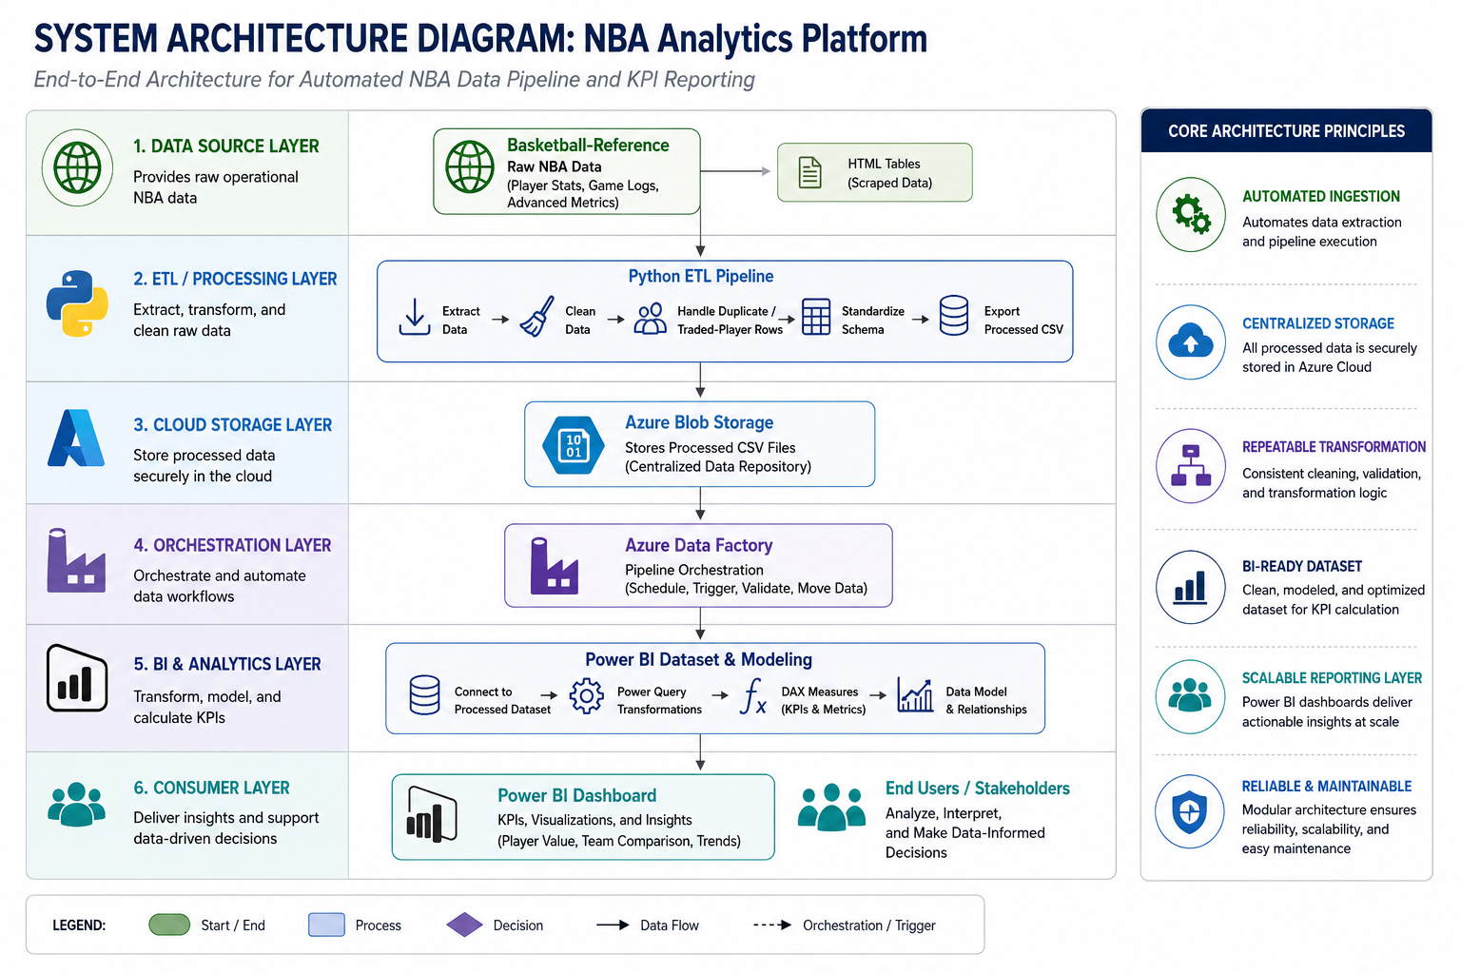
Cloud-Integrated Analytics Architecture
Notes:
This diagram represents the overall cloud-integrated architecture of the platform.
The workflow was intentionally separated into ingestion, transformation, storage, orchestration, reporting, and consumer layers to improve scalability, maintainability, and workflow organization.
Python handled ETL automation and transformations, Azure Blob Storage centralized processed datasets, Azure Data Factory orchestrated workflows and refresh scheduling, and Power BI supported KPI modeling and visualization.
The goal was to create a repeatable reporting infrastructure capable of supporting scalable analytics operations.

Slide 10
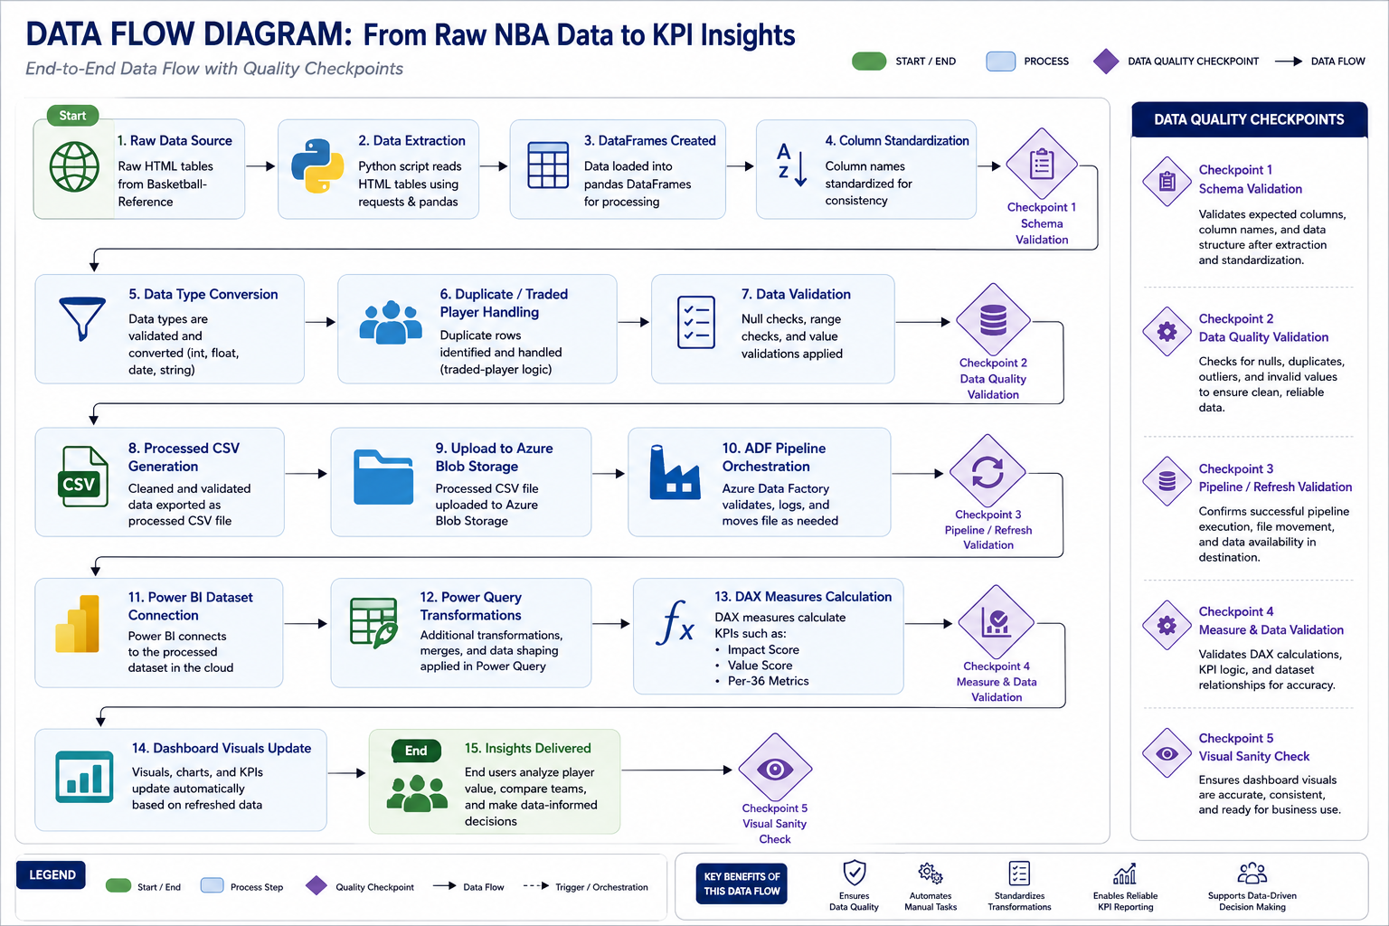
End-to-End Data Transformation Lifecycle
Notes:
This diagram focuses specifically on how raw operational data moves technically through the pipeline.
The workflow begins with raw HTML tables, which are processed and transformed through Python and pandas before being standardized, validated, and exported into processed datasets.
Azure services then manage orchestration and centralized storage, while Power BI consumes the cleaned datasets for final KPI calculations and dashboard reporting.
Validation checkpoints were also incorporated throughout the workflow to improve reporting consistency and reduce the risk of inaccurate outputs.

Slide 11
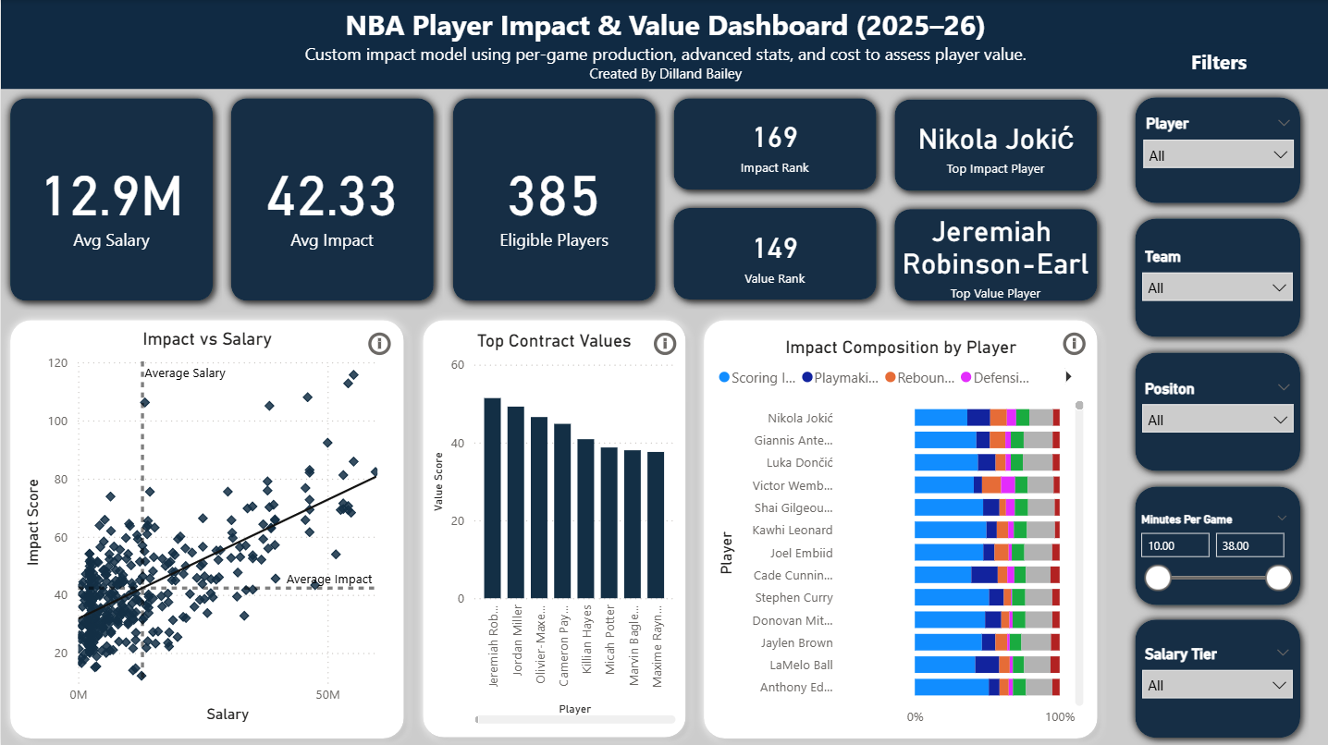

Dashboard & KPI Reporting
Live Link to Dashboard
Notes:
This slide shows the final reporting layer of the project and the analytical outputs generated by the workflow.
The dashboard was designed to evaluate player impact relative to salary investment using custom KPI models such as Impact Score, Value Score, and per-36-minute metrics.
Rather than simply displaying raw statistics, the reporting layer focused on standardized KPI-driven analytics capable of supporting insight generation and trend analysis.
This dashboard represents the final reporting output of the larger automated business intelligence workflow.
I’ve also included a live link to the interactive Power BI dashboard, which allows users to explore filters, KPIs, player comparisons, and reporting visuals dynamically in real time.

Slide 12
Technical Challenges & Solutions
Challenge | Impact | Solution Implemented
Duplicate traded-player records (2TM/3TM) | Inconsistent KPI calculations and duplicate reporting | Implemented combined-row transformation logic to standardize player records
Manual dashboard refresh dependency | Repetitive operational effort and delayed reporting | Designed automated reporting refresh workflows
Dataset consistency across multiple sources | Schema mismatches and reporting inconsistencies | Applied standardized transformation and validation logic
Workflow orchestration & scheduling | Limited automation and process scalability | Implemented Azure Data Factory pipeline orchestration
Data validation and refresh accuracy | Risk of inaccurate KPI reporting | Added validation checkpoints and transformation reviews
Notes:
Throughout the project, several technical and operational challenges emerged that required troubleshooting and workflow redesign.
One major issue involved duplicate traded-player records, which created inconsistencies in KPI calculations. To resolve this, I implemented combined-row transformation logic to standardize player records.
Another challenge involved manual refresh dependencies, which led to the implementation of automated reporting workflows using Azure Data Factory.
Additional challenges included schema consistency, orchestration reliability, and validation accuracy across multiple transformation stages.
This project significantly strengthened my troubleshooting, systems-thinking, and workflow optimization skills.

Slide 13
Business Value & Operational Impact
Operational Improvements
Reduced repetitive manual effort
Standardized reporting workflows
Scalable analytics architecture
Improved refresh consistency
Centralized cloud-based data management
Automated reporting lifecycle
Business Outcomes
Improved reporting efficiency
Faster analytics delivery
Repeatable reporting processes
Reduced operational dependency
Improved data consistency and reliability
Enhanced KPI-driven decision support
Organizational Impact
The redesigned workflow transformed a fragmented reporting process into a scalable cloud-integrated analytics platform capable of supporting repeatable and reliable business intelligence operations.
Notes:
One of the most important outcomes of this project was the operational value created through workflow automation and process redesign.
The updated workflow reduced repetitive manual effort, standardized reporting processes, centralized data management, improved refresh consistency, and enabled scalable analytics workflows.
From a business perspective, the project improved reporting efficiency, accelerated analytics delivery, reduced operational dependency, and created a more repeatable analytics lifecycle.
The project ultimately evolved from a dashboard initiative into a broader business technology and operational optimization solution.

Slide 14
Key Takeaways / Why This Matters
Why This Matters
This project demonstrates how analytics, automation, cloud infrastructure, and process optimization can be integrated into a scalable business intelligence workflow.
Although the operational dataset focused on NBA performance data, the architecture and workflow strategies were designed to mirror real-world enterprise reporting and business technology environments.
Core Competencies Demonstrated
Analytics engineering
Workflow optimization
Cloud integration
Business intelligence reporting
ETL automation
Systems thinking
Process mapping
Operational analytics
Requirements gathering
Technology evaluation
Notes:
This project demonstrates how analytics, automation, cloud infrastructure, and process optimization can be integrated into a scalable business intelligence workflow.
Although the dataset focused on NBA performance data, the workflows and architecture were intentionally designed to mirror real-world enterprise reporting and operational analytics environments.
The project strengthened competencies in analytics engineering, workflow optimization, ETL automation, cloud integration, business intelligence reporting, process mapping, and systems thinking.
Most importantly, it reinforced the importance of designing workflows and reporting systems that improve operational efficiency and support scalable decision-making.

Slide 15
Project Impact & Professional Alignment
Technologies Utilized
Miro
Python
pandas
Azure Blob Storage
Azure Data Factory
Power BI
DAX
Power Query
Core Business Concepts Applied
Requirements gathering
Process mapping
SaaS / technology evaluation
Workflow redesign
Reporting automation
KPI modeling
Operational analytics
Notes:
This project reflects the combination of technical and operational skills that I’m continuing to develop within business technology and process optimization environments.
Beyond analytics development, the project involved requirements gathering, workflow analysis, technology evaluation, cloud integration, reporting automation, troubleshooting, and scalable workflow design.
The experience helped strengthen my understanding of how systems, reporting platforms, automation tools, and operational processes work together to support business objectives.
Overall, the project evolved far beyond dashboard development into a broader business technology initiative focused on scalable reporting infrastructure and operational efficiency improvement.

