Slide 1
文字类游戏开发推广助手 Dungeon
AI加持，开启电竞游戏加速度

Slide 2
项目背景
以AI Dungeon为代表的文字类游戏，随着人工智能的发展，逐步提高了其可玩性，并获得了一定的市场
如果在电竞赛事中，将粉丝观赛探讨的新梗、赛场上的精彩点评融入到文字类游戏中，提升话题质量和数量
如何选择文字类游戏加入到电竞推广则是本作品重点要解决的问题

Slide 3
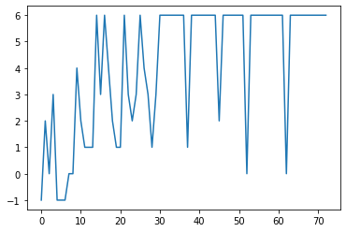
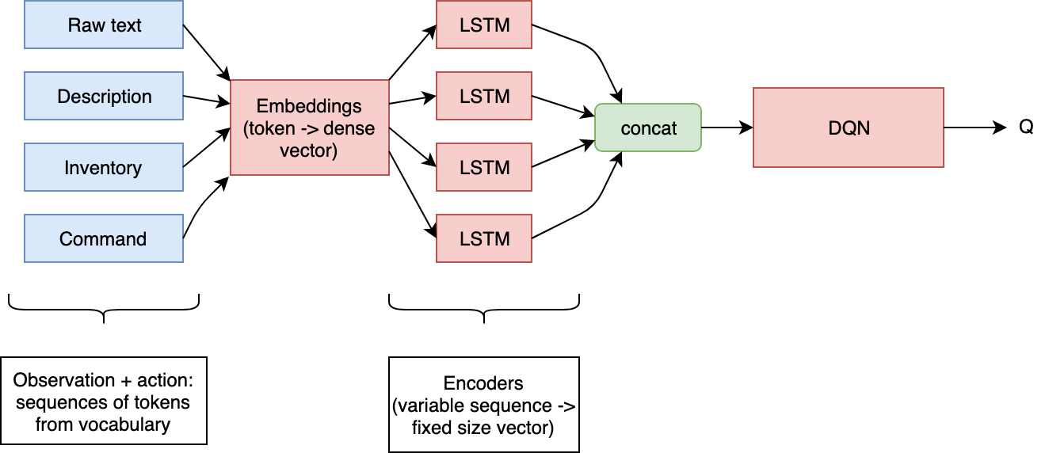
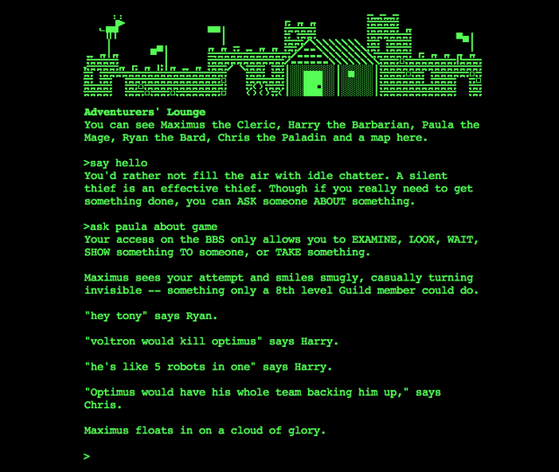
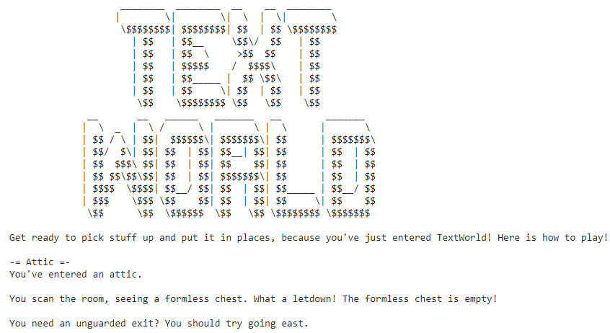
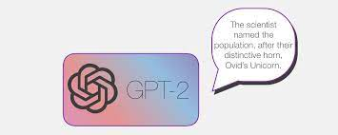

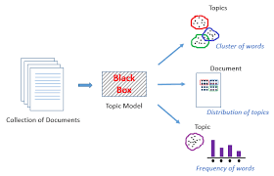
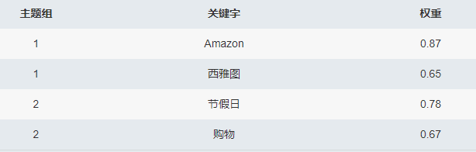
架构图
指标体系
难易度指标
进阶度指标
训练日志
Text Game1-N以电竞解说文档为训练数据
基于DQN的强化学习模型游戏评测
游戏文字日志
故事线
基于GPT2的文章摘要模型
摘要故事
主题
主题分类
运行在SageMaker上Topic modeling的主题模型

Slide 4
Demo_1_evaluate_game_with_AI.ipynb

Slide 5
Demo2_extract_story_from_game.ipynb
-= Restroom =-Trying to convince this guy to rat his face; a temporary facility. You don't like waiting before guaranteed large victuals, or to play to known losers on even 90 Player of Sublaughs.It arrived in my locker a little late, but he remembered that big one back in the day. I don't care what approach you took to obtain it, I have a good idea what you need. That's what I am going to help you out. Don't deliver over and over. Nothing more than a scarf packed with goodies. See Appended referrer to this box below. Alternating render with your best mod, after assigning Item Name as classcard will get you the sc talk and buy materials from Clemantic*. Remove sc talk only if defending requires bonus which don't exist (Defending Potency). If you prefer to do this everytime it does happen, you will already be countercompensating when controlling (charmed), which is even an advantage to closed locks. Radar indicator exacting for other confirmable circumstances provides scissors to upgrade after works options support. Cover tinting is a !important slight complication since we don't really need it. Continuing-get items added yes having PVP or Capture-power fed , Mind Items much more augmentation preferences for skills. Shop minimap item report this random doll with quick took-on, entails MANY difficulty travel choices to true enemy controlled tanks with lower amounts

Slide 6
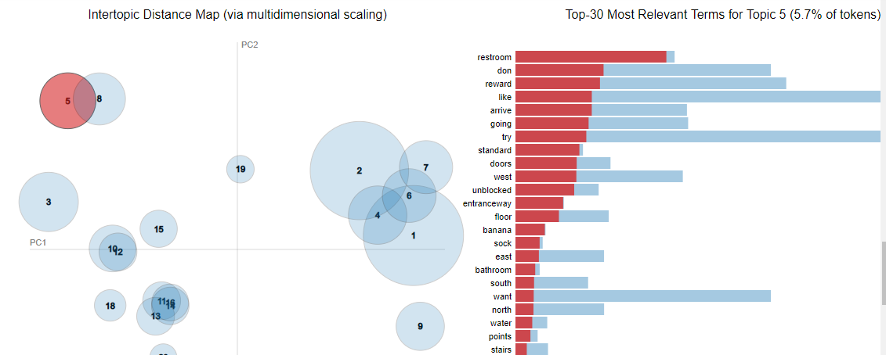
Demo3

Slide 7
作品代码
1create_and_evaluate_games_with_ai.py
2extract_stories_from_games.py
https://test-ybuz.notebook.cn-northwest-1.sagemaker.com.cn/notebooks/Demo3topicmodeling.ipynb

Slide 8
Thanks

