Slide 1
[insert photo of a printed owl]

Slide 2
3D printing is. . .
Additive process (as opposed to subtractive machining)
Built up layer by layer
Computer controlled

Slide 3
Many Types of Printing
Fused Filament Fabrication or Fused Deposition Modeling (FFF/FDM)
A precise hot glue gun
Stereo Lithography (SLA)
Light cured resin
Selective laser sintering (SLS)
A laser selectively melts powder
Other methods (?)
We will focus on FFF/FDM for this class

Slide 4
Correcting some Misconceptions
You can’t print everything
It may take some tweaking of printer settings
Prints can take a long time
You have to design (or scan) it first

Slide 5
Steps for printing
Obtain the 3D (mesh) model
Slice the model
Print
Clean up the physical model

Slide 6
Obtaining the 3D Model
Design with 3D software
FreeCAD, OpenSCAD, TinkerCAD, Rhino, Blender, SketchUp, Fusion360, SolidWorks
Download from an online repository
-thingiverse.com -youmagine.com -yeggi.com
Models must be .stl files that are “watertight” or “manifold”.

Slide 7
The Slicer
The Slicer is a piece of software that converts the 3D mesh model into code that can run on the machine of choice.
This is where we specify things like layer height, speeds, infill density.

Slide 8
More About Slicers
There are lots of different Slicer programs.
Cura, Slic3r, MatterControl, KISSicer
With the Ultimaker2+, we will use Cura
Cura 15 is what we will be teaching
Cura 2 is recently out of beta, and it has some really nice new features
Yes, the version numbers are odd

Slide 9
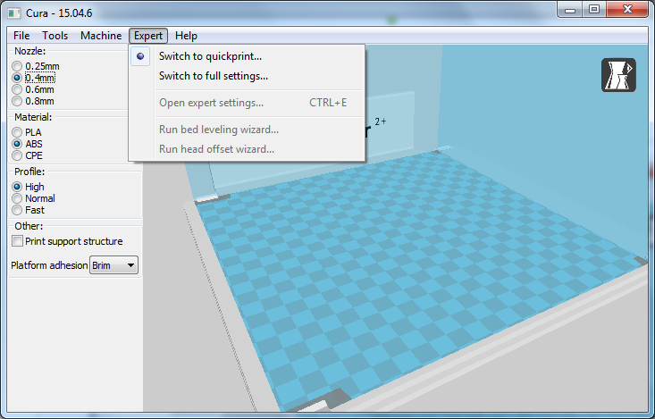
First Time Running
Change this to full settings

Slide 10
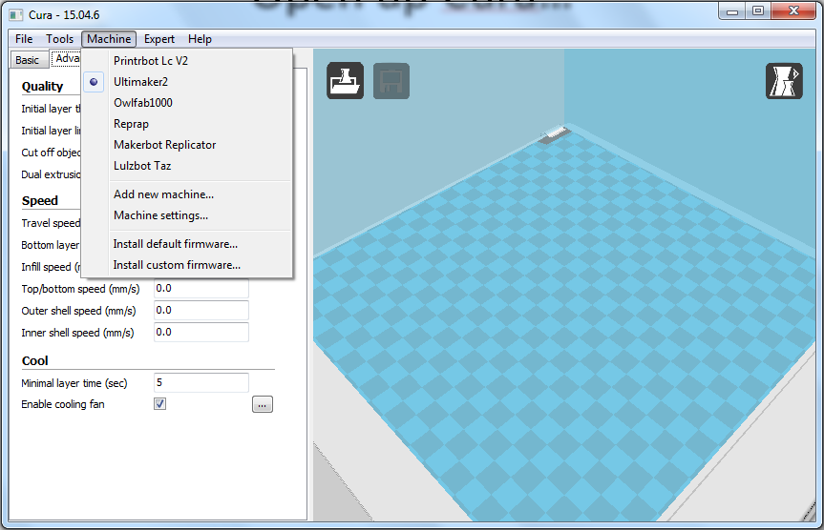
Open up Cura
Make sure you have “Ultimaker2+” selected for the machine!

Slide 11
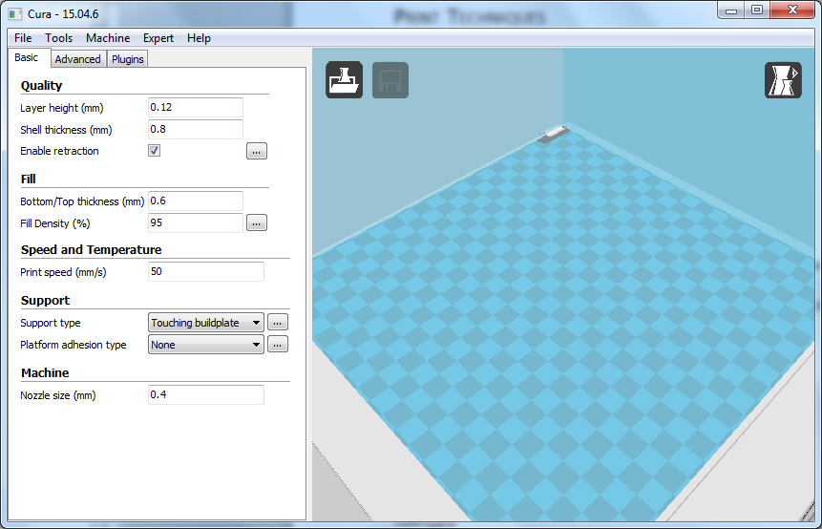
Basic Cura Settings
Layer height
Shell thickness
Bottom/Top thickness
Fill Density
Speed
Supports
Platform adhesion

Slide 12
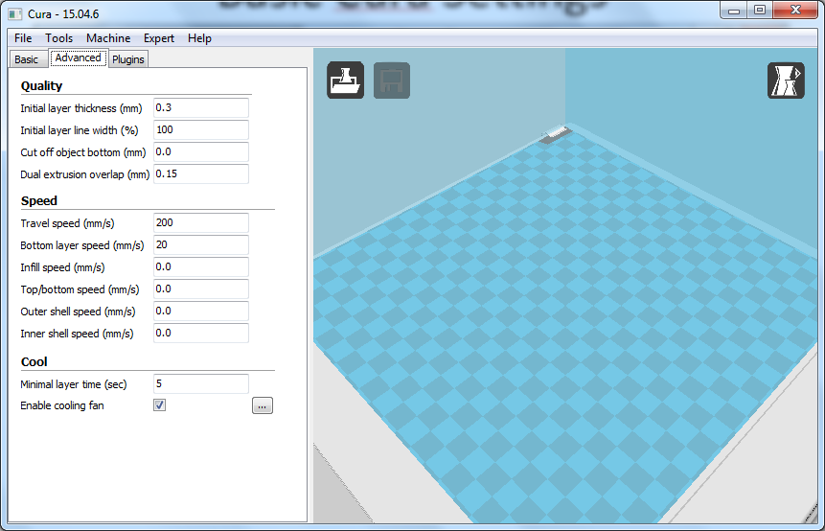
Advanced Cura Settings
Initial layer height/width
Cut off object
Detailed speed settings
Min layer time
Fan (should be on for PLA!)

Slide 13
Problematic Features
Small details
Print several at once, Increase cooling
Overhangs
Add supports, change layer height, increase cooling, change orientation
Unsupported features
Cooling, supports, do bridging
Large flat things
Brim, glue stick, hairspray, less cooling

Slide 14
Bed adhesion
It is sometimes hard to get the model to stay stuck to the bed. Many techniques are used:
Clean heated glass
Hair spray or glue stick on heated glass
Blue tape
PVA glue
PEI bed
Raft
Brim

