Slide 1
Sliced optimal partial transport
Yikun Bai & Dr. Soheil Kolouri
Vanderbilt University

Slide 2





Introduction of Optimal transport
$$c(x,y)$$
$$x$$
$$y$$
$$ν$$
$$μ$$

Slide 3
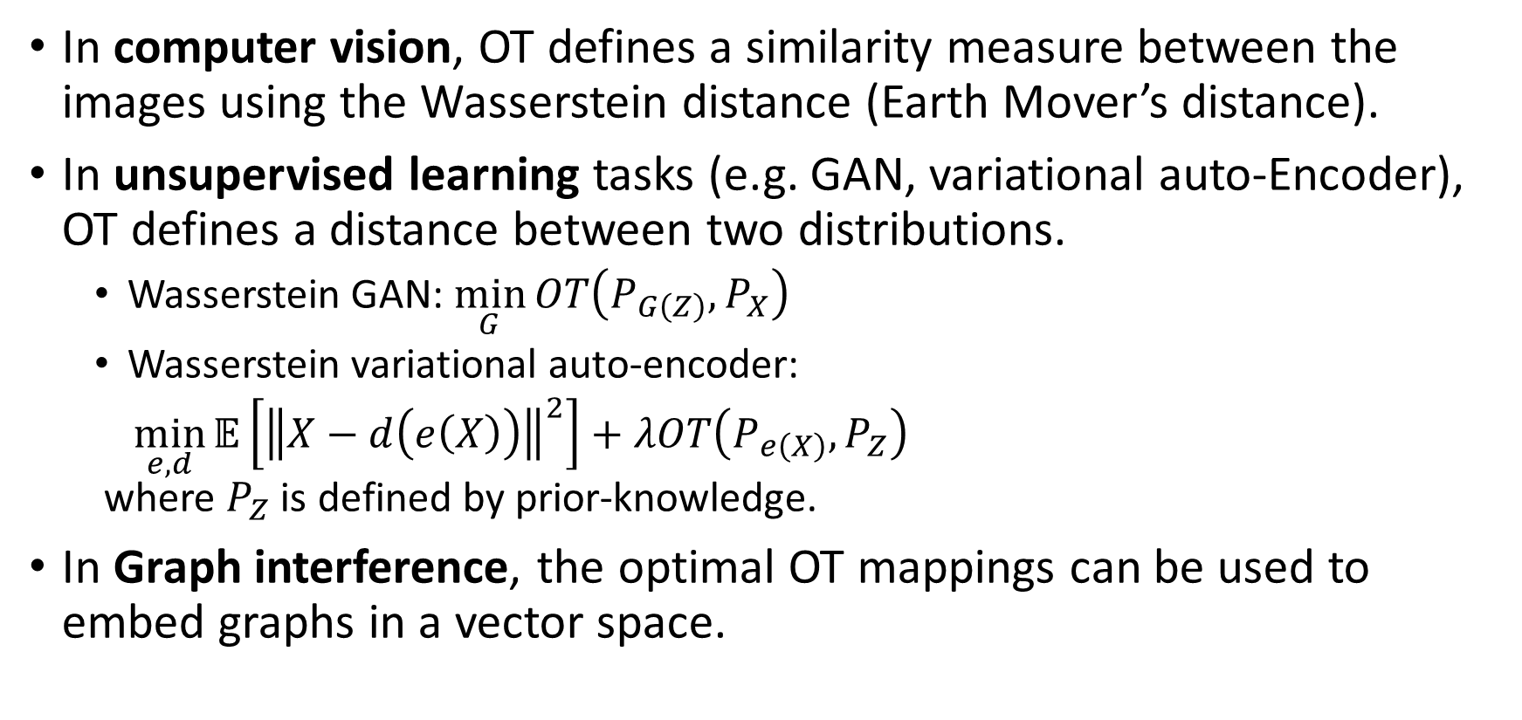
Applications of OT
In computer vision, OT defines a similarity measure between the images using the Wasserstein distance (Earth Mover’s distance).
In unsupervised learning tasks (e.g. GAN, variational auto-Encoder), OT defines a distance between two distributions.
Wasserstein GAN: $\min_{G}{OT\left(P_{G\left(Z\right)},P_{X}\right)}$
Wasserstein variational auto-encoder:
$\min_{e,d}{𝔼\left[{\left\|X−d\left(e\left(X\right)\right)\right\|}^{2}\right]+λOT\left(P_{e\left(X\right)},P_{Z}\right)}$ where $P_{Z}$ is defined by prior-knowledge.
In Graph interference, the optimal OT mappings can be used to embed graphs in a vector space.

Slide 4

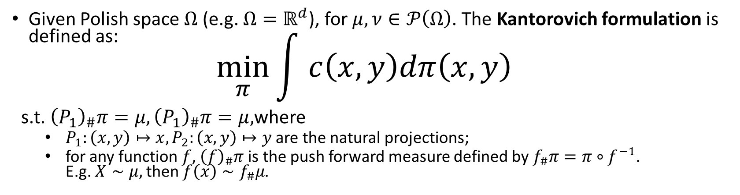

Kantorovich formulation
Given Polish space $Ω$ (e.g. $Ω=ℝ^{d}$), for $μ,ν∈𝒫\left(Ω\right)$. The Kantorovich formulation is defined as: $\min_{π}{\int{ c\left(x,y\right)dπ\left(x,y\right)}}$
s.t. ${\left(P_{1}\right)}_{\#}π=μ,{\left(P_{1}\right)}_{\#}π=μ,$where
$P_{1}:\left(x,y\right)↦x,P_{2}:\left(x,y\right)↦y$ are the natural projections;
for any function $f$, ${\left(f\right)}_{\#}π$ is the push forward measure defined by $f_{\#}π=π∘f^{−1}$. E.g. $X∼μ,$ then $f\left(x\right)∼f_{\#}μ$.
$$μ$$
$$ν$$

Slide 5
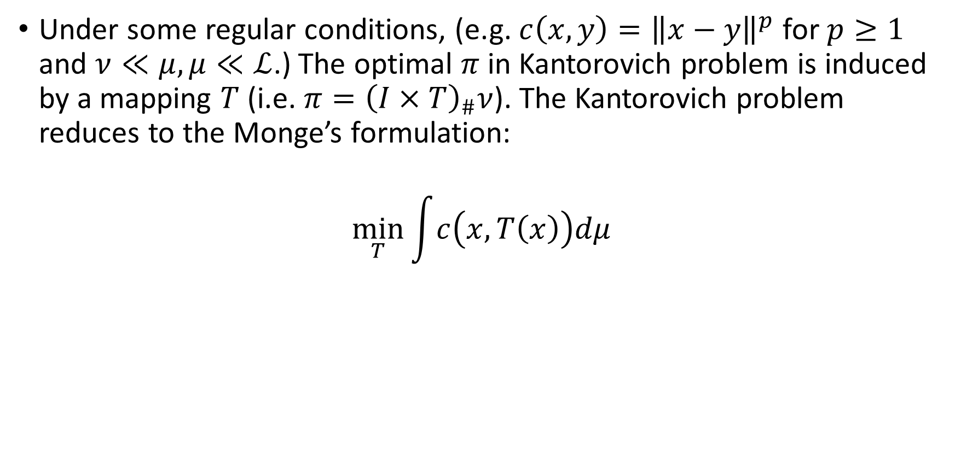
Monge’s formulation
Under some regular conditions, (e.g. $c\left(x,y\right)={\left\|x−y\right\|}^{p}$ for $p≥1$ and $ν≪μ,μ≪ℒ$.) The optimal $π$ in Kantorovich problem is induced by a mapping $T$ (i.e. $π={\left(I×T\right)}_{\#}ν$). The Kantorovich problem reduces to the Monge’s formulation:
$$\min_{T}{\int{c\left(x,T\left(x\right)\right)dμ}}$$

Slide 6


Optimal partial transport (OPT)
$$μ$$
outliers
$$ν$$
Motivation: we aim to find a Kantorovich style formulation such that:
It can measure the dissimilarity of two measures who do have different total masses.
E.g. MNIST vs EMNIST
The “outliers” increase the dissimilarity, but their locations does not affect it.

Slide 7
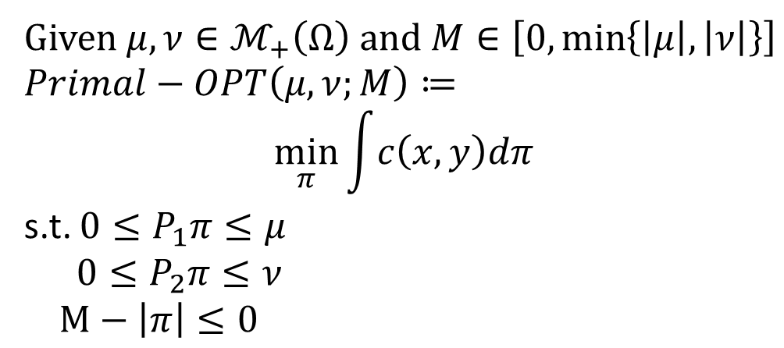
History of formulations of OPT
Primal form of OPT (Caffarelli and McCann, 2010),(Figalli, 2010):
Given $μ,ν∈ℳ_{+}\left(Ω\right)$ and $M∈\left[0,\min\left\{\left|μ\right|,\left|ν\right|\right\}\right]$
$Primal−OPT\left(μ,ν;M\right)≔$ $$\min_{π}{\int{c\left(x,y\right)dπ}}$$
s.t. $0≤P_{1}π≤μ$
$0≤P_{2}π≤ν$
$M−\left|π\right|≤0$

Slide 8
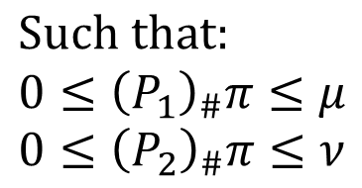
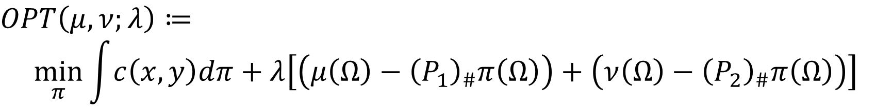
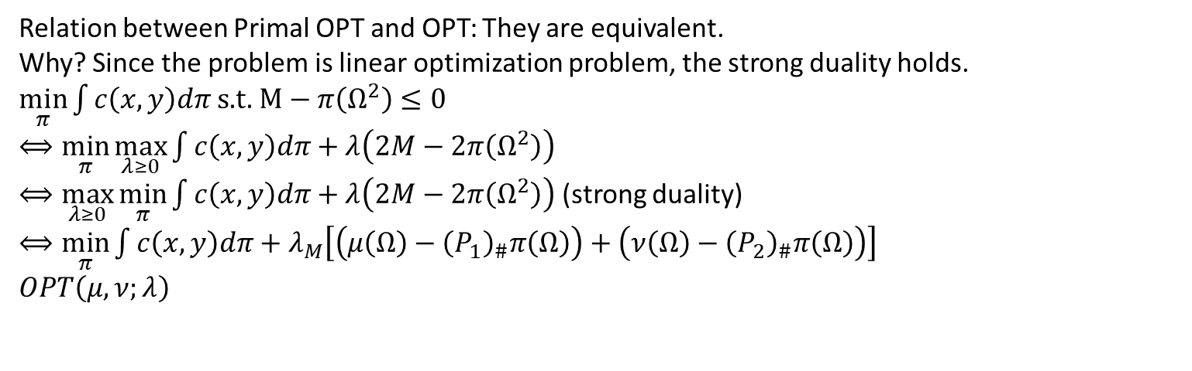

Formulation of OPT
$OPT\left(μ,ν;λ\right)≔$
$$\min_{π}{\int{c\left(x,y\right)dπ}+λ\left[\left(μ\left(Ω\right)−{\left(P_{1}\right)}_{\#}π\left(Ω\right)\right)+\left(ν\left(Ω\right)−{\left(P_{2}\right)}_{\#}π\left(Ω\right)\right)\right]}$$
mass destruction penalty
mass creation penalty
transportation
cost
$$Such that: \\ 0≤{\left(P_{1}\right)}_{\#}π≤μ \\ 0≤{\left(P_{2}\right)}_{\#}π≤ν$$
where $λ ≥0$ are constant.
Relation between Primal OPT and OPT: They are equivalent. Why? Since the problem is linear optimization problem, the strong duality holds.
$\min_{π}{\int{c\left(x,y\right)dπ}}$ s.t. $M−π\left(Ω^{2}\right)≤0$
$⟺\min_{π}{\max_{λ≥0}{\int{c\left(x,y\right)dπ}+λ\left(2M−2π\left(Ω^{2}\right)\right)}}$
$⟺\max_{λ≥0}{\min_{π}{\int{c\left(x,y\right)dπ}+λ\left(2M−2π\left(Ω^{2}\right)\right)}}$ (strong duality)
$⟺\min_{π}{\int{c\left(x,y\right)dπ}+λ_{M}\left[\left(μ\left(Ω\right)−{\left(P_{1}\right)}_{\#}π\left(Ω\right)\right)+\left(ν\left(Ω\right)−{\left(P_{2}\right)}_{\#}π\left(Ω\right)\right)\right]}$
$OPT\left(μ,ν;λ\right)$

Slide 9
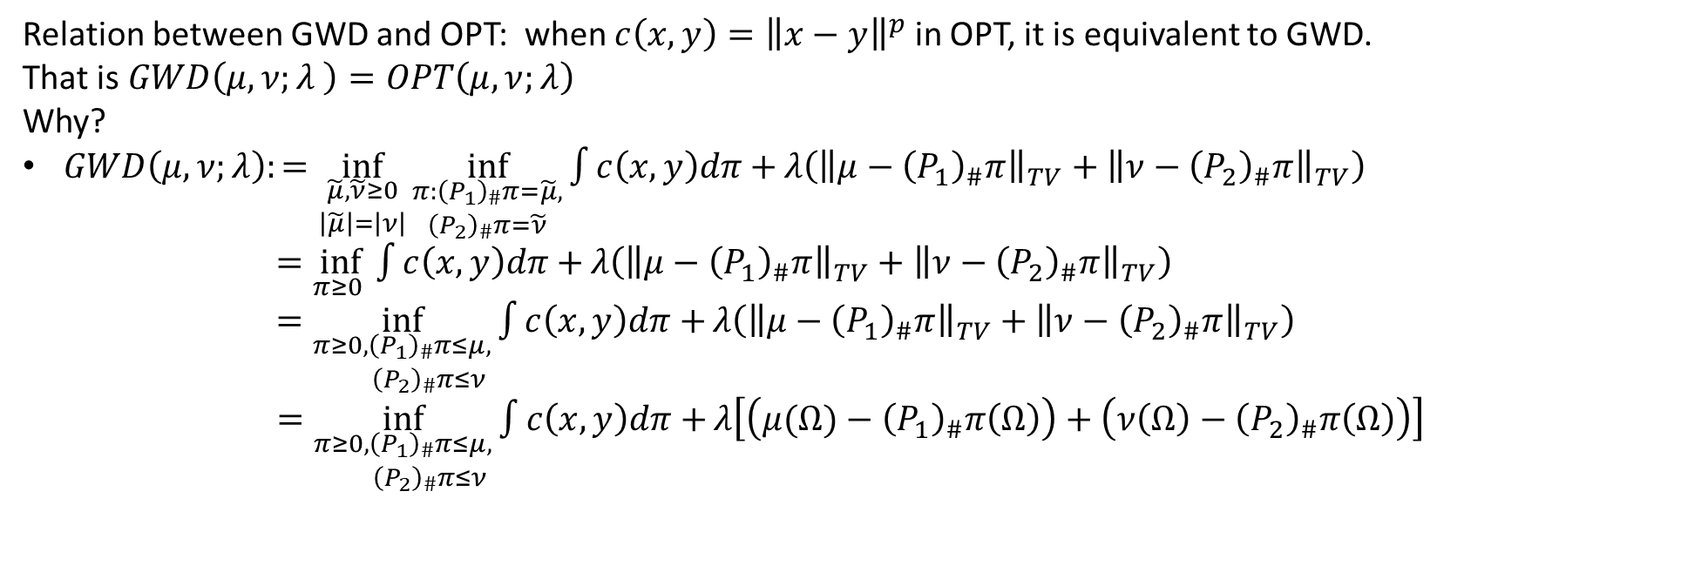
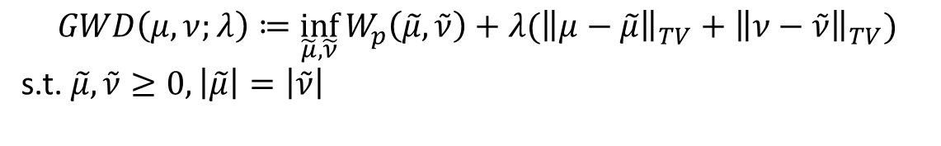
History of formulations of OPT
Generalized Wasserstein Distance (Piccoli and Rossi, 2014):
$$GWD\left(μ,ν;λ\right)≔\inf_{\tilde{μ},\tilde{ν}}{W_{p}\left(\tilde{μ},\tilde{ν}\right)+λ({\left\|μ−\tilde{μ}\right\|}_{TV}+{\left\|ν−\tilde{ν}\right\|}_{TV}})$$
s.t. $\tilde{μ},\tilde{ν}≥0,\left|\tilde{μ}\right|=\left|\tilde{ν}\right|$
Relation between GWD and OPT: when $c\left(x,y\right)={\left\|x−y\right\|}^{p}$ in OPT, it is equivalent to GWD. That is $GWD\left(μ,ν;λ \right)=OPT\left(μ,ν;λ\right)$ Why?
$GWD\left(μ,ν;λ\right):=\inf_{\begin{aligned}\tilde{μ},\tilde{ν}≥0 \\ \left|\tilde{μ}\right|=\left|ν\right|\end{aligned}}{\inf_{\begin{aligned}π:{\left(P_{1}\right)}_{\#}π=\tilde{μ}, \\ {\left(P_{2}\right)}_{\#}π=\tilde{ν}\end{aligned}}{\int{c\left(x,y\right)dπ}+}λ\left({\left\|μ−{\left(P_{1}\right)}_{\#}π\right\|}_{TV}+{\left\|ν−{\left(P_{2}\right)}_{\#}π\right\|}_{TV}\right)}$
$=\inf_{π≥0 }{\int{c\left(x,y\right)dπ}+}λ\left({\left\|μ−{\left(P_{1}\right)}_{\#}π\right\|}_{TV}+{\left\|ν−{\left(P_{2}\right)}_{\#}π\right\|}_{TV}\right)$
$=\inf_{\begin{aligned}π≥0,{\left(P_{1}\right)}_{\#}π≤μ, \\ {\left(P_{2}\right)}_{\#}π≤ν\end{aligned}}{\int{c\left(x,y\right)dπ}+}λ\left({\left\|μ−{\left(P_{1}\right)}_{\#}π\right\|}_{TV}+{\left\|ν−{\left(P_{2}\right)}_{\#}π\right\|}_{TV}\right)$
$=\inf_{\begin{aligned}π≥0,{\left(P_{1}\right)}_{\#}π≤μ, \\ {\left(P_{2}\right)}_{\#}π≤ν\end{aligned}}{\int{c\left(x,y\right)dπ}+}λ\left[\left(μ(Ω)−{\left(P_{1}\right)}_{\#}π\left(Ω\right)\right)+\left(ν\left(Ω\right)−{\left(P_{2}\right)}_{\#}π\left(Ω\right)\right)\right]$

Slide 10
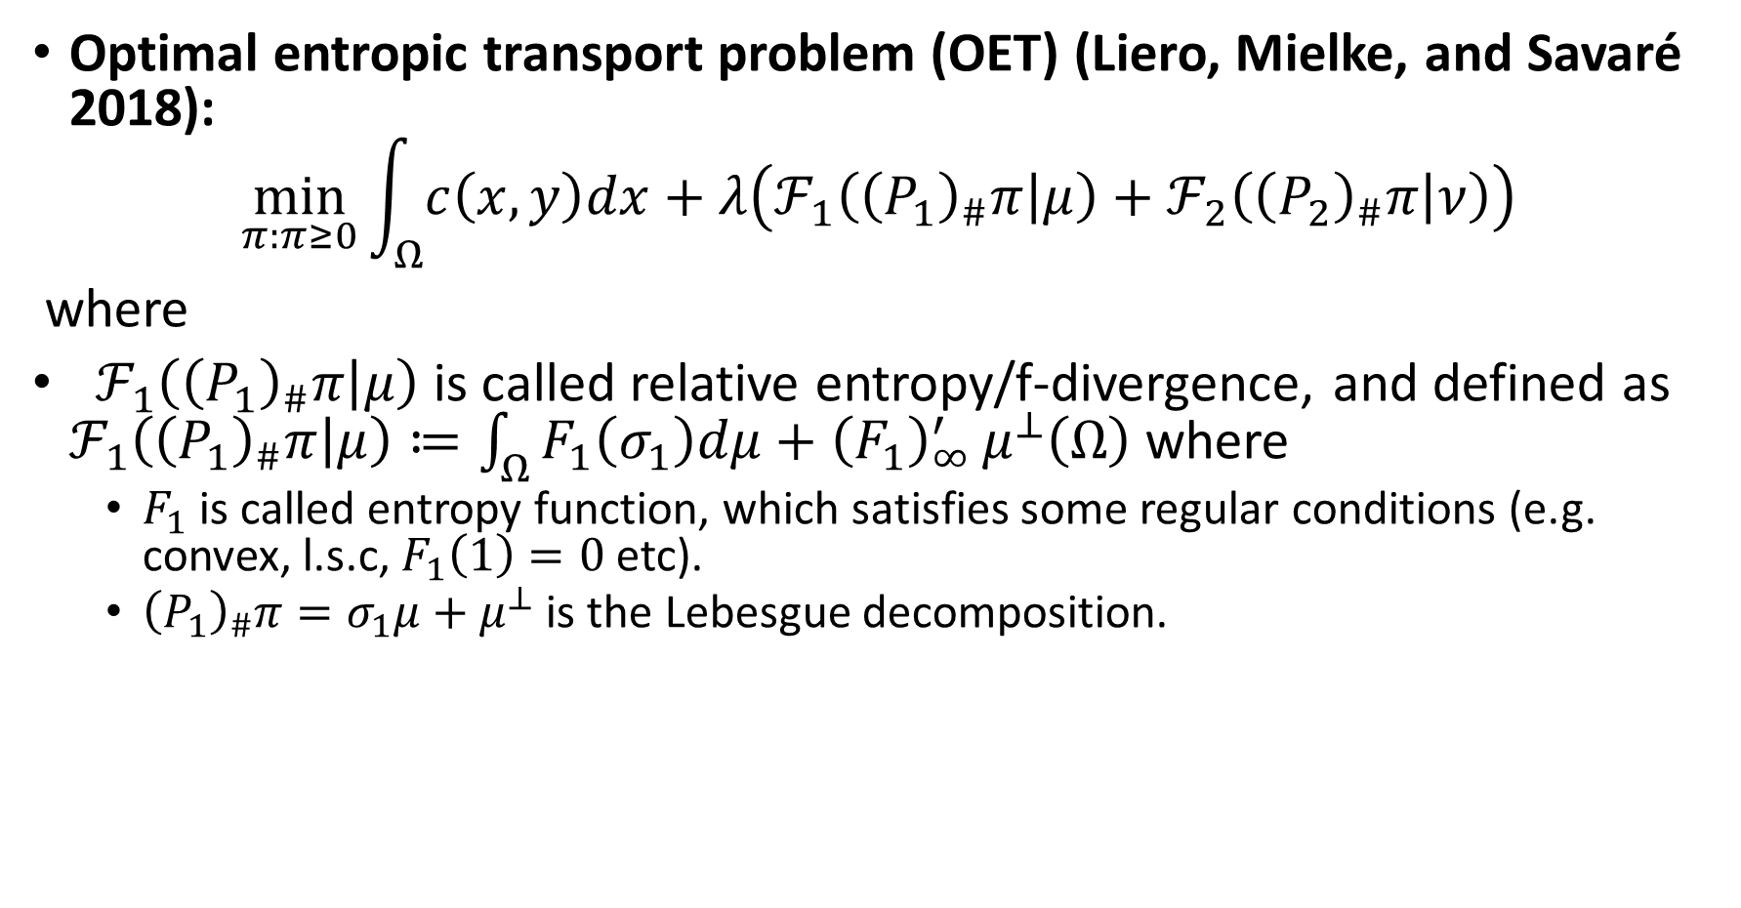
Generalization of OPT: Unbalanced OT
Optimal entropic transport problem (OET) (Liero, Mielke, and Savaré 2018):
$$\min_{π:π≥0}{\int_{Ω}{c\left(x,y\right)dx}+λ\left(ℱ_{1}\left({\left(P_{1}\right)}_{\#}π | μ\right)+ℱ_{2}\left({\left(P_{2}\right)}_{\#}π | ν\right)\right)}$$
where
$ℱ_{1}\left({\left(P_{1}\right)}_{\#}π | μ\right)$ is called relative entropy/f-divergence, and defined as $ℱ_{1}\left({\left(P_{1}\right)}_{\#}π | μ\right)≔\int_{Ω}{F_{1}\left(σ_{1}\right)dμ+{\left(F_{1}\right)}_{∞}^{′}}μ^{⊥}\left(Ω\right)$ where
$F_{1}$ is called entropy function, which satisfies some regular conditions (e.g. convex, l.s.c, $F_{1}\left(1\right)=0$ etc).
${\left(P_{1}\right)}_{\#}π=σ_{1}μ+μ^{⊥}$ is the Lebesgue decomposition.

Slide 11
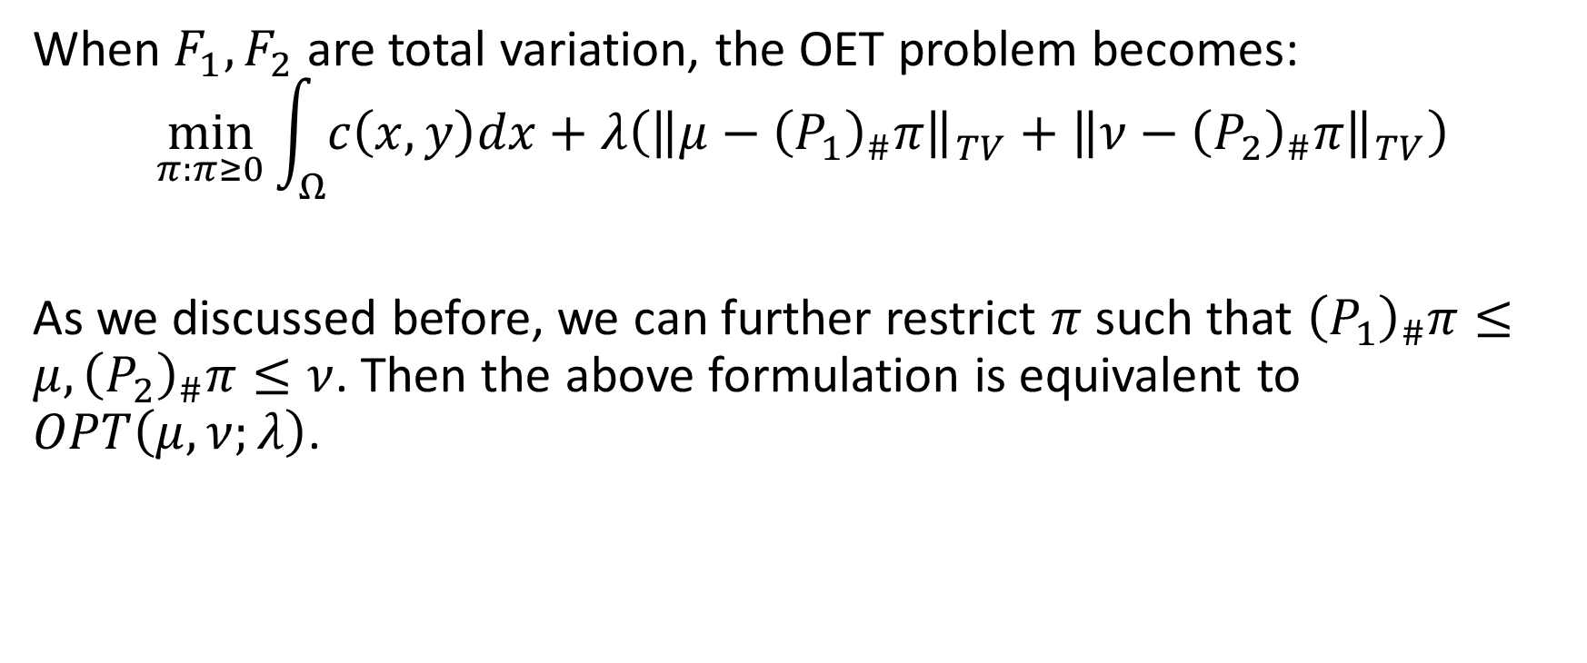
Relation between OET and OPT
When $F_{1},F_{2}$ are total variation, the OET problem becomes:
$$\min_{π:π≥0}{\int_{Ω}{c\left(x,y\right)dx}+λ\left({\left\|μ−{\left(P_{1}\right)}_{\#}π\right\|}_{TV}+{\left\|ν−{\left(P_{2}\right)}_{\#}π\right\|}_{TV}\right)}$$
As we discussed before, we can further restrict $π$ such that ${\left(P_{1}\right)}_{\#}π≤μ,{\left(P_{2}\right)}_{\#}π≤ν$. Then the above formulation is equivalent to $OPT\left(μ,ν;λ\right)$.

Slide 12
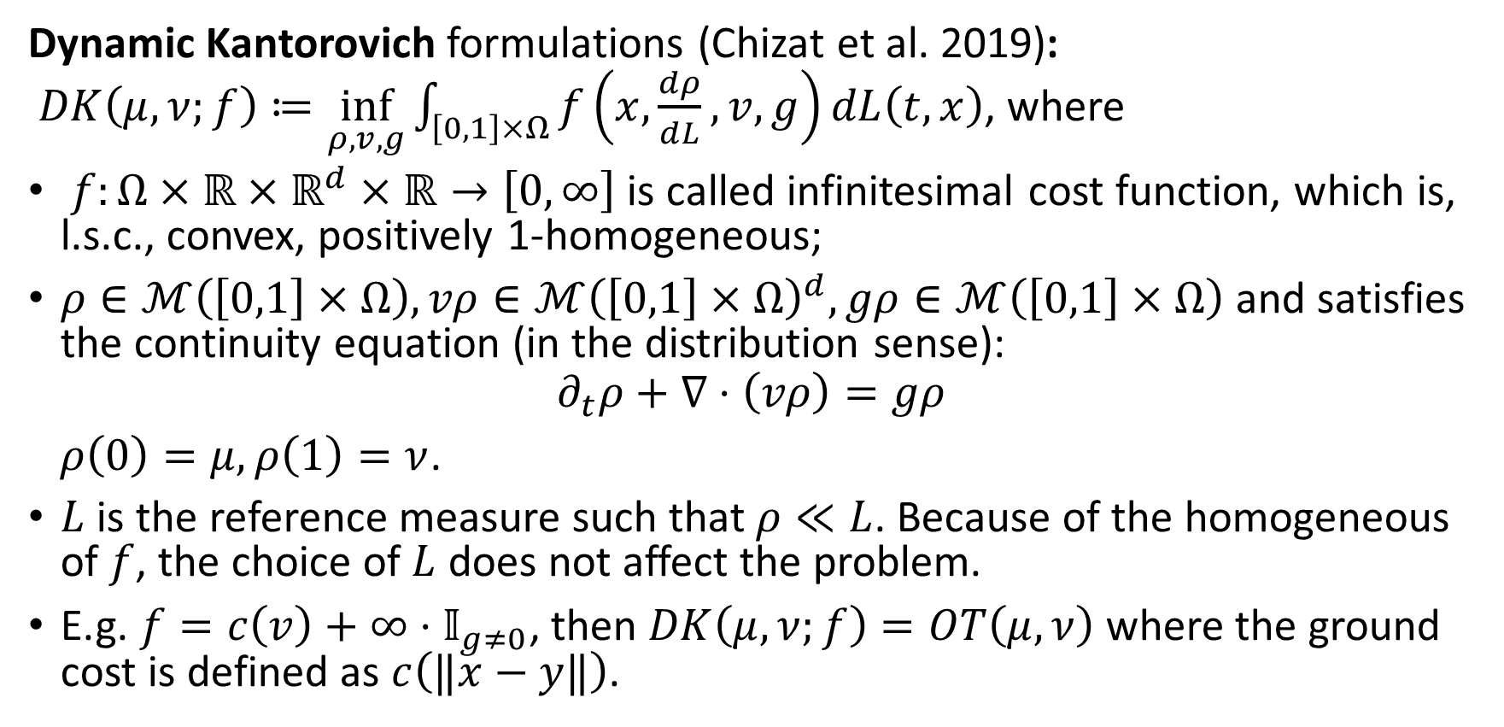
Generalization of OPT: Unbalanced OT
Dynamic Kantorovich formulations (Chizat et al. 2019): $DK\left(μ,ν;f\right)≔\inf_{ρ,v,g}{\int_{\left[0,1\right]×Ω}{f\left(x,\frac{dρ}{dL},v,g\right)dL\left(t,x\right)}}$, where
$f:Ω×ℝ×ℝ^{d}×ℝ→\left[0,∞\right]$ is called infinitesimal cost function, which is, l.s.c., convex, positively 1-homogeneous;
$ρ∈ℳ\left(\left[0,1\right]×Ω\right),vρ∈ℳ{\left(\left[0,1\right]×Ω\right)}^{d},gρ∈ℳ\left(\left[0,1\right]×Ω\right)$ and satisfies the continuity equation (in the distribution sense):
$$∂_{t}ρ+∇⋅\left(vρ\right)=gρ$$
$ρ\left(0\right)=μ,ρ\left(1\right)=ν$.
$L$ is the reference measure such that $ρ≪L$. Because of the homogeneous of $f$, the choice of $L$ does not affect the problem.
E.g. $f=c\left(v\right)+∞⋅𝕀_{g≠0}$, then $DK\left(μ, ν;f\right)=OT\left(μ,ν\right)$ where the ground cost is defined as $c\left(‖x−y‖\right)$.

Slide 13
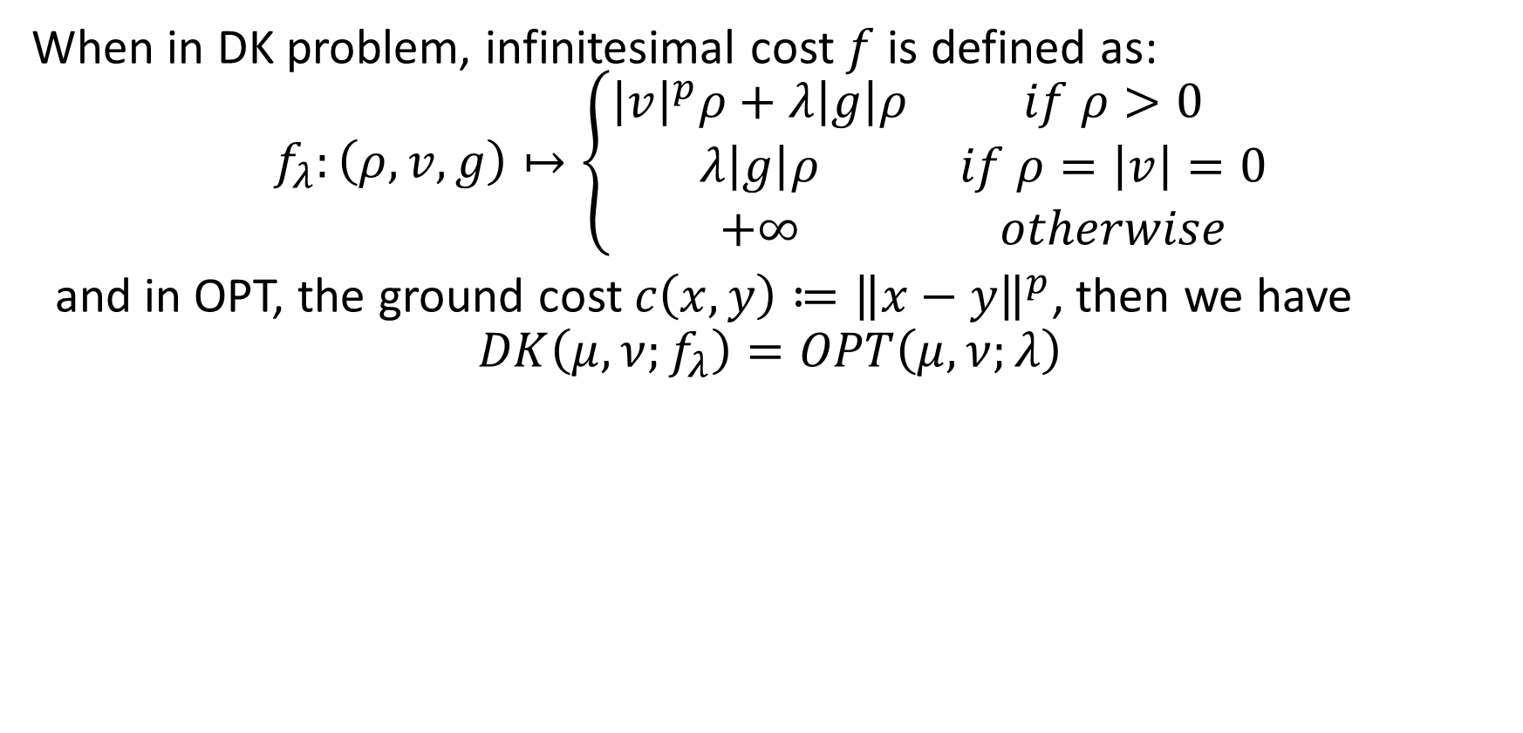
Relation between DK and OPT
When in DK problem, infinitesimal cost $f$ is defined as: $$f_{λ}:\left(ρ,v,g\right)↦\left\{\begin{matrix}{\left|v\right|}^{p}ρ+λ\left|g\right|ρ & if ρ>0 \\ λ\left|g\right|ρ & if ρ=\left|v\right|=0 \\ +∞ & otherwise\end{matrix}\right.$$
and in OPT, the ground cost $c\left(x,y\right)≔{\left\|x−y\right\|}^{p}$, then we have $$DK\left(μ,ν;f_{λ}\right)=OPT\left(μ,ν;λ\right)$$

Slide 14
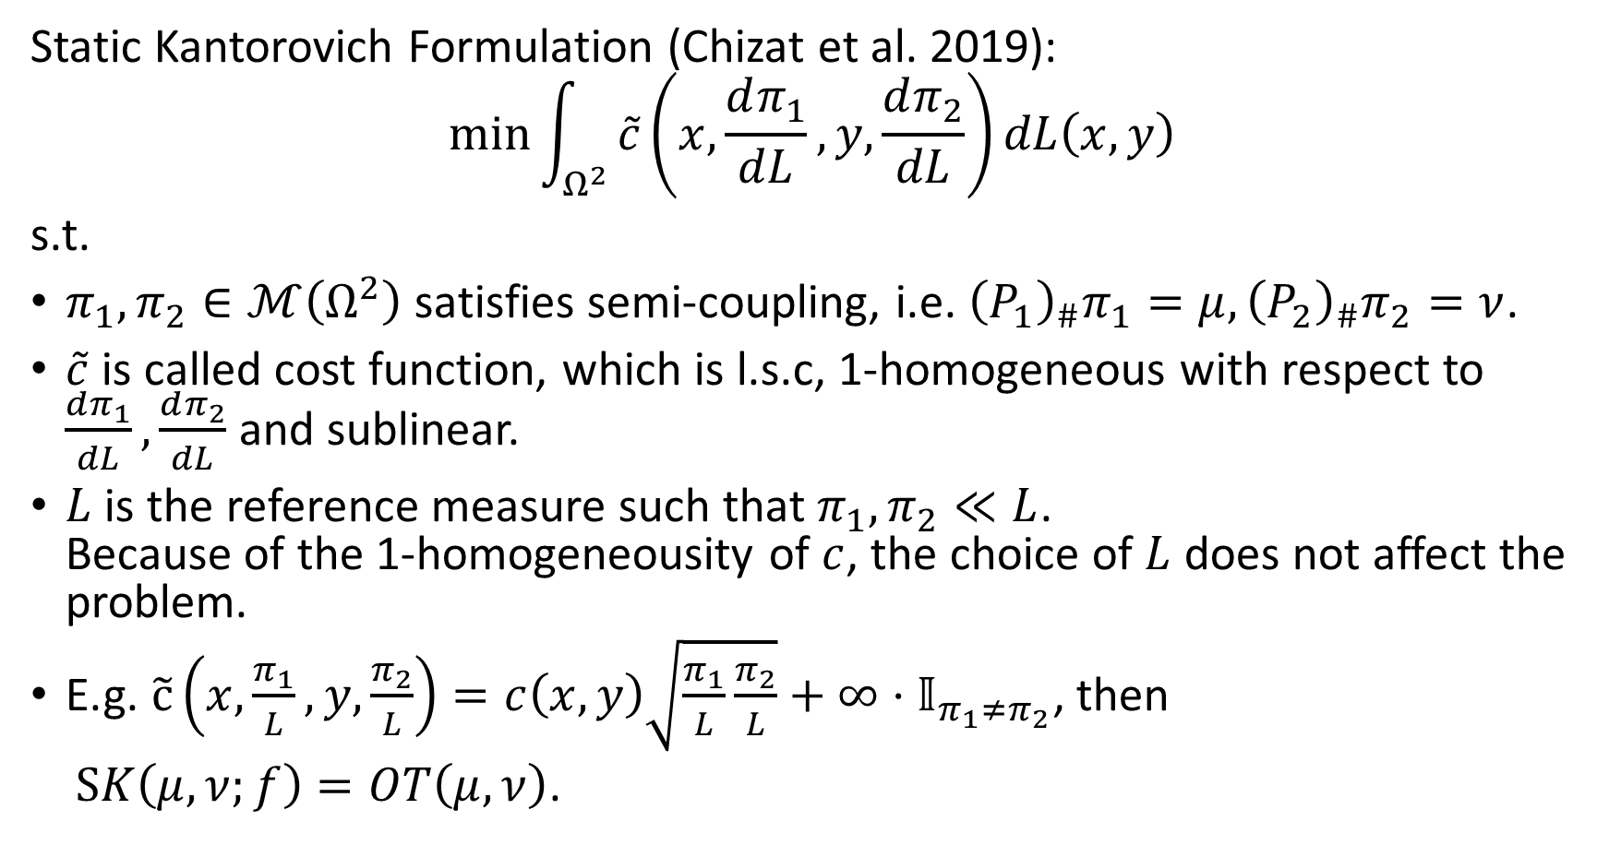
Generalization of OPT: Unbalanced OT
Static Kantorovich Formulation (Chizat et al. 2019):
$$\min{\int_{Ω^{2}}{\tilde{c}\left(x,\frac{dπ_{1}}{dL},y,\frac{dπ_{2}}{dL}\right)dL\left(x,y\right)}}$$
s.t.
$π_{1},π_{2}∈ℳ\left(Ω^{2}\right)$ satisfies semi-coupling, i.e. ${\left(P_{1}\right)}_{\#}π_{1}=μ,{\left(P_{2}\right)}_{\#}π_{2}=ν$.
$\tilde{c}$ is called cost function, which is l.s.c, 1-homogeneous with respect to $\frac{dπ_{1}}{dL},\frac{dπ_{2}}{dL}$ and sublinear.
$L$ is the reference measure such that $π_{1},π_{2}≪L$. Because of the 1-homogeneousity of $c$, the choice of $L$ does not affect the problem.
E.g. $\tilde{c}\left(x,\frac{π_{1}}{L},y,\frac{π_{2}}{L}\right)=c\left(x,y\right)\sqrt{\frac{π_{1}}{L}\frac{π_{2}}{L}}+∞⋅𝕀_{π_{1}≠π_{2}}$, then
$SK\left(μ, ν;f\right)=OT\left(μ,ν\right)$.

Slide 15
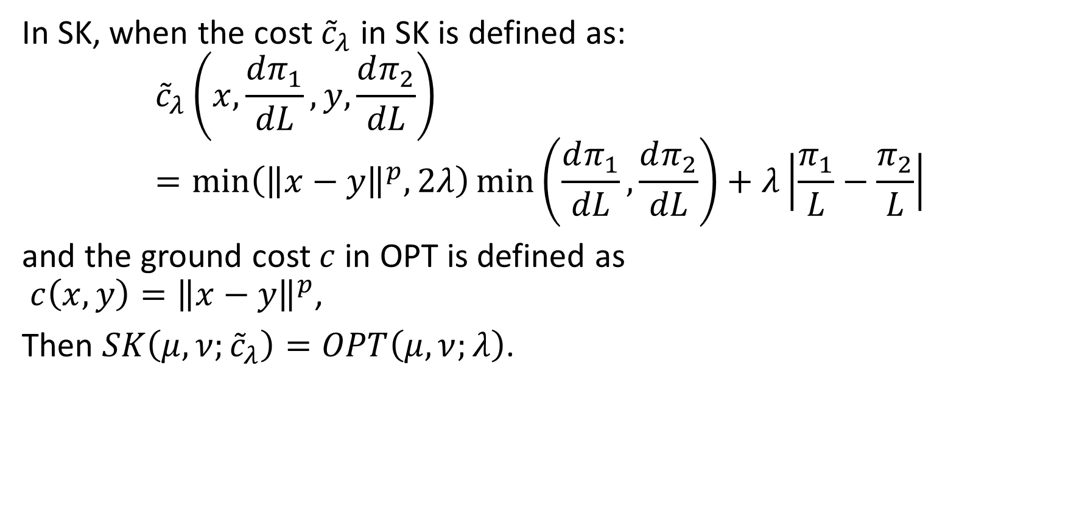
Relation between SK and OPT
In SK, when the cost ${\tilde{c}}_{λ}$ in SK is defined as: $${\tilde{c}}_{λ}\left(x,\frac{dπ_{1}}{dL},y,\frac{dπ_{2}}{dL}\right)=\min\left({\left\|x−y\right\|}^{p},2λ\right)\min\left(\frac{dπ_{1}}{dL},\frac{dπ_{2}}{dL}\right)+λ\left|\frac{π_{1}}{L}−\frac{π_{2}}{L}\right|$$
and the ground cost $c$ in OPT is defined as $c\left(x,y\right)={\left\|x−y\right\|}^{p}$,
Then $SK\left(μ,ν;{\tilde{c}}_{λ}\right)=OPT\left(μ,ν;λ\right)$.

Slide 16
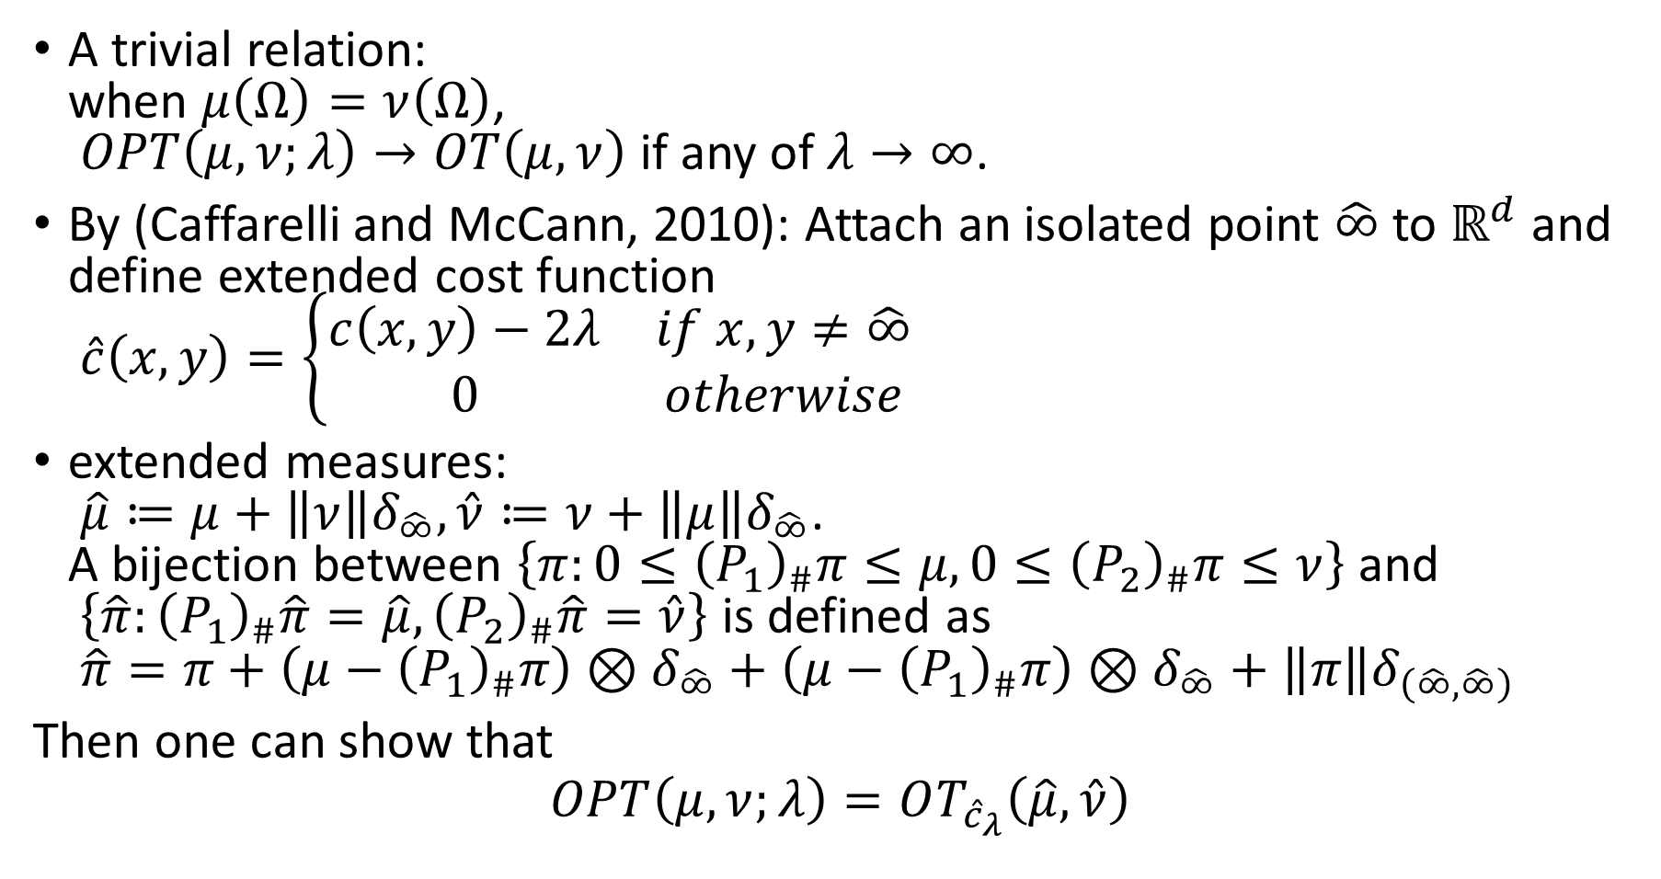
Relation of OT and OPT
A trivial relation: when $μ\left(Ω\right)=ν\left(Ω\right)$, $OPT\left(μ,ν;λ\right)→OT\left(μ,ν\right)$ if any of $λ→∞$.
By (Caffarelli and McCann, 2010): Attach an isolated point $\hat{∞}$ to $ℝ^{d}$ and define extended cost function $\hat{c}\left(x,y\right)=\left\{\begin{matrix}c\left(x,y\right)−2λ & if x,y≠\hat{∞} \\ 0 & otherwise\end{matrix}\right.$
extended measures: $\hat{μ}≔μ+\left\|ν\right\|δ_{\hat{∞}},\hat{ν}≔ν+\left\|μ\right\|δ_{\hat{∞}}$. A bijection between $\left\{π:0≤{\left(P_{1}\right)}_{\#}π≤μ,0≤{\left(P_{2}\right)}_{\#}π≤ν\right\}$ and $\left\{\hat{π}:{\left(P_{1}\right)}_{\#}\hat{π}=\hat{μ},{\left(P_{2}\right)}_{\#}\hat{π}=\hat{ν}\right\}$ is defined as $\hat{π}=π+\left(μ−{\left(P_{1}\right)}_{\#}π\right)⊗δ_{\hat{∞}}+\left(μ−{\left(P_{1}\right)}_{\#}π\right)⊗δ_{\hat{∞}}+\left\|π\right\|δ_{\left(\hat{∞},\hat{∞}\right)}$
Then one can show that
$$OPT\left(μ,ν;λ\right)=OT_{{\hat{c}}_{λ}}\left(\hat{μ},\hat{ν}\right)$$

Slide 17




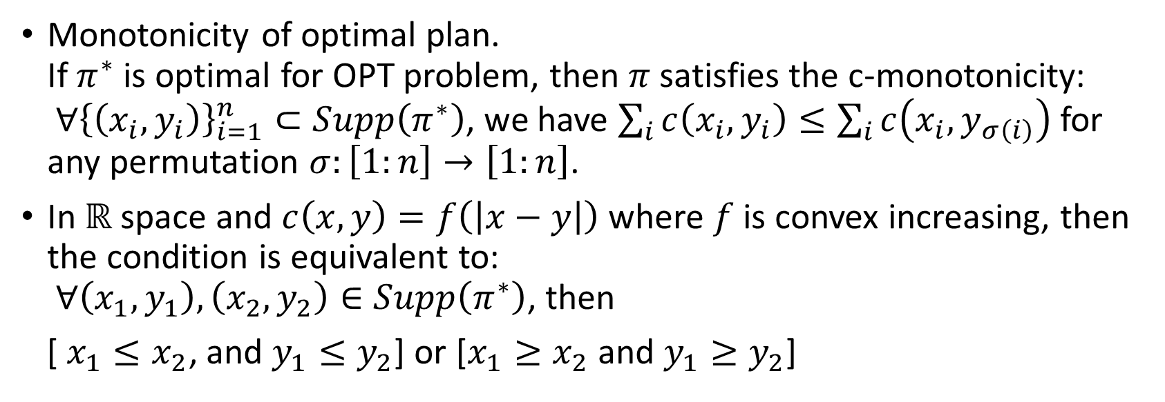


Basic properties of OPT
Monotonicity of optimal plan. If $π^{∗}$ is optimal for OPT problem, then $π$ satisfies the c-monotonicity: $∀{\left\{\left(x_{i},y_{i}\right)\right\}}_{i=1}^{n}⊂Supp\left(π^{∗}\right)$, we have $\sum_{i}{c\left(x_{i},y_{i}\right)}≤\sum_{i}{c\left(x_{i},y_{σ\left(i\right)}\right)}$ for any permutation $σ:\left[1:n\right]→\left[1:n\right]$.
In $ℝ$ space and $c\left(x,y\right)=f\left(\left|x−y\right|\right)$ where $f$ is convex increasing, then the condition is equivalent to: $∀\left(x_{1},y_{1}\right),\left(x_{2},y_{2}\right)∈Supp\left(π^{∗}\right)$, then
[ $x_{1}≤x_{2}$, and $y_{1}≤y_{2}$] or [$x_{1}≥x_{2}$ and $y_{1}≥y_{2}$]
$$X$$
$$X$$
$$Y$$
$$Y$$

Slide 18
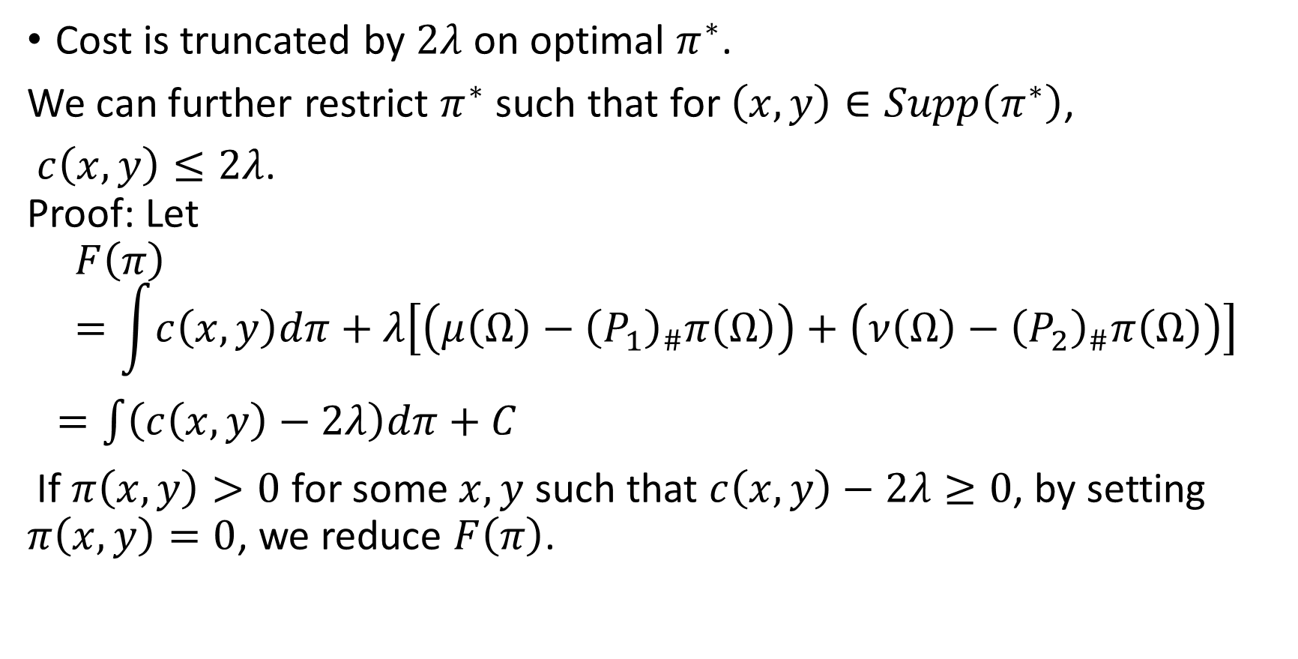
Basic properties of OPT
Cost is truncated by $2λ$ on optimal $π^{∗}$.
We can further restrict $π^{∗}$ such that for $\left(x,y\right)∈Supp\left(π^{∗}\right)$,
$c\left(x,y\right)≤2λ$. Proof: Let
$$F\left(π\right)=\int{c\left(x,y\right)dπ}+λ\left[\left(μ\left(Ω\right)−{\left(P_{1}\right)}_{\#}π\left(Ω\right)\right)+\left(ν\left(Ω\right)−{\left(P_{2}\right)}_{\#}π\left(Ω\right)\right)\right]$$
$=\int{\left(c\left(x,y\right)−2λ\right)dπ}+C$
If $π\left(x,y\right)>0$ for some $x,y$ such that $c\left(x,y\right)−2λ≥0$, by setting $π\left(x,y\right)=0$, we reduce $F\left(π\right)$.

Slide 19
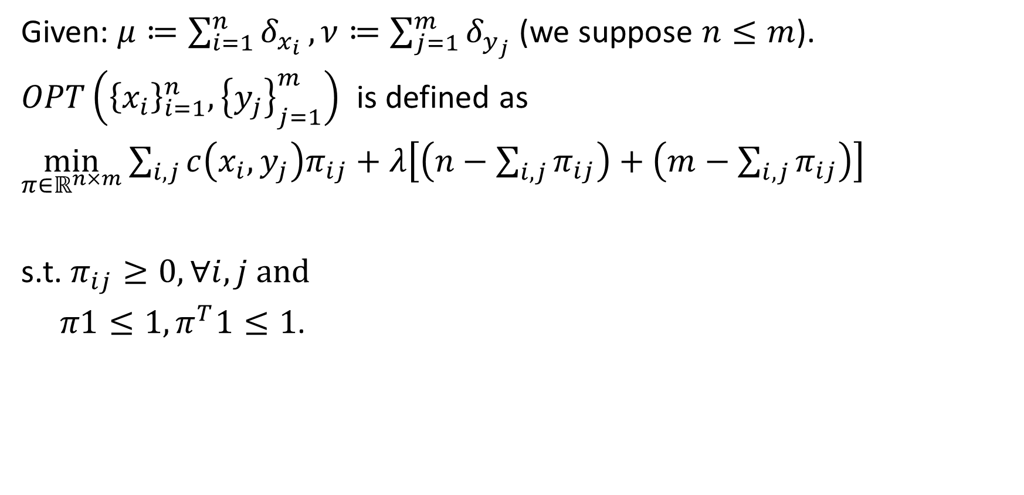
Empirical OPT
Given: $μ≔\sum_{i=1}^{n}{δ_{x_{i}}},ν≔\sum_{j=1}^{m}{δ_{y_{j}}}$ (we suppose $n≤m$).
$OPT\left({\left\{x_{i}\right\}}_{i=1}^{n},{\left\{y_{j}\right\}}_{j=1}^{m}\right)$ is defined as
$\min_{π∈ℝ^{n×m}}{\sum_{i,j}{c\left(x_{i},y_{j}\right)π_{ij}}+λ\left[\left(n−\sum_{i,j}{π_{ij}}\right)+\left(m−\sum_{i,j}{π_{ij}}\right)\right]}$
s.t. $π_{ij}≥0,∀i,j$ and
$π1≤1,π^{T}1≤1$.

Slide 20
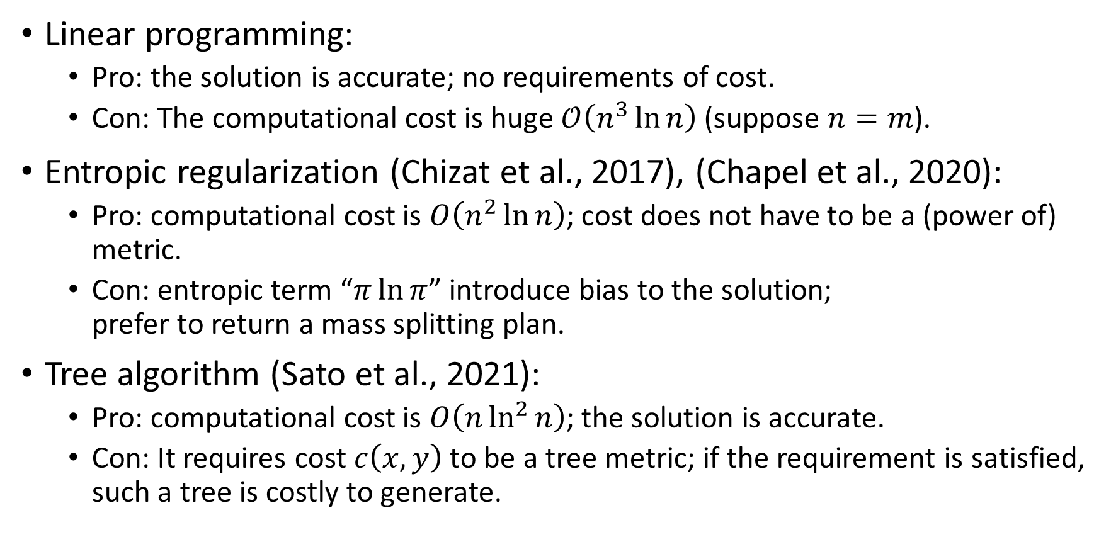
Computation of Empirical OPT
Linear programming:
Pro: the solution is accurate; no requirements of cost.
Con: The computational cost is huge $𝒪\left(n^{3}\ln{n}\right)$ (suppose $n=m$).
Entropic regularization (Chizat et al., 2017), (Chapel et al., 2020):
Pro: computational cost is $O\left(n^{2}\ln{n}\right)$; cost does not have to be a (power of) metric.
Con: entropic term “$π\ln{π}$” introduce bias to the solution; prefer to return a mass splitting plan.
Tree algorithm (Sato et al., 2021):
Pro: computational cost is $O\left(n\ln^{2}{n}\right)$; the solution is accurate.
Con: It requires cost $c\left(x,y\right)$ to be a tree metric; if the requirement is satisfied, such a tree is costly to generate.

Slide 21
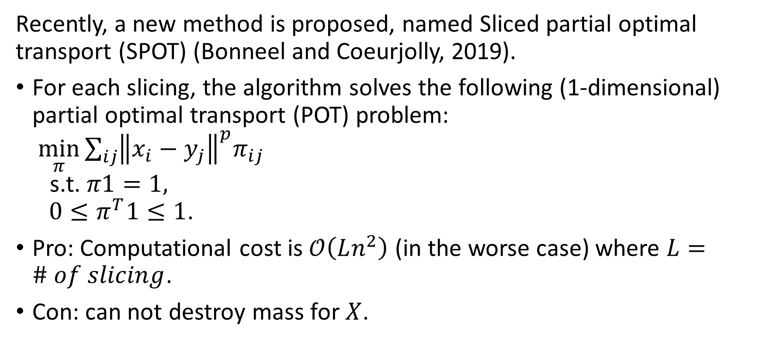
Sliced Partial Optimal Transport
Recently, a new method is proposed, named Sliced partial optimal transport (SPOT) (Bonneel and Coeurjolly, 2019).
For each slicing, the algorithm solves the following (1-dimensional) partial optimal transport (POT) problem: $\min_{π}{\sum_{ij}{{\left\|x_{i}−y_{j}\right\|}^{p}π_{ij}}}$ s.t. $π1=1,$ $0≤π^{T}1≤1$.
Pro: Computational cost is $𝒪\left(Ln^{2}\right)$ (in the worse case) where $L=\# of slicing$.
Con: can not destroy mass for $X$.

Slide 22

Relation between OPT and POT
A trivial relation:
as $λ →∞$,
$OPT\left({\left\{x_{i}\right\}}_{i=1}^{n},{\left\{y_{j}\right\}}_{j=1}^{m}\right)−λ(m−n)→POT\left({\left\{x_{i}\right\}}_{i=1}^{n},{\left\{y_{j}\right\}}_{j=1}^{m}\right)$

Slide 23
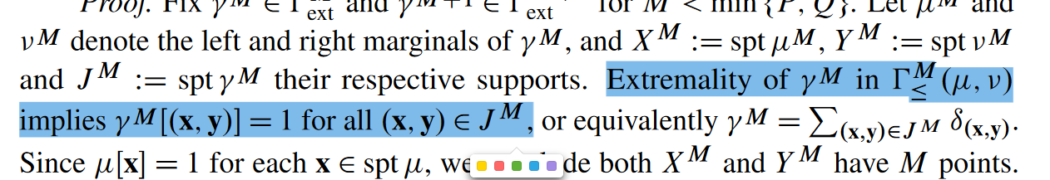
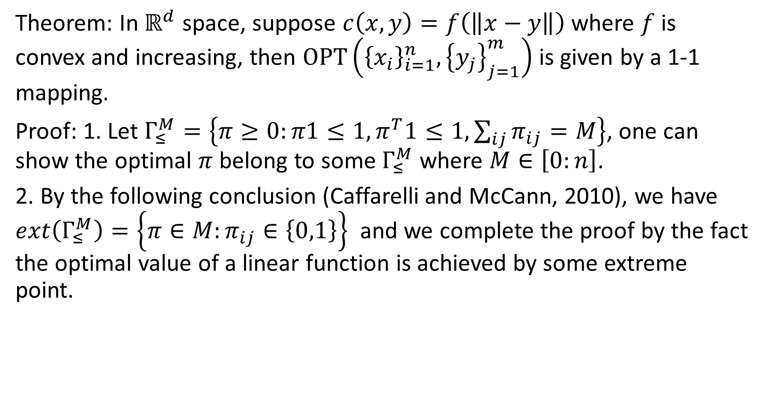
Theoretical result of empirical OPT
Theorem: In $ℝ^{d}$ space, suppose $c\left(x,y\right)=f\left(\left\|x−y\right\|\right)$ where $f$ is convex and increasing, then $OPT\left({\left\{x_{i}\right\}}_{i=1}^{n},{\left\{y_{j}\right\}}_{j=1}^{m}\right)$ is given by a 1-1 mapping.
Proof: 1. Let $Γ_{≤}^{M}=\left\{π≥0:π1≤1,π^{T}1≤1,\sum_{ij}{π_{ij}}=M\right\}$, one can show the optimal $π$ belong to some $Γ_{≤}^{M}$ where $M∈\left[0:n\right]$.
2. By the following conclusion (Caffarelli and McCann, 2010), we have $ext\left(Γ_{≤}^{M}\right)=\left\{π∈M:π_{ij}∈\left\{0,1\right\}\right\}$ and we complete the proof by the fact the optimal value of a linear function is achieved by some extreme point.

Slide 24
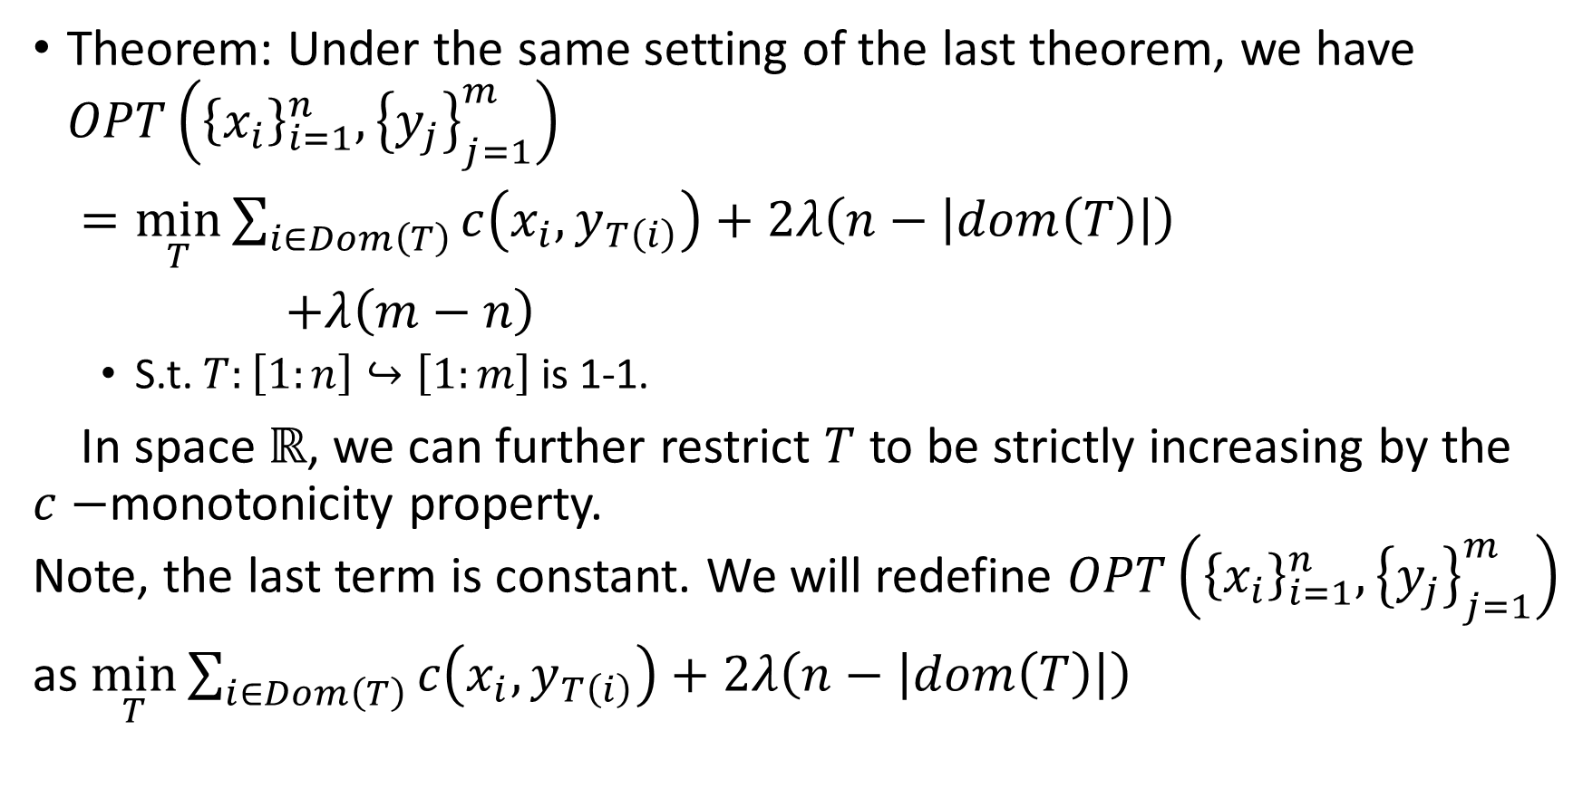
Theoretical result of empirical OPT
Theorem: Under the same setting of the last theorem, we have $OPT\left({\left\{x_{i}\right\}}_{i=1}^{n},{\left\{y_{j}\right\}}_{j=1}^{m}\right)$
$=\min_{T}{\sum_{i∈Dom\left(T\right)}{c\left(x_{i},y_{T\left(i\right)}\right)}+2λ\left(n−\left|dom\left(T\right)\right|\right)}$
$+λ\left(m−n\right)$
S.t. $T:\left[1:n\right]↪\left[1:m\right]$ is 1-1.
In space $ℝ$, we can further restrict $T$ to be strictly increasing by the $c−$monotonicity property. Note, the last term is constant. We will redefine $OPT\left({\left\{x_{i}\right\}}_{i=1}^{n},{\left\{y_{j}\right\}}_{j=1}^{m}\right)$
as $\min_{T}{\sum_{i∈Dom\left(T\right)}{c\left(x_{i},y_{T\left(i\right)}\right)}+2λ\left(n−\left|dom\left(T\right)\right|\right)}$

Slide 25
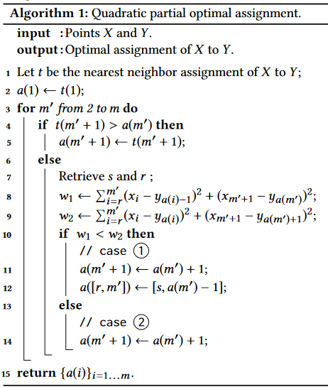
























Algorithm of 1D-POT
conflict:
$$X$$
$$x_{r}$$
$$x_{m^{′}}$$
$$x_{m^{′}+1}$$
$$Y$$
$$y_{s}$$
$$y_{a\left(m\right)}=y_{t\left(m^{′}+1\right)}$$
case 1:
$$X$$
$$x_{r}$$
$$x_{m^{′}}$$
$$x_{m^{′}+1}$$
$$Y$$
$$y_{l}$$
$$y_{s}$$
$$y_{a\left(m^{′}\right)}$$
$$y_{a\left(m^{′}\right)+1}$$
case 2:
$$X$$
$$x_{r}$$
$$x_{m^{′}}$$
$$x_{m^{′}+1}$$
$$Y$$
$$y_{l}$$
$$y_{s}$$
$$y_{a\left(m^{′}\right)}$$

Slide 26























Algorithm for 1D OPT (version 1)
No conflict:
$$x_{1}$$
$$x_{2}$$
$$j_{k}=\arg{\min_{j∈\left[1:m\right]}\left\{c\left(x_{k},y_{j}\right)\right\}}$$
$$X$$
$$x_{3}$$
$$x_{k−1}$$
$$x_{k}$$
$$Y$$
$$y_{1}$$
$$y_{2}$$
$$y_{3}$$
$$y_{4}$$
$$y_{j_{last}}$$
$$y_{j_{k}}$$
cost 1n
cost 0
$$x_{k−1}$$
$$x_{k}$$
$$x_{k−1}$$
$$x_{k}$$
$$X$$
$$X$$
$$Y$$
$$Y$$
$$y_{j_{last}}$$
$$y_{j_{k}}$$
$$y_{j_{last}}$$
$$y_{j_{k}}$$
$$cost=min \left\{cost 0, cost 1n \right\}$$

Slide 27



























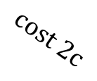
Algorithm for 1D OPT (v1)
$$j_{k}=\arg{\min_{j∈\left[1:m\right]}\left\{c\left(x_{k},y_{j}\right)\right\}}$$
conflict:
$$X$$
$$x_{k−1}$$
$$x_{k}$$
$$x_{k−1}$$
$$x_{k}$$
$$X$$
$$cost 0$$
$$Y$$
$$Y$$
$$y_{j_{last}}=y_{j_{k}}$$
$$y_{j_{last}}$$
$$cost 2c$$
$$cost 1c$$
Solve $OPT\left({\left\{x_{i}\right\}}_{i=1}^{k−1},{\left\{y_{j}\right\}}_{j=1}^{j_{last}−1}\right)$
$$X$$
$$x_{k−1}$$
$$x_{k}$$
$$X$$
$$x_{1}$$
$$x_{k−1}$$
$$x_{k}$$
$$Y$$
$$Y$$
$$y_{l_{last}}$$
$$y_{j_{last}+1}$$
$$y_{1}$$
$$y_{j_{last}}$$
$$cost=min \left\{cost 0, cost 1c, cost 2c\right\}$$

Slide 28
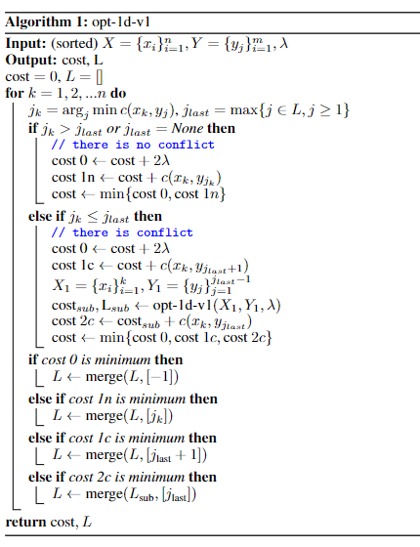
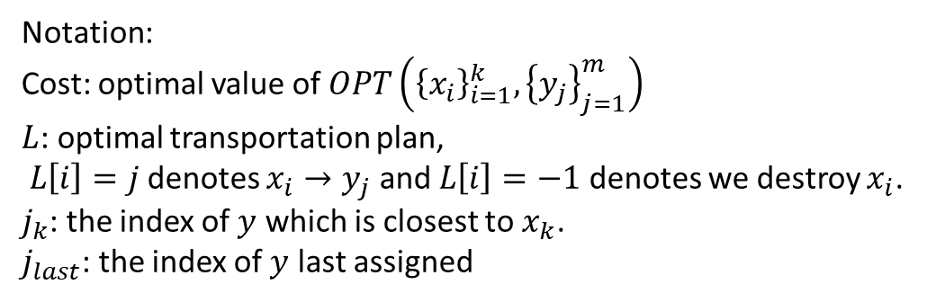
Algorithm for 1D OPT (version 1)
Notation:
Cost: optimal value of $OPT\left({\left\{x_{i}\right\}}_{i=1}^{k},{\left\{y_{j}\right\}}_{j=1}^{m}\right)$
$L$: optimal transportation plan, $L\left[i\right]=j$ denotes $x_{i}→y_{j}$ and $L\left[i\right]=−1$ denotes we destroy $x_{i}$.
$j_{k}$: the index of $y$ which is closest to $x_{k}$.
$j_{last}$: the index of $y$ last assigned

Slide 29

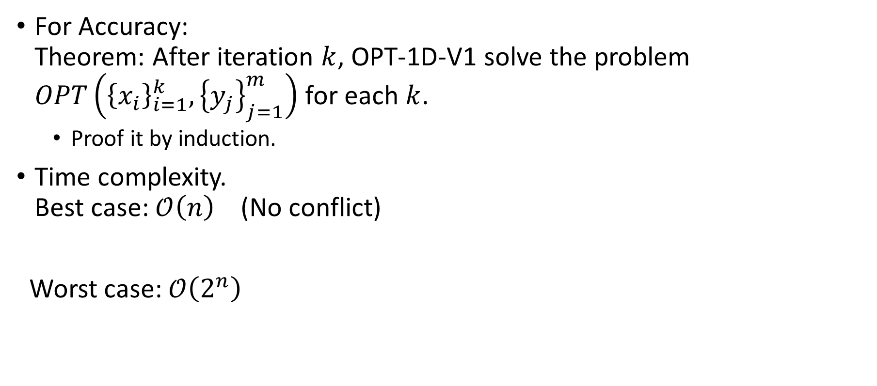



Performance
For Accuracy: Theorem: After iteration $k$, OPT-1D-V1 solve the problem $OPT\left({\left\{x_{i}\right\}}_{i=1}^{k},{\left\{y_{j}\right\}}_{j=1}^{m}\right)$ for each $k$.
Proof it by induction.
Time complexity. Best case: $𝒪\left(n\right)$ (No conflict)
Worst case: $𝒪\left(2^{n}\right)$
$$X$$
$$Y$$
$$X$$
$$Y$$

Slide 30
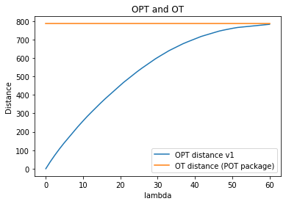

Experiment 1: OPT and OT
Set-up:${\left\{x_{i}\right\}}_{i=1}^{n}∼i.i.d. Unif\left[0,10\right], n=25,$ ${\left\{y_{j}\right\}}_{j=1}^{m}∼i.i.d. Unif\left[5,20\right],m=25$
Tips: $OPT≤OT$
since for OPT we have one more choice.

Slide 31
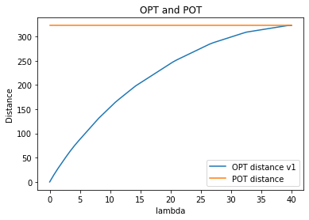

Experiment 2: OPT and POT
Set-up: ${\left\{x_{i}\right\}}_{i=1}^{n}∼iid Unif\left[0,10\right], n=20$ ${\left\{y_{j}\right\}}_{j=1}^{m}∼iid Unif\left[5,20\right],m=25$

Slide 32
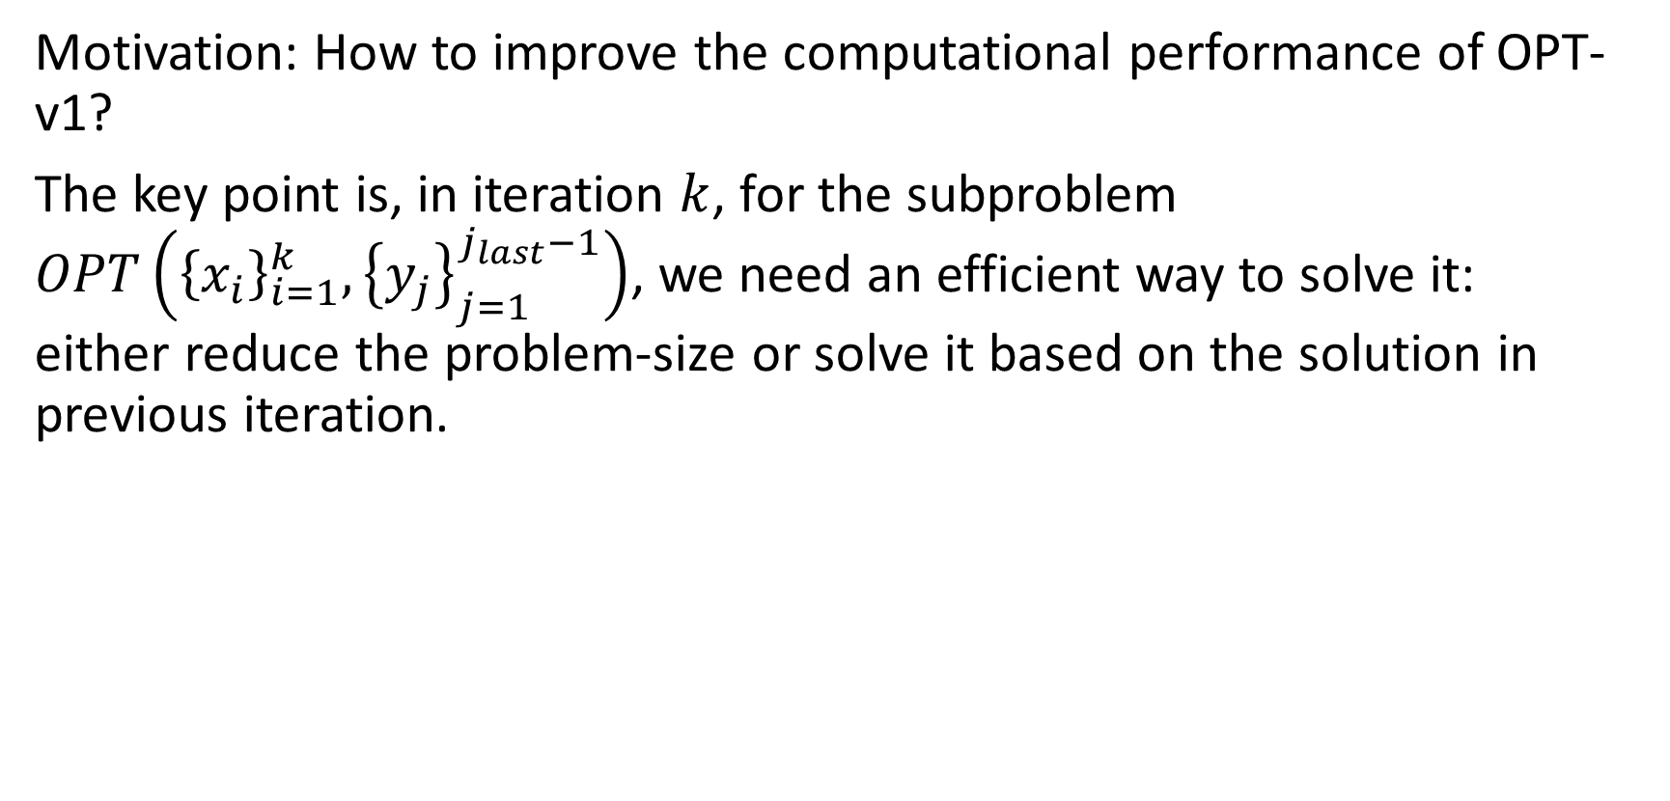
Algorithm for 1D OTP (Version 2)
Motivation: How to improve the computational performance of OPT-v1?
The key point is, in iteration $k$, for the subproblem $OPT\left({\left\{x_{i}\right\}}_{i=1}^{k},{\left\{y_{j}\right\}}_{j=1}^{j_{last}−1}\right)$, we need an efficient way to solve it: either reduce the problem-size or solve it based on the solution in previous iteration.

Slide 33


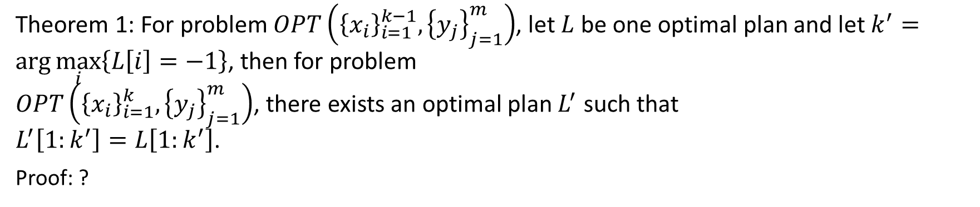



Reduce the problem size
Theorem 1: For problem $OPT\left({\left\{x_{i}\right\}}_{i=1}^{k−1},{\left\{y_{j}\right\}}_{j=1}^{m}\right)$, let $L$ be one optimal plan and let $k^{′}=\arg{\max_{i}\left\{L\left[i\right]=−1\right\}}$, then for problem $OPT\left({\left\{x_{i}\right\}}_{i=1}^{k},{\left\{y_{j}\right\}}_{j=1}^{m}\right)$, there exists an optimal plan $L^{′}$ such that $L^{′}\left[1:k^{′}\right]=L\left[1:k^{′}\right]$.
Proof: ?
Previous-problem
$$x_{k^{′}}$$
$$x_{i_{start}}$$
$$x_{k−1}$$
$$x_{k}$$
$$y_{j_{start}}$$

Slide 34



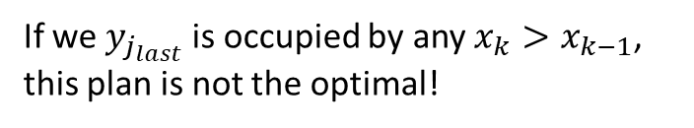























Proof of theorem 1
$$x_{1}$$
$$x_{2}$$
$$x_{3}$$
$$x_{4}$$
$$x_{5}$$
$$x_{k−1}$$
$$x_{k}$$
$$y_{1}$$
$$y_{2}$$
$$y_{3}$$
$$y_{4}$$
$$y_{5}$$
$$y_{j_{last}}$$
If we $y_{j_{last}}$ is occupied by any $x_{k}>x_{k−1}$, this plan is not the optimal!
$$x_{1}$$
$$x_{2}$$
$$x_{3}$$
$$x_{4}$$
$$x_{5}$$
$$x_{k−1}$$
$$x_{k}$$
$$y_{1}$$
$$y_{2}$$
$$y_{3}$$
$$y_{4}$$
$$y_{5}$$
$$y_{j_{last} }$$

Slide 35






























Algorithm: 1D OPT (V2)
Case 0
$$cost 0$$
Previous-problem
conflict
Previous-problem
$$x_{k^{′}}$$
$$x_{i_{start}}$$
$$x_{k−1}$$
$$x_{k}$$
$$x_{k^{′}}$$
$$x_{i_{start}}$$
$$x_{k−1}$$
$$x_{k}$$
$$y_{j_{start}}$$
$$y_{j_{last}}$$
$$y_{j_{last}}$$
$$y_{j_{start}}$$
Case 1c
Case 2c
$$sub−problem$$
Previous-problem
$$OPT\left({\left\{x_{i}\right\}}_{i=i_{start}}^{k−1},{\left\{y_{j}\right\}}_{j=j_{start}}^{l_{last}−1}\right)$$
Previous-problem
$$x_{k^{′}}$$
$$x_{k^{′}}$$
$$x_{i_{start}}$$
$$x_{k−1}$$
$$x_{k}$$
$$x_{i_{start}}$$
$$x_{k−1}$$
$$x_{k}$$
$$y_{j_{start}}$$
$$y_{j_{last}}$$
$$y_{j_{start}}$$
$$y_{j_{last}}$$
$$y_{j_{last}+1}$$
$$cost 1c$$
$$cost 2c$$
$$cost=min \left\{cost 0, cost 1c, cost 2c\right\}$$

Slide 36













Algorithm: 1D OPT (V2): update previous problem
If Cost 0 is the minimal cost:
Previous-problem
$$x_{k^{′}}$$
$$x_{i_{start}}$$
$$x_{k−1}$$
$$x_{k}$$
$$x_{k+1}$$
$$y_{j_{start}}$$
$$y_{j_{last}}$$
Previous-problem
$$x_{k^{′}}$$
$$x_{k−1}$$
$$x_{k}$$
$$x_{i_{start}}=x_{k+1}$$
$$y_{j_{last}}$$
$$y_{j_{start}}=y_{j_{last}+1}$$

Slide 37









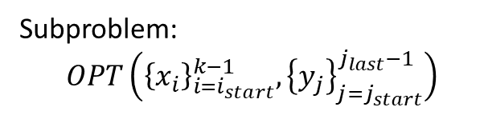


Algorithm: 1D OPT (V2): update previous problem
Subproblem: $$OPT\left({\left\{x_{i}\right\}}_{i=i_{start}}^{k−1},{\left\{y_{j}\right\}}_{j=j_{start}}^{j_{last}−1}\right)$$
If Cost 2c is the minimal cost:
Previous-problem
$$x_{k^{′}}$$
$$x_{i_{start}}$$
$$x_{k−1}$$
$$x_{k}$$
$$x_{k+1}$$
$$y_{j_{start}}$$
$$y_{j_{last}}$$
$$x_{k^{′}}$$
$$x_{k^{′′}}$$
$$x_{i_{start}}$$
$$x_{k}$$
$$x_{k+1}$$
Previous-problem
$$y_{j_{start}}$$
$$y_{j_{last}}$$
Sub-previous-problem

Slide 38
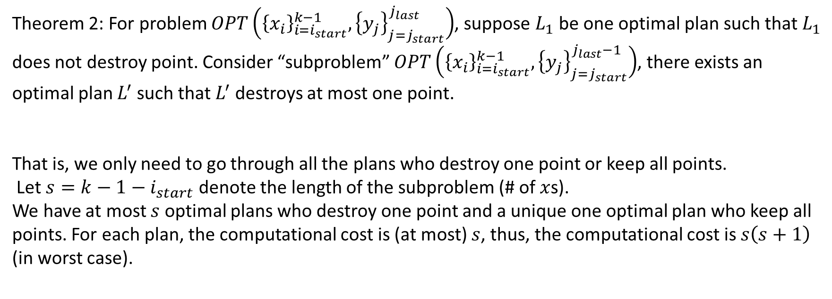
Solve the subproblem by previous plan
Theorem 2: For problem $OPT\left({\left\{x_{i}\right\}}_{i=i_{start}}^{k−1},{\left\{y_{j}\right\}}_{j=j_{start}}^{j_{last}}\right)$, suppose $L_{1}$ be one optimal plan such that $L_{1}$ does not destroy point. Consider “subproblem” $OPT\left({\left\{x_{i}\right\}}_{i=i_{start}}^{k−1},{\left\{y_{j}\right\}}_{j=j_{start}}^{j_{last}−1}\right)$, there exists an optimal plan $L^{′}$ such that $L^{′}$ destroys at most one point.
That is, we only need to go through all the plans who destroy one point or keep all points.
Let $s=k−1−i_{start}$ denote the length of the subproblem (# of $x$s). We have at most $s$ optimal plans who destroy one point and a unique one optimal plan who keep all points. For each plan, the computational cost is (at most) $s$, thus, the computational cost is $s\left(s+1\right)$ (in worst case).

Slide 39


































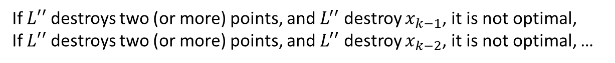







Proof of theorem 2:
Need to solve:
Given:
$$x_{1}$$
$$x_{2}$$
$$x_{3}$$
$$x_{4}$$
$$x_{k−1}$$
$$x_{1}$$
$$x_{2}$$
$$x_{3}$$
$$x_{4}$$
$$x_{k−1}$$
$$L_{1}$$
$$y_{1}$$
$$y_{3}$$
$$y_{4}$$
$$y_{5}$$
$$y_{j_{last}}$$
$$y_{3}$$
$$y_{4}$$
$$y_{5}$$
$$y_{j_{last}}$$
$$y_{1}$$
$$x_{1}$$
$$x_{2}$$
$$x_{3}$$
$$x_{4}$$
$$x_{k−1}$$
$$x_{1}$$
$$x_{2}$$
$$x_{3}$$
$$x_{4}$$
$$x_{k−1}$$
$$y_{1}$$
$$y_{3}$$
$$y_{4}$$
$$y_{5}$$
$$y_{j_{last}}$$
$$y_{1}$$
$$y_{3}$$
$$y_{4}$$
$$y_{5}$$
$$y_{j_{last}}$$
It is not optimal!
It is not optimal!
If $L′′$ destroys two (or more) points, and $L^{′′}$ destroy $x_{k−1}$, it is not optimal,
If $L′′$ destroys two (or more) points, and $L^{′′}$ destroy $x_{k−2}$, it is not optimal, …

Slide 40









Solve the subproblem
Sub problem: $OPT\left({\left\{x_{i}\right\}}_{i=i_{start}}^{k−1},{\left\{y_{j}\right\}}_{j=j_{start}}^{j_{last}−1}\right)$
inactive problem
active problem
$$x_{i_{active}}$$
$$x_{k−1}$$
$$x_{k}$$
$$x_{i_{start}}$$
$$y_{j_{active}}$$
$$y_{j_{start}}$$
$$y_{j_{last}}$$
Store: $cost_{inact},L_{inact}$

Slide 41





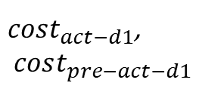









Solve the subproblem
Sub problem: $OPT\left({\left\{x_{i}\right\}}_{i=i_{start}}^{k−1},{\left\{y_{j}\right\}}_{j=j_{start}}^{j_{last}−1}\right)$
inactive problem
active problem
Destroy $x_{k}$
Destroy $x_{k−1}$
Store: $cost_{inact},L_{inact}$
$$x_{i_{act}+2}$$
$$x_{i_{act}+1}$$
$$x_{i_{start}}$$
$$x_{i_{act}}$$
$$x_{k−1}$$
$$x_{k}$$
$$y_{j_{act}}$$
$$y_{j_{act}+1}$$
$$y_{j_{act}+2}$$
$$y_{j_{act}+3}$$
$$y_{start}$$
$$y_{j_{last}}$$
$cost_{act−d1}$,
$$cost_{pre−act−d1}$$

Slide 42

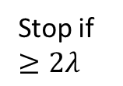










Solve the subproblem
Sub problem: $OPT\left({\left\{x_{i}\right\}}_{i=i_{start}}^{k−1},{\left\{y_{j}\right\}}_{j=j_{start}}^{j_{last}−1}\right)$
inactive problem
active problem
Destroy $x_{k−2}$
Store: $cost_{inact},L_{inact}$
$$x_{i_{act}}$$
$$x_{k−2}$$
$$x_{k−1}$$
$$x_{k}$$
$$x_{i_{start}}$$
Stop if $≥2λ$
$$y_{j_{act}}$$
$$y_{start}$$
$$cost_{act−pre−d1}$$
$$y_{j_{last}}$$
$$cost_{act−d1}$$

Slide 43

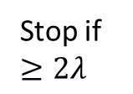






Solve the subproblem
Sub problem: $OPT\left({\left\{x_{i}\right\}}_{i=i_{start}}^{k−1},{\left\{y_{j}\right\}}_{j=j_{start}}^{j_{last}−1}\right)$
active problem
inactive problem
Destroy $x_{k−3}$
Store: $cost_{inactive},L_{inactive}$
$$x_{i_{act}}$$
$$x_{k−3}$$
$$x_{k−2}$$
$$x_{k−1}$$
$$x_{k}$$
$$x_{i_{start}}$$
Stop if $≥2λ$
$$y_{j_{act}}$$
$$y_{start}$$
$$y_{j_{last}}$$
$$cost_{pre−act−d1}$$
$$cost_{act−d1}$$

Slide 44








Solve the subproblem
Sub problem: $OPT\left({\left\{x_{i}\right\}}_{i=i_{start}}^{k−1},{\left\{y_{j}\right\}}_{j=j_{start}}^{j_{last}−1}\right)$
active problem
inactive problem
Destroy $x_{i_{active}}$
Store: $cost_{inactive},L_{inactive}$
$$x_{i_{act}}$$
$$x_{k−3}$$
$$x_{k−2}$$
$$x_{k−1}$$
$$x_{k}$$
$$x_{i_{start}}$$
Stop if $≥2λ$
$$y_{j_{act}}$$
$$y_{start}$$
$$y_{j_{last}}$$
$cost_{pre−act}$=0
$$cost_{act−d_{1}}$$
Find the optimal cost $cost_{d1}$

Slide 45



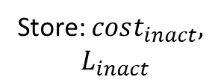


Solve the subproblem
Sub problem: $OPT\left({\left\{x_{i}\right\}}_{i=i_{start}}^{k−1},{\left\{y_{j}\right\}}_{j=j_{start}}^{j_{last}−1}\right)$
active problem
inactive problem
Destroy $x_{i_{active}}$
$$x_{i_{start}}$$
$$x_{i_{active}}$$
$$x_{k−3}$$
$$x_{k−2}$$
$$x_{k−1}$$
$$x_{k}$$
Stop if $≥2λ$
$$y_{j_{active}}$$
$$y_{start}$$
$$y_{j_{last}}$$
Store: $cost_{inact},$
$$L_{inact}$$
$$cost_{act−d_{0}}$$

Slide 46
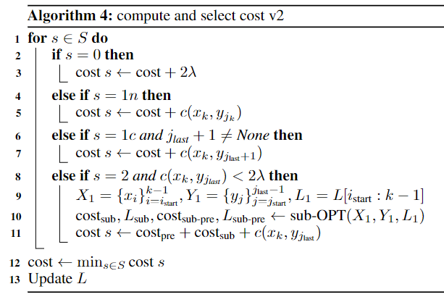
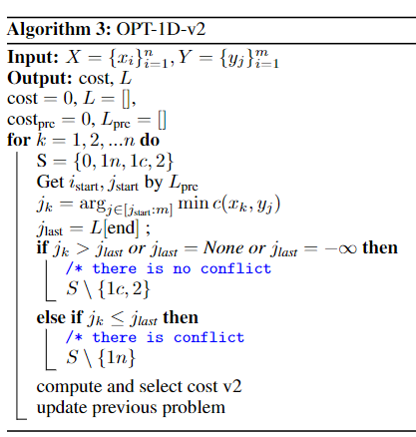
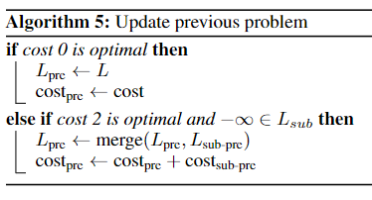
Algorithm for 1D OTP (Version 2)

Slide 47
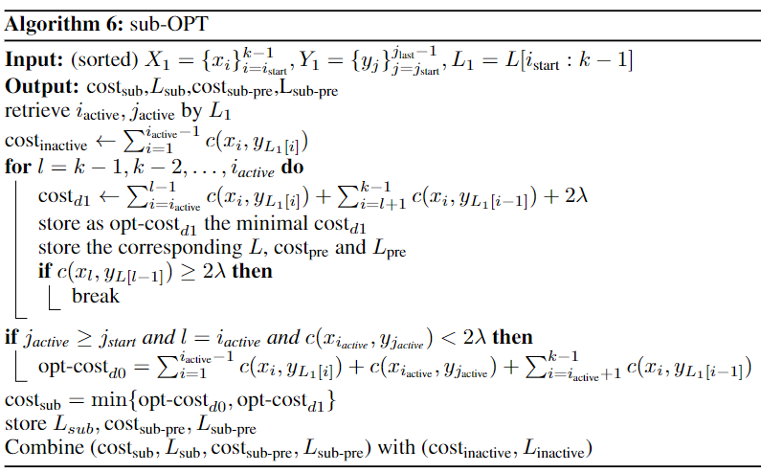
Algorithm for sub-OPT problem

Slide 48

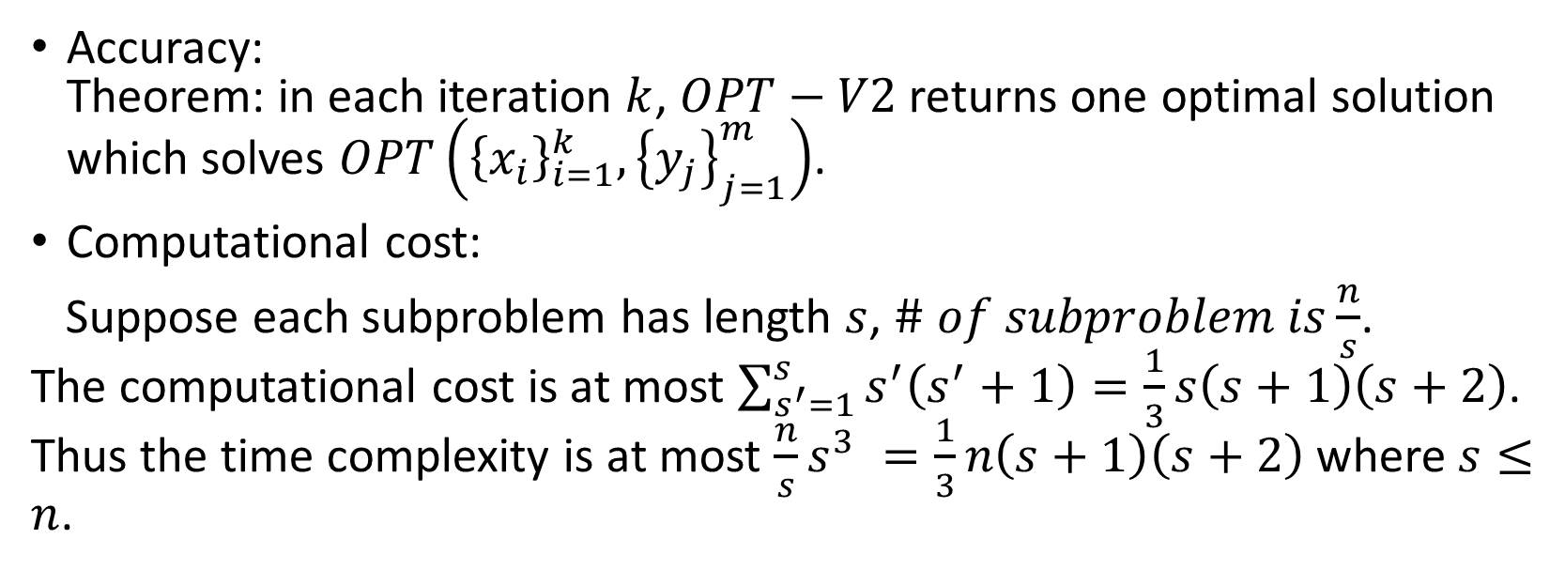
Performance of OPT-V2
Accuracy: Theorem: in each iteration $k$, $OPT−V2$ returns one optimal solution which solves $OPT\left({\left\{x_{i}\right\}}_{i=1}^{k},{\left\{y_{j}\right\}}_{j=1}^{m}\right)$.
Computational cost:
Suppose each subproblem has length $s$, $\# of subproblem is\frac{n}{s}$. The computational cost is at most $\sum_{s^{′}=1}^{s}{s^{′}\left(s^{′}+1\right)}=\frac{1}{3}s\left(s+1\right)\left(s+2\right)$. Thus the time complexity is at most $\frac{n}{s}s^{3} =\frac{1}{3}n\left(s+1\right)\left(s+2\right)$ where $s≤n$.
$$s=3$$

Slide 49
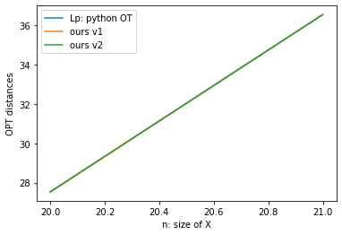
Experiment 3: Accuracy of our methods
$${\left\{x_{i}\right\}}_{i=1}^{n}∼Unif\left(\left[0,10\right]\right),{\left\{y_{j}\right\}}_{j=1}^{m}∼Unif\left(\left[5,20\right]\right),λ=5$$

Slide 50
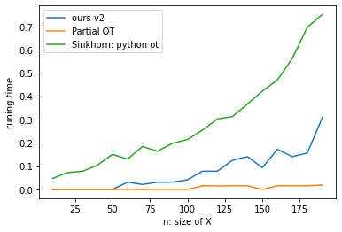


Experiment 4: time complexity of our methods
$${\left\{x_{i}\right\}}_{i=1}^{n}∼Unif\left(\left[0,10\right]\right),{\left\{y_{j}\right\}}_{j=1}^{m}∼Unif\left(\left[5,20\right]\right),λ=8$$
Tips:
In practice, Sinkhorn algorithm needs more time
since the iteration time should be $Ω\left(\ln\left(n\right)\right)$.

Slide 51

Application 1: find the optimal shift and scaling
Suppose $Y=θ_{1}^{∗}X+θ_{0}^{∗}$
$\hat{X}=\left\{\begin{aligned}X with Pr=0.9 \\ N_{X} with Pr=0.1\end{aligned}\right.,\hat{Y}=\left\{\begin{aligned}Y with Pr=0.9 \\ N_{Y} with Pr=0.1\end{aligned}\right.$
Suppose we observe $\left\{{\hat{x}}_{1},…,{\hat{x}}_{n}\right\}$ and $\left\{{\hat{y}}_{1},…,{\hat{y}}_{m}\right\}$ and we want to estimate $θ_{1}^{∗},θ_{0}^{∗}$.
To simplify the problem, we assume $supp\left(X\right),supp\left(N_{X}\right)$ are disjoint and $Supp\left(Y\right),Supp\left(N_{Y}\right)$ are disjoint.

Slide 52



Application 1: find the optimal shift and scaling
Setup: $X={\left\{x_{i}\right\}}_{i=1}^{n}∼i.i.d.Unif\left(\left[0,10\right]\right),n=18$
$Y={\left\{y_{i}\right\}}_{i=1}^{n}$ is given by $y_{i}=θ_{0}^{∗}+θ_{1}^{∗}x_{i},∀i$ where $θ_{0}^{∗}=5,θ_{1}^{∗}=2$
Thus $y_{i}∼Unif\left(\left[5,25\right]\right)$
${nx}_{1},{nx}_{2}∼Unif\left(\left[−10,−5\right]\right),{\left\{\hat{x}\right\}}_{i}={\left\{x_{i}\right\}}_{i=1}^{n}∪{\left\{{nx}_{i}\right\}}_{i=1}^{2}$ ${ny}_{1},{ny}_{2}∼Unif\left(\left[30,40\right]\right), {\left\{\hat{y}\right\}}_{j}={\left\{y_{j}\right\}}_{j=1}^{n}∪{\left\{{my}_{j}\right\}}_{j=1}^{2}$ solve $\min_{θ_{0},θ_{1}}{OPT\left({{\left\{θ_{0}+θ_{1}\hat{x}\right\}}_{i=1}^{n+2},\left\{\hat{y}\right\}}_{j=1}^{n+2}\right)}$
When $\left\{{nx}_{i}\right\},\left\{x_{i}\right\}$ (or $\left\{{ny}_{i}\right\},\left\{y_{i}\right\}$) are not disjoint,
$θ_{0},θ_{1}$ converge to incorrect values.
It may return constant when $λ$ is too small.

Slide 53


Application 2: Sliced OPT
Setup: ${\left\{x_{i}\right\}}_{i=1}^{n}∼𝒩\left(0,I_{3}\right),n=40,{\left\{y_{i}\right\}}_{j=1}^{m}∼𝒩\left(1, \frac{3}{2}I_{3}\right),m=40$ # of slicing= 1000

Slide 54



Application 2: point clounds matching
$X={\left\{x_{i}\right\}}_{i=1}^{n}∪\left\{n_{x}\right\},Y={\left\{y_{i}\right\}}_{i=1}^{n}∪\left\{n_{y}\right\}$, where $y_{i}=D^{∗}R^{∗}x_{i}+β^{∗},∀x_{i}∈X_{0}$. $$\min_{D,R,β}{OPT\left(DRX+β,Y\right)}$$

Slide 55
References
Caffarelli, L., McCann, R., 2010. Free boundaries in optimal transport and Monge-Ampère obstacle problems. Ann. Math. 171, 673–730. https://doi.org/10.4007/annals.2010.171.673
Chapel, L., Alaya, M.Z., Gasso, G., 2020. Partial Optimal Transport with Applications on Positive-Unlabeled Learning. ArXiv200208276 Cs Stat.
Chizat, L., Peyré, G., Schmitzer, B., Vialard, F.-X., 2019. Unbalanced Optimal Transport: Dynamic and Kantorovich Formulation. ArXiv150805216 Math.
Chizat, L., Peyré, G., Schmitzer, B., Vialard, F.-X., 2017. Scaling Algorithms for Unbalanced Transport Problems. ArXiv160705816 Math.
Figalli, A., 2010. The Optimal Partial Transport Problem. Arch. Ration. Mech. Anal. 195, 533–560. https://doi.org/10.1007/s00205-008-0212-7
Liero, M., Mielke, A., Savaré, G., 2018. Optimal Entropy-Transport problems and a new Hellinger–Kantorovich distance between positive measures. Invent. Math. 211, 969–1117. https://doi.org/10.1007/s00222-017-0759-8
Sato, R., Yamada, M., Kashima, H., 2021. Fast Unbalanced Optimal Transport on a Tree. ArXiv200602703 Cs Stat.

