Slide 1
RoboWatch – AI-Enabled Autonomous Multi-Robot Surveillance
Team Members:
Ch.Siri (2303A51281) Tharun Bairi (2405A44L02) Vaishnavi Bairagoni (2303A51347) Manivardhan (2303A52250)

Slide 2
Problem Statement
Limitations of Existing Systems
Fixed camera blind spots
Manual human monitoring
High risk to security personnel
Single-point system failure
No intelligent decision-making

Slide 3
Proposed system and objectives
An AI-powered multi-robot surveillance system capable of:
Autonomous patrolling
AI-based human detection
Real-time alert generation
Fault-tolerant operation
Objectives
Develop autonomous patrol robots
Implement real-time human detection
Enable robot-to-robot communication
Reduce human exposure to threats

Slide 4
System architecture
Architecture Style
Hierarchical Distributed Robotic Architecture
Components
Supervisor Robot – Command & intelligence unit
Assistant Robots – Autonomous patrol agents

Slide 5
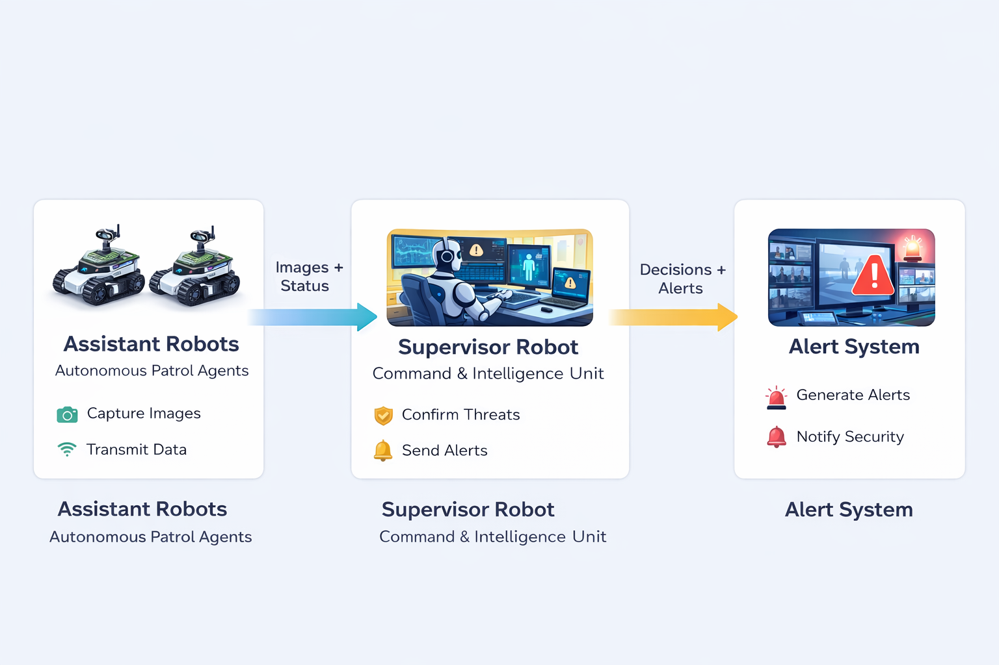
Supervisor and assistant robots
Supervisor Robot
Receives images from assistants
Confirms threats
Logs events
Sends alerts
Reassigns patrol routes
Assistant Robots
Navigate assigned zones
Capture surveillance images
Run lightweight AI
Detect abnormal activity

Slide 6
System Operation
Enables long-range wireless communication for transmitting alerts, system status, and location data without dependence on local Wi-Fi networks (SIM Communication Module / 4G Module)
Controls the movement of robotic units by regulating motor speed and direction to support autonomous patrolling (Motor Driver Module – L298N)
Maintains stable power supply to all electronic units, ensuring uninterrupted and safe system operation (Voltage Regulator / Buck Converter)
Generates local audible indications during threat detection, emergency conditions, or system faults (Buzzer)

Slide 7
Intelligent Sensing & Awareness
Detects human motion in the surveillance area and triggers monitoring actions only when activity is present (PIR Motion Sensor)
Identifies nearby objects or intrusions to avoid collisions during autonomous movement (IR Proximity Sensor)
Provides real-time geographical location of each robotic unit for tracking and alert verification (GPS Module – NEO-7M)
Displays system status such as normal operation, alert condition, communication activity, or fault state using visual indicators (LED Indicators)

Slide 8
Features Enabled by These Operations
Network-independent alert transmission using cellular communication (SIM Communication Module / 4G Module)
Motion-triggered surveillance, reducing unnecessary processing and power consumption (PIR Motion Sensor)
Location-aware threat reporting with precise tracking information (GPS Module – NEO-7M)
Fault-tolerant operation, where last known status and location are transmitted during failure conditions (GPS Module + SIM Communication Module)
Reliable autonomous patrolling, supported by stable power regulation and obstacle awareness (Voltage Regulator + IR Proximity Sensor + Motor Driver)

Slide 9
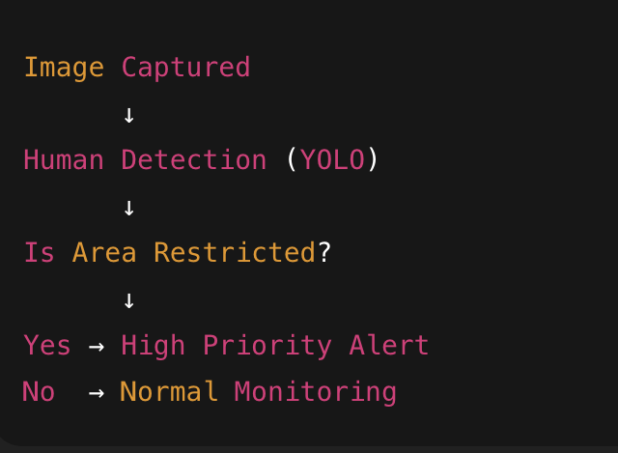
AI-BASED HUMAN DETECTION & DECISION LOGIC
Human detection is performed using YOLO (You Only Look Once)
Implemented with Python and OpenCV
Runs directly on Raspberry Pi 5 (Edge AI)
Detects humans in real time from camera input
Optimized for fast inference and low power consumption
Decision Logic (Context-Aware Surveillance)
Human detection alone is not treated as a threat. The system combines AI output with rule-based logic.

Slide 10
AI-BASED HUMAN DETECTION & DECISION LOGIC
Alert Generation Logic
If a human is detected in a restricted area:
Supervisor robot validates detection
Threat is classified as High Priority
Alert is generated immediately
If detection occurs in a non-restricted area:
Event is logged
No alert is triggered
This approach reduces unnecessary alerts and improves system reliability

Slide 11
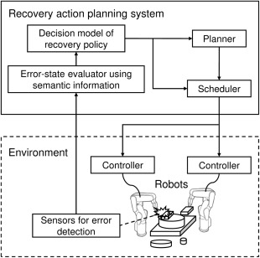
FAULT TOLERANCE
Fault Tolerance & Self-Preservation
Supervisor detects robot failure
Backup robot rerouted automatically
Last image & location transmitted

Slide 12
TECHNoLogies used
Technology Stack
Raspberry Pi 5
Python
OpenCV
YOLO (lightweight)

Slide 13
conclusion
The proposed system provides a smart, adaptive, and reliable surveillance solution, reducing human risk and ensuring continuous monitoring using AI-powered multi-robot coordination.

Slide 14
Components
Parts List | Quantity | Price | Total
SIM Communication Module / 4G Module | 3 | 1200 | 3600
Motor Driver Module (L298N) | 3 | 350 | 1050
Voltage Regulator / Buck Converter | 3 | 150 | 450
Buzzer | 3 | 100 | 300
LED Indicators | 6 | 5 | 40
PIR Motion Sensor | 3 | 150 | 450
IR Proximity Sensor | 3 | 100 | 300
GPS Module (NEO-7M) | 3 | 800 | 2400
Total |  |  | 8590

Slide 15
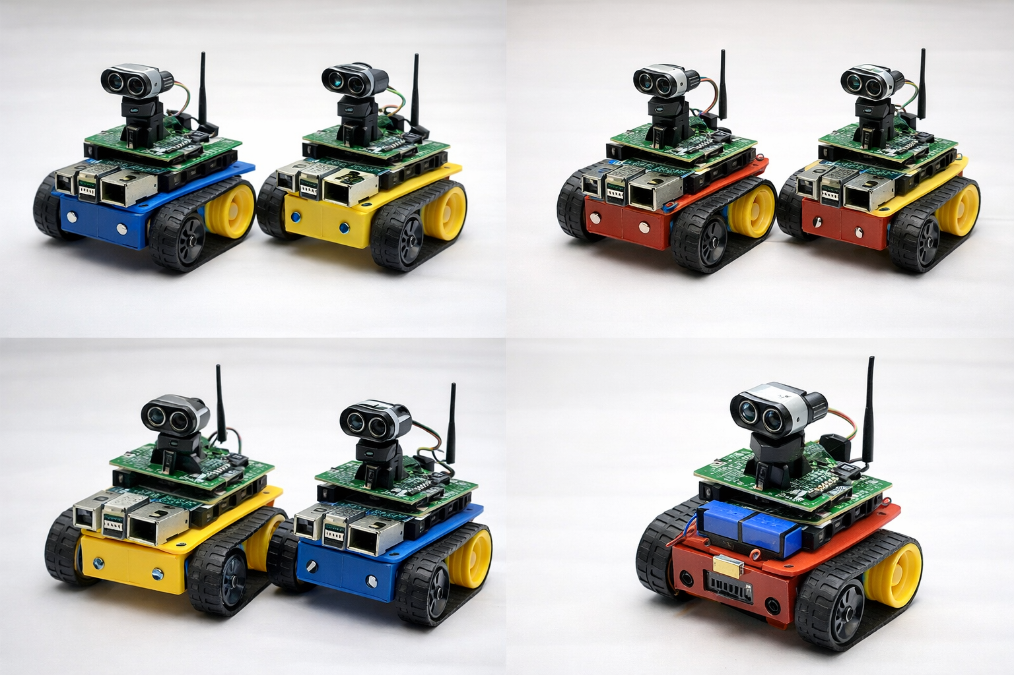
Thank you

