Slide 1
Credit Card Fraudulent Transaction Detection
Rohith Reddy Bairi (A20526972)
Pavitrasai Vegiraju (A20525304 )
Brijeshkumaryadav Bandi (A20528371)

Slide 2
The Problem
Global credit card fraud losses reached $34.36 billion in 2022, up from $21.84 billion in 2015.
U.S. card fraud losses are forecast to reach $165.1 billion over the next 10 years.
Fraudulent transactions account for a small fraction of all transactions, typically less than 1%.
Our sample dataset shows:
284,315 Authentic Transactions
492 Fraudulent Transactions
0.172% of Total Transactions were Fraudulent

Slide 3
How Frauds are Recognized
Predefined rules to identify suspicious transactions
Advanced machine learning models trained on historical data
Analyzing transaction patterns to detect anomalies
Personalized models based on cardholder's spending habits
Real-time monitoring to quickly flag potential fraud

Slide 4
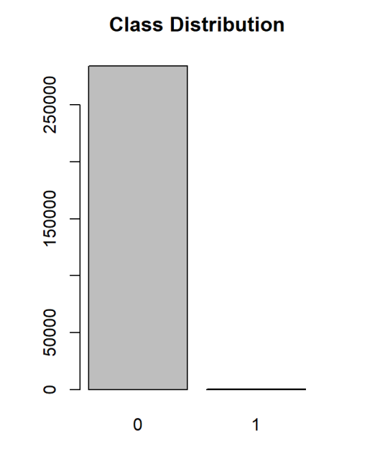
Challenges
Since the data is highly skewed
Authentic
Fraud

Slide 5
Data Exploration
Dataset : creditcard.csv
Features: Time, V1, V2,…., V28, Amount, Class.
Class Imbalance:
Majority of the transactions are non-fraudulent
SMOTE oversampling required to balance the classes.

Slide 6
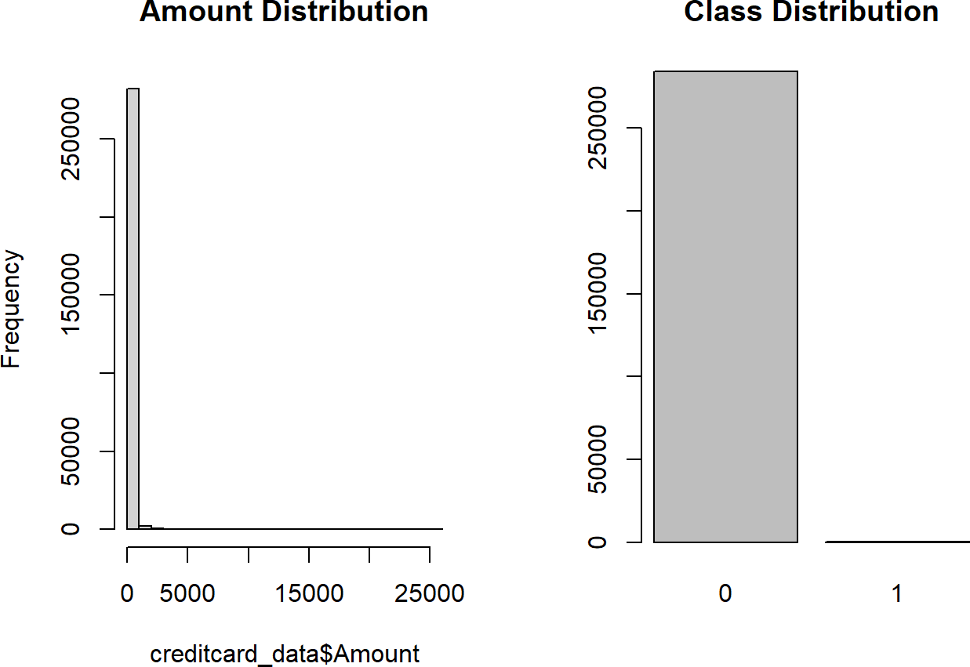
Data Exploration

Slide 7
Resampling Methods
The resampling methods are used to adjust the class distribution of the data as the minority class is not equally represented.
There are two methods to perform the resampling.
Oversampling
Undersampling

Slide 8
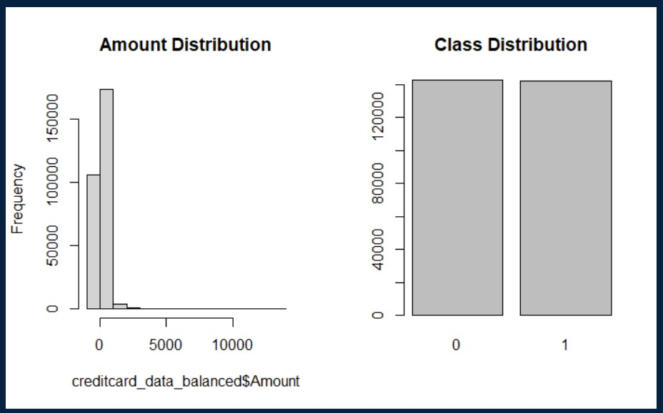
SMOTE Oversampling
SMOTE (Synthetic Minority Over-Sampling Technique)
Generates synthetic examples for minority class
Balances the dataset by oversampling the minority class
Balanced dataset: creditcard_data_balanced

Slide 9
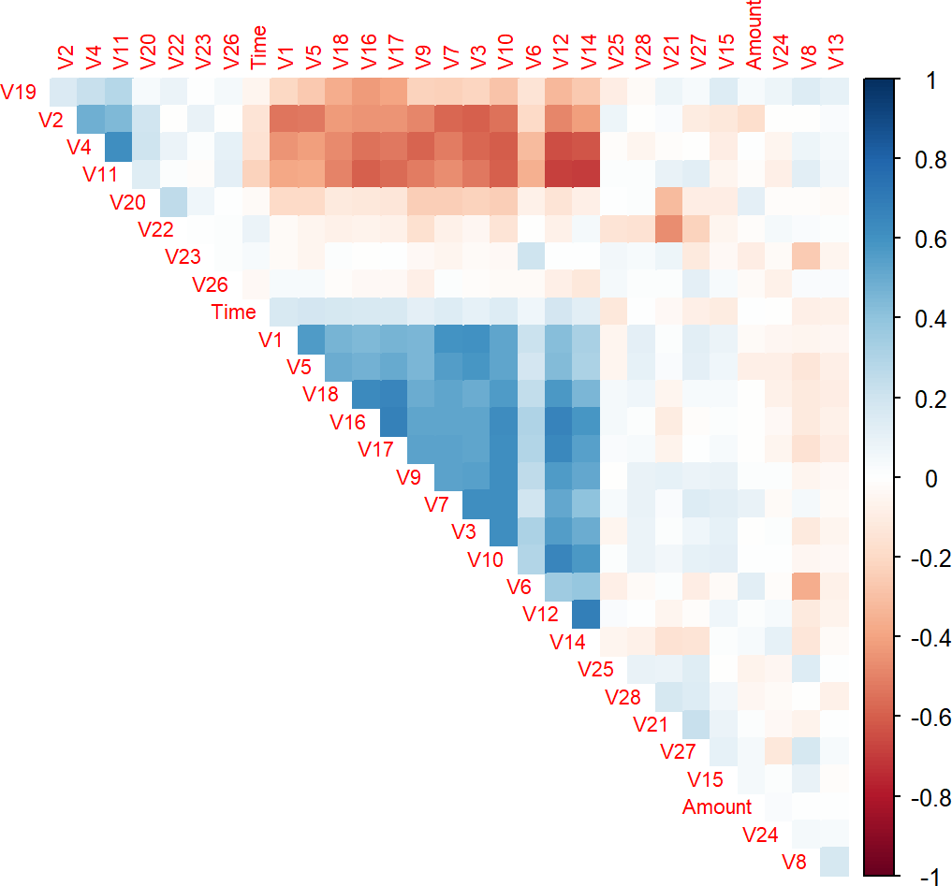
Correlation Factor Among Features
Observations:
V4, V11, V20, V22 highly positively correlated group
V19 moderately correlated with V13, V23, Amount
Amount negatively correlated with V27, V15
V8, V24 strongly negatively correlated
V12, V14, V25, V28, V21 negatively correlated with positive group

Slide 10
Dividing the dataset into Test & Train
To validate our model's prediction
Divide dataset into
80% for Training
20% for Testing

Slide 11
Logistic Regression
Logistic regression is a binary classifier based on the regression model, where the dependable variable is categorical.
In logistic regression, we find
logit(P) = a + b X,

Slide 12
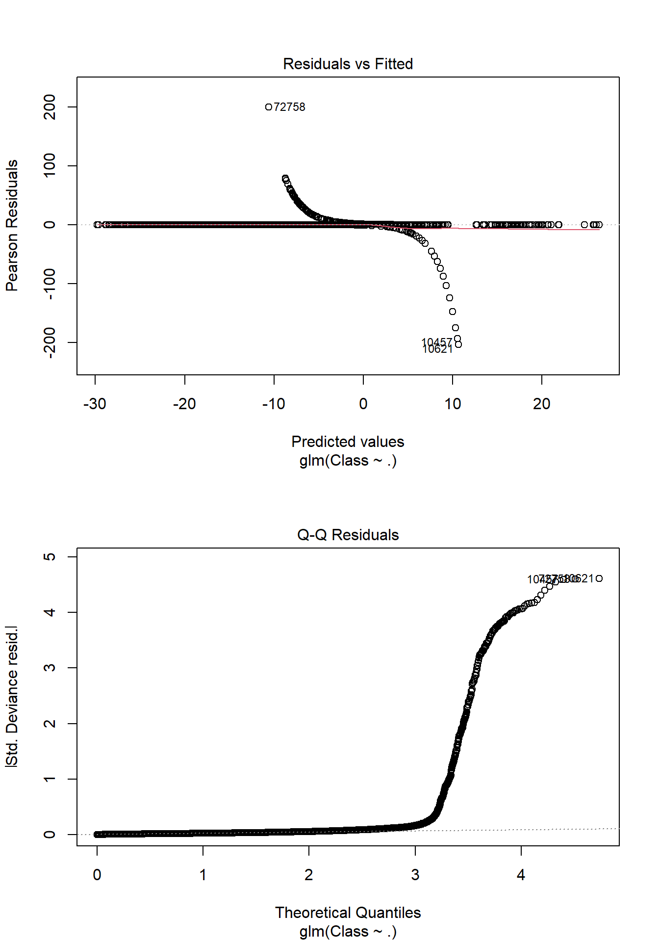
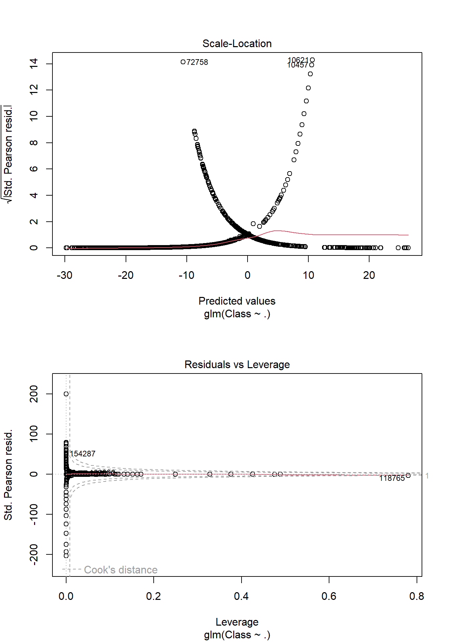
Model Implementation Before SMOTE - Logistic Regression

Slide 13
LOGISTIC REGRESSION WITH SMOTE
SMOTE stands for Synthetic Minority Oversampling Technique to an input dataset
This is a statistical technique to increase the number of samples in minority class in the dataset to make it balanced.
It works by generating new instances of data from the existing by taking feature space of each target class and its nearest neighbors

Slide 14
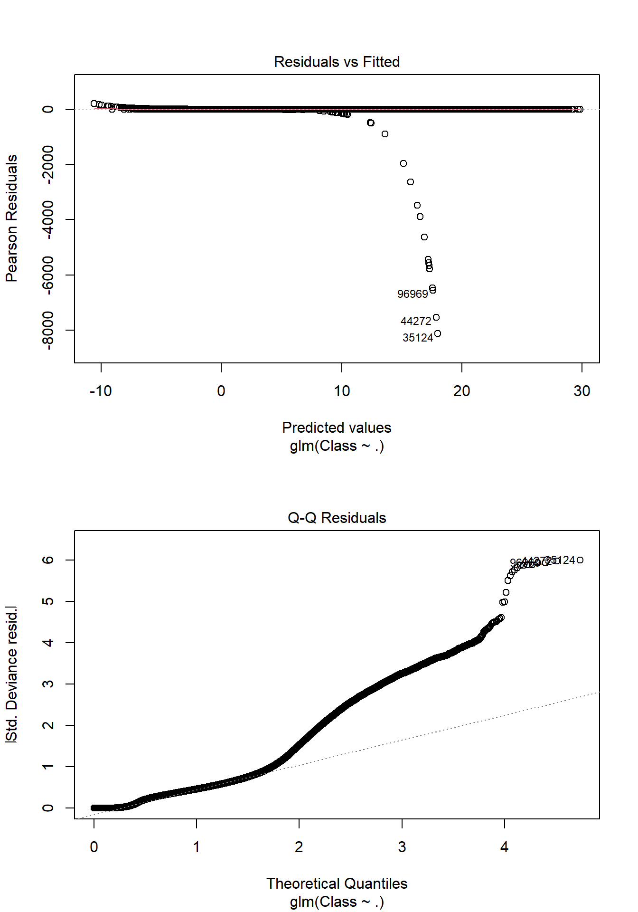
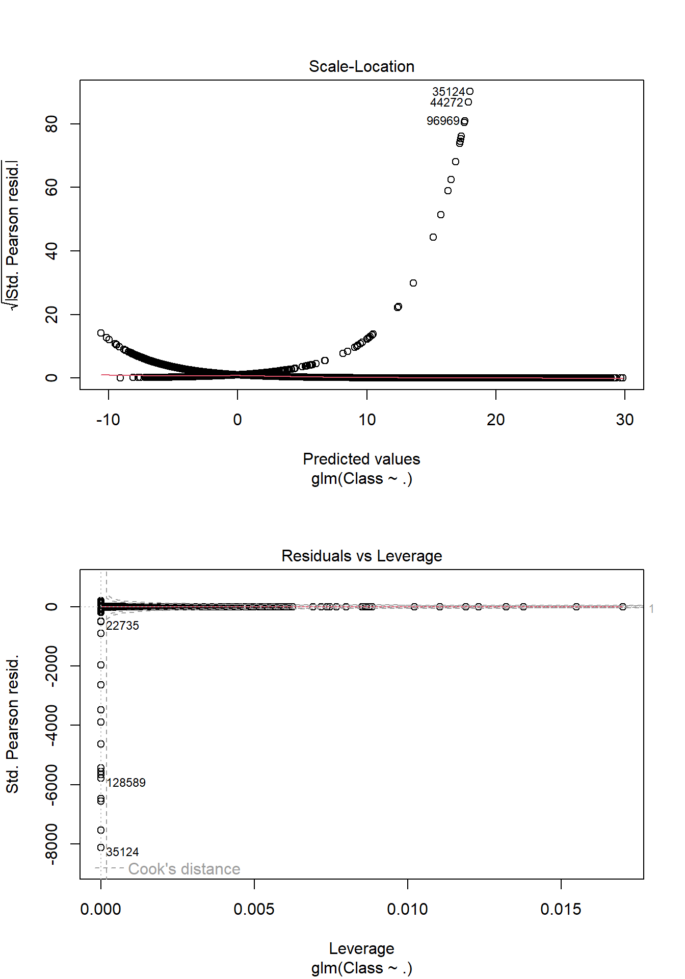
LOGISTIC REGRESSION AFTER SMOTE

Slide 15
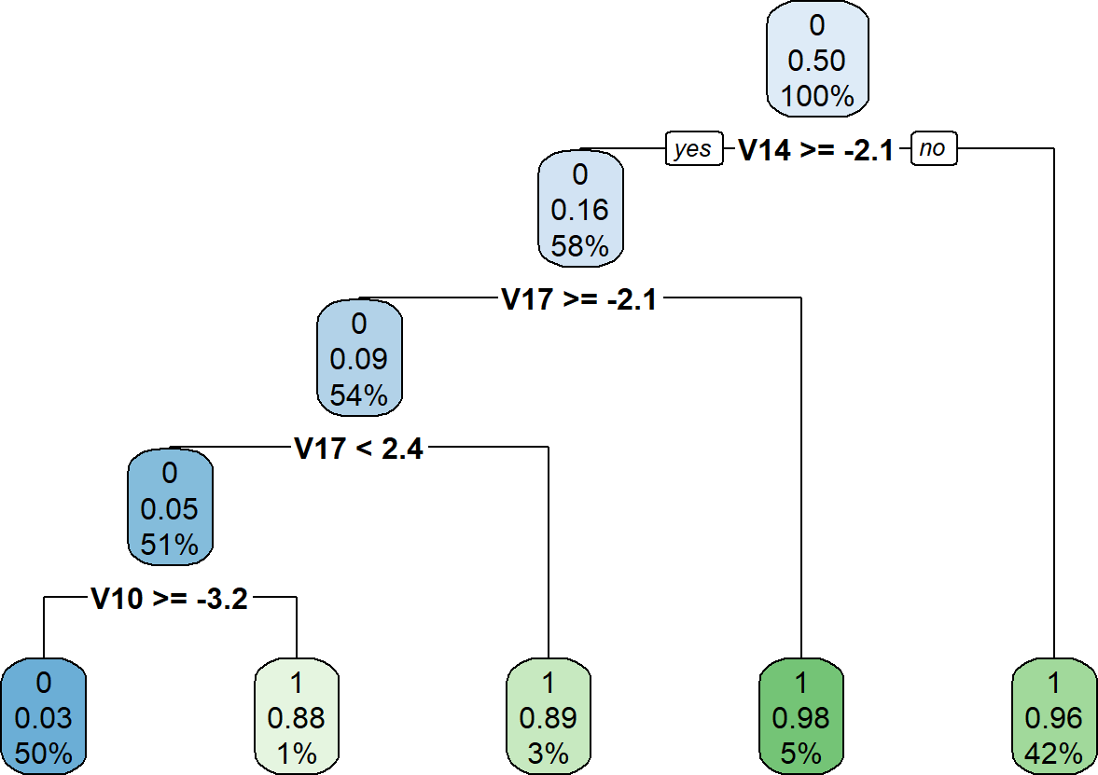
Decision Tree Model after SMOTE

Slide 16
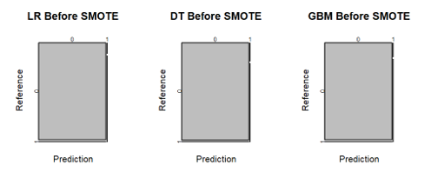
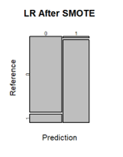
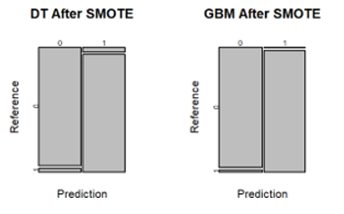
Confusion matrices Before and After smote

Slide 17
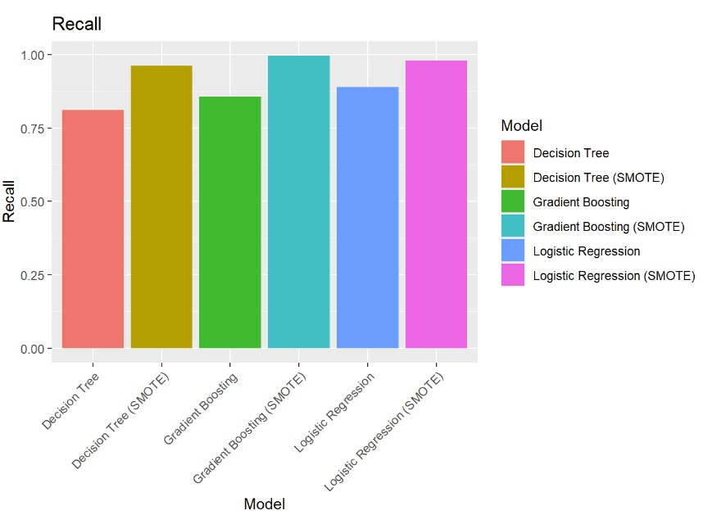
Precision and Recall

Slide 18
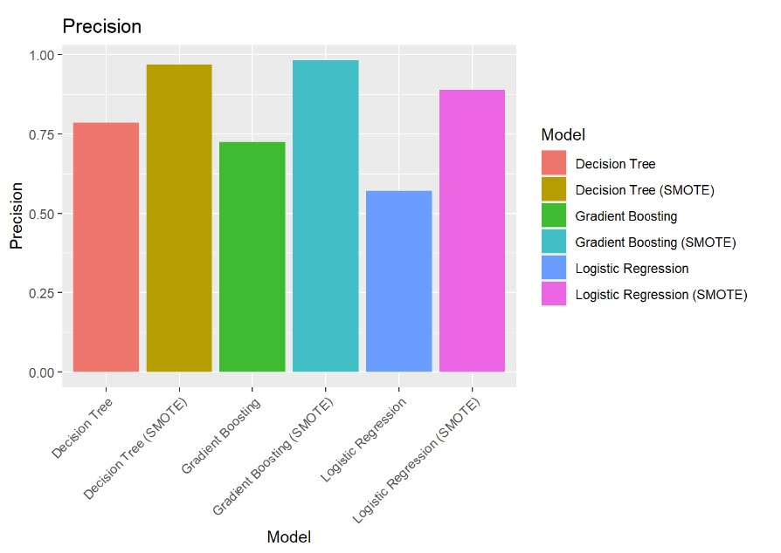

Slide 19
Performance Analysis
Logistic Regression (SMOTE): Achieves high precision (0.889) and recall (0.980), effectively identifying positive cases while minimizing false positives.
Decision Tree (SMOTE): Demonstrates robustness with remarkable precision (0.969) and recall (0.962), effectively classifying both positive and negative instances.
Gradient Boosting (SMOTE): Performs exceptionally well with near-perfect precision (0.982) and recall (0.996), effectively identifying positive cases while minimizing false negatives.
Conclusion: SMOTE significantly improves predictive capabilities, effectively addressing class imbalance and enhancing model performance.

Slide 20
APPLICATIONS
These techniques of detecting the fraud transactions can be implemented to make the transactions through the credit cards more secure.
The learned models can be deployed on high-performance computers to monitor all the transactions in real time and stop the ongoing transaction while also alerting the owner about the steps required to further eliminate the risk

Slide 21
CONCLUSION
SMOTE oversampling significantly elevated the performance of key algorithms:
Logistic Regression (After SMOTE): Achieved top-tier performance, boasting exceptional precision (0.889) and recall (0.980).
Decision Tree (After SMOTE): Demonstrated a substantial leap forward, showcasing notable precision (0.969) and recall (0.962).
GBM (After SMOTE): Presented enhanced results, with precision (0.982) and recall (0.996) nearing perfection.
Before SMOTE, algorithms showed:
Logistic Regression (Before SMOTE): Displayed commendable performance.
Decision Tree & GBM (Before SMOTE): Presented moderate results.

Slide 22
References
[1] G. O. [1]Andrea Dal Pozzolo, Olivier Caelen, Reid A. Johnson and Gianluca Bontempi. Calibrating Probability with Undersampling for Unbalanced Classification. In Symposium on Computational Intelligence and Data Mining (CIDM), IEEE, 2015
[2] [2]http://mlg.ulb.ac.be(URL).
[3] [3]http://www.businesswire.com/news/home/20150804007054/en/Global-Card-Fraud-Losses-Reach-16.31-Billion
[4] [4]http://www.kaggle.com(URL).
[5] [5]The Nilson Report
[6] [6]http://www.thinksaveretire.com/2015/09/14/how-credit-card-fraud-detection-works/(URL).
[7] [7]SMOTE: Synthetic Minority Over-sampling Technique. Nitesh V. Chawla chawla@csee.usf.edu. Department of Computer Science and Engineering
[8] [8]Area Under the Precision-Recall Curve: Point Estimates and Confidence Intervals Kendrick Boyd1 , Kevin H. Eng , and C. David Page
[9] [9]http://scikit-learn.org/stable/auto_examples/model_selection/plot_precision_recall.html(URL).
[10] [11]Scikit-learn: Machine Learning in Python, Pedregosa et al., JMLR 12, pp. 2825-2830, 2011.
[11] [10]Jones E, Oliphant E, Peterson P, et al. SciPy: Open Source Scientific Tools for Python, 2001-, http://www.scipy.org/ [Online; accessed 2017-03-30]
[12] [11]Stéfan van der Walt, S. Chris Colbert and Gaël Varoquaux. The NumPy Array: A Structure for Efficient Numerical Computation, Computing in Science & Engineering, 13, 22-30 (2011), DOI:10.1109/MCSE.2011.37

